Slide 1
Schalendar
By Kelvin Lin, Arnav Chaudry, John Zhao

Slide 2
Agenda for Today
1. Introduction/Team Responsibilities
2. What is Schalendar? What is Our Vision For Our Project?
3. Introduce Our Personas and Scenarios
4. UI/UX Design and Mockup Using Figma
5. Requirements for Our Product
7. The Risks/Solutions
6. Questions

Slide 3
Our Vision
For Schalendar

Slide 4
Using Moore’s Vision Template
The FOR
The WHO
PRODUCT NAME
College students and faculty (Specifically for BU right now)
People who want to keep track of their schedules and have everything integrated into one place including weather and location functionality
Schalendar is a mobile based productivity and scheduling app

Slide 5
Using Moore’s Vision Template
The THAT
The UNLIKE
OUR PRODUCT
Enables you to keep your schedule in one place and share with others, connect with other people at your institution and to be keep track of your commitments
Unlike Google Calendar and other scheduling apps which may not be tailored to account for weather, transportation, and ease of use
Schalendar provides an efficient and intuitive way to maintain your schedule with a focus on ease of use and no cost.

Slide 6
Putting It All Together…
Schalendar is for college students and faculty (Specifically for BU right now). It is for people who want to keep track of their schedules and have everything integrated into one place including weather and location functionality. Schalendar is a mobile based productivity and scheduling app. Our app enables you to keep your schedule in one place and share with others, connect with other people at your institution and to be keep track of your commitments. Unlike Google Calendar and other scheduling apps which may not be tailored to account for weather, transportation, and ease of use. Schalendar provides an efficient and intuitive way to maintain your schedule with a focus on ease of use and no cost.

Slide 7
WHY SHOULD IT BE MOBILE???

Slide 8
Our Scenarios
For Schalendar

Slide 9

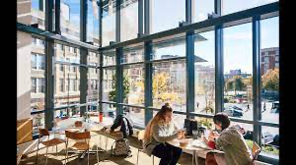


Persona 1: Jerry, 21
Bu Student
Dining Hall Employee
- College Junior
- Anthropology Major
- Infatuated with chimpanzees
- ~$30,000 worth of student debt
- Has two 8 hour shifts twice a week
- Tuesdays is Warren, Wednesdays is Marciano
On Academic Probation
Alpha Beta Gamma Fraternity Brother
- Has a 1.3 GPA
- In extreme danger of expulsion
- Forgets class because of his busy schedule
- Has weekly meetings
- Required functions that he has to go to
- Meetings are held no matter the circumstance
Goal: He wants to be able to attend all of his classes and all of his things outside of school

Slide 10
Scenario: Getting to Class
Jerry is BU student and a junior in college. He is an anthropology major and he wants to be a chimpanzee biologist after he graduates. He plans on getting his degree and getting into a prestigious chimpanzee biology program after, so it is imperative he gets his degree.
Jerry is very extroverted and he has joined Alpha Beta Gamma as a frat brother. The frat holds meetings every Friday at 4pm even if it is a holiday.
Jerry is also in a lot of student debt, so he is a dining hall employee and has two shifts every week. Every Tuesday, he is required to be at Warren Dining Hall from 1-9, and every Thursday he is required to be at Marciano Dining Hall from 8-12.
Jerry has a very busy schedule, with his classes and other things so he often forgets about class. His fraternity also holds meetings in different places every week, so often he does not know where each location is. Unfortunately, due to his commitments, he is currently holding a 1.3 GPA and in extreme danger of expulsion if he does not do better this coming semester.
Jerry while doing research on ways to get to class and on time, stumbles across the Schalendar app. It is an app that is specifically designed to help students manage their time and to ensure that they are able to meet their commitments. Jerry connects his student link schedule to the app and the app automatically puts his schedule in his calendar. He also inputs his commitment schedule updating the calendar with location changes and time changes as needed. He also enjoys sharing his schedule with his fraternity brothers so they can see when their schedules match up.
With the help of the Schalendar app, Jerry is able to make it to classes frequently on time and is taken off of academic probation with a 3.5 GPA next semester. He continues to maintain a robust social life.

Slide 11


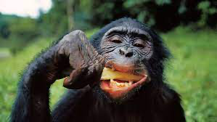
Persona 2: Marie, 57
BU Professor
Classes
- Tenured Professor
- Head of the BU Anthropology Department
- Studies chimpanzees and is very well known in her field
- Although she is most dedicated to her research, she also teaches four classes to BU students
- She also is required to hold office hours which adds on to an already enormous workload
- She often forgets commitments because of her workload
Researcher
Meetings
- Above all else, she is a researcher at heart. Every month, she goes to the forests of Ngogo, Africa and observes chimp behavior for a week
- She runs a lab for motivated student researchers as well
- She also has to attend faculty meetings which happen sporadically
- Since she is well known in her field, these meetings are very often, and with many different people, meaning that times and locations vary
Goal: Keep track of and be reminded of the things that she must attend. She also wants an intuitive agenda that she can update with many features and customizability

Slide 12
Scenario: The Busy Professor
Marie is a professor of anthropology and head of the department at BU. She is a lover of chimpanzees and researching the next big thing in primate biology. She needs to be on campus to teach four times a week. She also attends in-person faculty meetings, but they are not as frequent.
Once a month, Marie flies to Ngogo for a week to study the behavior of her favorite chimps, Carl and Ellie. She’s doing this to write a new research article for the Journal of Anthropology about her findings, so this is very important for her.
Some nights, she runs a lab on campus for extra motivated students who want to learn more outside of class.
With the help of Schalendar, Marie will be able to see all her obligations easily and stay on top of her taxing schedule. She will benefit from meeting reminders and schedule sharing to allow her to keep good relationships with her department and students. When she’s out of the country, Marie will also benefit from the weather reminders, so she knows how to dress and what the day has ahead.

Slide 13
Our UI/UX Design
For Schalendar

Slide 14
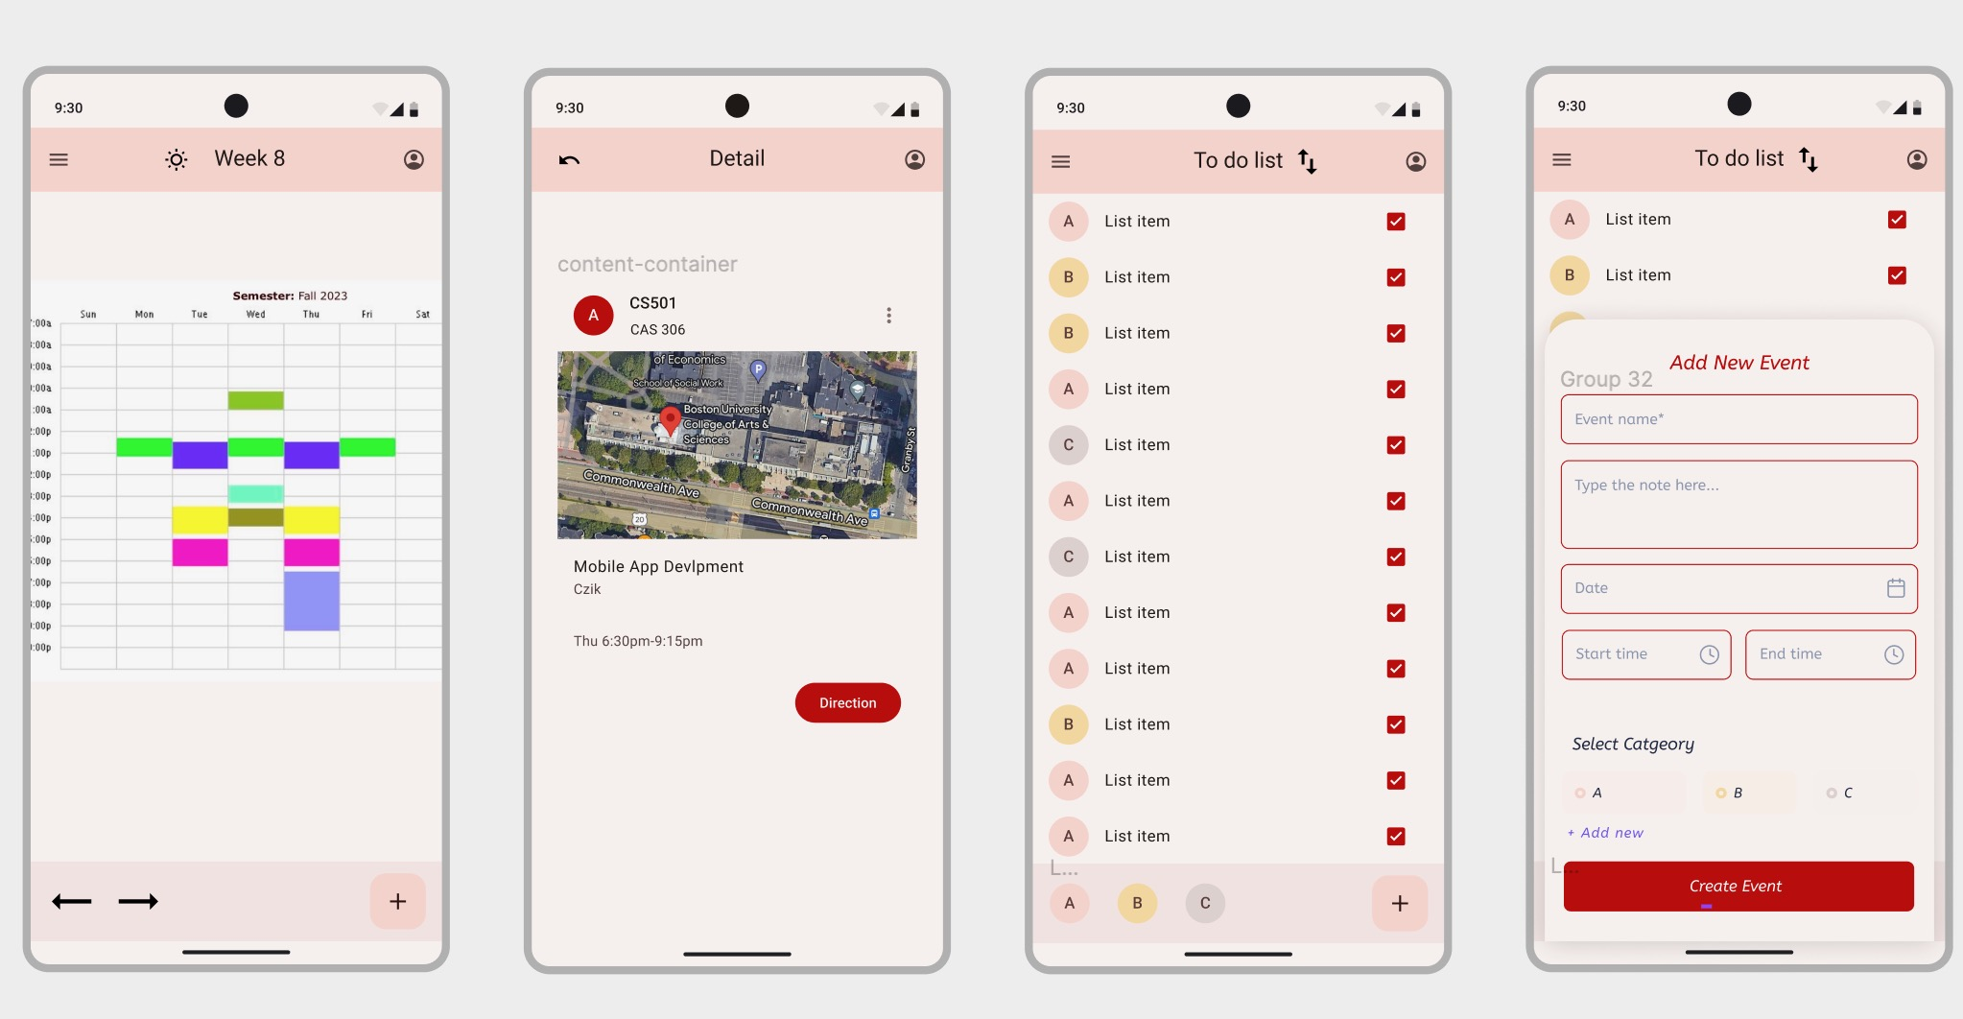
Using Figma

Slide 15
The Requirements
For Schalendar

Slide 16
The Must Haves
Schedules
Meetings
Google Maps
- Need to have the ability to create the schedule in the app
- As a student, it would be nice to have an intuitive scheduling app
- The ability to set meetings and activities that fall outside of your class schedule
- As an educator, it would be nice to set meetings and be reminded of them when the time comes
- The ability to know when to start going to class, and where to go
- As a new student, it would be nice to know where my classes are
- As a student, it would be nice to know when to leave so I can get to class on time

Slide 17
The Want-To-Haves
Schedule Sharing
BU Bus Live View
Weather Integration
- The ability to share schedules with your friends
- As a professor, I want to be able to show people my availability
- As a student, I want to be able to meet up with my friends during my off time
- The ability for the app to be integrated with the BU shuttle. Our app can notify you when you should go to meet the bus.
- As a student, I want to be able to know when the BU shuttle is coming so I can make my classes
- The ability for the app to utilize a weather API so our app can notify users about different weather conditions
- As a professor, I would like to know if it is raining/snowing outside so I can be equipped

Slide 18
The Nice-To-Haves
Shared Classes
Due Dates
Holidays
- Connect with users who also are in the same class as the user
- As a student, I want to find other people who have the same class as me
- Notify users of due dates of homework
- As a student, it would be nice to be reminded of when my problem sets are due
- Automatically changing the schedule when there is a holiday
- As a student, it would be nice to know how the schedule is changed due to holidays and special events

Slide 19
High Level Architecture
For Schalendar

Slide 20
The APIs We’re Going To Use
Google Maps API
OpenWeatherMap API
- For map functionality
BU Bus Live View (BUBusTracker)
- Web scraping for BU course information (schedule, professors, location)
ChatGPT API
- for schedule integration
- For weather information
Web Scraping Course Information
- Web scraping for BU course information (schedule, professors, location)

Slide 21
The Sensors We’re Going To Use
GPS
Bluetooth
- For location tracking used in maps and weather
Camera
- Potentially for being able to take photos of physical schedules
- For sharing schedules with other users

Slide 22
The Risks
For Schalendar

Slide 23
The Risks
- Front End Development
- Time Commitments and Classes
- APIs Integration
- Hard to login with BU credentials
- Sharing schedule details

Slide 24
Our Solutions
- Use MaterialComponents for front end development
- Set schedule to meet up and work on the project
- Less ambitious for API integration, rely less on APIs
- Use ChatGPT API/Web Scraping
- QR code, link, code, groups

Slide 25
Thank you
Any Questions?

