Slide 1
Schalendar Final Product
By Team A2

Slide 2
Our Motivation
Our drive for this project stems from the need to create a comprehensive mobile app that can help students and educators keep track of their commitments

Slide 3
Completed Stories and Roles
The Busy Professor
Professor Rhett has many commitments. He is a professor visiting from France teaching at Boston University. He downloads the Schalendar mobile app where his phone is set to French to help him keep track of his commitments. Thankfully, the app has a French translation so he is able to use the app with relative ease. He enters his commitment info into the application. He can input regularly occurring classes in which he is teaching. He is also able to schedule and keep track of different student meetings that do not occur on a regular basis. He also has the feature to add his information via Google Oauth. Since he is a visiting professor, he also is not completely familiar with the Boston University campus so the built in directions feature to the different buildings is extremely useful. Also due to him being from a foreign country, he is not very familiar with the weather in Boston. He uses the weather function in order to get a recommendation from the app on how to approach the day. Using the Schalendar mobile app, he is able to keep track of his commitments as a University professor.

Slide 4
Completed Stories and Roles
The Struggling Student
Rhettina is a student studying engineering at Boston University. She is currently on academic probation due to her lack of organization and not showing up to classes on time. To help with her situation and to not be academically dismissed from Boston University, she downloads the Schalendar mobile app to help keep track of her commitments. She is a local student, but she is most comfortable speaking Chinese because that is what she grew up speaking. Luckily, the Schalendar mobile app has a Chinese translation. Using Schalendar, she is able to input all of her recurring class information and meetings with professors with ease. Although she is familiar with the Boston University campus, her class locations change every semester and are often in many unknown buildings. She is able to find the classes that she wants with relative ease after utilizing the directions feature. Using Schalendar, she keeps better track of her classes, and shows up to enough classes to be taken off of academic probation the next semester.

Slide 5
Completed Stories and Roles
The Commuter
Rhetty is a graduate student studying anthropology at Boston University. Due to him living off campus, and in a rather far place, he has to commute a rather long way to classes. He downloads the Schalendar app in order to help him. He finds the app useful in that he can seamlessly add his courses and add any one-off meetings. The feature that helps him the most however, is the directions feature. Because the directions feature will let him know the exact time that he needs to leave by to reach classes on time. He also relies on the weather recommendations heavily as well because since he has to commute a long way to classes in the harsh Boston winter and he would like to not be freezing the whole way to classes. Using the Schalendar mobile app, he is able to make it to classes on time despite living far from campus.

Slide 6
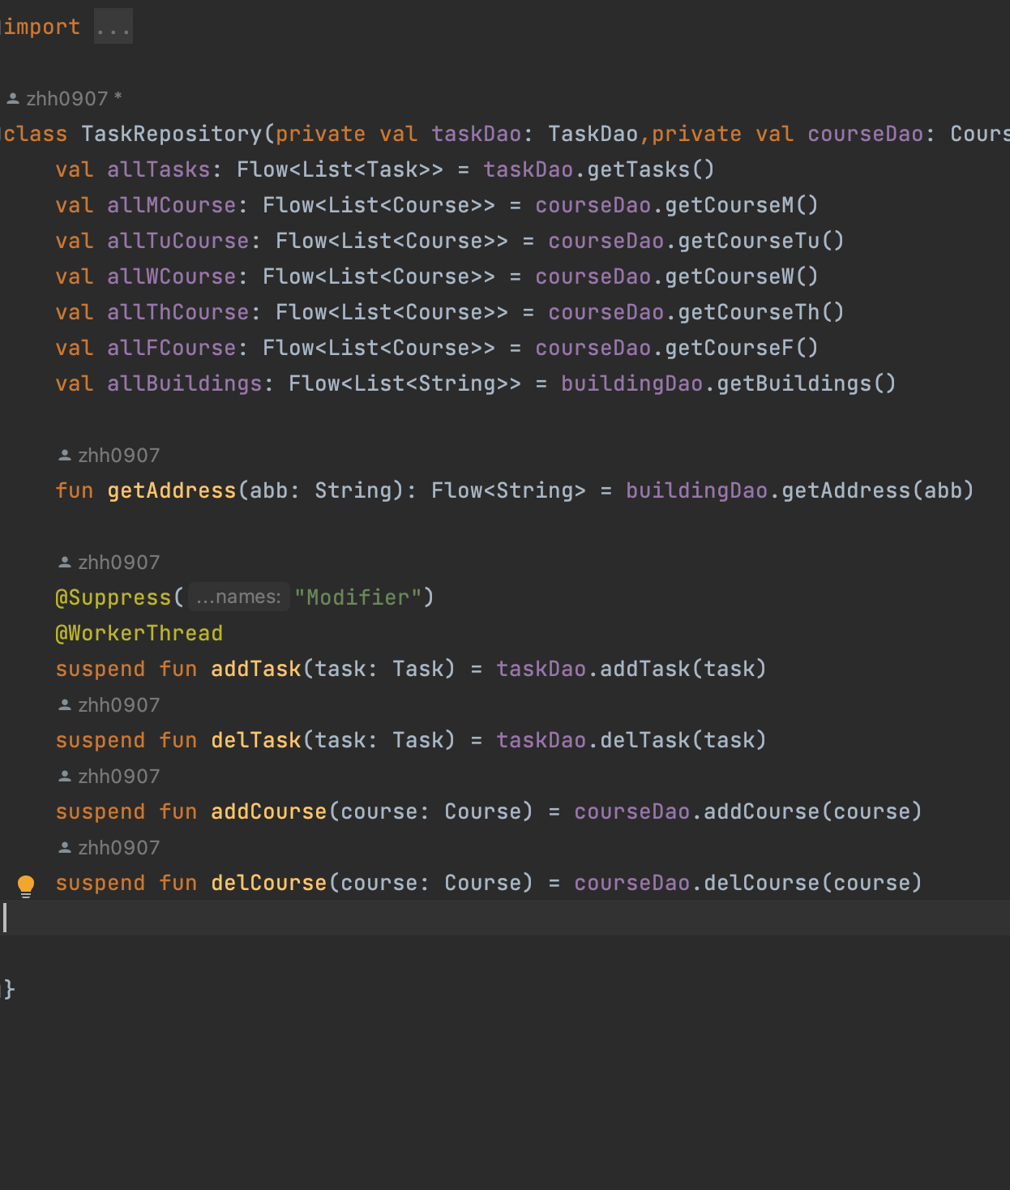
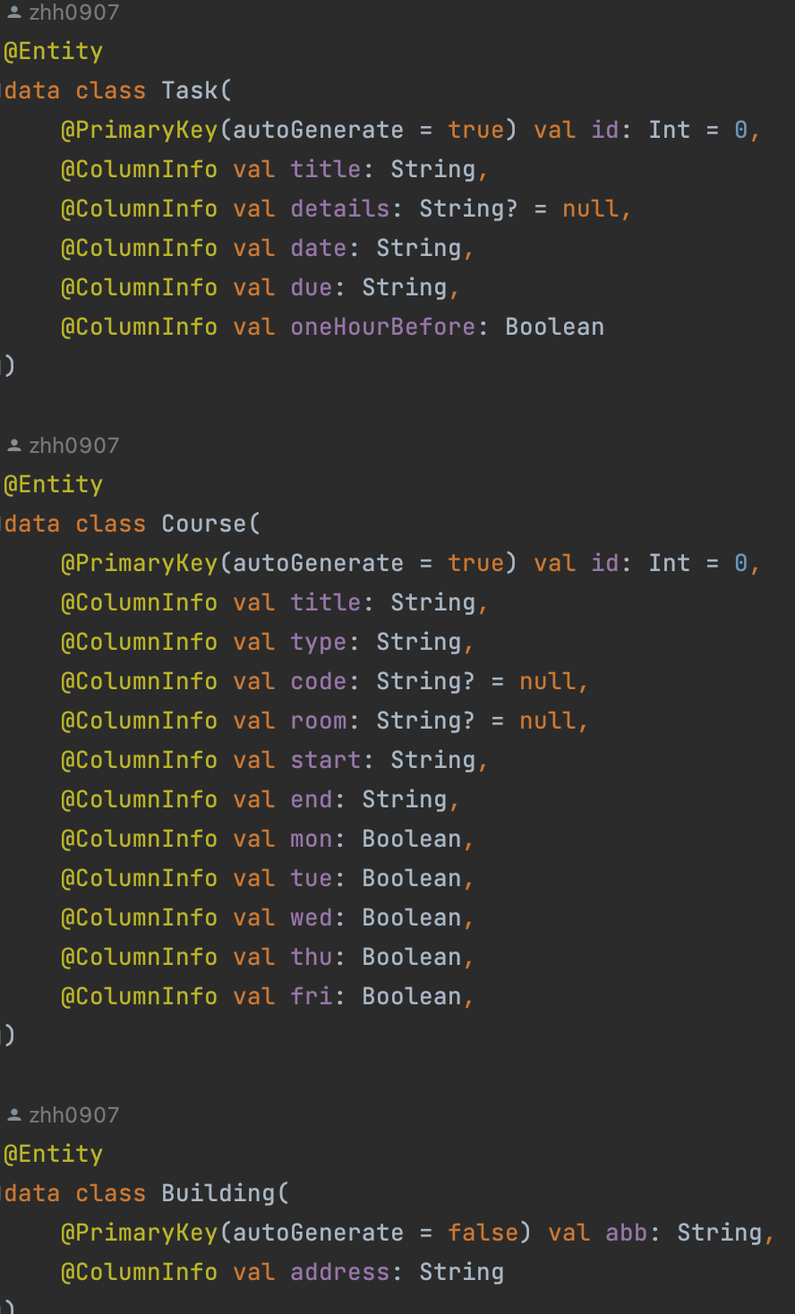
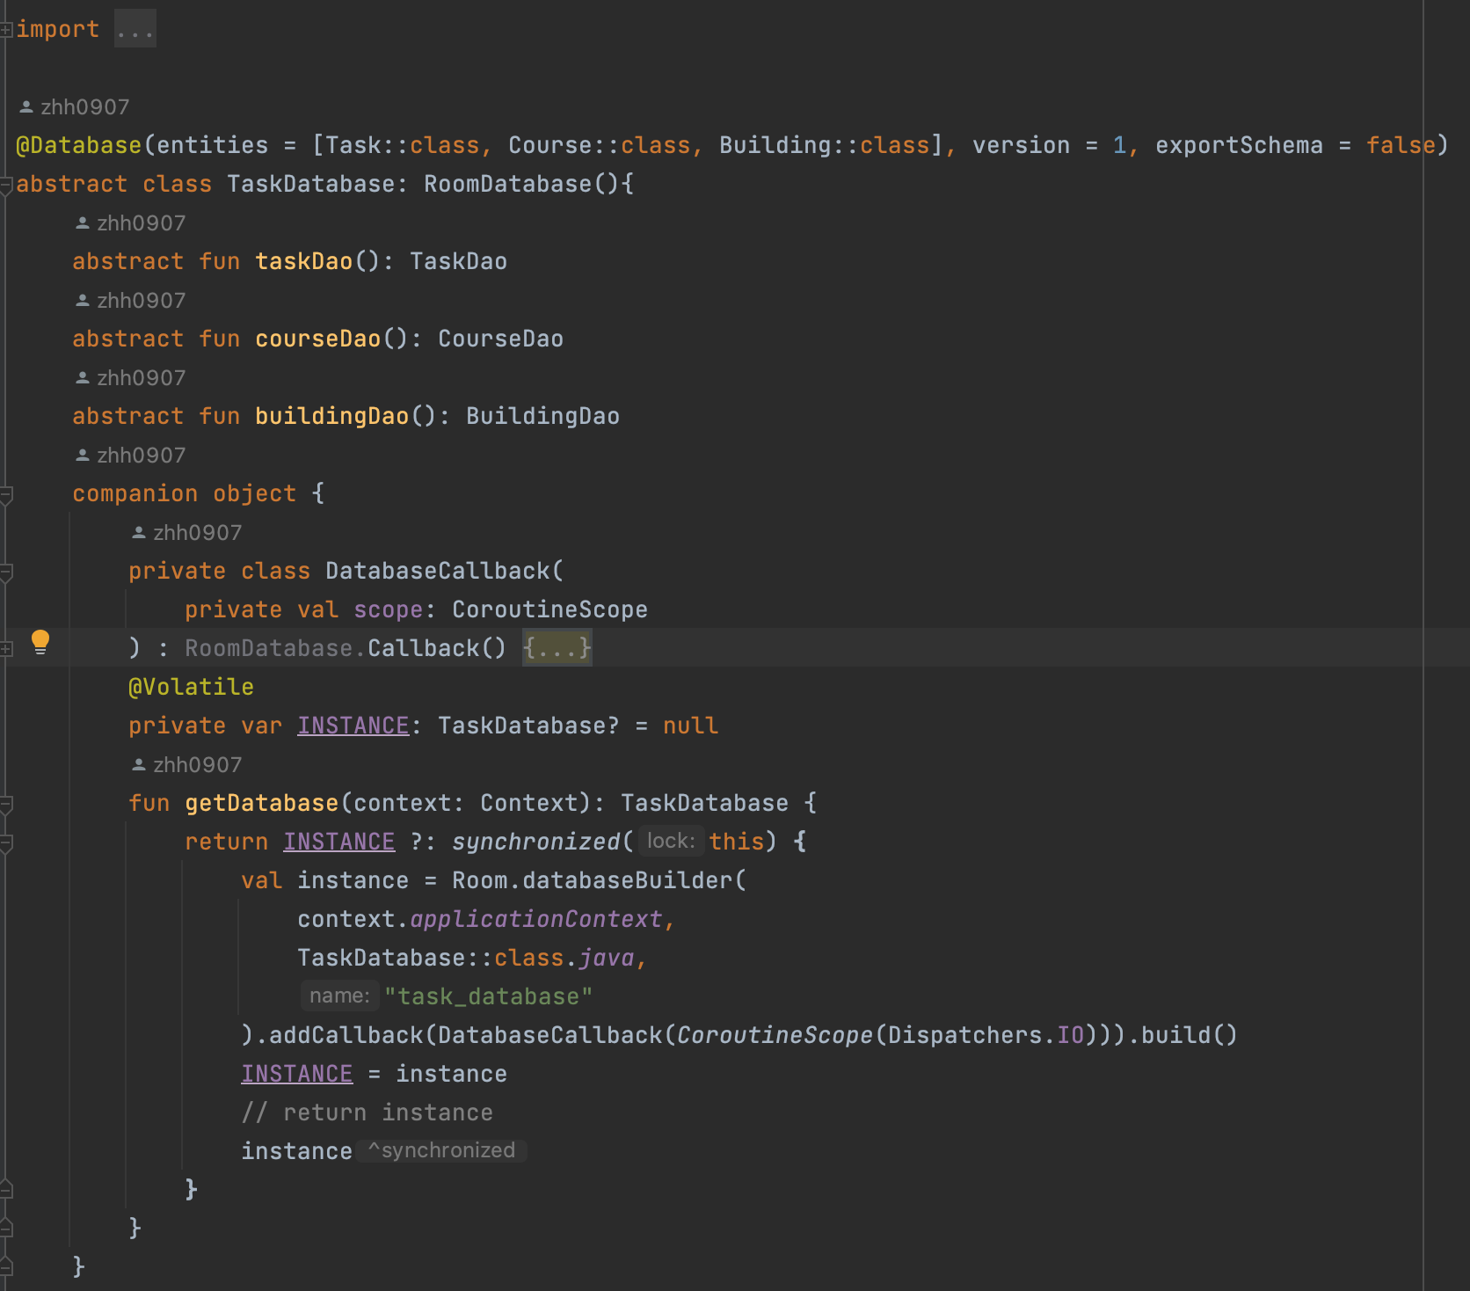
DataBase Implementation
Pre-fill Building data
Three Tables:
Courses
Tasks
Buildings

Slide 7
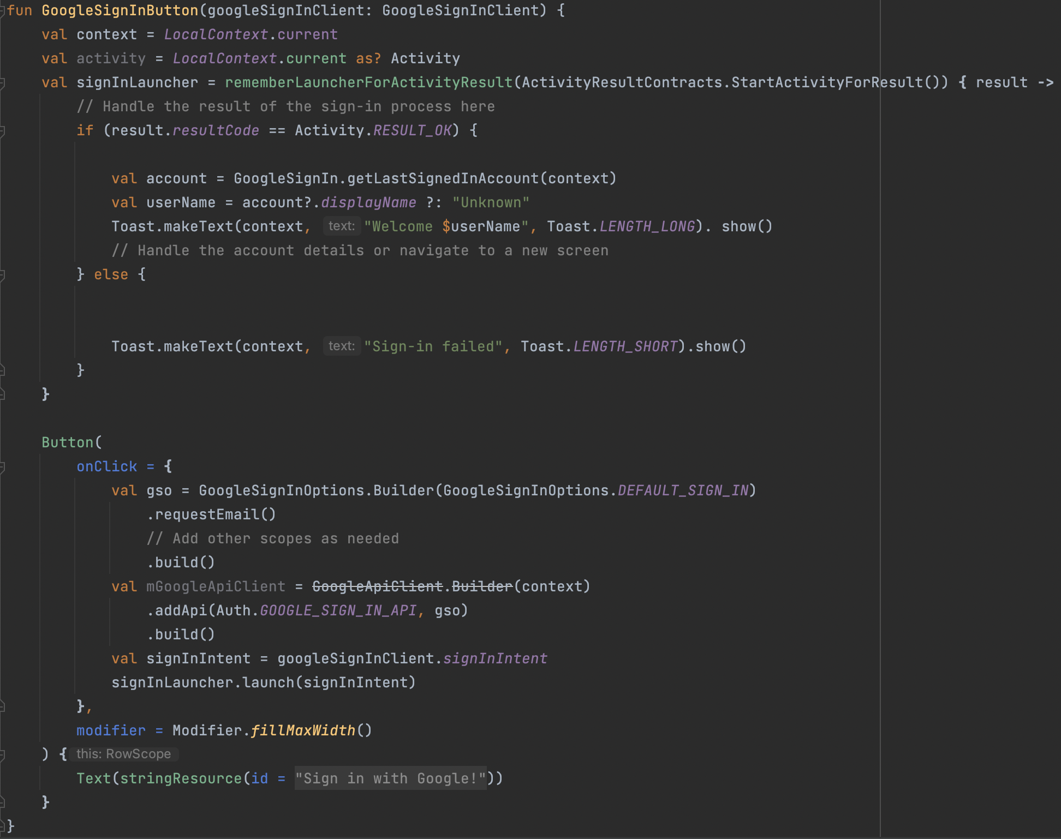
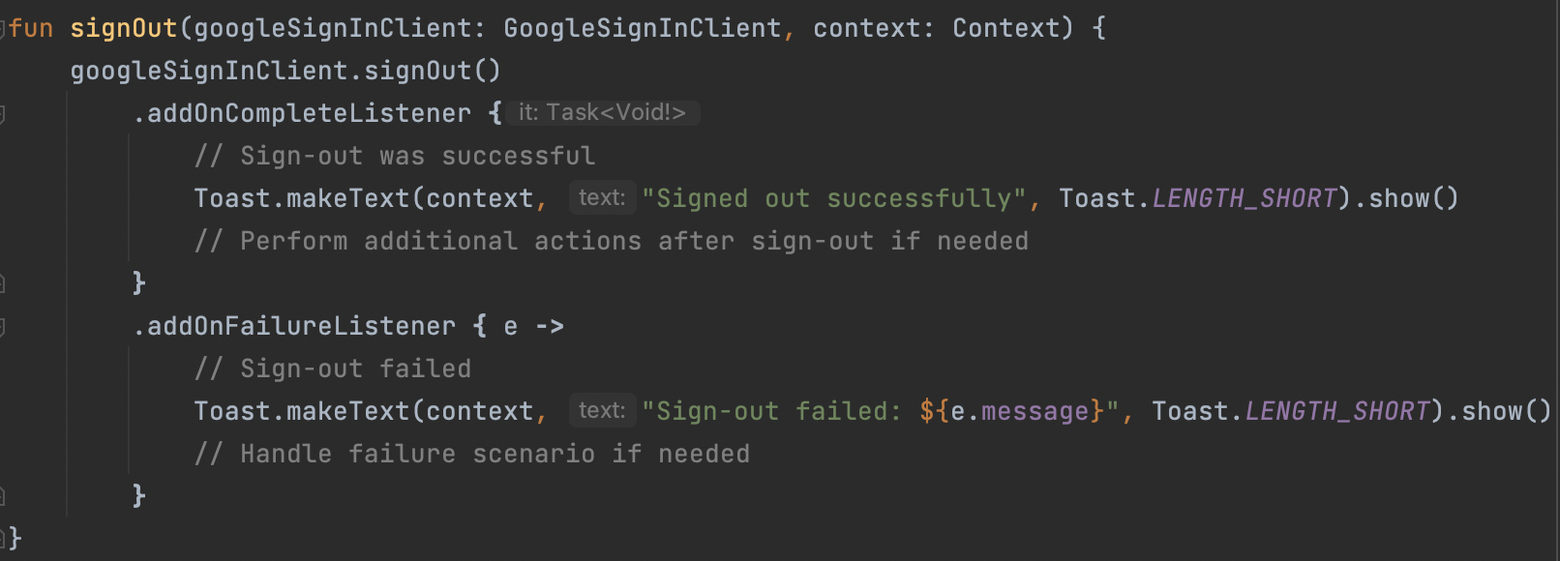
Google Oauth
- Can see how the Google Oauth API is called and built
- Also see how we disconnect from the Google Oauth API
- Activated with a click of a button
- Need to sign in to use the app

Slide 8
UI/UX Design & Software Architecture
Using Jetpack Compose and Material3
Changing weather button icon
Navigation bottom bar to control different page
Using ViewModel & FlowData
Switching between apps

Slide 9
Roadblocks and Surprises
We weren’t satisfied with our UI/UX design using XML
Database implementation also proved to be very difficult and a lot of our time was devoted towards building that
Google Oauth implementation was more difficult than expected; Had to set up on Google Cloud
APIs were of various difficulties to implement. Features were often deprecated and there were many version issues.
ChatGPT proved to be very unreliable

Slide 10
Workarounds
JetPack Compose
Databases
We found that Jetpack Compose allowed us to create a better UI/UX for the app than XML
We also found that it was easier to work with, at least for us
It also allowed us to avoid overcomplicating different features with lots of messy code
Using Jetpack Compose also proved to help in the implementation of our Room database
We changed from using an SQL database to one using Room to better fit an Android application

Slide 11
Workarounds
Time Management
API Implementation Tutorials
Due to us all being extremely busy with other schoolwork, it was difficult to meet up in person sometimes. During these times, we met up over Zoom
We also found time to meet up and collaborate on weekends/holidays
We also made sure to regularly push code to Github so all of us would have the latest code to avoid conflicts in the future
Using tutorials and guides found online, we were able to better implement the different APIs we planned on implementing.
We made sure to look at the most recent documentation before implementing an API in order to not waste time on deprecated versions of APIs
In order to resolve version issues, again we referenced the most recent documentation

Slide 12
What Would We Do Differently?
We would have started with using Jetpack Compose instead of spending a few weeks using XML
We would have been more realistic about what could be accomplished in a month with our busy schedules. Not to say that we shouldn’t have high standards for ourselves, but to have the opportunity to really hone and refine existing features rather than spreading ourselves thin with many different features
We would have used a project management software such as Trello to stay on track
We would have a more methodical approach to implementing features

Slide 13
For Future Implementation
ReFine ChatGPT
More Locales
Although we have the basics of the ChatGPT API down, we would've liked for it to work better.
In the future, we would like to further refine and optimize the ChatGPT scheduling feature to realize our vision of creating a schedule using ChatGPT
Having more locales can allow more users to use our app
Having an app in a foreign language can deter users from using our app

Slide 14
For Future Implementation
Security Features
Additional Devices
Due to the information on our app having the potential to be revealing, it is important to keep the data safe even if users are required to sign in before accessing the data
We would like to implement a Multi-Factor Authentication to keep adversaries from stealing our data
For now, our application works in landscape and for some phones
We would like to expand to other devices and implement a seamless design tailored for each device

Slide 15
For Future Implementation
More Uses for OAUTH
Increased Customization
For right now, users can input their Google account information into the app
Later, we would like to implement features that better utilize this function
For example, automatically filling out fields, connecting with Google Calendar, etc
We would like to add more customization features for tasks and courses
This can range from customizing notification times to customizing sorting of classes and courses

Slide 16
Demonstration
Our code and our External APIs; Code Snippets and Samples

Slide 17
References
APIs:
Google Oauth: For User Sign In
Openweather: For weather info and recommendations
External Resources:
ChatGPT: For code debugging
Youtube: For tutorials
Android Developer Docs: For code reference
Stack Overflow: For code debugging
Iconmonstr: For Icon design

