Slide 1




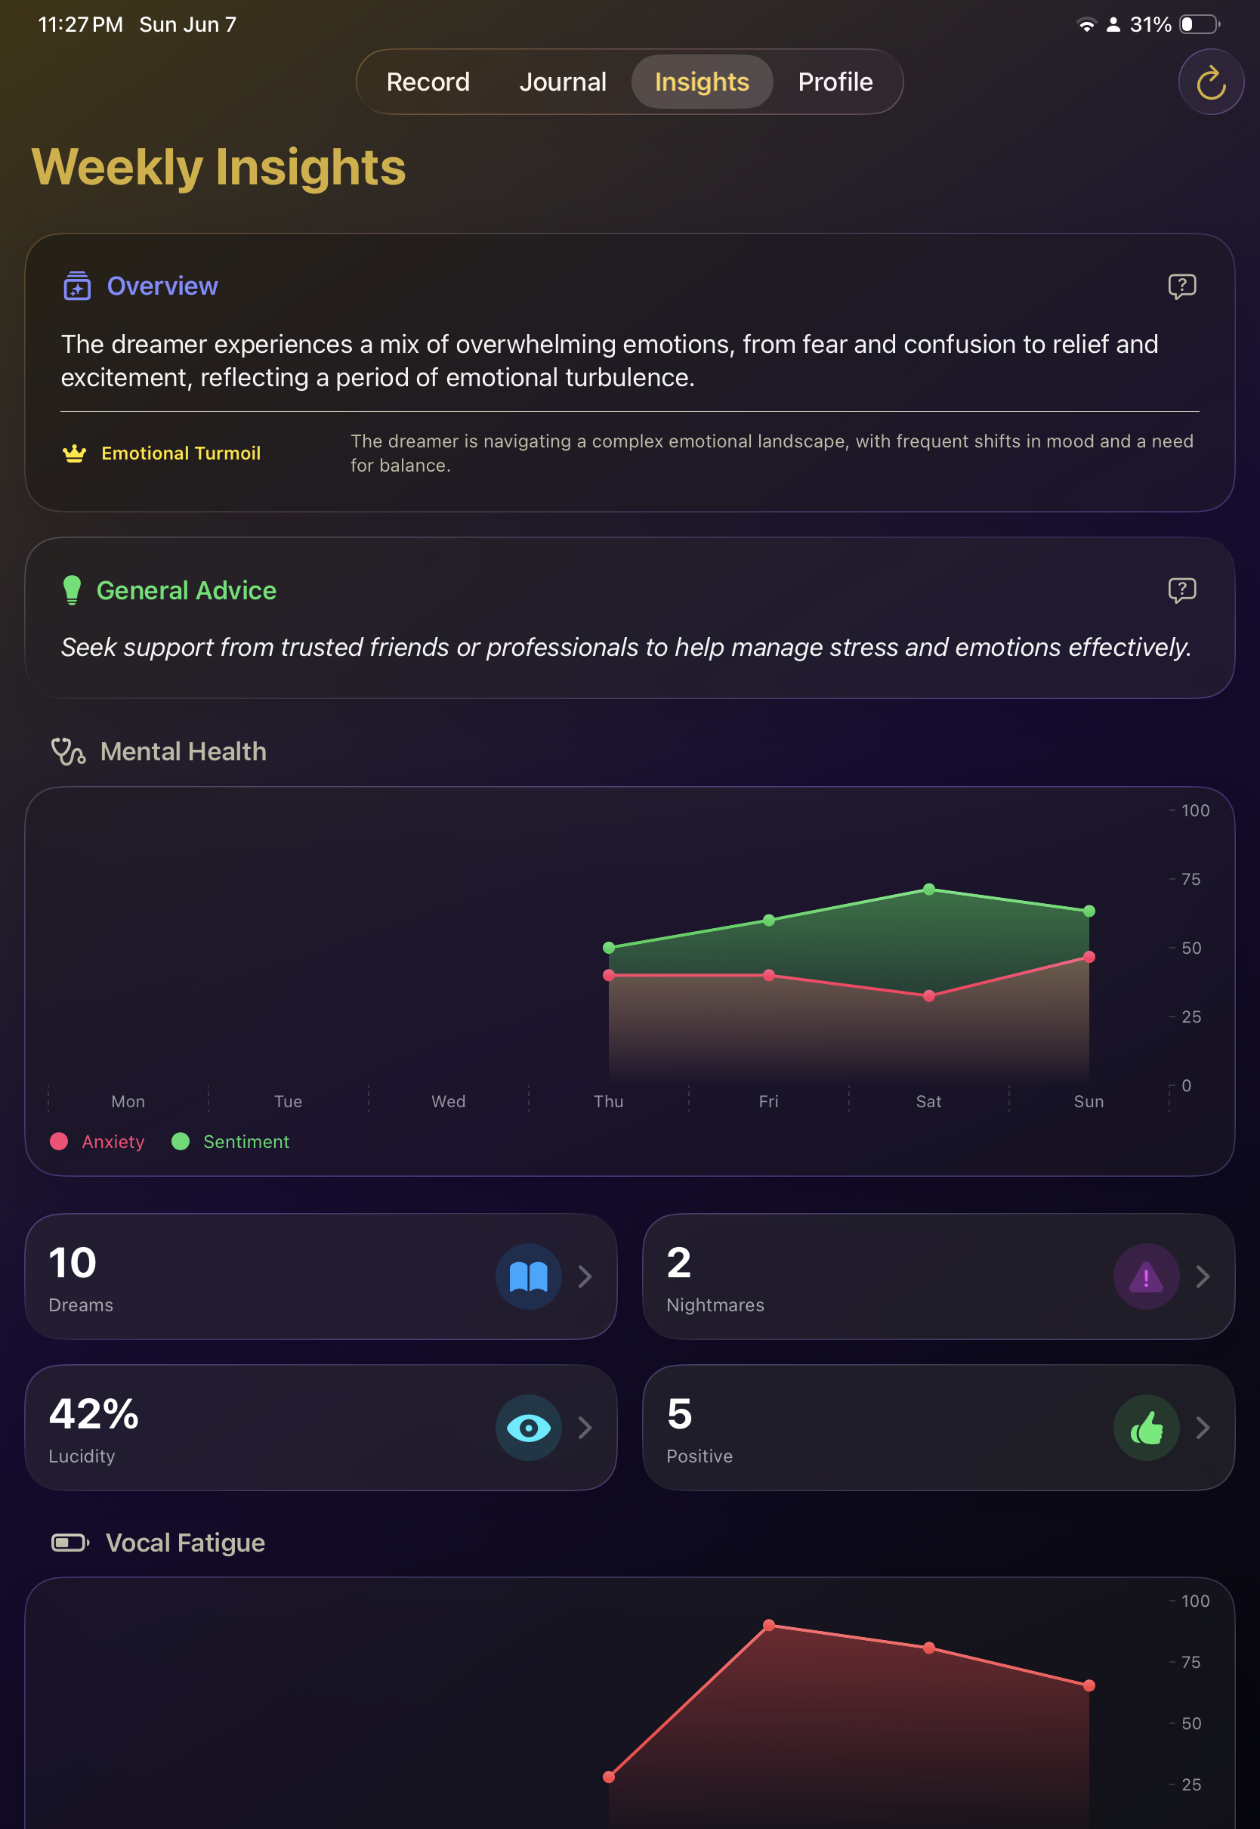

Waitlist
Dorsal
Dream Psychologist
By Kelvin Mathew

