Slide 1

Housing Price Prediction
GROUP MEMBERS
Kelvin Simon –C0866577
Amal V.T- C0863255
Karthi Kuthalingam-C0864345
Sarathchandran Santhosh-C0864346
Tega Orido-C0857045

Slide 2
Participation
NAME | TASK
Kelvin Simon | Deploying Flask and Model Building
Amal V.T | Model Building
Karthi Kuthallingam | User interface and Presentation
Sarath | Model Building and Data Exploration
Tega Orido | Data Exploration

Slide 3
Data Selection
Took Home Sales Data in Milwaukee USA in 2012.
Utilised Data Set Containing about 2000 records and 16 features.
Link:https://study.sagepub.com/rogerson5e/student-resources/datasets

Slide 4
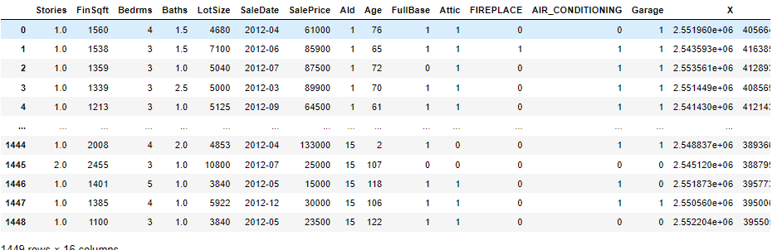
Preview Of data

Slide 5
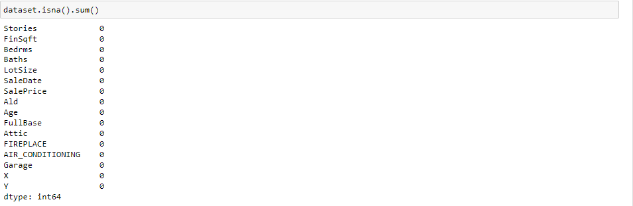
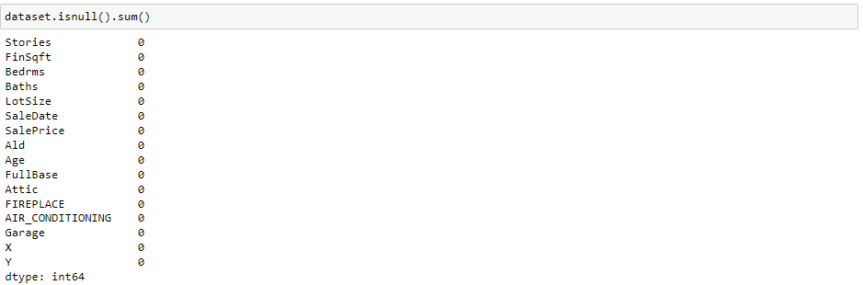
Data Cleaning
No Null Values or NaN Values

Slide 6
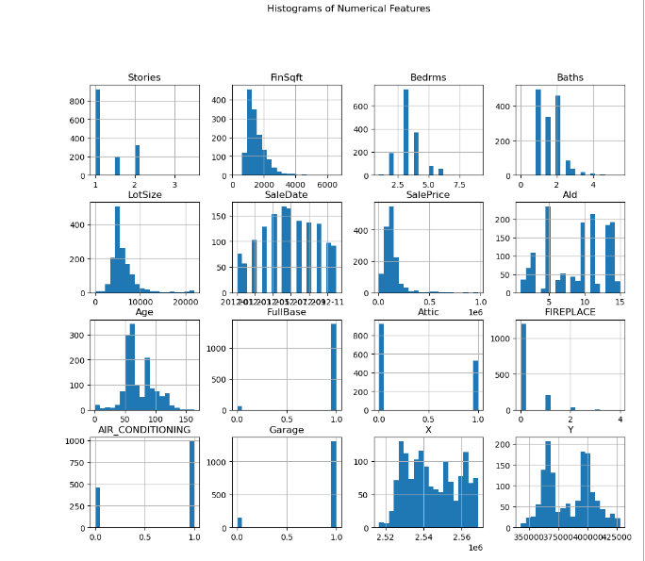
Data Exploration

Slide 7
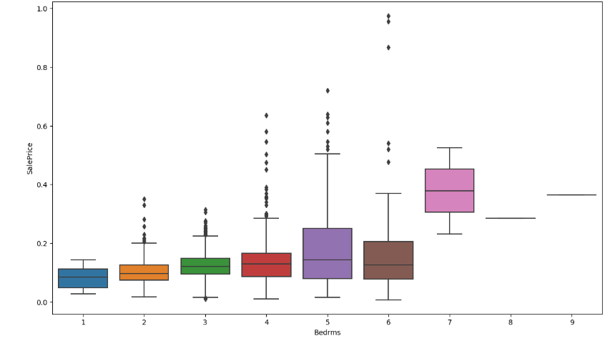
Data Exploration

Slide 8
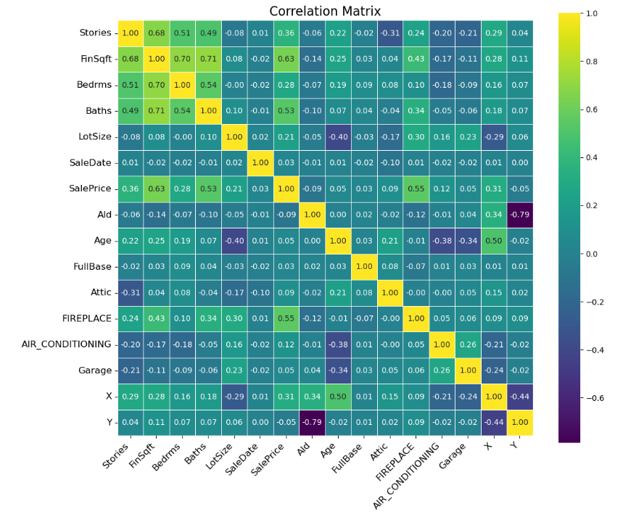
Data Exploration

Slide 9
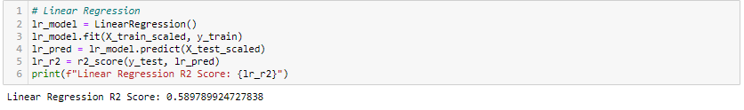
Model Selection –Linear Regression
The R2 Score obtained by using Linear Regression was 0.59

Slide 10
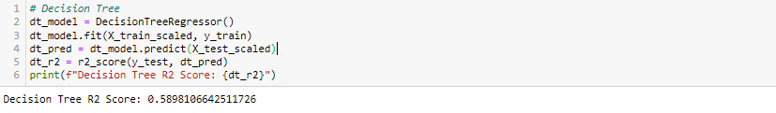
Model Selection –Decision Tree
The R2 Score obtained by Decision Tree was 0.59

Slide 11
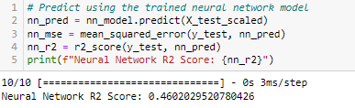
Model Selection –ANN
The R2 Score obtained by ANN was 0.46

Slide 12
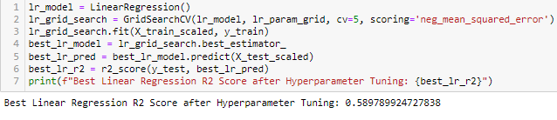
HyPerparameter tuning- Linear Regression
Using GridSearchCV for tuning , the R2 score we obtained is 0.59 which does not show much improvement

Slide 13
HyPerparameter tuning- Decision Tree
Presenting the best parameters found through grid search in Decision Tree model, the new R2 score obtained is 0.71
As tuned Decision Tree model produce more score, we are going to take this as our model for price prediction

Slide 14
FLASK WEB Application

Slide 15
Flask Web Application
Developed a Flask web application for calculating sale prices to simplify the process for users.
Users can easily input the necessary details into the application, such as Bedrooms, Lot Size, and any additional factors influencing the sale price.
Once processed, the calculated sale price is displayed prominently, ensuring users can easily see and utilize the result.

Slide 16
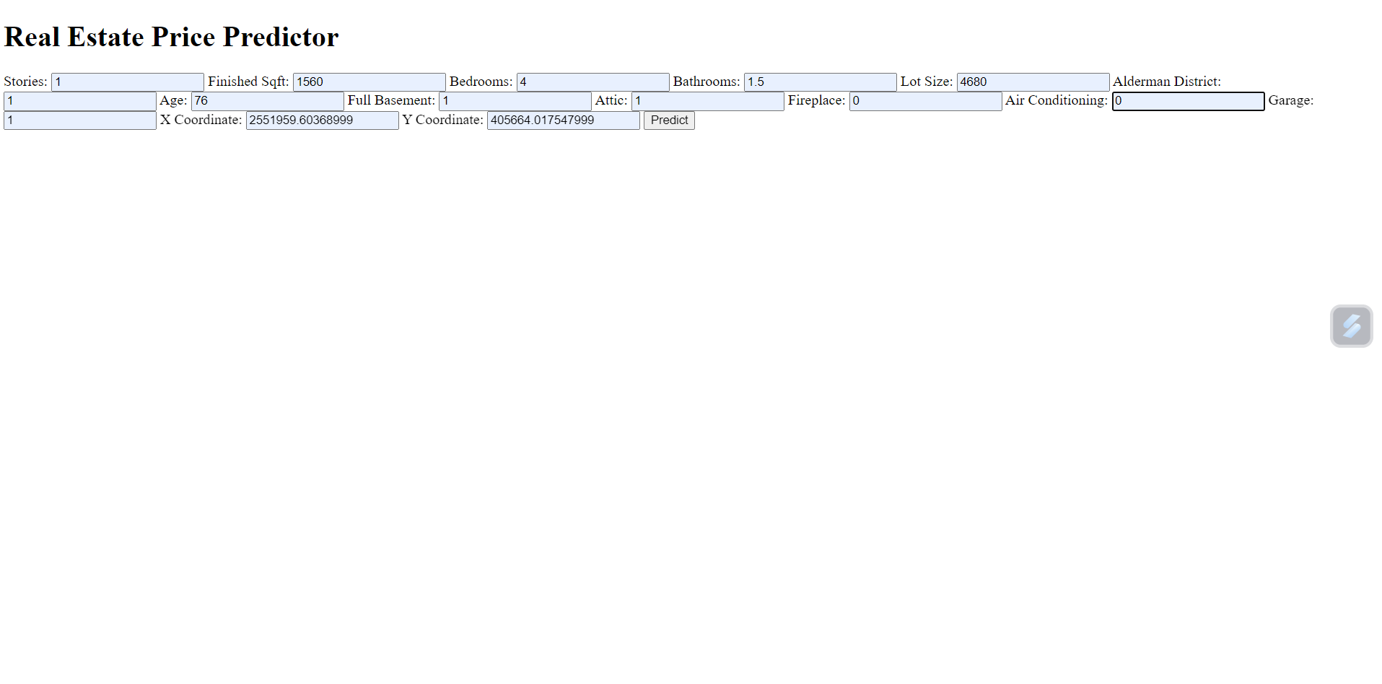
Flask Web Application-Examples

Slide 17
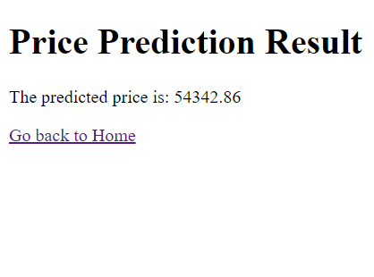
Flask Web Application-Examples

Slide 18
GITHUB
Link:https://github.com/KelvinSimon09/Housing-Price-prediction-using-Flask

Slide 19
Demo of using Flask Web application

