Slide 1
CUSTOMER CHURN PROJECT
BY: KELVIN DANKWA-SMITH
(JUNIOR DATA SCIENTIST)
JULY 2022

Slide 2
PRESENTATION OUTLINE
01
Problem Statement
02
Project Goals
03
Tools Used
04
About The Project
05
Conclusion

Slide 3
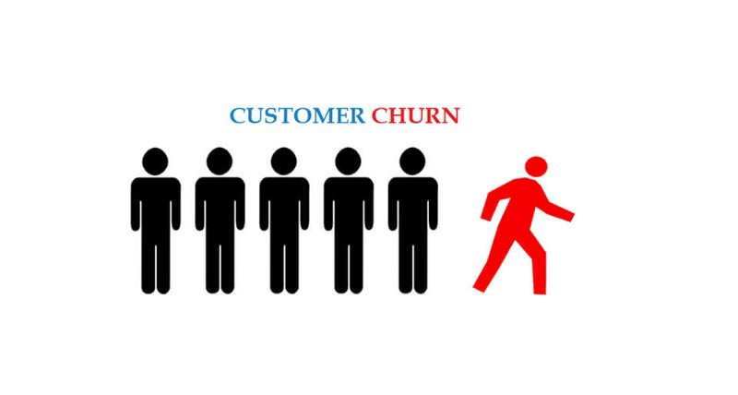
PROBLEM STATEMENT
Company XYZ in the month of April recorded vast dop in customers renewing for the following month. The company want to find out what is leading to the customer churn. As the Data Scientist, the company's data for the month of April has been presented to you to make analysis for the business use cases attached and develop a machine learning model that can help predict if a customer will renew or not.

Slide 4
PROJECT OBJECTIVES
01
Develop a predictive model to find out whether a customer will renew or not
02
Perform analytical research on the number of customers who didn’t renew
03
The type of contracts of those not renewing with company and average tenure days per contract
04
Find out if those leaving have phone service or not

Slide 5
TOOLS USED
Jupyter notebook
Python programming language
Dataset (CSV file)
Visualization

Slide 6
ABOUT THE PROJECT
How many customers didn’t renew?
 | No. Of Customers
Renewed | 5163
Not Renew | 1869
Total | 7032

Slide 7
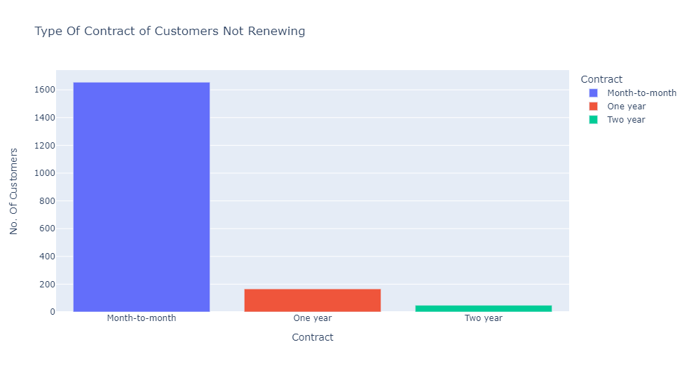
ABOUT THE PROJECT
What is the contract type of customers who didn’t renew?

Slide 8
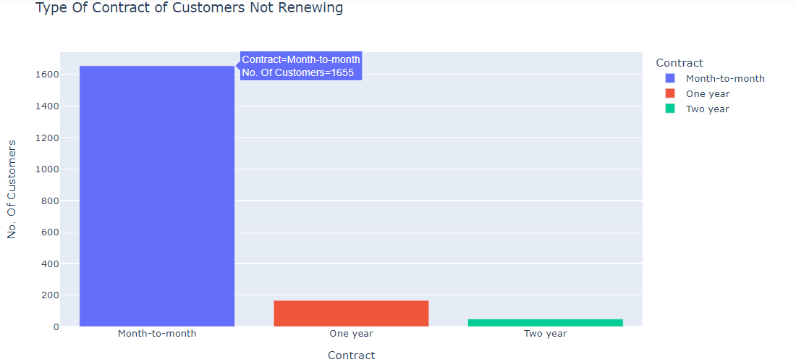

Slide 9
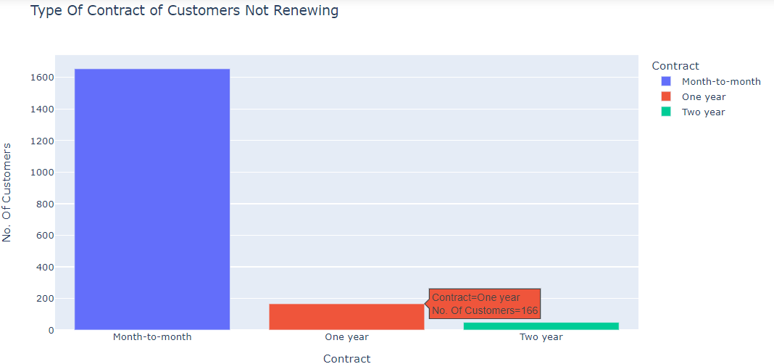

Slide 10
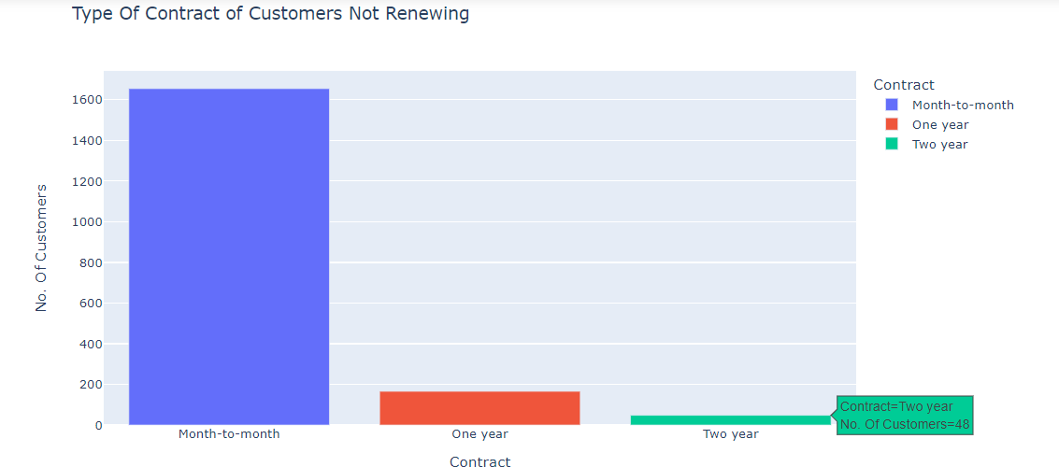

Slide 11
ABOUT THE PROJECT
Average tenure per contract
Contract | Average Tenure
Month-to-month | 14
One year | 45
Two year | 61

Slide 12
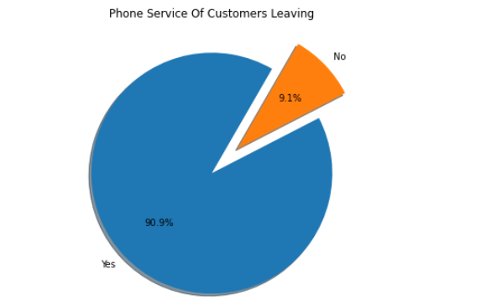
ABOUT THE PROJECT
Do the customers not renewing have phone service or not?

Slide 13
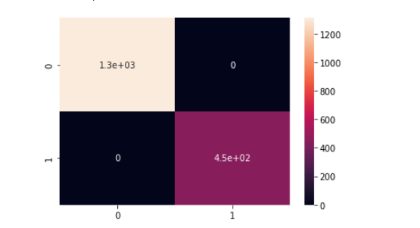
ABOUT THE PROJECT
Machine learning developed to predict whether customer will renew or not.
The accuracy of the model is 99% since it predicted all test data right after checking with confusion matrix.

Slide 14
Conclusion
The tenure and customer ID are crucial factors in determining whether a customer will renew or not. The average tenure for customers not renewing in a month-to-month contract was 14 as compared to customers which renews at 21
Ability to predict whether a customer will renew or not with the developed machine learning model
Majority of customers not renewing are on a month-to-month contract type

Slide 15

THANK YOU!
Phone:
+971547263843
Email:
kelvindankwasmith@gmail.com

