Slide 1

Airline Review Analysis
Kelvin Chow

Slide 2
Tools
numpy, pandas, matplotlib.pyplot, seaborn, beautifulsoup
statsmodels.api, statsmodels.formula.api, patsy
sklearn.model_selection: train_test_split, Kfold, cross_val_score
sklearn.linear_model: LinearRegression, Ridge, RidgeCV, Lasso, LassoCV, lars_path
sklearn.preprocessing: StandardScaler, PolynomialFeatures
sklearn.metrics: r2_score
sklearn.pipline: Pipeline
scipy.stats

Slide 3
Scope
Web scraping via beautifulsoup
Simple Linear Regression
Ridge and Polynomial Regression
Simple Validation
Cross Validation
Lasso and Ridge with simple Validation
Lasso with Cross Validation
Alpha tuning
Lars_Path and QQ Plot
Conclusion

Slide 4
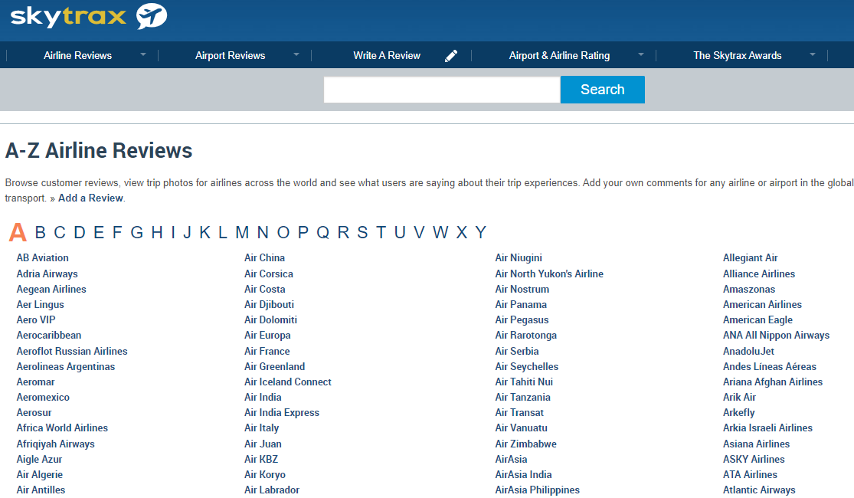
Web Scrapping

Slide 5
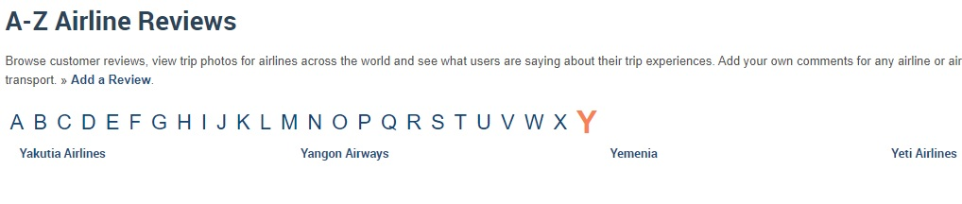
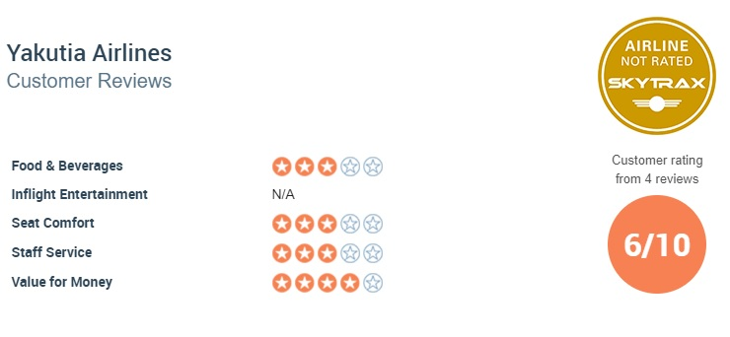
Airline Reviews

Slide 6
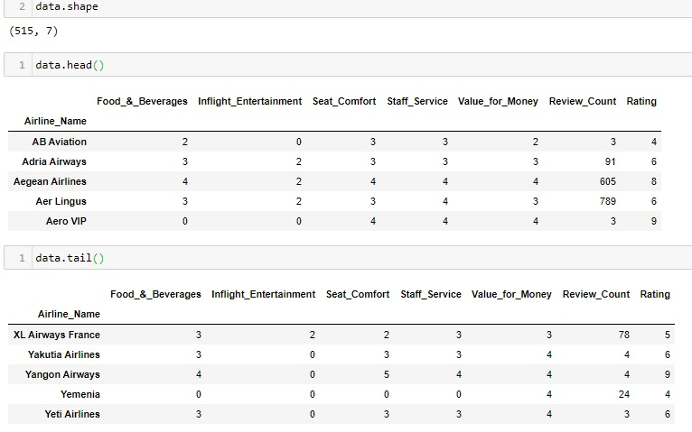
Data Set

Slide 7
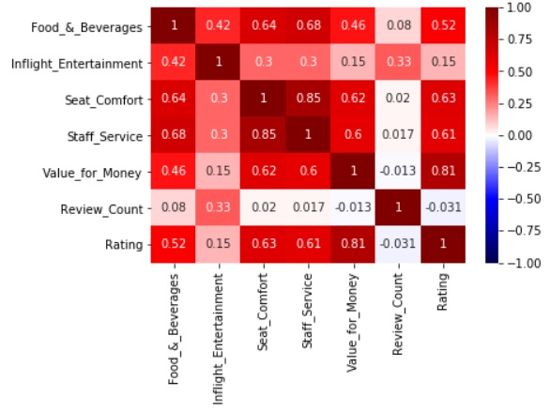
Correlation Heat-Map

Slide 8
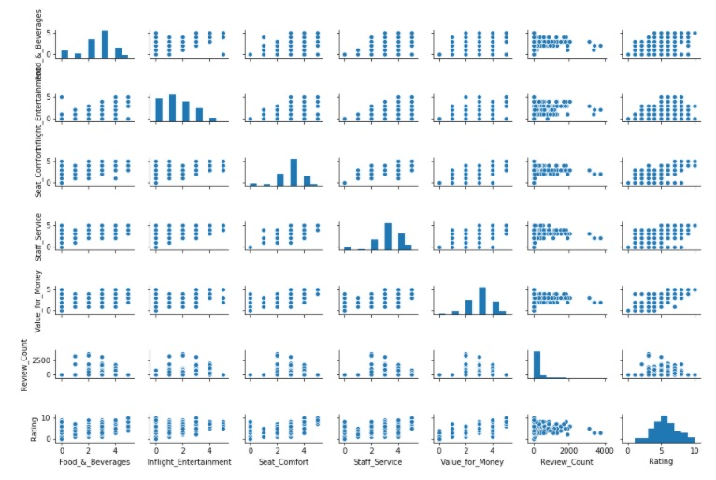
Seaborn Pair-Plot

Slide 9

Seaborn Pair-Plot

Slide 10
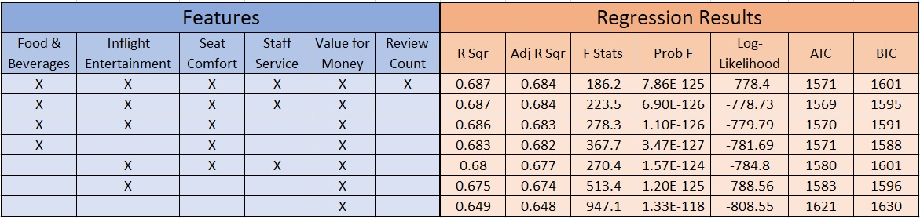
Linear Regression

Slide 11
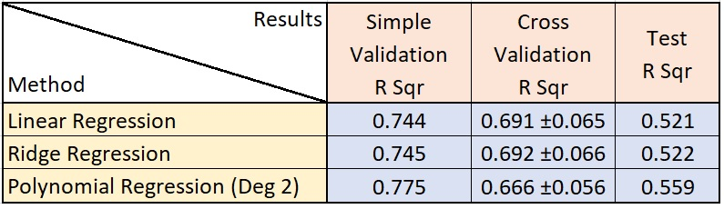
Ridge and Polynomial

Slide 12
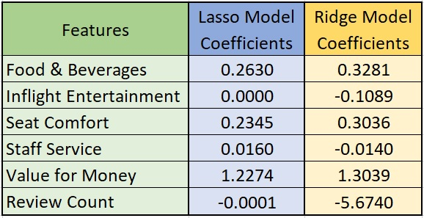
Lasso & Ridge (α=0.1)

Slide 13
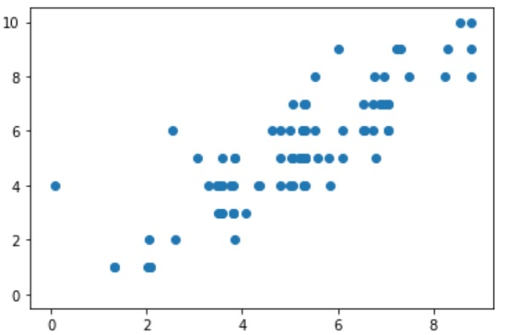
Lasso
R² with Test Set
0.706
Mean Absolute Error
0.82
Target
Prediction
With standardscaling on train features:
R² : 0.718
MAE : 0.80

Slide 14
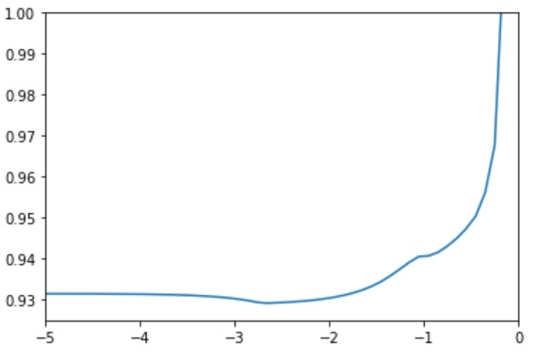
Aplha & Lasso CV
Lowest MAE
0.9291
Alpha (α)
0.002
Error
With new α = 0.002:
R² : 0.713
MAE : 0.7998
lg(α)
With Lasso Cross Validation:
α = 0.01
R² : 0.714 MAE : 0.7984

Slide 15
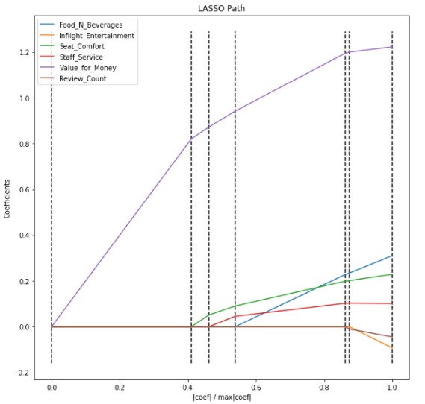
Lasso Path

Slide 16
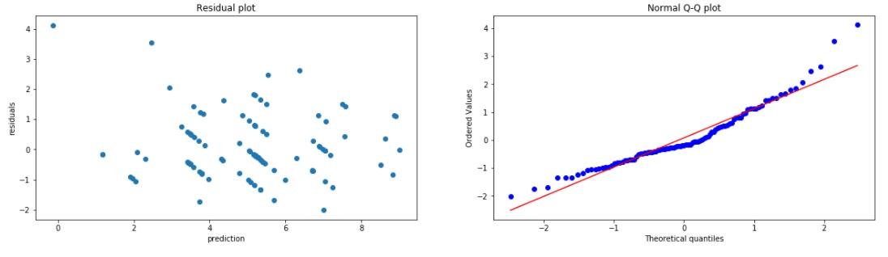
Residuals & QQ

Slide 17
Conclusion
Lasso CV model yields the best model so far with 71% accuracy and 0.8 rating point error.
Customers look heavily for value-for money airlines
With more time, transform the variables with polynomial or log for Lasso CV.
Take out the two least essential features and try Lasso CV again.
Evaluate Ridge CV model.
And try on non-linear models.
Improve on the graphics presented.

Slide 18

Thank You

