Slide 1

Bank Account Closure Analysis
Kelvin Chow

Slide 2
Objective
To predict which clients of the bank are going to close their account.

Slide 3




Tools

Slide 4
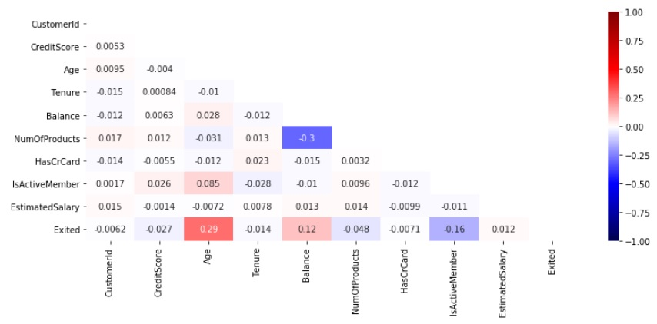
Data
10,000 Observations and 13 Features

Slide 5
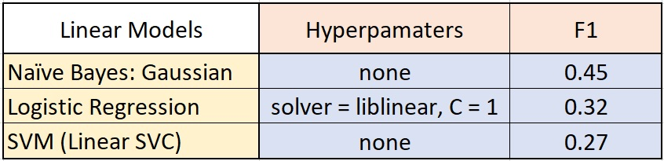
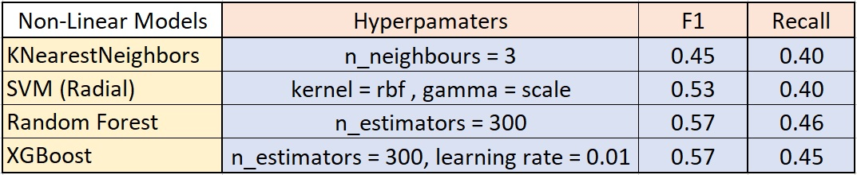
Models

Slide 6
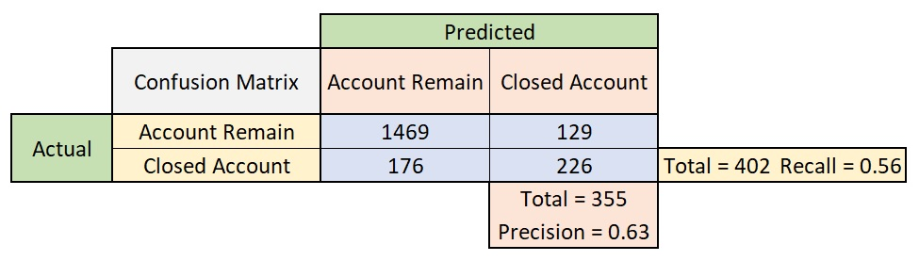
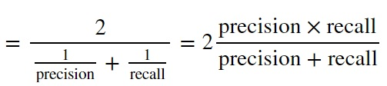
Score Metrics
F1

Slide 7
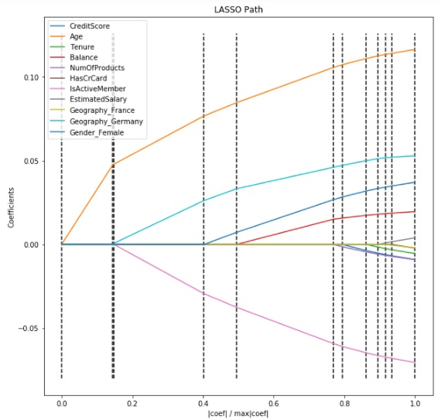
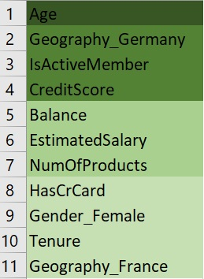
Feature Importance

Slide 8
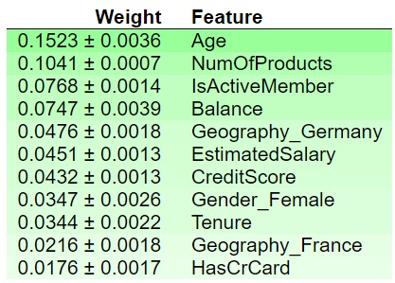
Feature Importance
Permutation Importance
Lasso Path

Slide 9
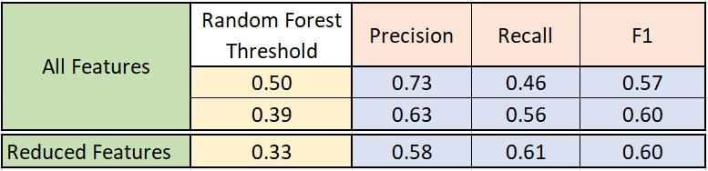
Random Forest

Slide 10
Conclusion
Recall of 61%, Precision of 58%
More data, features
Simple features groupby between account remain and closed
Interest rates, number of support calls, number of complaints
With all the predicted closure clients, initiate calls to them survey their satisfactory, address their concerns

Slide 11

Thank You
Kaggle: https://www.kaggle.com/kelvinchow1979
LinkedIn: https://www.linkedin.com/in/kelvin-chow-3a8b678/

