Slide 1
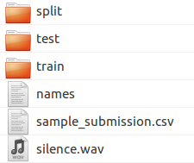
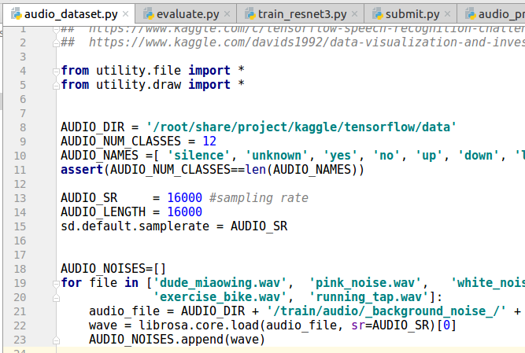
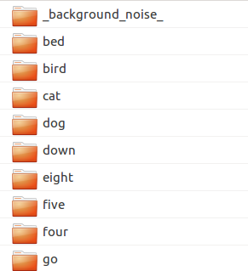
1. verify setup is correct
- using pycharm as python IDE
- pytorch 0.3 / python 3.6
A. setup data
(*.wave files are inside )
(*.wave files are inside )

Slide 2
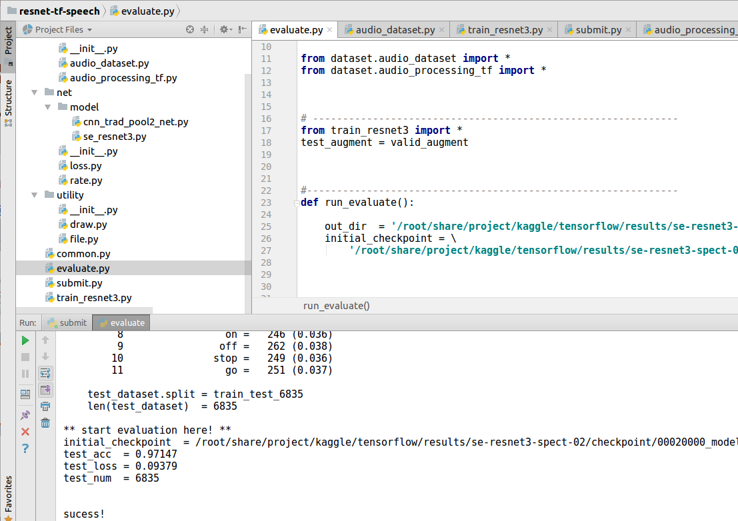
B. run evaluation
trained model
example results (see next slide)

Slide 3
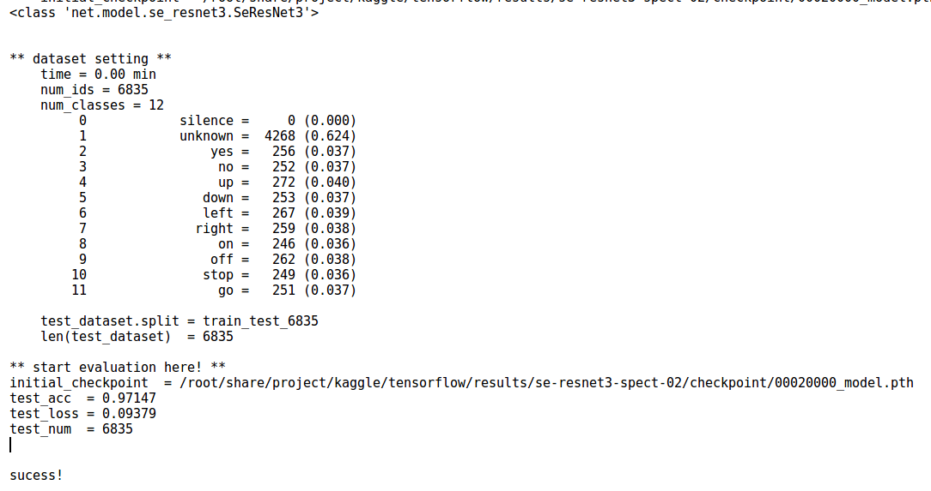
make sure you get this!

Slide 4

C. for csv submission, see submit.py

Slide 5
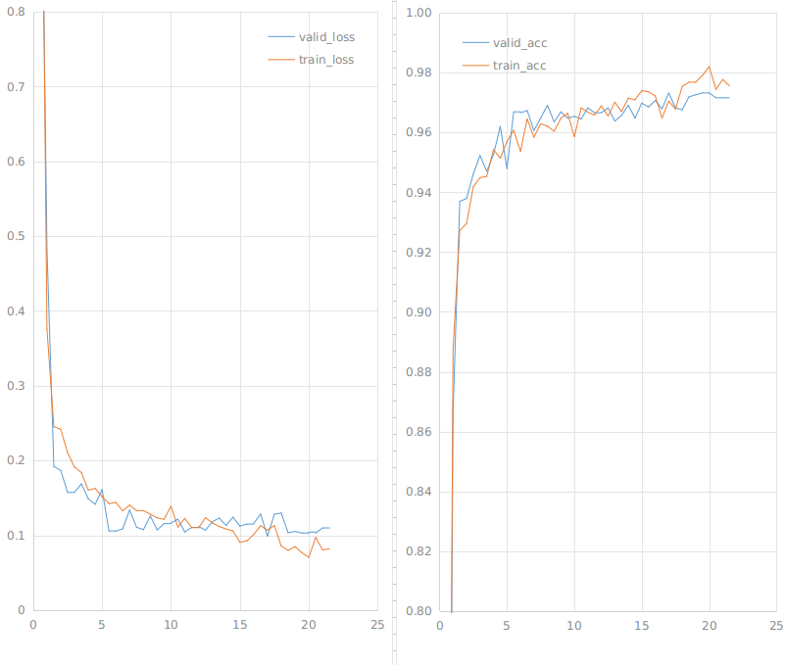
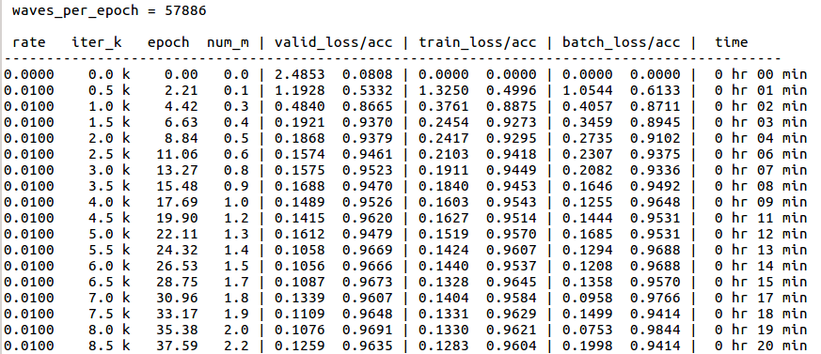
D. for training, see train_resnet3.py
/root/share/project/kaggle/tensorflow/results/se-resnet3-spect-02/checkpoint/00020000_model.pth
LB@20k = 0.86
Valid = 0.1130 0.9688 Train = 0.0988 0.9719
rate=0.01
rate=0.001
K iterations
K iterations

