Slide 1
Some results for melspectrogram/ MFCC/ raw wave nets

Slide 2
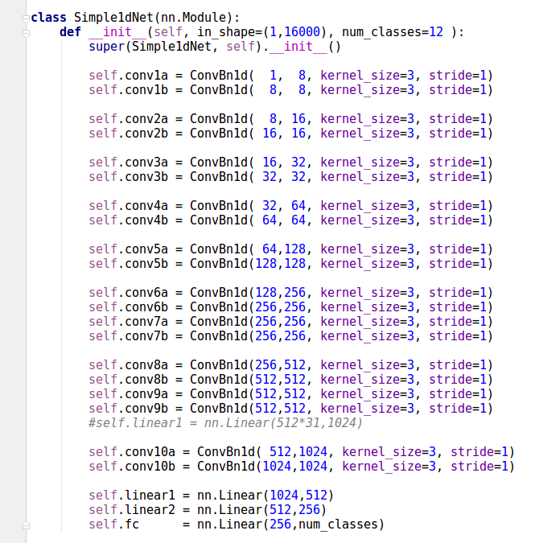
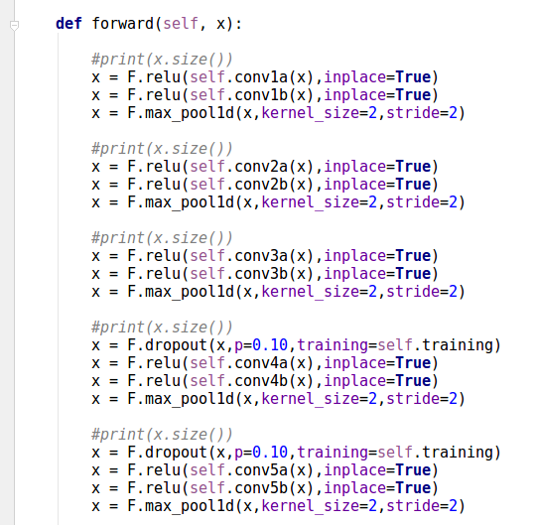
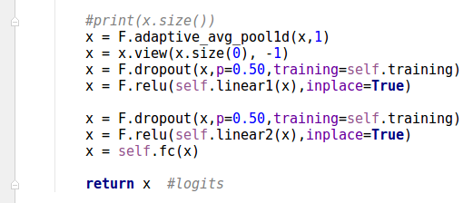
1. raw wave (1d)
...

Slide 3
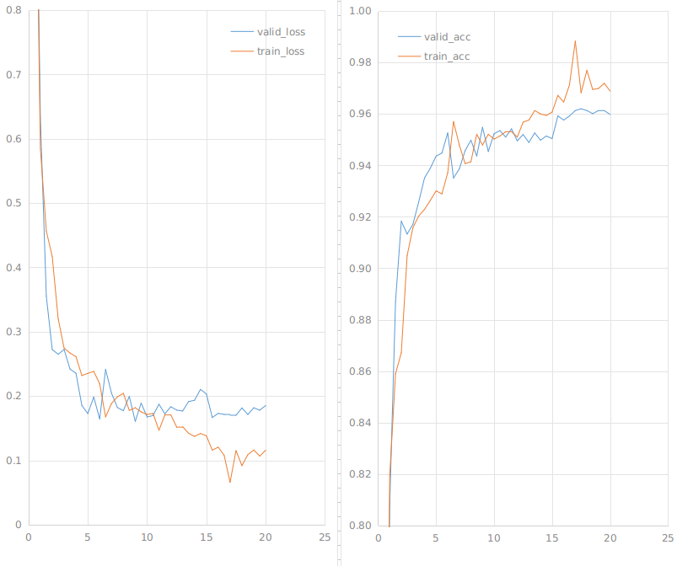
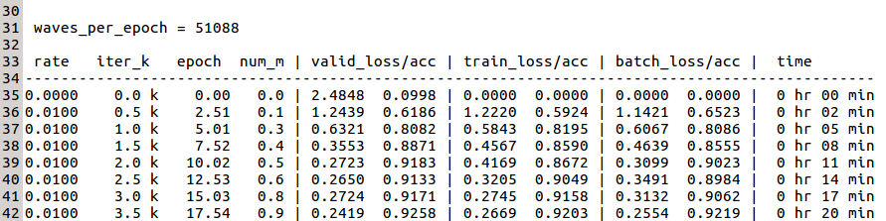
/root/share/project/kaggle/tensorflow/results/simple1d_net-10a/checkpoint/00019000_model.pth
LB@19k = 0.86
Valid = 0.1818 0.9613 Train = 0.1161 0.9699
rate=0.01
rate=0.001
K iterations
K iterations

Slide 4
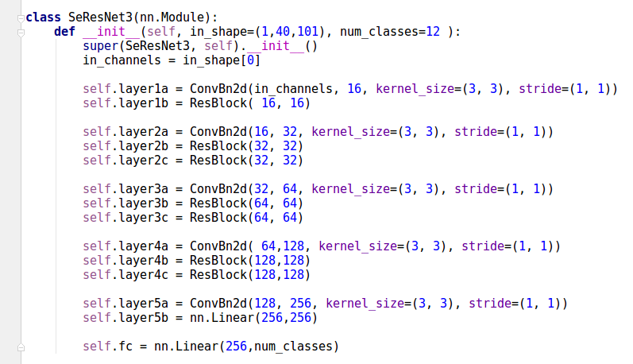
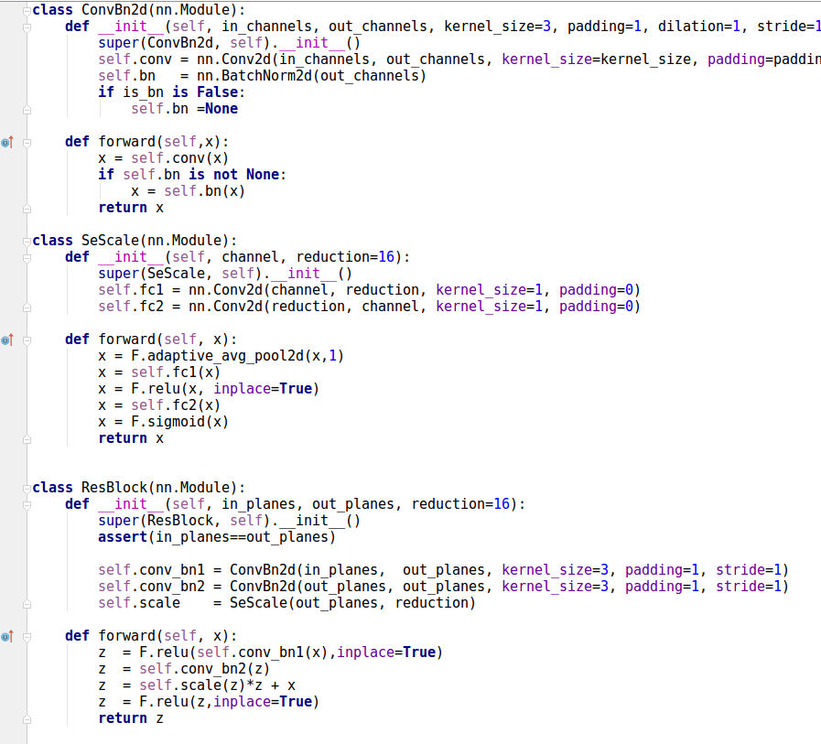
2. melspectrogram (2d)

Slide 5
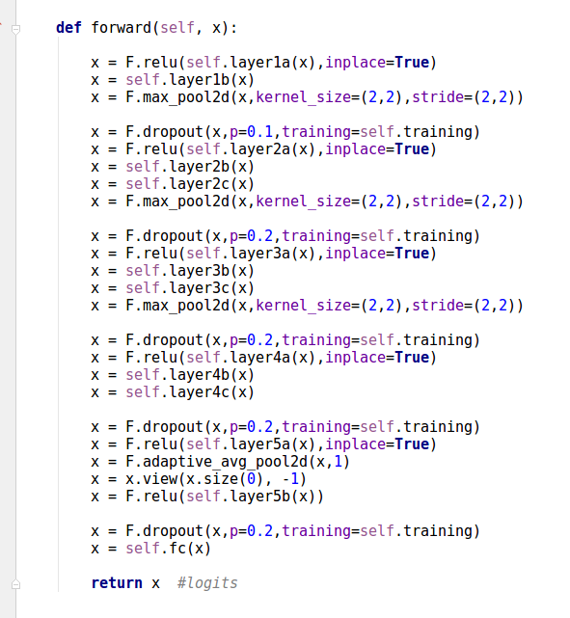

Slide 6
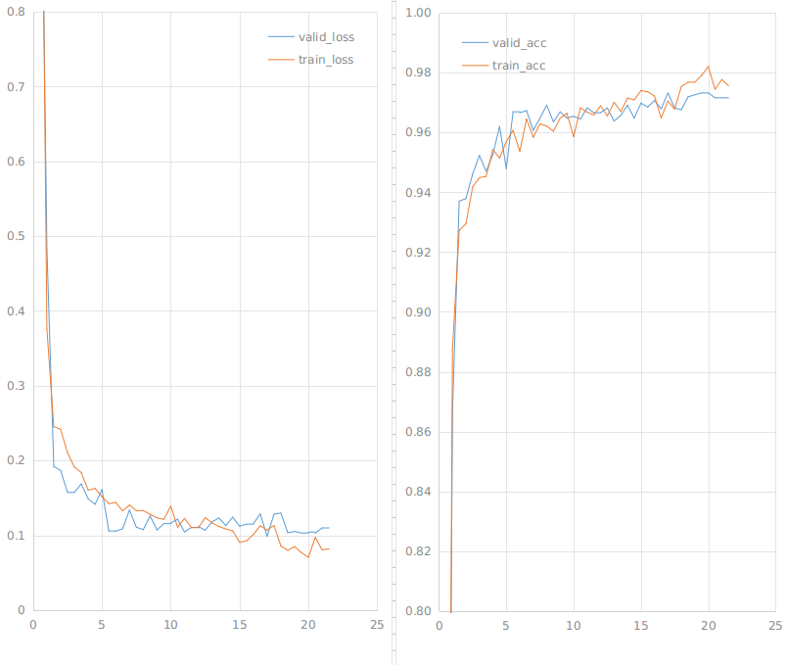
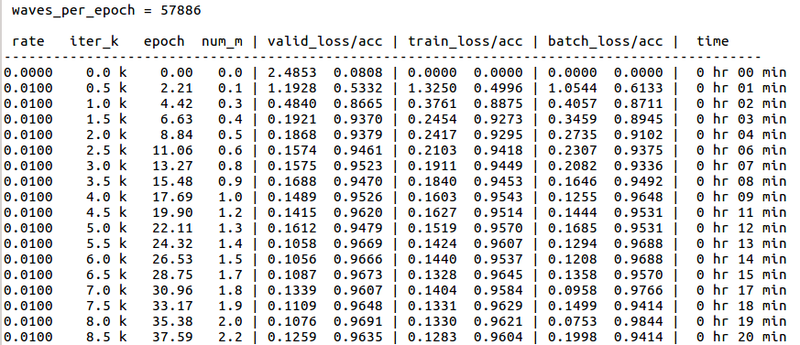
/root/share/project/kaggle/tensorflow/results/se-resnet3-spect-02a/checkpoint/00021000_model.pth
LB@21k =?
Valid = 0.1099 0.9716 Train = 0.0804 0.9777
LB@20k = 0.86
Valid = 0.1130 0.9688 Train = 0.0988 0.9719
rate=0.01
rate=0.001
K iterations
K iterations

Slide 7
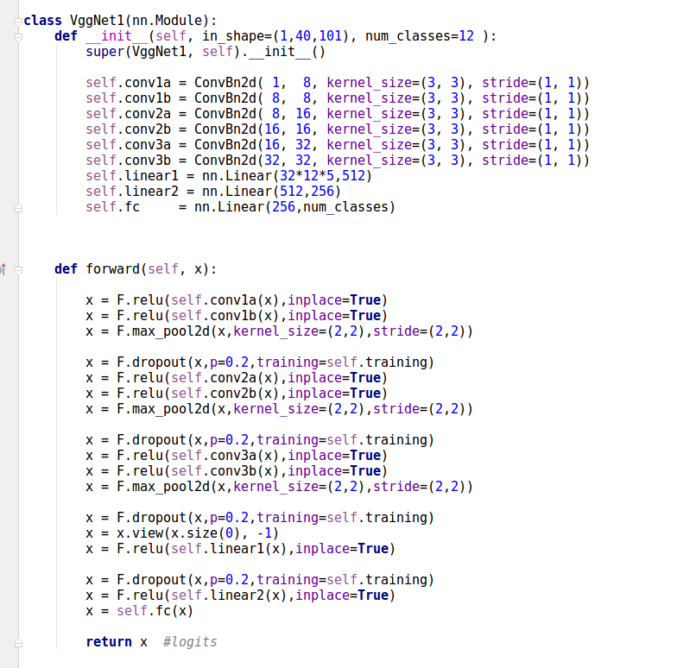
3. mfcc(2d)

Slide 8
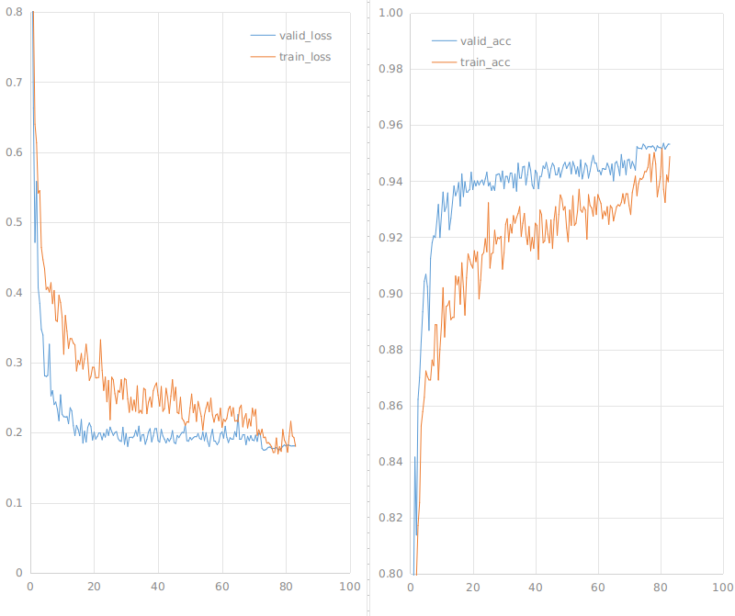
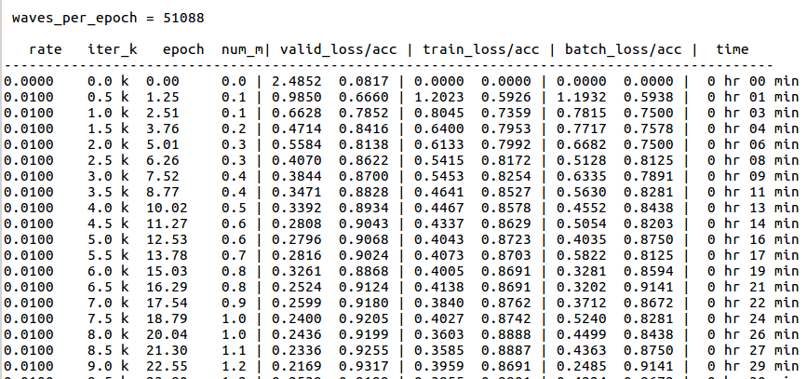
/root/share/project/kaggle/tensorflow/results/vgg1_net-06b/checkpoint/00083000_model.pth
LB@83k = 0.86
Valid = 0.1821 0.9532 Train = 0.1803 0.9488
K iterations
K iterations

