Slide 1
KK’s Customer Behavior & Retention Dashboard
A Power BI Analysis of Customer Segments, Retention, and Purchase Behavior
Prepared by: Kelvin Etisi Tool Used: Power BI Project Type: Customer Analytics Dashboard
Built in Power BI by Kelvin Etisi

Slide 2
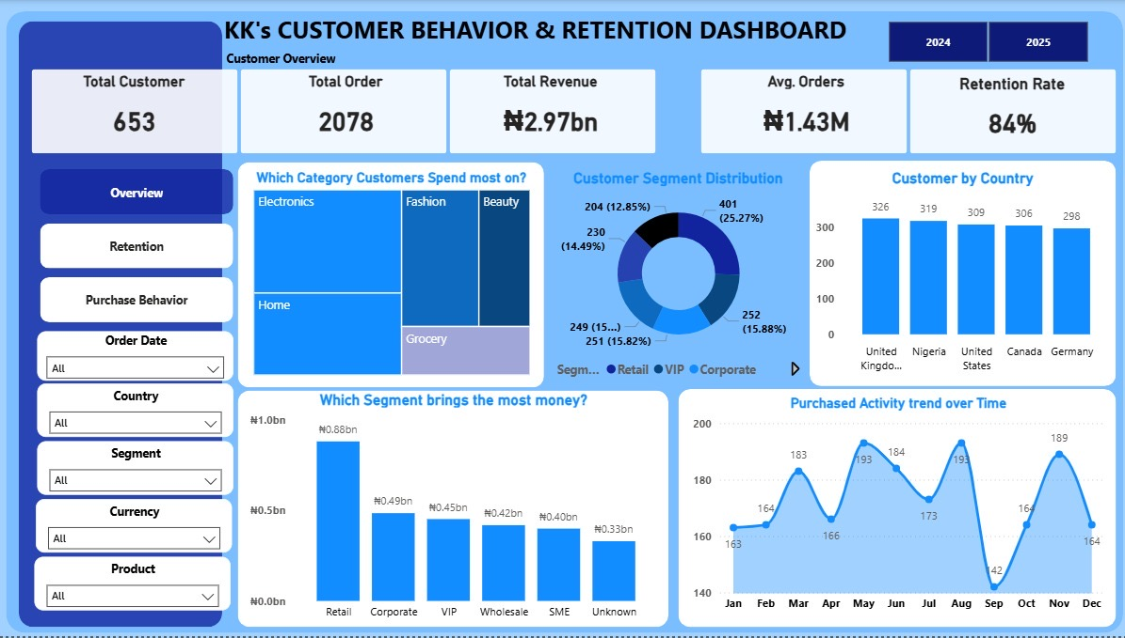
Project Overview
This dashboard was created to analyze customer purchasing activity and uncover meaningful business insights.
The analysis focused on customer segments, repeat purchase behavior, retention patterns, and spending habits.
The goal was to help a business better understand who its customers are, how often they return, and how they purchase.
The final dashboard was structured into three key analytical views: Overview, Retention, and Purchase Behavior.
Built in Power BI by Kelvin Etisi

Slide 3
Dashboard Objectives
Identify key customer segments
Measure customer retention and repeat behavior
Analyze customer spending patterns
Understand how customers purchase across channels, devices, and payment methods
Support better business decision-making through visual analytics
Main Business Question
How can customer data be used to improve retention, increase revenue, and understand buying behavior?
Built in Power BI by Kelvin Etisi

Slide 4
Data Overview
Transaction ID / Customer ID
Order Date / Country / City
Customer Segment
Product Category / Product Name
Quantity / Unit Price / Revenue
Payment Method / Currency
Acquisition Channel
Device Type
Customer Rating
Repeat Purchase Indicators
The dataset used for this project was intentionally dirty and required cleaning, transformation, and modeling before dashboard development.
Built in Power BI by Kelvin Etisi

Slide 5
Data Preparation Summary
Standardized customer and transaction fields
Fixed missing and inconsistent values
Created a revenue field for analysis
Built customer-level retention metrics
Created supporting Date, Currency, and Customer Summary tables
Prepared measures for dashboard KPIs and visuals
Why this mattered
A clean data model was necessary to ensure the dashboard insights were reliable, structured, and easy to interpret.
Built in Power BI by Kelvin Etisi

Slide 6
Dashboard Overview
The dashboard was designed in three analytical views: Customer Overview, Customer Retention, and Customer Purchase Behavior.
Built in Power BI by KK

Slide 7
Key Insights: Customer Overview
The business recorded 653 total customers and 2,078 total orders, showing strong customer activity.
Total revenue reached approximately ₦2.97bn, indicating strong commercial performance.
The Retail segment generated the highest revenue among all customer groups.
Electronics and Home were the strongest spending categories.
Customer count was relatively balanced across countries.
Order activity fluctuated across the year, showing seasonal buying patterns.
Built in Power BI by Kelvin Etisi

Slide 8
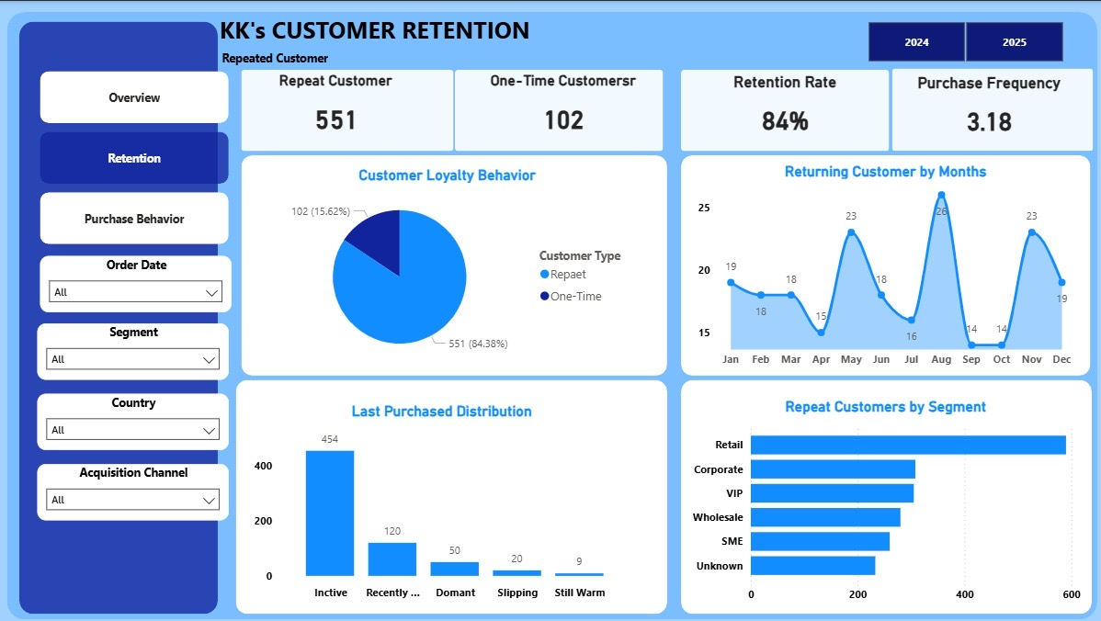
Key Insights: Customer Retention
Retention rate stood at 84%, indicating a strong returning customer base.
551 customers were repeat buyers, compared to 102 one-time customers.
Purchase frequency of 3.18 shows customers purchased more than once on average.
The Retail segment had the highest repeat customer count.
A large number of customers appeared inactive based on recency distribution.
Returning customer activity varied across months.
Built in Power BI by Kelvin Etisi

Slide 9
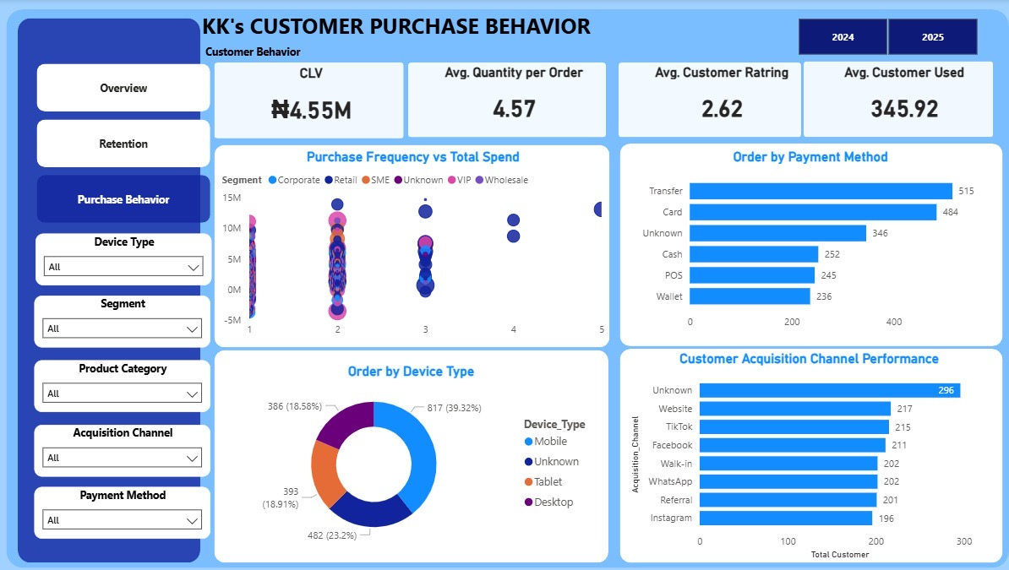
Key Insights: Customer Purchase Behavior
Customer Lifetime Value (CLV) was ₦4.55M, suggesting strong long-term customer value.
Customers purchased an average of 4.57 items per order.
Average customer rating was 2.62, suggesting possible satisfaction issues.
Transfer and Card were the most preferred payment methods.
Mobile was the dominant device used for purchases.
Website, TikTok, and Facebook performed strongly as acquisition channels.
Built in Power BI by Kelvin Etisi

Slide 10
Business Recommendations
Prioritize Retail customer retention through loyalty and repeat purchase campaigns.
Re-engage inactive and dormant customers with personalized offers and reminders.
Improve customer satisfaction by reviewing product quality, service delivery, and support experience.
Invest more in high-performing acquisition channels such as Website, TikTok, and Facebook.
Optimize the mobile shopping experience to improve conversion and retention.
Promote high-spend categories such as Electronics and Home through targeted campaigns.
Built in Power BI by Kelvin Etisi

Slide 11
Conclusion
This dashboard provides a clear view of customer behavior, retention, and purchase patterns.
The business shows strong customer activity, high repeat behavior, and valuable customer segments.
The analysis also reveals opportunities to improve retention, customer satisfaction, and channel performance.
Overall, the dashboard demonstrates how Power BI can transform raw customer transactions into meaningful business insights.
Built in Power BI by Kelvin Etisi

Slide 12
Thank you for viewing
KK’s Customer Behavior & Retention Dashboard
Questions?
Built in Power BI by Kelvin Etisi

