Slide 1
Typayhub Gadget and Electronic Store
Sales Performance Dashboard Analysis
Prepared by: Kelvin Etisi Tool Used: Power BI Project Type: Sales Dashboard Analysis

Slide 2
Table of Contents
Project Overview
Report Pages
Data Source
Data Cleaning Process
Data Model & Assumptions
Key Metrics
DAX Measures
Insights
Recommendations
How to Use the Report
Disclaimer
Conclusion

Slide 3
Project Overview
Built an interactive Sales Dashboard in Power BI
Used a dirty sales dataset for realistic analysis
Cleaned and transformed data using Power Query
Designed dashboard to track:
revenue
sales trend
product performance
customer performance
regional sales
Objective
To turn raw sales data into meaningful business insights for decision-making.

Slide 4
Report Pages
The dashboard was divided into three main report pages for easy analysis:
Overview Page
Provides a high-level summary of business performance including:
Total Orders
Total Revenue
Average Revenue
Quantity Sold
Monthly Sales Trend
Top Customers
Top Product by Revenue
Customer Analysis Page
Highlights customer contribution and regional buying patterns:
Top Customers by Order
Revenue by Region
Regional Customer Performance
Product Analysis Page
Focuses on product performance across categories and regions:
Top Product by Quantity Sold
Top Product by Revenue
Product Performance by Regio

Slide 5
Data Source
The data used for this project was a simulated dirty sales dataset created to reflect a realistic retail business environment
Simulated retail sales dataset
Contains transaction-level sales records
Dataset fields include:
Order ID
Order Date
Customer Name
Product Name
Region
Quantity
Unit Price
Revenue
Payment Method
Order Status
Dataset Type
Large and intentionally messy/dirty for cleaning practice.

Slide 6
Data Cleaning Process
Issues Found
Mixed date formats
Inconsistent text values
Duplicate-like records
Wrong revenue values
Blank fields in key columns
Missing values
Cleaning Done in Power Query
Standardized text entries
Fixed date formats
Replaced blank values
Corrected data types
Recalculated revenue
Cleaned product, customer, and region fields

Slide 7
Data Model & Assumptions
Assumptions
Revenue = Quantity × Unit Price
Blank customer names → Unknown Customer
Blank product names → Unknown Product
Blank regions → Unknown State
Blank sales reps → Unassigned
Inconsistent entries were standardized
Data Model
Single-table sales model used for analysis
Reason
To make the dataset clean, usable, and report-ready.

Slide 8
Key Metrics
Additional Metrics
Monthly Sales Trend
Top Products by Revenue
Top Products by Quantity
Top Customers by Revenue
Top Customers by Orders
Revenue by Region
Main KPIs
Total Orders
Total Revenue
Average Revenue
Quantity Sold

Slide 9
Key Metrics
Additional Metrics
Total Revenue = SUM(Sales[Revenue])
Total Orders = COUNT(Sales[Order ID])
Quantity Sold = SUM(Sales[Quantity])
Avg Revenue = DIVIDE([Total Revenue], [Total Orders], 0)
Month Name = FORMAT(Sales[Order Date], "MMMM")
Month Number = MONTH(Sales[Order Date])
Year Month = FORMAT(Sales[Order Date], "YYYY-MMM")
Quarter = "Q" & FORMAT(Sales[Order Date], "Q")
DAX Maseures Used
Total Orders
Total Revenue
Average Revenue
Quantity Sold

Slide 10
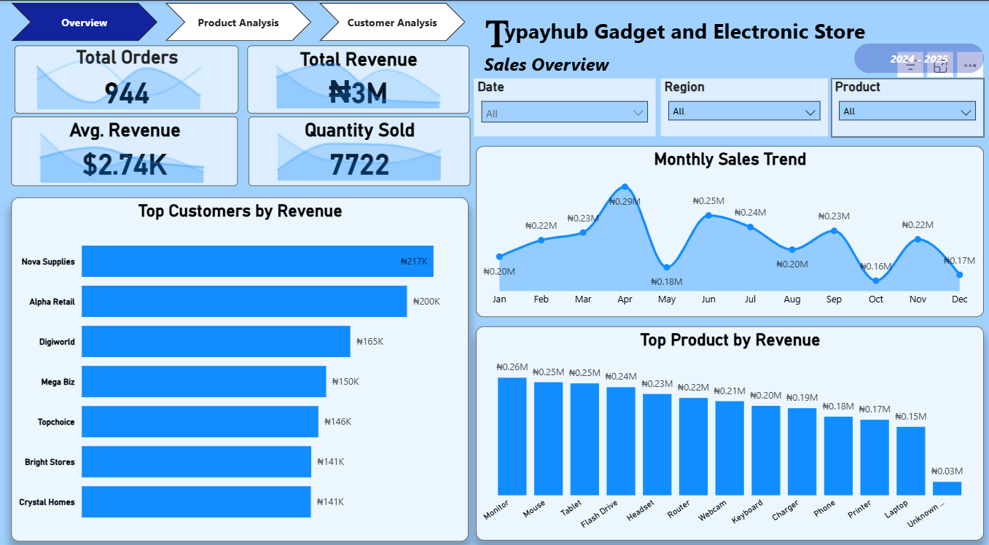
Overview Insights
Dashboard recorded approximately ₦3M in revenue
Total of 944 orders were processed
7,722 units were sold
Sales trend shows a gradual decline over time
A few customers contributed heavily to total revenue
Top-performing products generated a strong share of sales

Slide 11
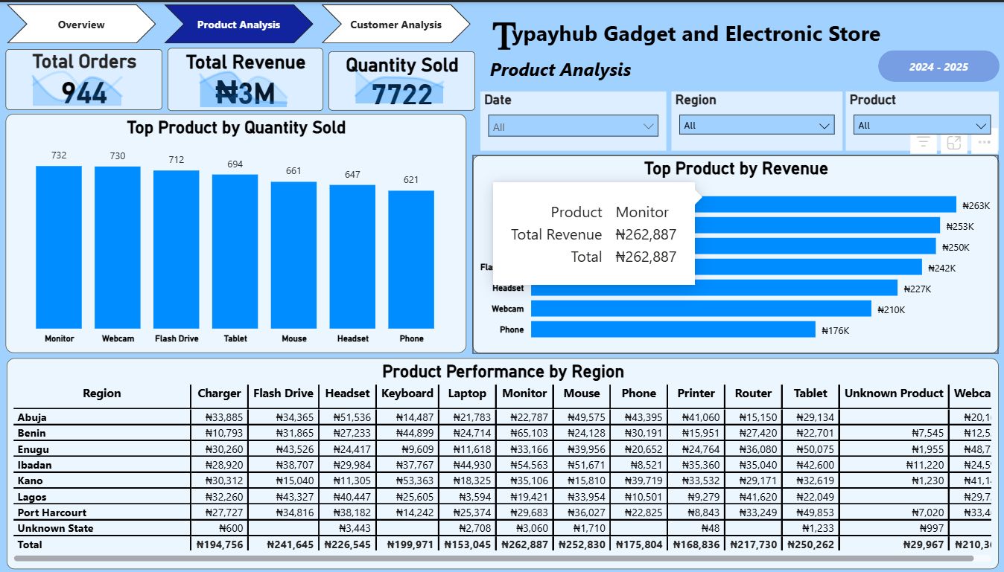
Product Insights
Monitor, Webcam, Flash Drive, and Tablet had high quantity sold
Monitor and Mouse generated the highest revenue
Product performance varied across regions
Some missing product values appeared as Unknown Product
Certain products clearly outperformed others in both sales and revenue

Slide 12
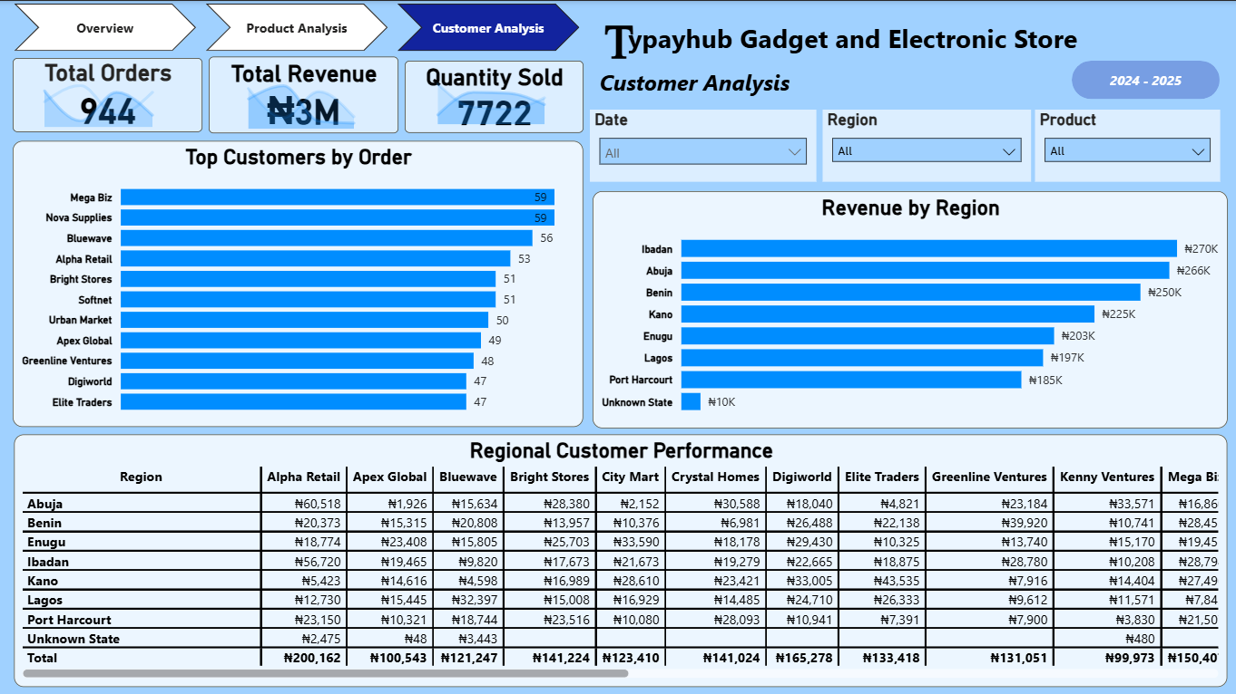
Customer Insights
Top customers placed significantly more orders than others
Mega Biz, Nova Supplies, Bluewave, and Alpha Retail were strong contributors
Ibadan, Abuja, and Benin showed high customer revenue
Customer buying behavior varied by region
Sales were influenced by a small number of high-performing customers

Slide 13
Insights & Recommendations
Based on the dashboard findings, the following recommendations can be made:
Focus on High-Performing Products
Products with strong revenue and quantity performance should receive:
more inventory attention
promotional support
stronger visibility
Improve Sales in Declining Months
The downward monthly trend suggests a need to:
investigate seasonal demand
run targeted campaigns
improve customer retention in low months
Strengthen High-Value Customer Relationships
Top customers contribute significantly to revenue and should be prioritized through:
loyalty offers
follow-up engagement
personalized service

Slide 14
Insights & Recommendations
Based on the dashboard findings, the following recommendations can be made:
Optimize Regional Strategy
Since revenue differs by region, the business should:
target strong regions more aggressively
investigate weaker-performing regions
align products with regional demand
Improve Data Entry Process
The presence of missing and inconsistent data suggests a need for:
better transaction capture
standardized entry rules
improved data governance

Slide 15
How to Use the Report
Users can:
Track overall sales performance
Monitor monthly revenue trend
Identify top products and customers
Compare sales by region
Filter the dashboard for focused analysis
Use Cases
Sales reporting
Business review meetings
Product tracking
Customer performance analysis

Slide 16
Disclaimer
This project uses a simulated sales dataset
Data was intentionally made dirty for cleaning and analysis practice
Business name and records are used for demonstration purposes only
Project was created to showcase:
Power Query cleaning
DAX calculations
dashboard design
business storytelling

Slide 17
Conclusion
This project demonstrates:
Data cleaning and preparation
Power Query transformation
DAX measure creation
Dashboard design in Power BI
Business insight generation
Final Outcome
A clean, interactive sales dashboard built from messy raw data. First Pbi project1.pbix

