Slide 1
Java Network Programming

Slide 2
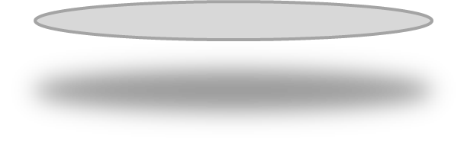
CONTENTS
Socket Programming
Socket Practice
Java Mail Sending Practice
Java Connect Database

Slide 3
Socket Programming

Slide 4
Socket Programming
-Network programming refers to writing programs that run on multiple devices (computers), all connected by a network.
-The J2SE API in the Java.NET package contains classes and interfaces that provide low-level communication details.
-Two common networking protocols is provided in the Java.net package:
Transmission Control Protocol (TCP)
is a connection-oriented, reliable, and byte stream based transport layer communication Protocol. The TCP layer is located above the IP layer and below the application layer. TCP ensures reliable communication between two applications. Commonly used for Internet protocols, it is called TCP/IP.
Notes:
网络编程是指编写运行在多个设备（计算机）的程序，这些设备都通过网络连接起来。
java.net 包中 J2SE 的 API 包含有类和接口，它们提供低层次的通信细节。你可以直接使用这些类和接口，来专注于解决问题，而不用关注通信细节。
java.net 包中提供了两种常见的网络协议的支持：

Slide 5
Socket Programming
-Network programming refers to writing programs that run on multiple devices (computers), all connected by a network.
-The J2SE API in the Java.NET package contains classes and interfaces that provide low-level communication details.
-Two common networking protocols is provided in the Java.net package:
UDP: User Datagram Protocol (UDP)
located at the transport layer of the OSI model. A connectionless protocol. Datagrams are provided to send data between applications. Because UDP is unreliable and a connectionless protocol, applications must generally tolerate some lost, incorrect, or duplicate packets.
Notes:
网络编程是指编写运行在多个设备（计算机）的程序，这些设备都通过网络连接起来。
java.net 包中 J2SE 的 API 包含有类和接口，它们提供低层次的通信细节。你可以直接使用这些类和接口，来专注于解决问题，而不用关注通信细节。
java.net 包中提供了两种常见的网络协议的支持：

Slide 6
Socket Programming
-Sockets use TCP to provide a communication mechanism between two computers.
-The client program creates a socket and attempts to connect to the server's socket.
-When a connection is established, the server creates a Socket object. The client and server can now communicate by writing and reading Socket objects.
-The java.net.Socket class represents a socket, and the java.net.ServerSocket class provides a mechanism for server programs to listen to and establish connections with clients.
Notes:
套接字使用TCP提供了两台计算机之间的通信机制。 客户端程序创建一个套接字，并尝试连接服务器的套接字。
当连接建立时，服务器会创建一个 Socket 对象。客户端和服务器现在可以通过对 Socket 对象的写入和读取来进行通信。
java.net.Socket 类代表一个套接字，并且 java.net.ServerSocket 类为服务器程序提供了一种来监听客户端，并与他们建立连接的机制。

Slide 7
Socket Programming
A socket process is used to establish a TCP connection between two computers:
-The server instantiates a ServerSocket object that represents communication through a port on the server.
-The server invokes the Accept () method of the ServerSocket class, which will wait until the client connects to the given port on the server.
-While the server is waiting, a client instantiates a Socket object specifying the server name and port number to request a connection.
-The constructor of the Socket class attempts to connect the client to the specified server and port number. If communication is established, a Socket object is created on the client side to communicate with the server.
-On the server side, the Accept () method returns a new reference to the socket on the server that connects to the socket on the client.
Notes:
以下步骤在两台计算机之间使用套接字建立TCP连接时会出现：
服务器实例化一个 ServerSocket 对象，表示通过服务器上的端口通信。
服务器调用 ServerSocket 类的 accept() 方法，该方法将一直等待，直到客户端连接到服务器上给定的端口。
服务器正在等待时，一个客户端实例化一个 Socket 对象，指定服务器名称和端口号来请求连接。
Socket 类的构造函数试图将客户端连接到指定的服务器和端口号。如果通信被建立，则在客户端创建一个 Socket 对象能够与服务器进行通信。
在服务器端，accept() 方法返回服务器上一个新的 socket 引用，该 socket 连接到客户端的 socket。

Slide 8
Socket Programming
Each socket has an output stream and an input stream.
The output of the client is connected to the input stream of the server, and the input of the client is connected to the output stream of the server.
TCP is a two-way communication protocol, so data can be sent over two data streams at the same time.
Notes:
连接建立后，通过使用 I/O 流在进行通信，每一个socket都有一个输出流和一个输入流，客户端的输出流连接到服务器端的输入流，而客户端的输入流连接到服务器端的输出流。
TCP 是一个双向的通信协议，因此数据可以通过两个数据流在同一时间发送.

Slide 9
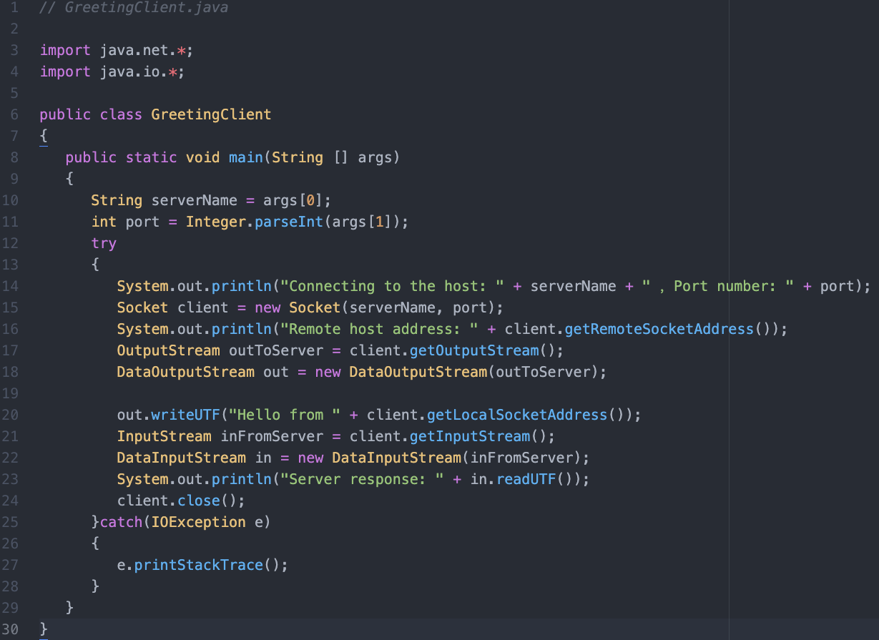

Slide 10
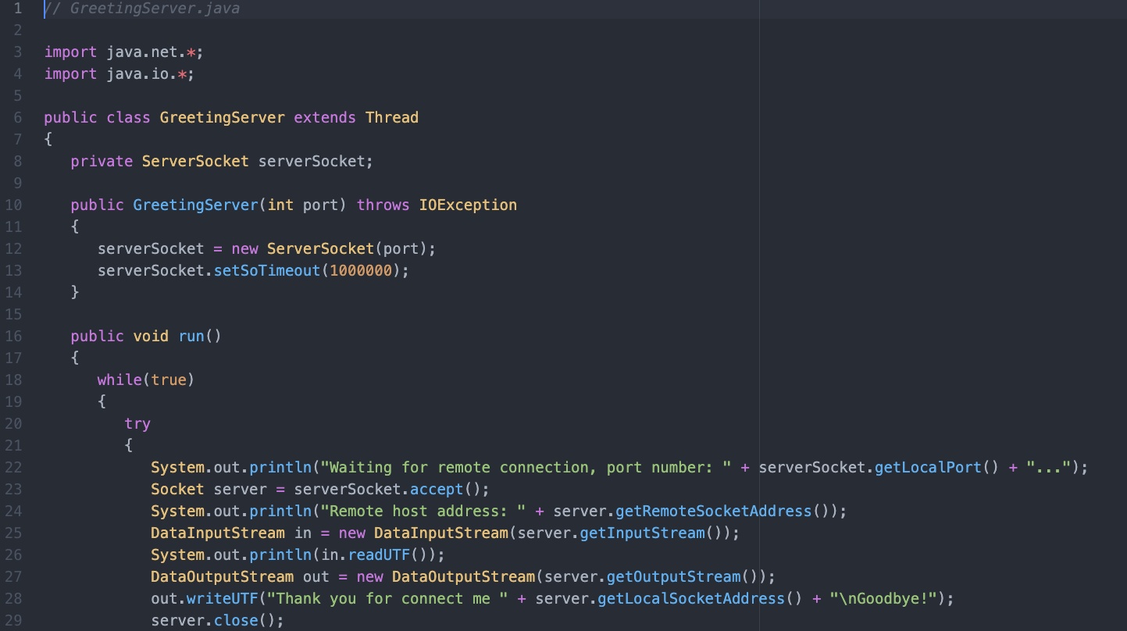

Slide 11
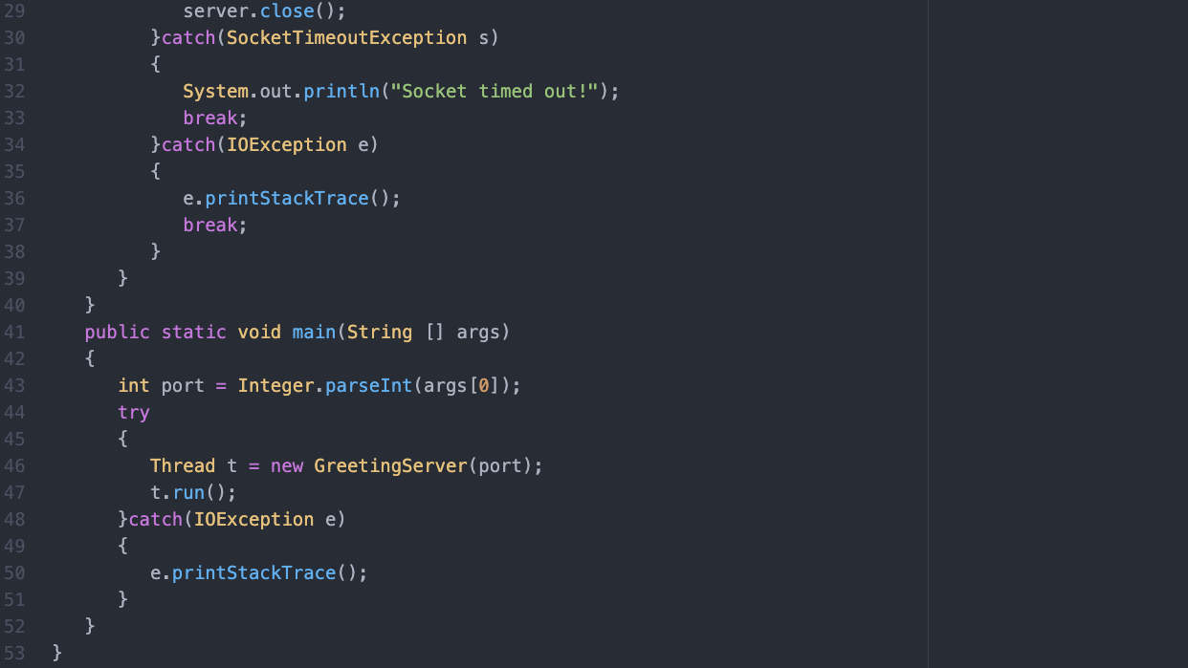

Slide 12
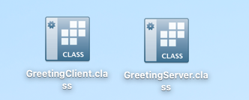
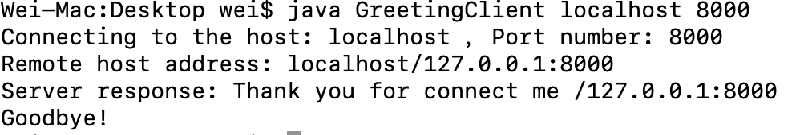
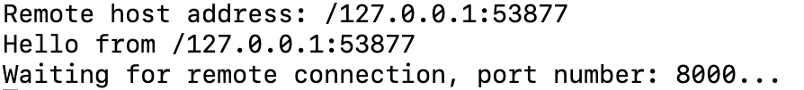
javac GreetingServer.java
javac GreetingClient.java

Slide 13
Java Mail Sending Practice

Slide 14
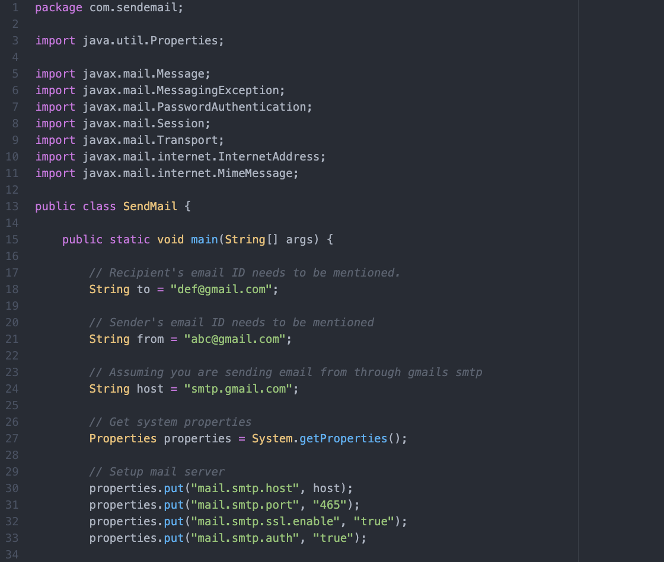

Slide 15
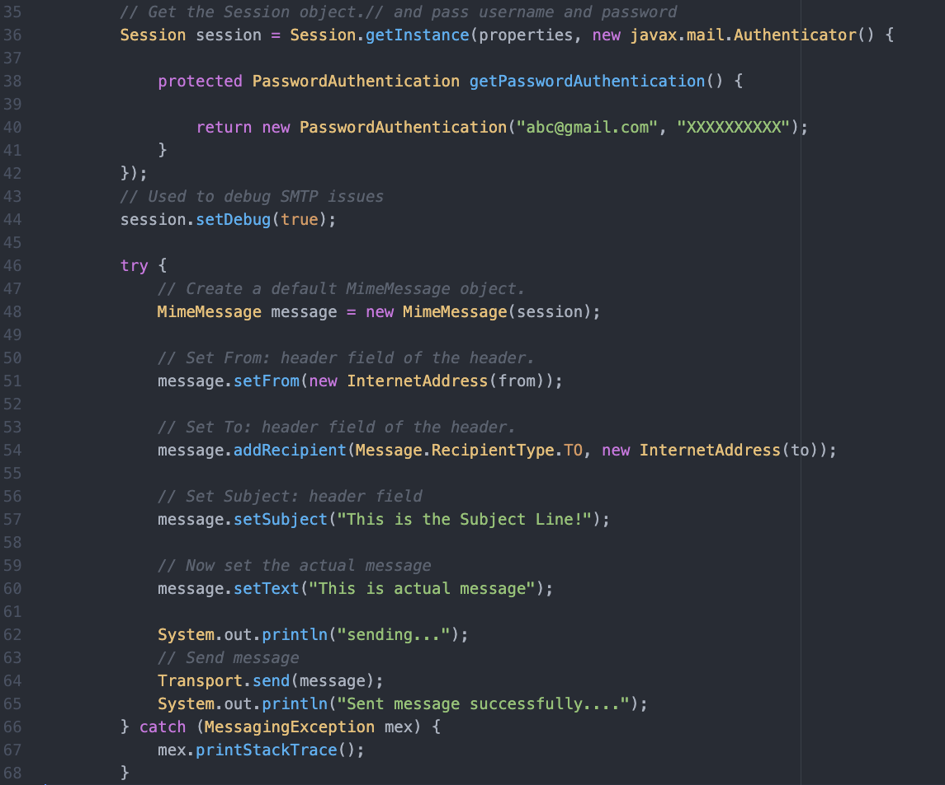

Slide 16
Java Connect Database

Slide 17
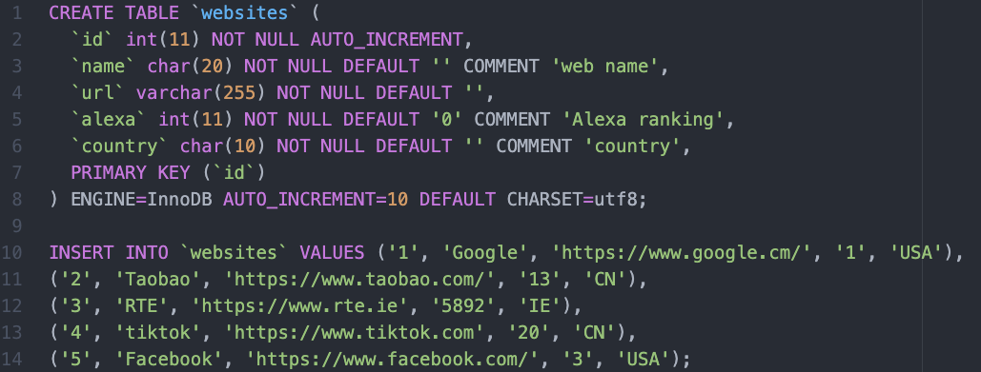

Slide 18
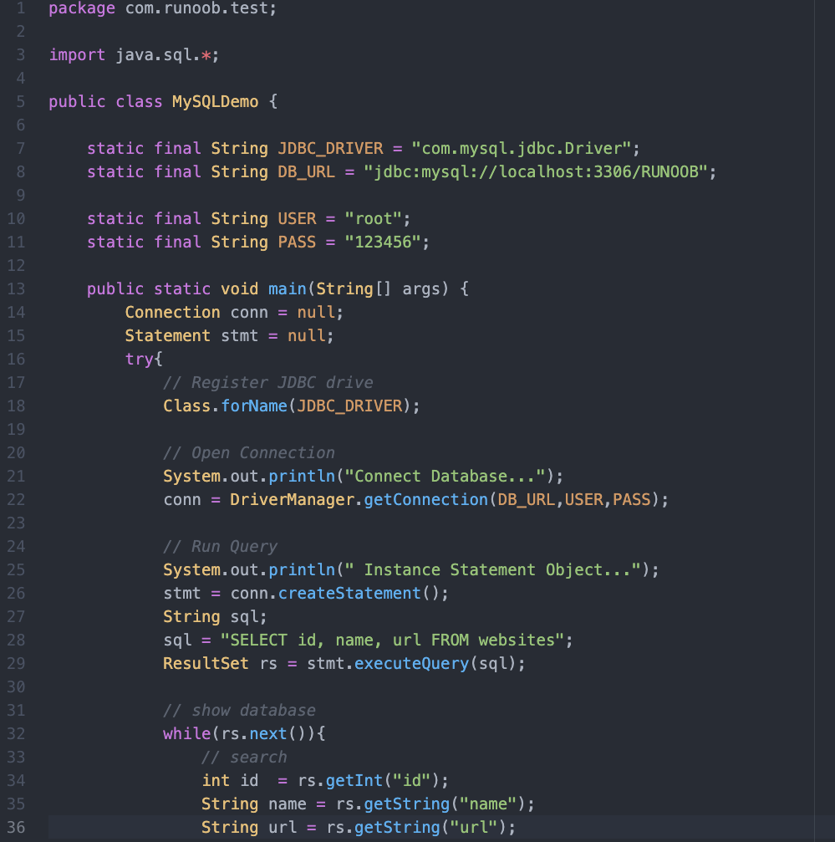

Slide 19
