Slide 1
OBJECT ORIENTED PROGRAMMING
Esther Tosin Balogun

Slide 2
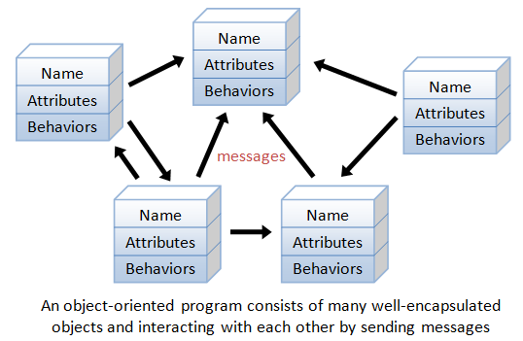
Definition of oop
Programming in the object-oriented (OOP) manner identifies classes of objects that are closely related to the methods (functions) with which they are associated. It also includes ideas of inheritance of attributes and methods.

Slide 3
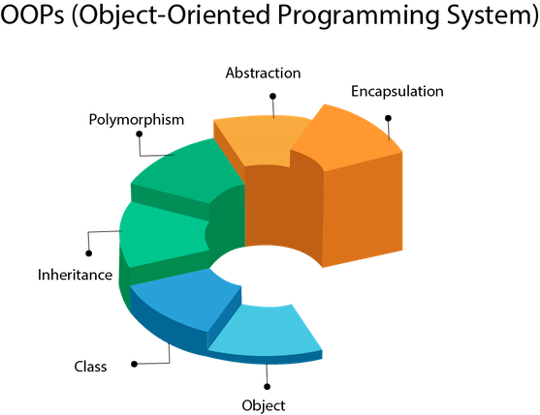
Object oriented programming system

Slide 4
IMPORTANCE/benefits OF OOP
Benefits of OOP include:
Modularity. Encapsulation enables objects to be self-contained, making troubleshooting and collaborative development easier.
Reusability
Productivity
Easily upgradable and scalable
Interface descriptions
Security
Flexibility

Slide 5
SOME EXAMPLES OF OBJECT-ORIENTED PROGRAMMING
Ada
ActionScript
C++
Common Lisp
C#
Dart
Eiffel
Fortran 2003
Haxe
Java
JavaScript
Scala
JavaScript,
Kotlin
logo
MATLAB
Objective-C
Object Pascal
Perl
PHP
Python
R
Raku
Visual Basic. Net

