Slide 1
AIN 420 Introduction to Deep Learning Course Project Presentation
Kemal Şahin – 2200765021
Burak Kurt - 2200765010

Slide 2





Project Overview
This project proposes the development of a hierarchical encoder transformer model for the purpose of multi-label text classification, specifically designed to identify and categorize offensive content within textual data.
Our model aims to first determine the presence of offensive content and then classify such content into four distinct categories: Sexist, Racist, Profanity, and Insult.

Slide 3



Data Collection
The dataset for this project was compiled from a variety of sources, including publicly available datasets on Kaggle, a collection of tweets and comments from Reddit.
Since there are no exact labels for our task, we manually labeled the dataset.
A total of 81,800 rows of text data were collected.

Slide 4
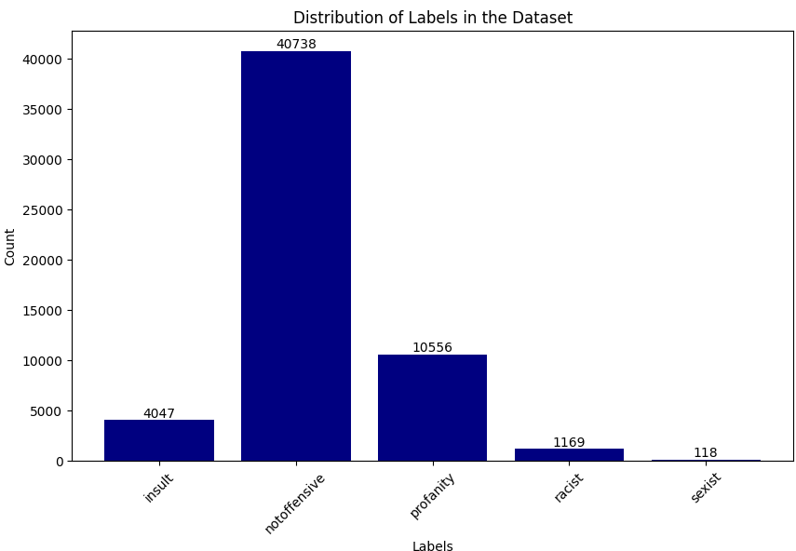
Challenges with Data - 1
Duplicate Data
- Since data comes from different sources, same text is occured twice or more in some cases.
Inconsistent Labels
- Due to manuel labeling, typos or wrong labeling appeared.
Class imbalance

Slide 5
Challenges with Data - 2
Unnecessary Information
Some of the text (especially in tweets) have useless informations like hashtags, mentions and usernames.
Meaningless sentences
- Some sentences only consist of punctutation or numbers

Slide 6
Challenges With Data - 3
Misspelled words
Some of the words are misspelled and needed a correction before fed into model.
Emojis and Special Characters
- Emojis, punctutations and other special characters are removed in order to improve model’s performance.

Slide 7
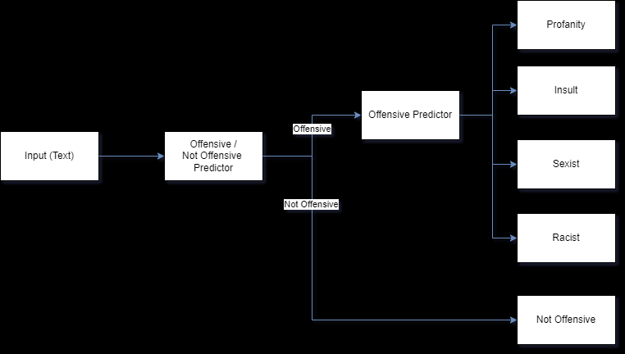
Model Hierarchy
Task is divided into 2 subtasks.
First task is predicting if text has offensive meaning or not. Offensive / Not Offensive predictor model is used in this stage. If prediction is ‘Not Offensive’ then text is labeled as it.
Second task aims to find category of the offensive text. Offensive Predictor model is used in this stage.

Slide 8
Offensive / Not Offensive Predictor
Fine-tuning is applied to pretrained BERT model on Turkish language [1].
Last layer is changed according to our task.
Sigmoid activation function is used because it is a binary classification problem.
Training Settings:
Epoch Number : 3
Batch Size : 16
Optimizer : AdamW
Learning Rate : 2e-5
[1] https://huggingface.co/dbmdz/bert-base-turkish-cased

Slide 9
Training Results
Training Set
Validation Set
Epoch / Metric | 1 | 2 | 3
Loss | 0.1910 | 0.1273 | 0.0767
Accuracy | 0.9252 | 0.9492 | 0.9700
Epoch / Metric | 1 | 2 | 3
Loss | 0.1583 | 0.1630 | 0.1993
Accuracy | 0.9375 | 0.9361 | 0.9363

Slide 10
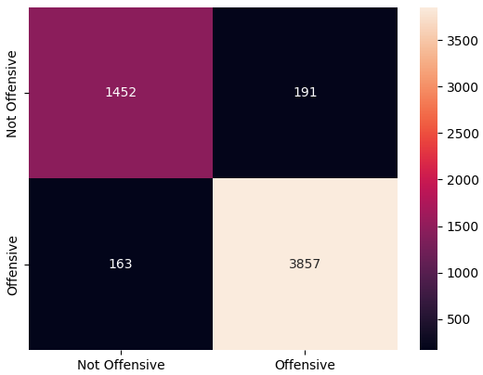
Test Results
Confusion Matrix
Loss : 0.2089
Accuracy : 0.9375
F1 Score : 0.9373
MCC Score : 0.8475

Slide 11
Offensive Predictor
Fine-tuning is applied to the same model as used in Offensive / Not Offensive Predictor
Only last layer is changed and sigmoid activation function is used at last layer since it is a multi-label classification problem.
Training Settings:
Epoch Number : 3
Batch Size : 16
Optimizer : AdamW
Learning Rate : 2e-5

Slide 12
Training Results
Training Set
Validation Set
Epoch / Metric | 1 | 2 | 3
Loss | 0.0808 | 0.0523 | 0.0378
Accuracy | 0.9032 | 0.9308 | 0.9503
F1 Score | 0.8261 | 0.8630 | 0.8945
Epoch / Metric | 1 | 2 | 3
Loss | 0.0608 | 0.0545 | 0.0586
Accuracy | 0.9204 | 0.9230 | 0.9227
F1 Score | 0.8541 | 0.8439 | 0.8437

Slide 13
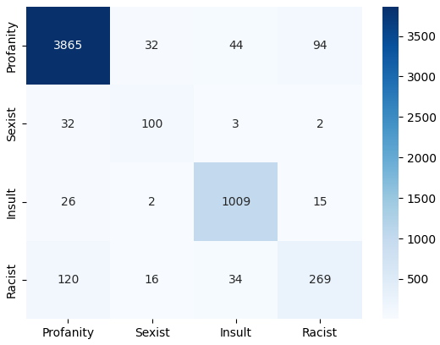
Test Results
Confusion Matrix
Loss : 0.0640
Accuracy : 0.9227
F1 Score : 0.8381
MCC Score : 0.8352

