Slide 1

ABOUT: Pest control and Pest management company.
SERVICES : a) General Pest Control Works
(ants, rats, lizards, cockroach and other pest)
b) Soil Corrective Anti Termite Works and Anti Termite Baiting Treatment
(termites)
c) Fogging and Larva Ciding Works
(mosquitoes)
AREA COVERED : Selangor,Nilai,Sepang,Klang Valley,Purajaya,Cyberjaya
TEAM : a) Name: Zahid
Position: Manager
b) Name: Affian
Position: Pest Control Operator
c) Name: Luqman
Position: Admin and Pest Control Operator
d) Name: Riyad
Position: Pest Control Operator
PRICING: a) General Pest Control Works – RM220
b) Soil Corrective Anti Termite Works and Anti Termite Baiting Treatment- RM1200 to RM1400
c) Fogging and Larva Ciding Works – RM220
CONTACT DETAILS : Whatsapp: 013-3555119 (Zahid)
Facebook: ZR TERMITE
Instagram: mesra_pest_control

Slide 2
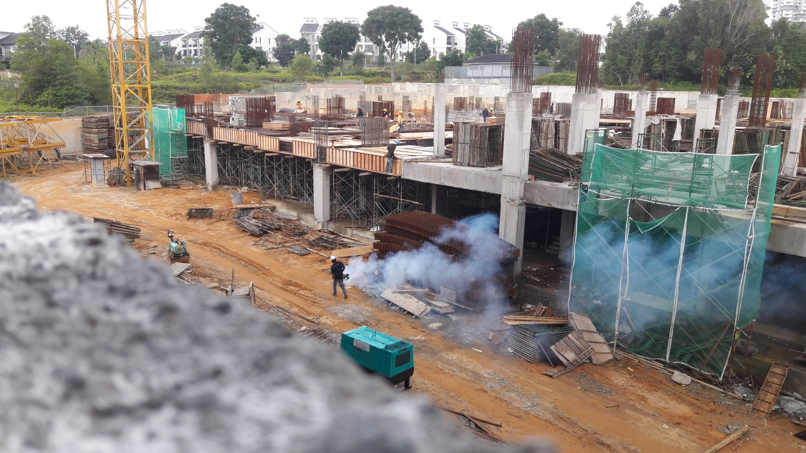
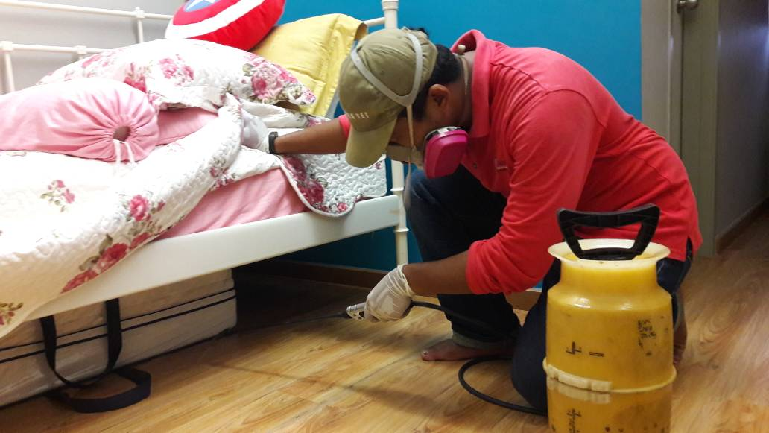

Slide 3
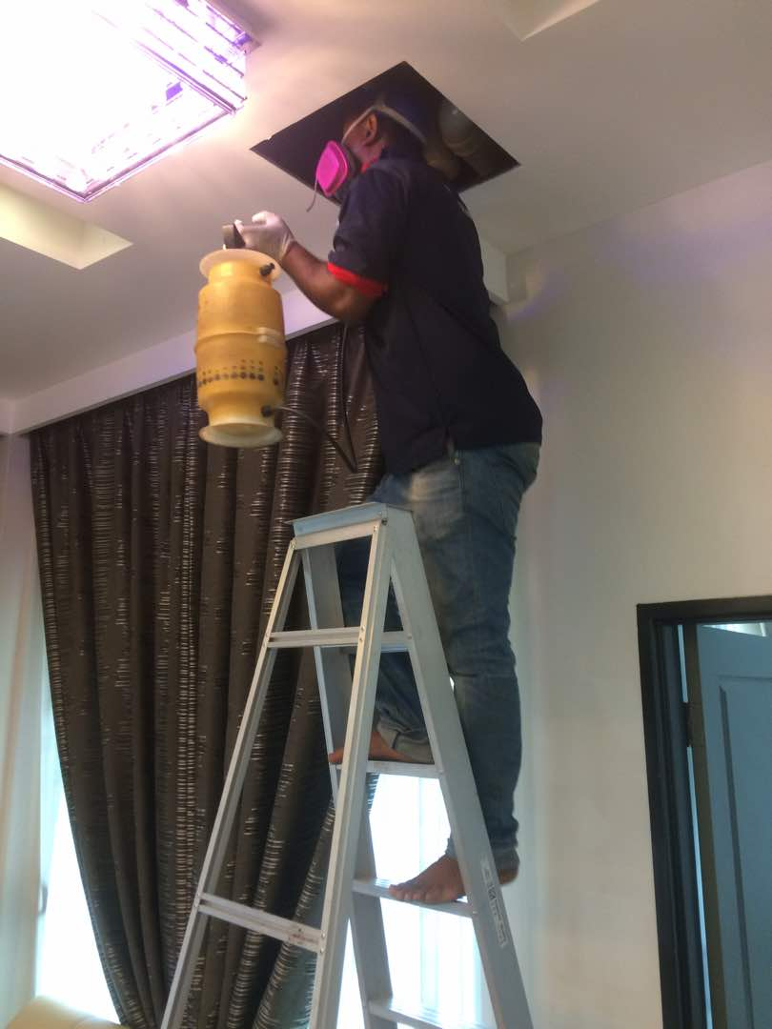
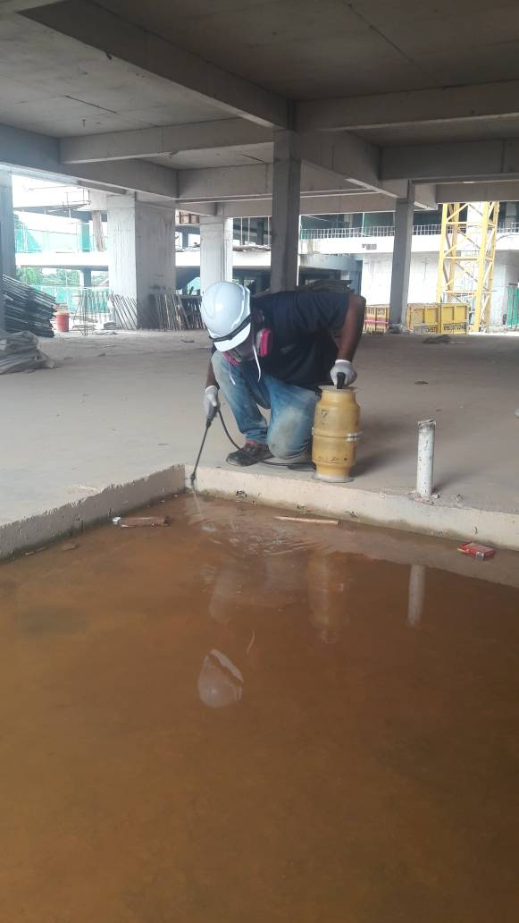
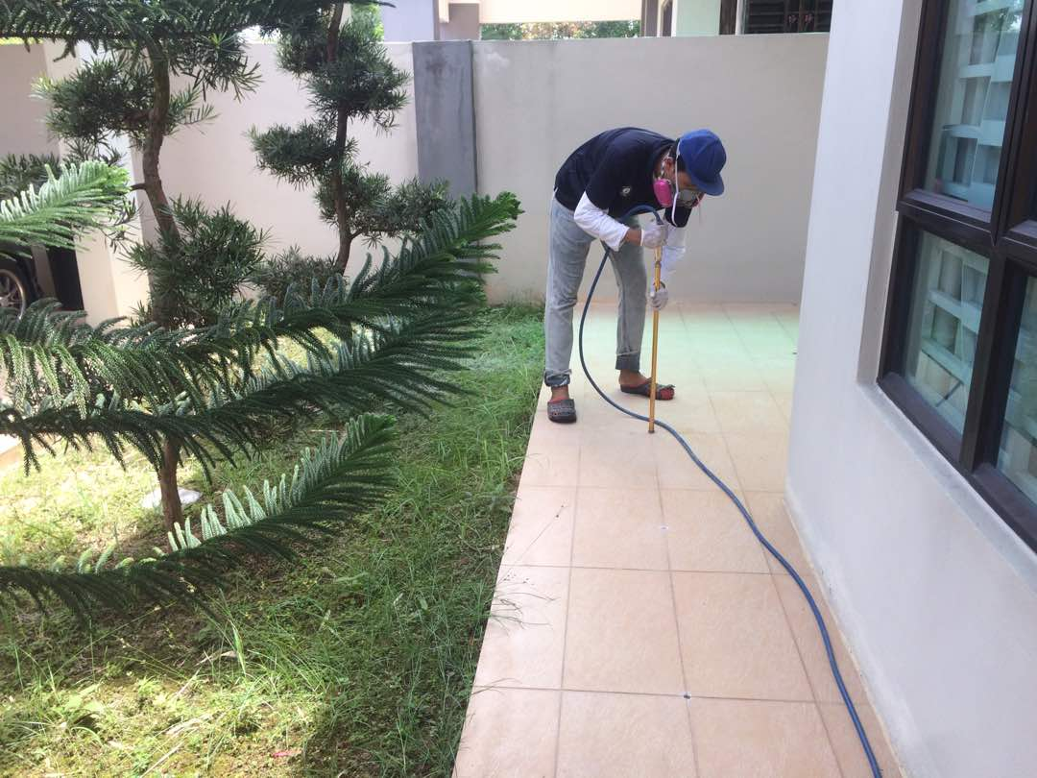

Slide 4
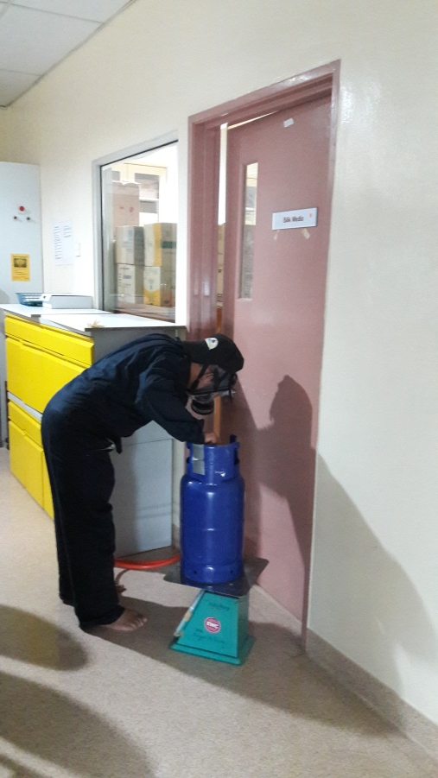
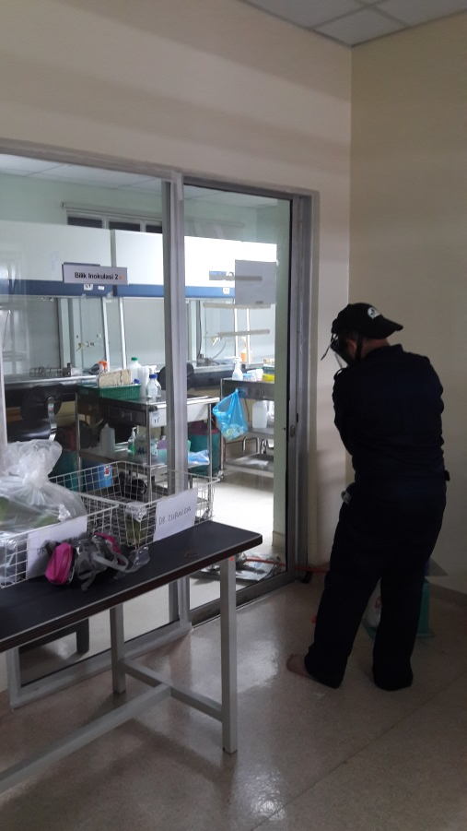
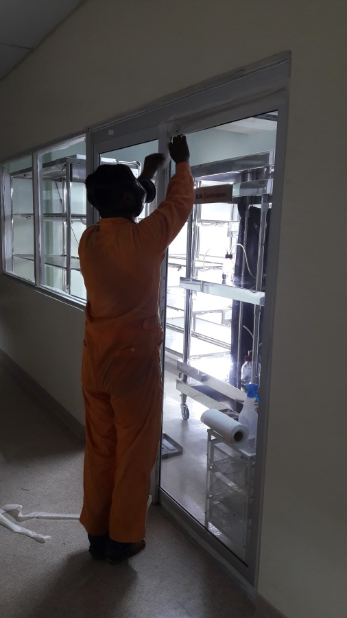
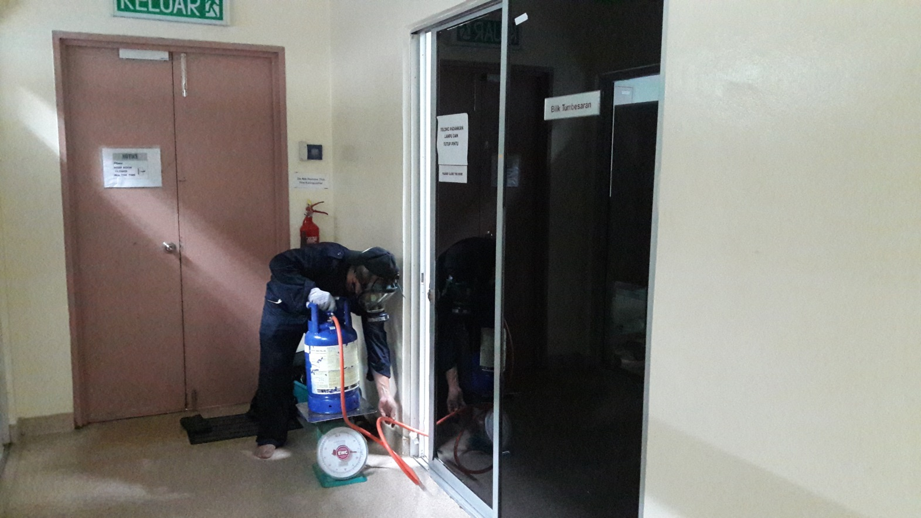
PAST PROJECT: Mardi Fumigation

Slide 5
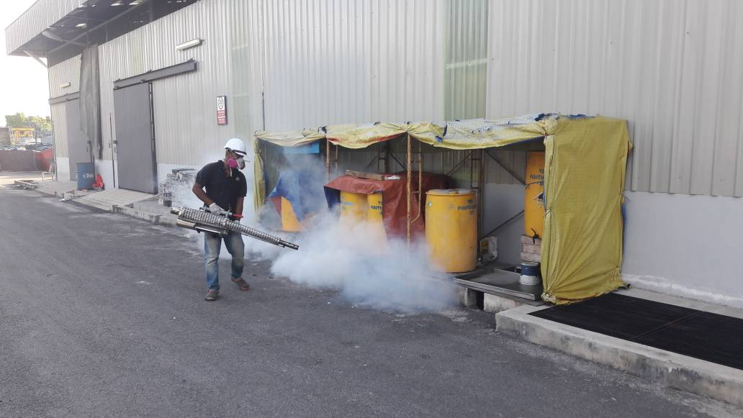
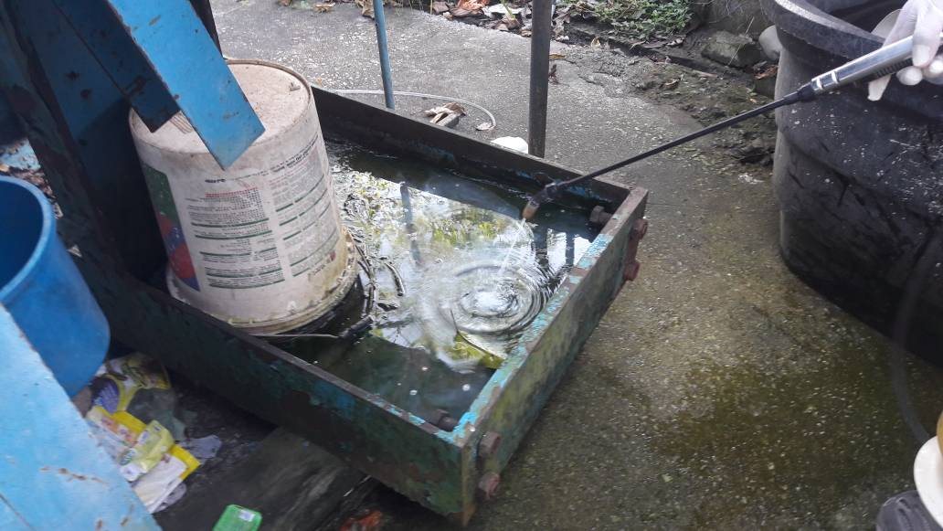
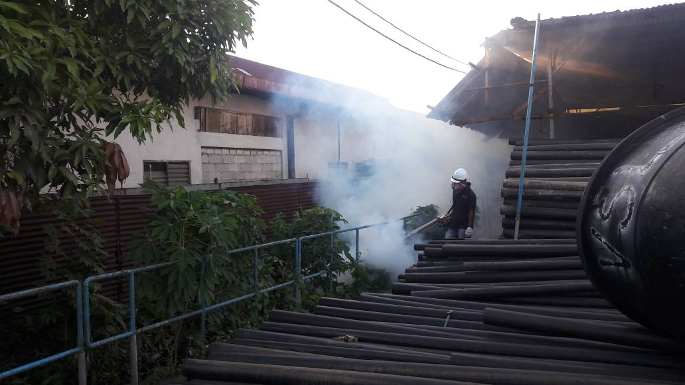
CURRENT PROJECT : VSL ENGINEERS SDN BHD(Fogging and Larva Ciding Works)

Slide 6
ONGOING CONTRACTS :
VSL ENGINEERS SDN BHD
TJCS SDN BHD
MASTERPLAN CONSULTING SDN BHD
NICHICON(M) SDN BHD
T-SYSTEM MALAYSIA SDN BHD

