Slide 1
Data-driven computer animation
Tutorial: Position Based Dynamics
Prof. Taku Komura
TAs: Kemeng Huang(kmhuang@cs.hku.hk)

Slide 2
Assignment 3
Implement a simple cloth simulator based on position based dynamics.
Due: 23:59, November 28th

Slide 3
PBD
Position Based Dynamics (PBD) is a physics simulation method that manipulates object positions to meet certain constraints, without direct incorporating physical principles.
Advantage: Enables real-time simulations for interactive applications such as video games and virtual reality.

Slide 4
The Stiffness Issue
Real-world fabrics resist strongly to stretching, once they stretch beyond certain limits.
But large stiffness can cause problems.
Explicit integrators will be unstable
Solution: smaller time steps with large time cost.
The linear systems involved in Implicit integrators will be ill-conditioned, resulting in large time cost for solving linear system.
Can we achieve high stiffness, with a low computational cost?

Slide 5




A Single Spring
If a spring is infinitely stiff, we can treat the length as a constraint.
When the constraint is always satisfied, the spring has the rest length
= It is infinitely stiff
rest length $L$
$$x_{i}$$
$$x_{j}$$
$$φ(x)=\left\|x_{i}− x_{j}\right\|−L=0$$
Constraint

Slide 6


A Single Spring
What we need now: a function that maps x to x_new so that the spring satisfies our constraint.
$$x_{j}$$
rest length $L$
$$x_{i}^{new}$$
$$x_{j}^{new}$$
$$x_{i}$$
$$x_{i}$$
$$x_{j}$$
$$x_{j}$$
$$x_{j}^{new}$$
$$φ(x)=\left\|x_{i}− x_{j}\right\|−L=0$$
$$x_{i}^{new}$$
Constraint
$$x_{i}$$
Stretched case
Compressed Case
Notes:
... ->

Slide 7



A Single Spring
Now the problem is how to move the point into the solution space (blue region).
rest length $L$
$${x=\{x}_{i},x_{j}\}$$
$$x_{i}$$
$$x_{j}$$
Boundary $∂Ω$
$$φ(x)=\left\|x_{i}− x_{j}\right\|−L=0$$
Constraint
$$Ω=\{x∈R^{6}:φ(x)=0\}$$

Slide 8

A Single Spring
We want the moving distance to be as small as possible
→ This becomes a projection problem.
$$\left\{x_{i}^{new},x_{j}^{new}\right\}=argmin\frac{1}{2}\left\{{m_{i}\left\|x_{i}^{new}−x_{i}\right\|}^{2}+{m_{j}\left\|x_{j}^{new}−x_{j}\right\|}^{2}\right\}$$
such that $φ(x)=0$
rest length $L$
$${x=\{x}_{i},x_{j}\}$$
$$x_{i}$$
$$x_{j}$$
Boundary $∂Ω$
$$φ(x)=\left\|x_{i}− x_{j}\right\|−L=0$$
Constraint
$$Ω=\{x∈R^{6}:φ(x)=0\}$$

Slide 9



A Single Spring
We want the moving distance to be as small as possible
→ This becomes a projection problem.
$$\left\{x_{i}^{new},x_{j}^{new}\right\}=argmin\frac{1}{2}\left\{{m_{i}\left\|x_{i}^{new}−x_{i}\right\|}^{2}+{m_{j}\left\|x_{j}^{new}−x_{j}\right\|}^{2}\right\}$$
$$x_{j}$$
such that $φ(x)=0$
The center of mass need to be kept
$$x_{j}^{new}$$
$$x^{new}⟵Projection(x)$$
$$x_{i}^{new}⟵x_{i}−\frac{m_{j}}{m_{i}+m_{j}}\left(\left\|x_{i}− x_{j}\right\|−L\right)\frac{x_{i}− x_{j}}{\left\|x_{i}− x_{j}\right\|}$$
$$x_{i}^{new}$$
$$x_{j}^{new}⟵x_{j}+\frac{m_{i}}{m_{i}+m_{j}}\left(\left\|x_{i}− x_{j}\right\|−L\right)\frac{x_{i}− x_{j}}{\left\|x_{i}− x_{j}\right\|}$$
$$x_{i}$$

Slide 10

A Single Spring
We want the moving distance to be as small as possible
→ This becomes a projection problem.
$$\left\{x_{i}^{new},x_{j}^{new}\right\}=argmin\frac{1}{2}\left\{{m_{i}\left\|x_{i}^{new}−x_{i}\right\|}^{2}+{m_{j}\left\|x_{j}^{new}−x_{j}\right\|}^{2}\right\}$$
such that $φ(x)=0$
$$x_{j}$$
$$x^{new}⟵Projection(x)$$
$$x_{j}^{new}$$
$$x_{i}^{new}⟵x_{i}−\frac{m_{j}}{m_{i}+m_{j}}\left(\left\|x_{i}− x_{j}\right\|−L\right)\frac{x_{i}− x_{j}}{\left\|x_{i}− x_{j}\right\|}$$
$$x_{j}^{new}⟵x_{j}+\frac{m_{i}}{m_{i}+m_{j}}\left(\left\|x_{i}− x_{j}\right\|−L\right)\frac{x_{i}− x_{j}}{\left\|x_{i}− x_{j}\right\|}$$
$$x_{i}^{new}$$
The center of mass is kept
$$x_{i}$$
$$φ\left(x^{new}\right)=\left\|x_{i}^{new}− x_{j}^{new}\right\|−L=\left\|x_{i}−x_{j}−x_{i}+x_{j}+L\frac{x_{i}− x_{j}}{\left\|x_{i}− x_{j}\right\|}\right\|−L=0$$

Slide 11

A Single Spring
We want the moving distance to be as small as possible
→ This becomes a projection problem.
$$\left\{x_{i}^{new},x_{j}^{new}\right\}=argmin\frac{1}{2}\left\{{m_{i}\left\|x_{i}^{new}−x_{i}\right\|}^{2}+{m_{j}\left\|x_{j}^{new}−x_{j}\right\|}^{2}\right\}$$
such that $φ(x)=0$
$$x_{j}$$
$$x^{new}⟵Projection(x)$$
$$x_{j}^{new}$$
$$x_{i}^{new}⟵x_{i}−\frac{m_{j}}{m_{i}+m_{j}}\left(\left\|x_{i}− x_{j}\right\|−L\right)\frac{x_{i}− x_{j}}{\left\|x_{i}− x_{j}\right\|}$$
$$x_{j}^{new}⟵x_{j}+\frac{m_{i}}{m_{i}+m_{j}}\left(\left\|x_{i}− x_{j}\right\|−L\right)\frac{x_{i}− x_{j}}{\left\|x_{i}− x_{j}\right\|}$$
$$x_{i}^{new}$$
When $m_{i}=∞$ , the particle becomes a stationary node.
$$x_{i}$$

Slide 12
Multiple Springs
What about multiple springs? The Gauss-Seidel approach projects each spring sequentially in a certain order.

Slide 13
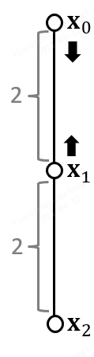
Multiple Springs
What about multiple springs? The Gauss-Seidel approach projects each spring sequentially in a certain order.
Suppose there are two springs and their rest lengths are 1.
We can start from solving the first spring

Slide 14
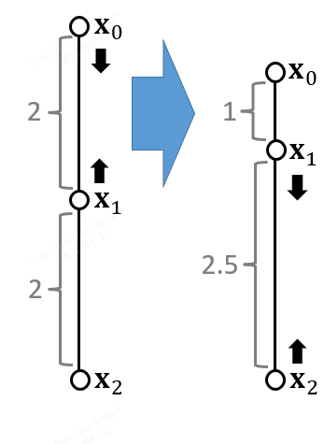
Multiple Springs
What about multiple springs? The Gauss-Seidel approach projects each spring sequentially in a certain order.
After the first spring satisfies the constraint,
We solve the second spring.

Slide 15
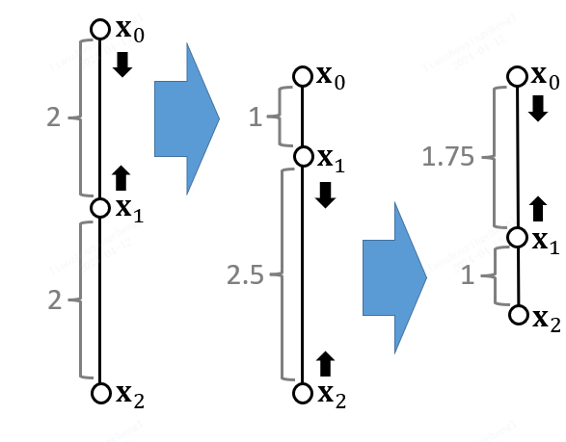
Multiple Springs
What about multiple springs? The Gauss-Seidel approach projects each spring sequentially in a certain order.
However, when the second spring satisfies the constraint, the first spring violates it again.

Slide 16
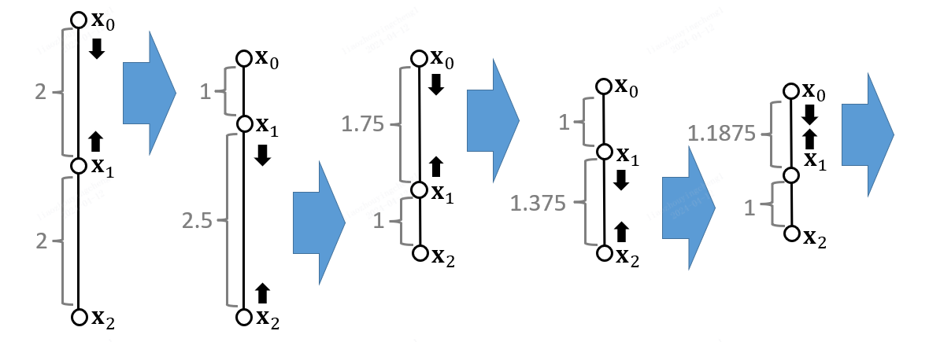
Multiple Springs
We repeat this process iteratively, and the final result will converge to the constraint.

Slide 17






PBD Simulator
Based on the projective approach, we can now build a PBD simulator.
A PBD Simulator
//update $x$ and $v$
$$v ⟵ v + ∆t f(x)/m$$
$$x ⟵x +∆t v$$
//projection
$$x^{new} ⟵Projection(x)$$
$$v ⟵(x^{new}−x)/∆t$$
$$x⟵x^{new}$$
Notes:
this is the pseudocode of each iteration for each spring

Slide 18
PBD Simulator
PBD does not have many concept of physics, e.g., stiffness coefficient, elastic force. How do we describe how much stiffness is there?

Slide 19
PBD Simulator
The stiffness of the constraints is controlled by non-physical parameters.
The number of iterations
When there’re more iteration, the edge lengths converge to the rest lengths, i.e., it looks more stiff.
The mesh resolution
When the mesh has a lower resolution, it leads to faster convergence. Thus, with the same number of iterations, it looks more stiff.

Slide 20
PBD Simulator
Advantages
Easy to implement
Fast in low resolutions
Disadvantages
Not physically correct
Low performance in high resolutions

Slide 21
Strain Limiting
Besides PBD, strain limiting (projective function) can be used elsewhere.

Slide 22

Strain Limiting
Strain limiting aims at using the projection function for correction only.
A Strain Limiting Simulator
//update $x$ and $v$
$$v ⟵ v + ∆t f(x)/m$$
$$x ⟵x +∆t v$$
//projection
$$x^{new} ⟵Projection(x)$$
$$v ⟵(x^{new}−x)/∆t$$
$$x⟵x^{new}$$

Slide 23


Strain Limiting
We can set the spring strain, i.e., the stretching ratio $σ$, to be within a limit.
$$x_{j}$$
$$x_{j}^{new}$$
rest length $L$
$$L$$
$$x_{i}^{new}$$
$$x_{i}$$
$$x_{j}$$
$$x_{i}$$
$$x_{j}$$
$$x_{j}^{new}$$
$$σ^{min}≤\frac{1}{L}\left\|x_{i}− x_{j}\right\|≤σ^{max}$$
$$x_{i}^{new}$$
Constraint
$$x_{i}$$
Stretched case
Compressed Case

Slide 24





Strain Limiting
We can set the spring strain, i.e., the stretching ratio $σ$, to be within a limit.
$$x^{new}⟵Projection(x)$$
$$σ⟵\frac{1}{L}\left\|x_{i}− x_{j}\right\|$$
rest length $L$
$$x_{i}$$
$$x_{j}$$
$$σ_{0}⟵min\left(\max\left(σ,σ^{min}\right),σ^{max}\right)$$
$$x_{i}^{new}⟵x_{i}−\frac{m_{j}}{m_{i}+m_{j}}\left(\left\|x_{i}− x_{j}\right\|−σ_{0}L\right)\frac{x_{i}− x_{j}}{\left\|x_{i}− x_{j}\right\|}$$
$$σ^{min}≤\frac{1}{L}\left\|x_{i}− x_{j}\right\|≤σ^{max}$$
$$x_{j}^{new}⟵x_{j}+\frac{m_{j}}{m_{i}+m_{j}}\left(\left\|x_{i}− x_{j}\right\|−σ_{0}L\right)\frac{x_{i}− x_{j}}{\left\|x_{i}− x_{j}\right\|}$$
Constraint
PBD: $σ_{0}≡1$;

