Slide 1
The "Last Mile" Logistics Auditor
Delivery Performance Audit for Veridi Logistics
Dataset: Olist Brazilian E-Commerce | 84,432 Orders | 2016-2018
Built with Python · Pandas · Plotly · Streamlit

Slide 2
Executive Summary
84,432
91.8%
8.2%
+10.9 days
4.15 ★
Total Orders
On-Time Rate
Late / Super Late
Avg Days Early
Avg Review Score
• ~8% of delivered orders arrive late, with Super Late orders averaging 3+ weeks overdue
• Northern/Northeastern states (AL, MA, PI) have the worst late delivery rates (15-20%)
• Late deliveries directly correlate with poor reviews: On-Time = 4.2★, Late = 3.4★, Super Late = 1.3★
• Late delivery spike of ~21% occurred in early 2018, suggesting seasonal logistics strain
• Product categories like electronics and furniture have higher late rates than average

Slide 3
Data Schema & Methodology
Schema Builder (Story 1)
Delay Calculator (Story 2)
• Loaded 6 CSV files from the Olist dataset • Master table joins: Orders → Customers (on customer_id) Orders → Reviews (on order_id, deduplicated) Orders → Items → Products (on order_id, product_id) • Final master table: 84,432 rows × 16 columns • Assertion: row count preserved after joins • Datetime columns parsed for time calculations
• Days_Difference = estimated − actual delivery date • Positive = early, Negative = late Classification Logic: • On Time: Days_Difference ≥ 0 • Late: −7 ≤ Days_Difference < 0 • Super Late: Days_Difference < −7 Results: • On Time: 77,364 (91.8%) • Late: 5,159 (6.1%) • Super Late: 1,748 (2.1%)

Slide 4
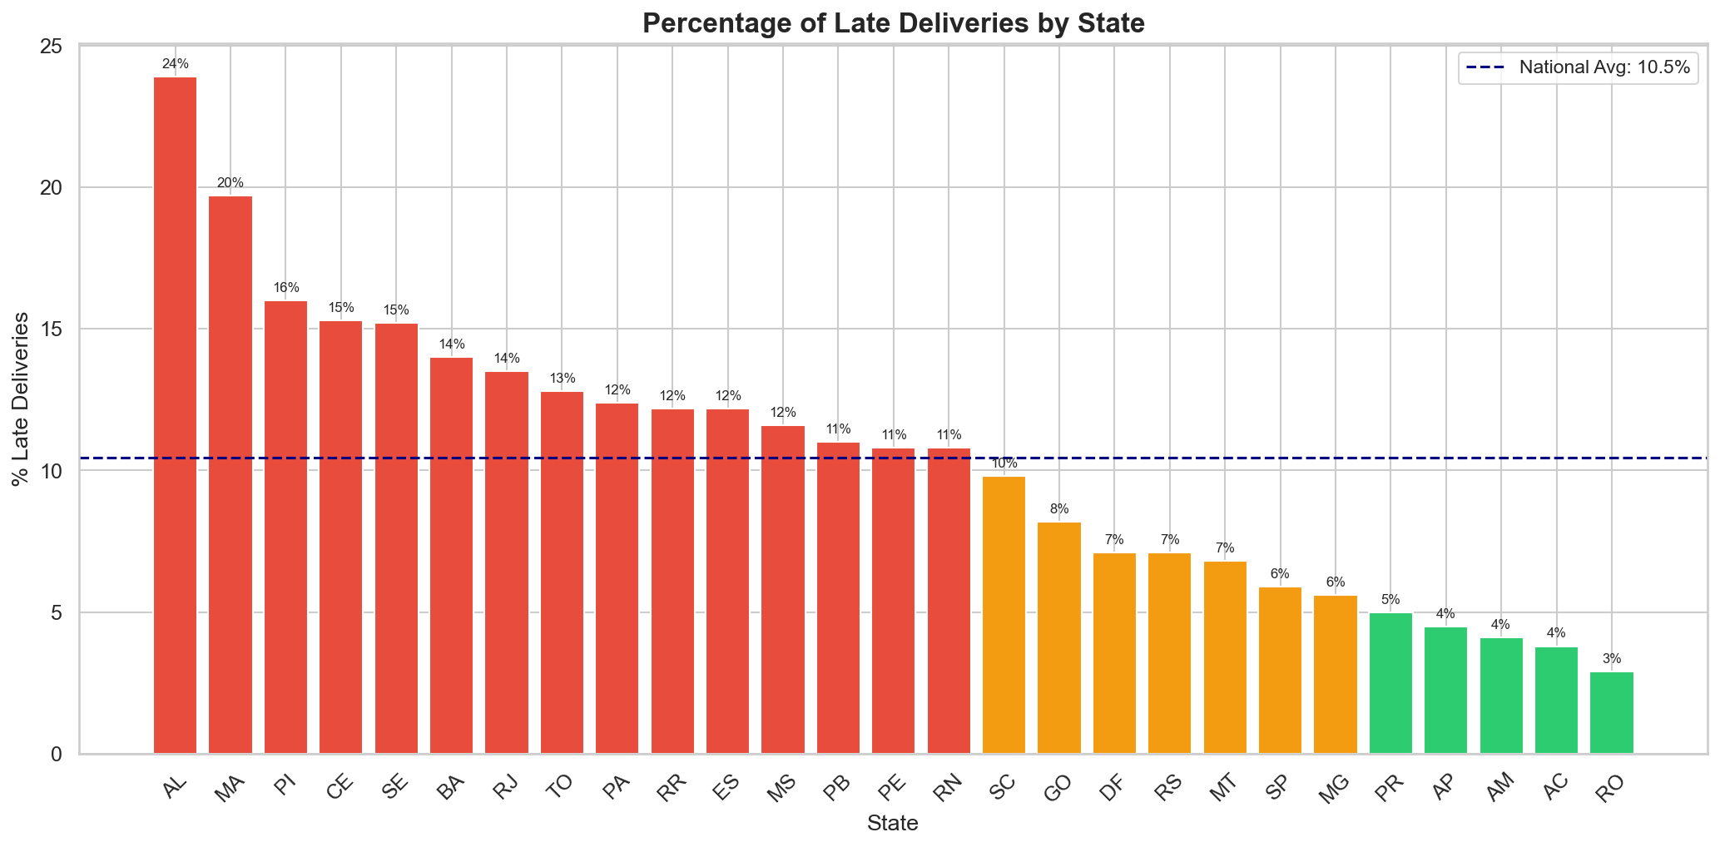
Geographic Analysis — Late Deliveries by State
Key Insights
• Northern states have 2-3x higher late delivery rates than the national average • Worst performers: • Alagoas (AL): ~20% • Maranhão (MA): ~18% • Piauí (PI): ~17% • Best performers: • São Paulo (SP): ~6% • Paraná (PR): ~6% • Suggests infrastructure and distance from logistics hubs drive delivery failures

Slide 5
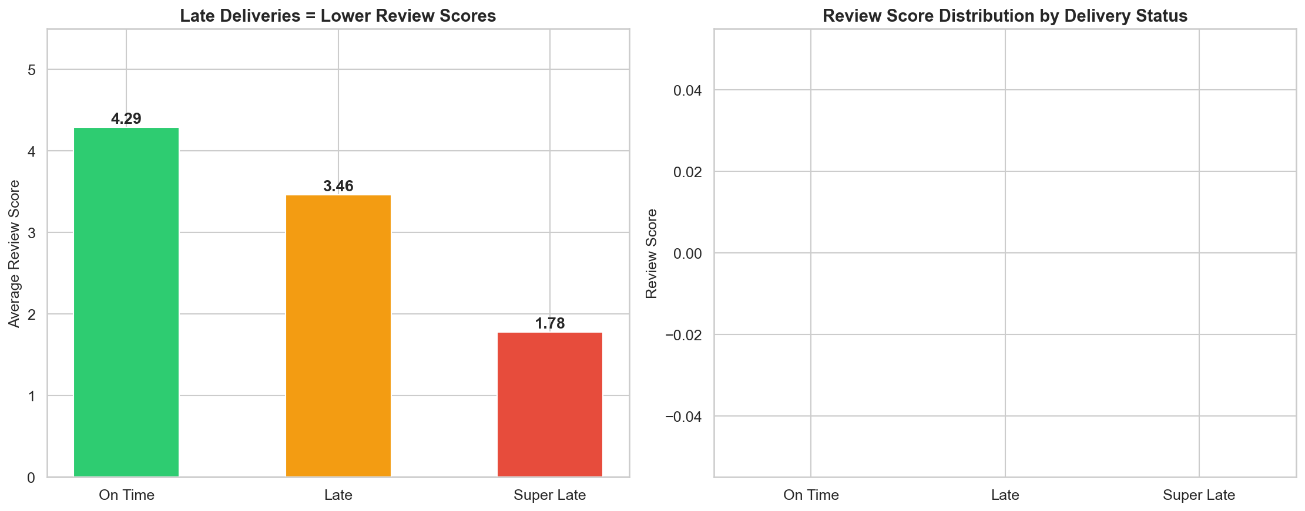
Sentiment vs. Delivery Performance
Key Findings
• Clear inverse correlation between delay and satisfaction On Time: 4.24 ★ Late: 3.39 ★ Super Late: 1.34 ★ • Super Late orders receive 68% fewer stars than On Time • Even small delays (≤1 week) drop scores by ~0.8 stars • Business impact: Each late delivery risks losing a repeat customer

Slide 6
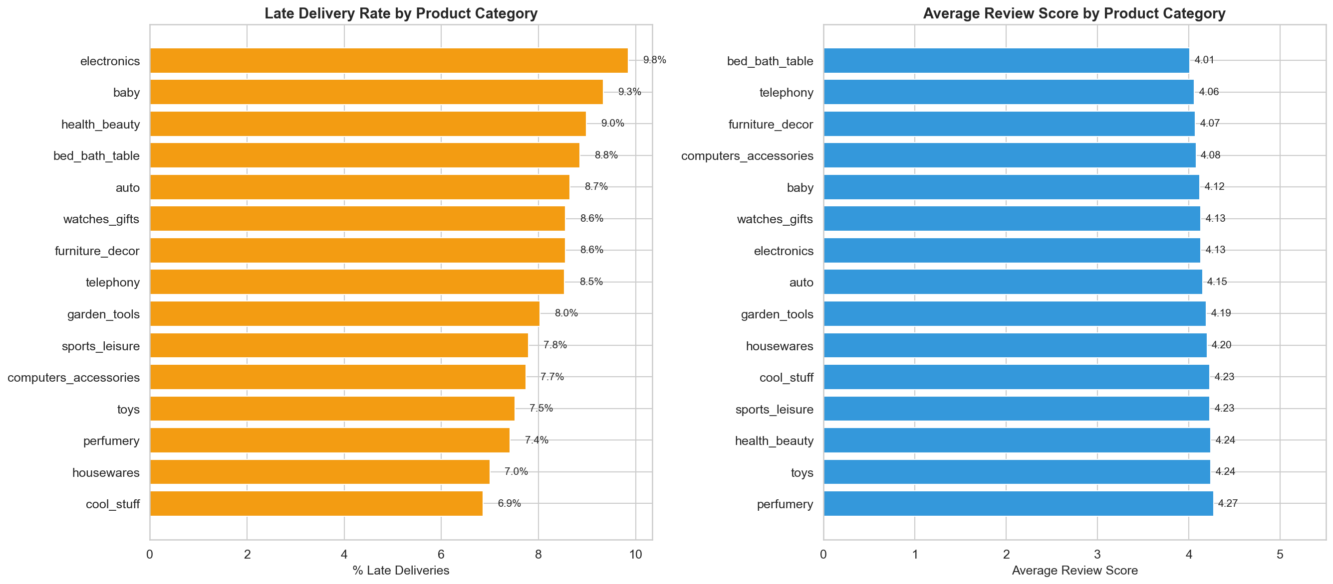
Product Category Performance — Candidate's Choice
Business Value
Analysis: • Joined order_items + products + category translations • Computed per-category: late %, avg delay, avg review Insights: • Electronics & furniture have highest late delivery rates • Categories with bulky items suffer more logistics delays • Lightweight items (stationery, fashion accessories) perform best on delivery timelines Action: Prioritize fulfillment optimization for high-delay product categories

Slide 7
Recommendations & Next Steps
[1]
Expand Regional Logistics Hubs
Open distribution centers in the North/Northeast (AL, MA, PI) to reduce transit times by 40-60%.
[2]
Prioritize Bulky Product Fulfillment
Electronics and furniture have the highest delay rates. Implement category-specific SLAs and packaging protocols.
[3]
Seasonal Capacity Planning
Late delivery rates spiked to 21% in Q1 2018. Pre-scale carrier capacity for predictable demand surges.
[4]
Customer Recovery Program
Super Late orders get 1.3-star reviews. Implement proactive alerts + compensation for delays >7 days to recover NPS.
[5]
Real-Time Monitoring Dashboard
Deploy the Streamlit dashboard for operations teams to track KPIs and identify at-risk shipments in real time.

Slide 8
Thank You
Questions? Let’s discuss the findings.
Notebook: logistics_auditor.ipynb | Dashboard: dashboard.py Full HTML Report: logistics_auditor.html

