Slide 1
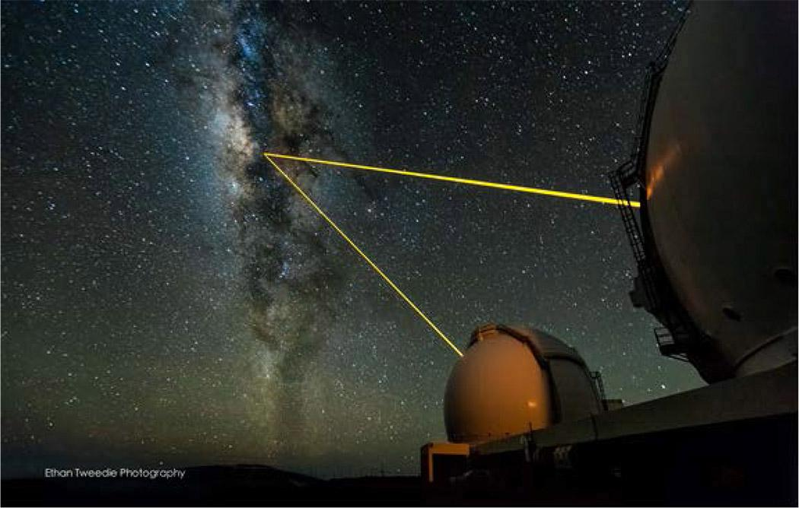
Guide Star Laser Interface (Semiconductor Laser on Wattle)
A. Stuchbery, G. Kennedy, J. Davies, M. Dirnberger, S. Nilon
Client: Céline D’Orgeville
Advanced Instrumentation and Technology Centre (AITC)
Space Environment Research Centre (SERC)

Slide 2
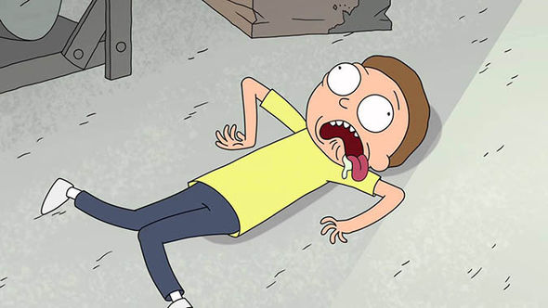
LIFE WITHOUT INTERNET

Slide 3

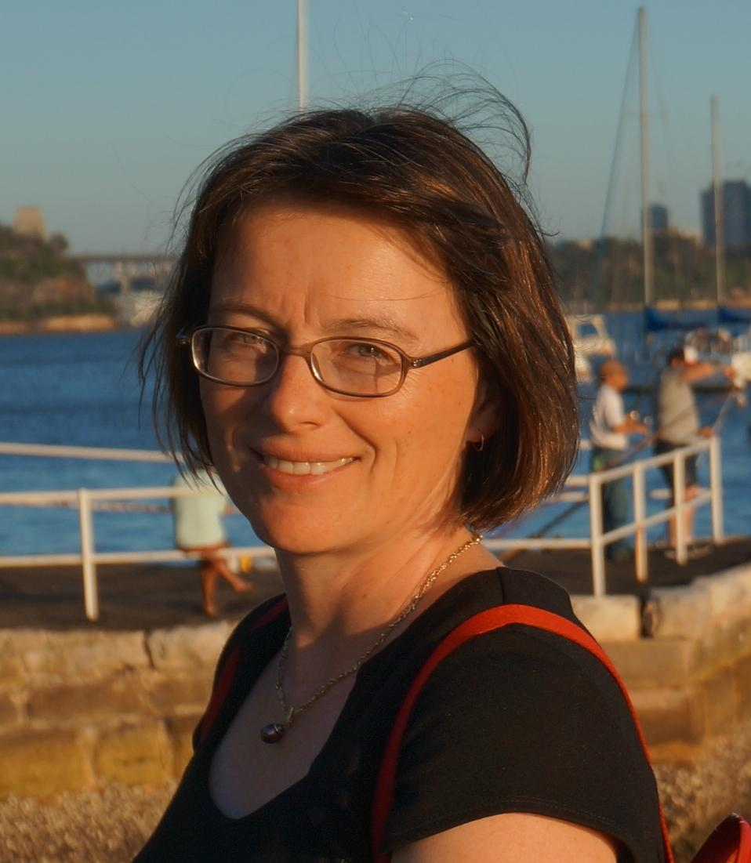


Progress
Verification of Initial SSS
Delivered 120+ Preliminary Requirements
Solution Agnostic Preliminary Concepts
Our Client is happy! So are all our stakeholders!
Our Client Celine
Notes:
Also keeping our stakeholder in the loop, managing relations with all stakeholders
Logos

Slide 4
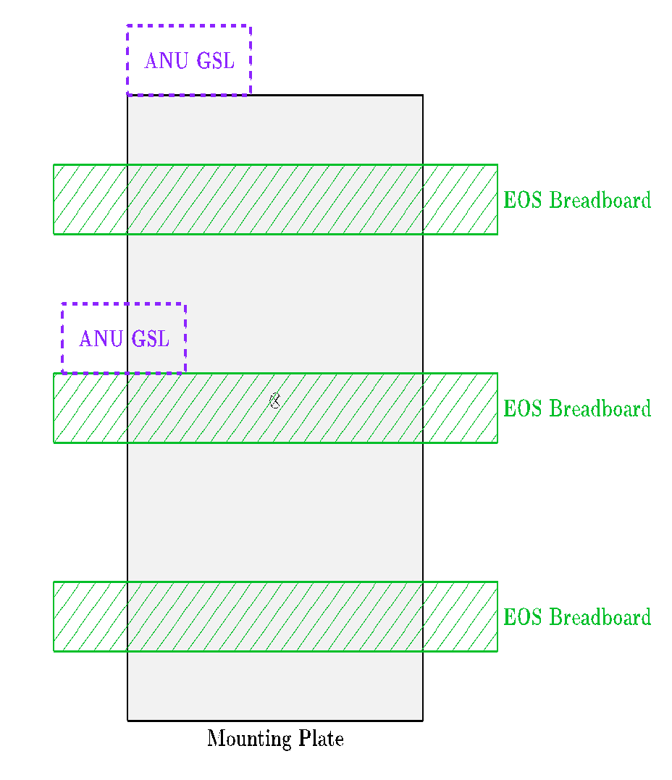
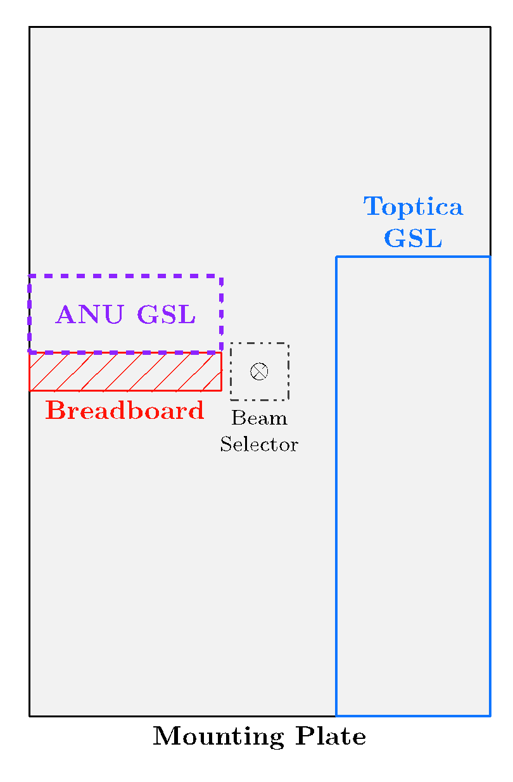
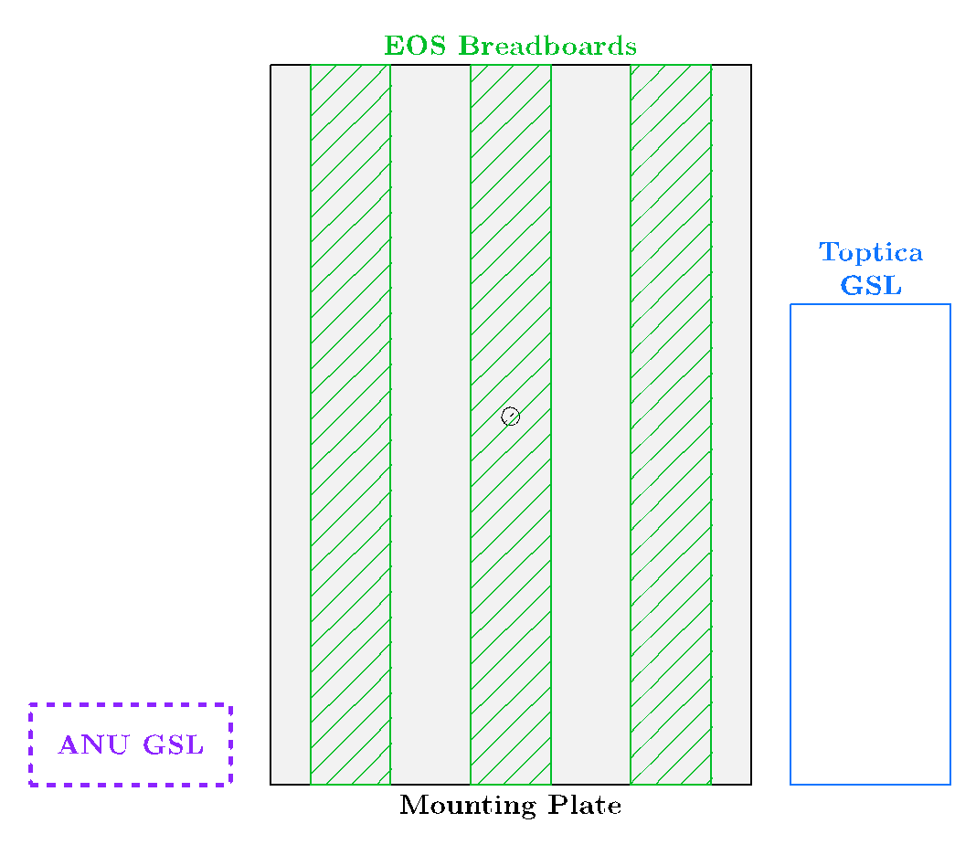
Solution Agnostic Concepts

Slide 5
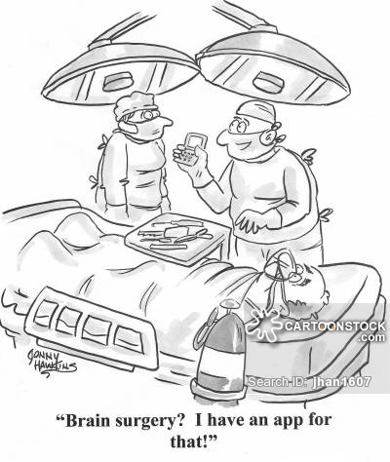
System Requirements Management
Our LaTeX macros are available on Tech Launcher. Thank you to Markus!
bit.do/4221macros
a macro

Slide 6
From Here
On schedule
Facetime organise with out client
Continue developing conceptual designs
Finalise requirements
Make sure our client stays Happy!

Slide 7
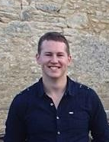
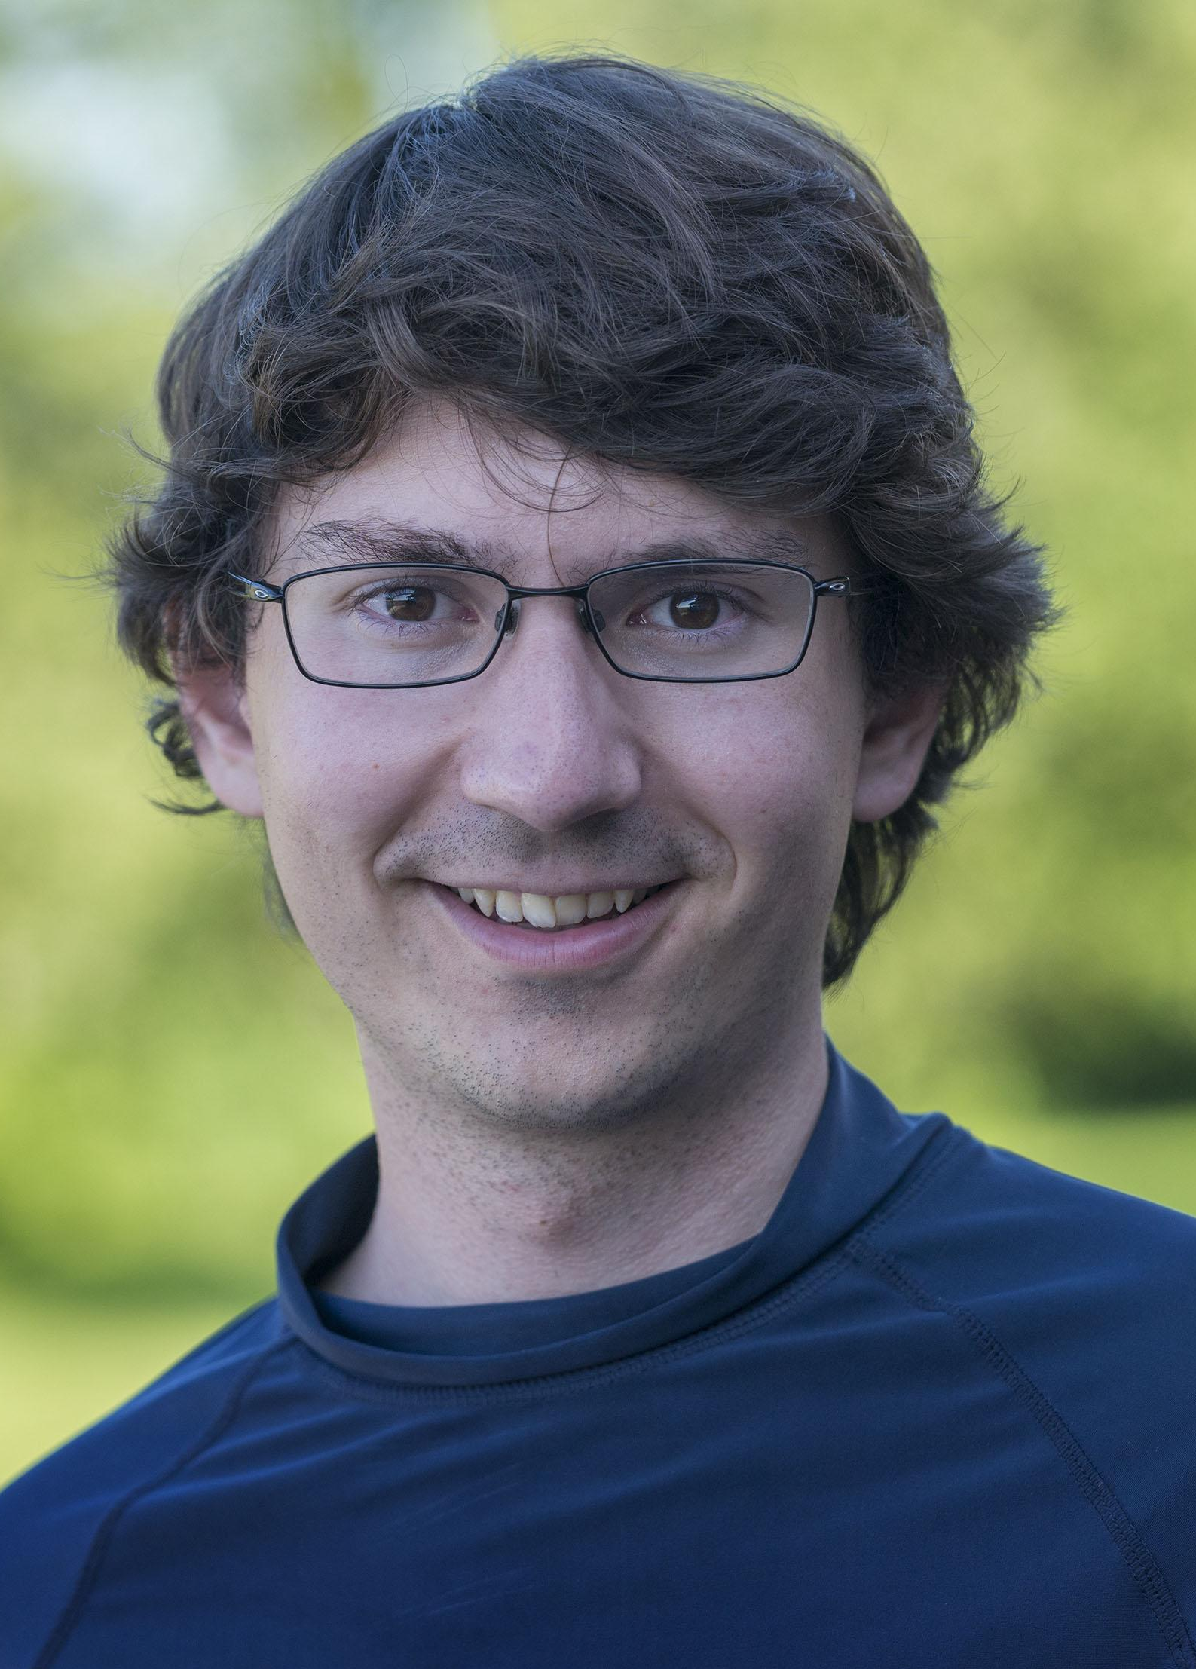
Questions
Alex Sys-Eng
Gerard Sys-Eng
Jordan Sys-Eng
Markus LaTeX Wizard
Samson Pick a RO

