Slide 1
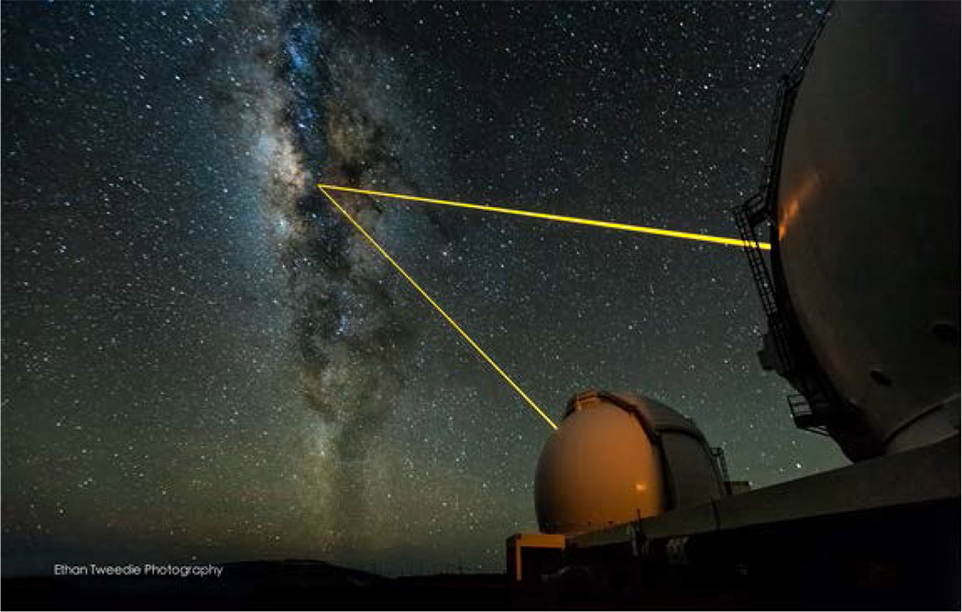
Guide Star Laser Interface (Semiconductor Laser on Wattle)
A. Stuchbery, G. Kennedy, J. Davies, M. Dirnberger, S. Nilon
Client: Céline D’Orgeville
Advanced Instrumentation and Technology Centre (AITC)
Space Environment Research Centre (SERC)

Slide 2
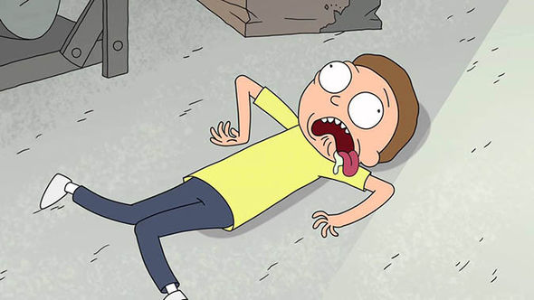
LIFE WITHOUT INTERNET

Slide 3

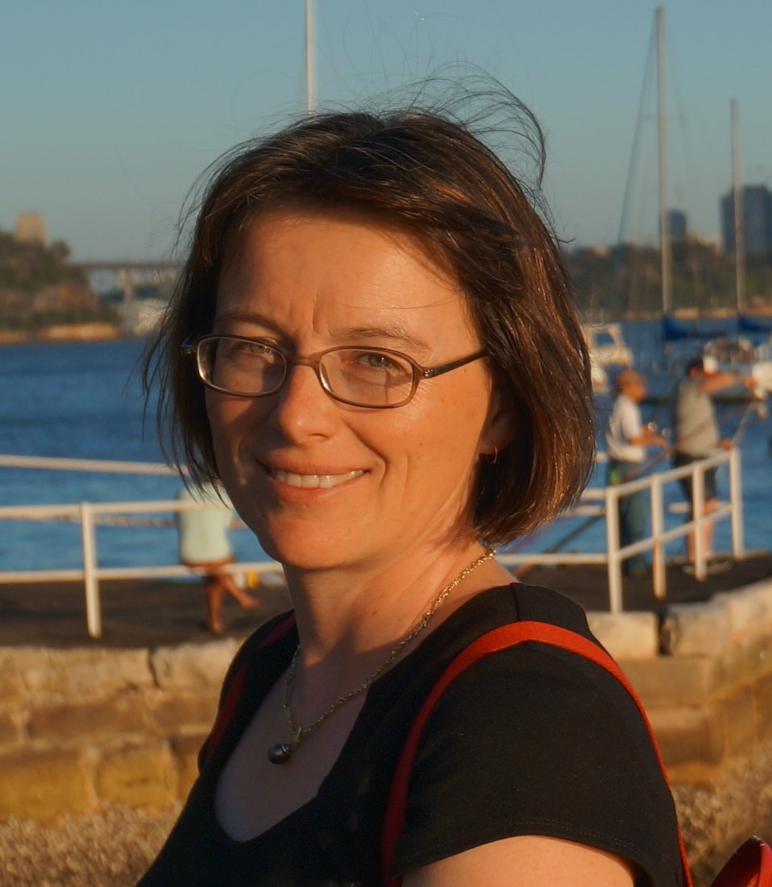

Progress
Verification of initial SSS
Delivered 120+ preliminary requirements
Solution agnostic conceptual designs
Our Client is happy! So are all our stakeholders!
Stakeholders
Our Client Celine
Notes:
Also keeping our stakeholder in the loop, managing relations with all stakeholders
Logos

Slide 4
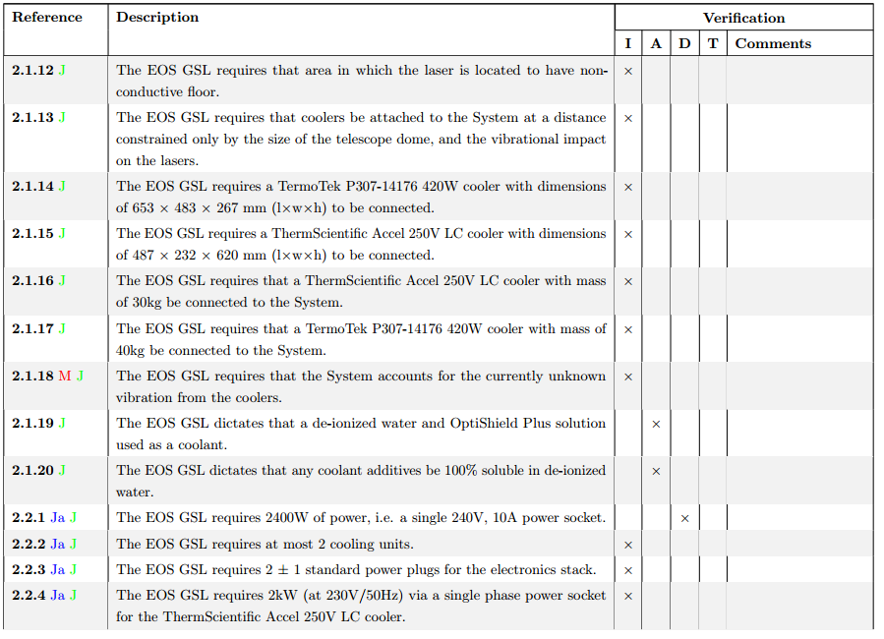
Requirements
Notes:
Also keeping our stakeholder in the loop, managing relations with all stakeholders
Logos

Slide 5
Solution Agnostic Concepts

Slide 6
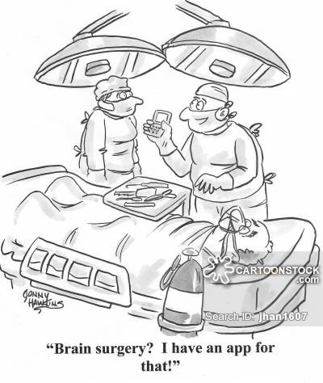
System Requirements Management
Our LaTeX macros are available on Tech Launcher. Thank you to Markus!
bit.do/4221macros
a macro

Slide 7
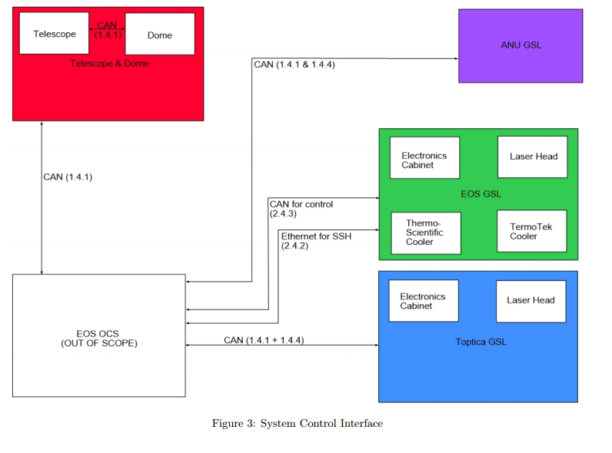
Interface Management
Notes:
Also keeping our stakeholder in the loop, managing relations with all stakeholders
Logos

Slide 8
From Here
On schedule
Facetime organise with out client
Continue developing conceptual designs
Finalise requirements
Make sure our client stays Happy!

Slide 9
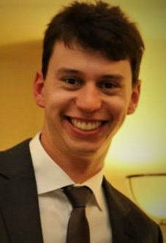
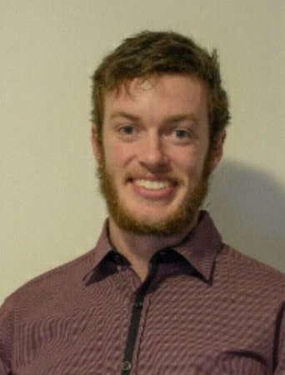
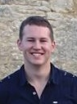
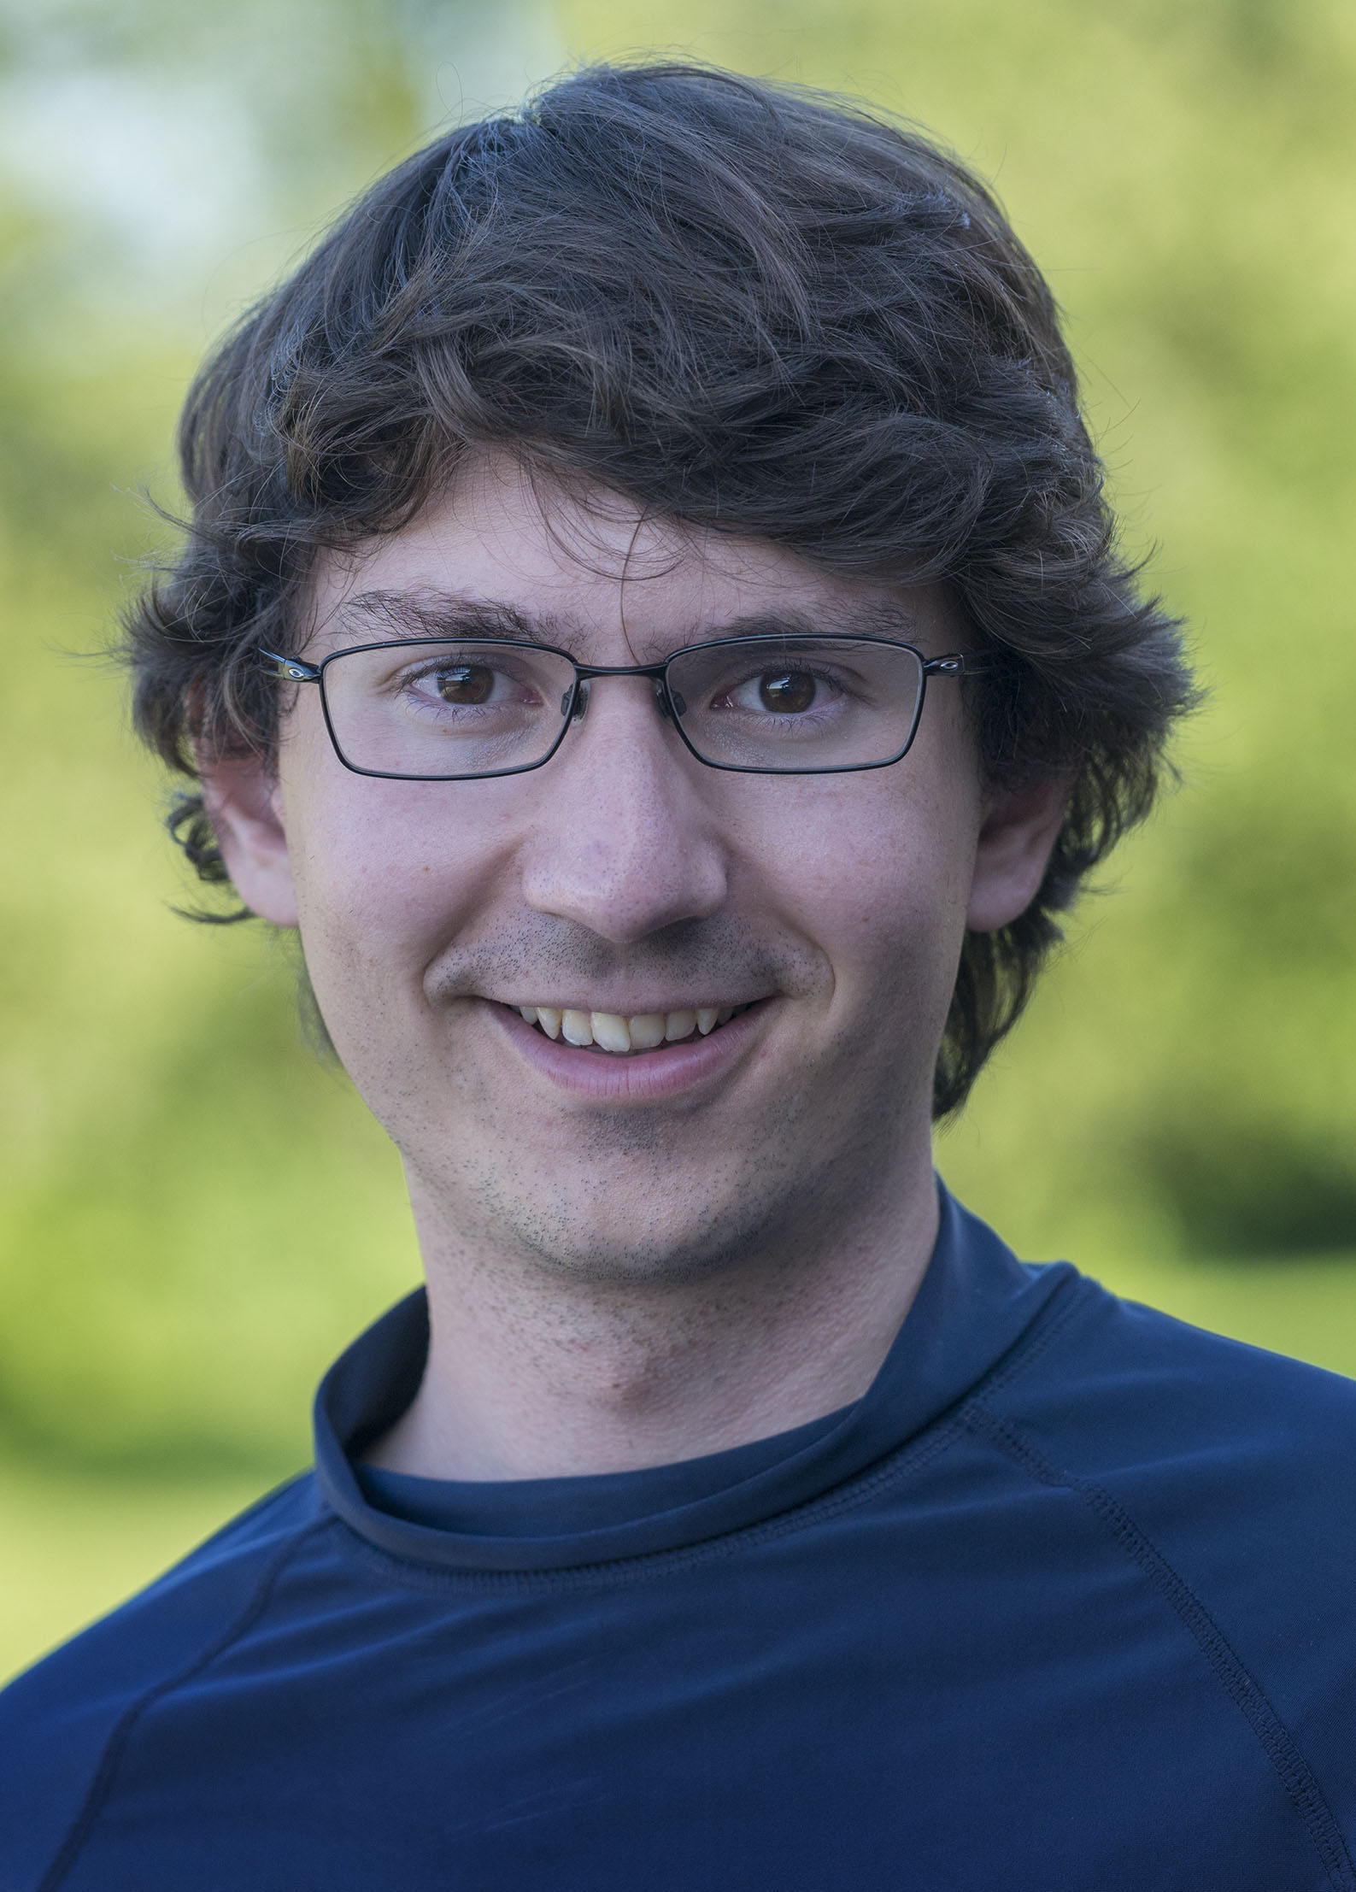
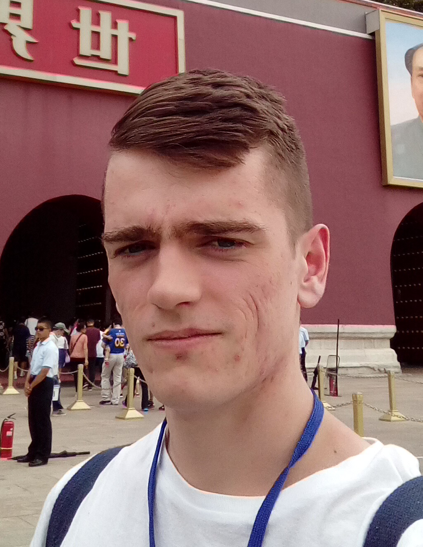
Questions
Alex Sys-Eng, CAD
Gerard Sys-Eng
Jordan Sys-Eng
Markus LaTeX Wizard
Samson Control-Sys

