Slide 1
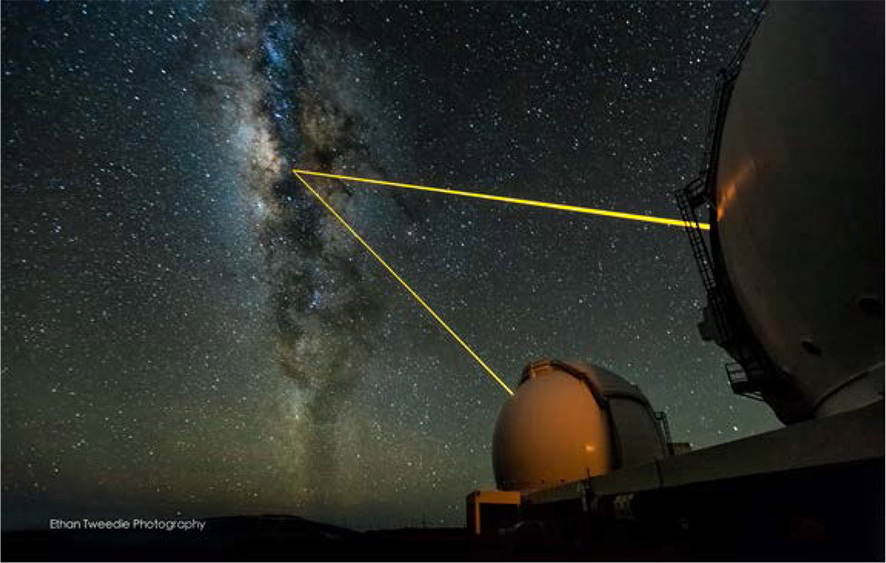
Guide Star Laser Interface (Semiconductor Laser on Wattle)
A. Stuchbery, G. Kennedy, J. Davies, M. Dirnberger, S. Nilon
Client: Céline D’Orgeville
Advanced Instrumentation and Technology Centre (AITC)
Space Environment Research Centre (SERC)

Slide 2


Slide 3
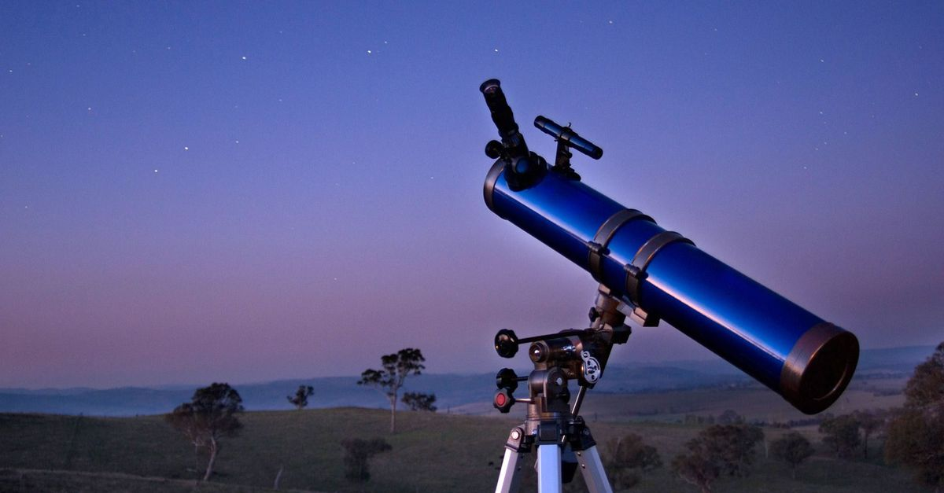
Adaptive Optics (AO) – What is it?
Animation curtesy of Anna Zovaro, PhD student

Slide 4
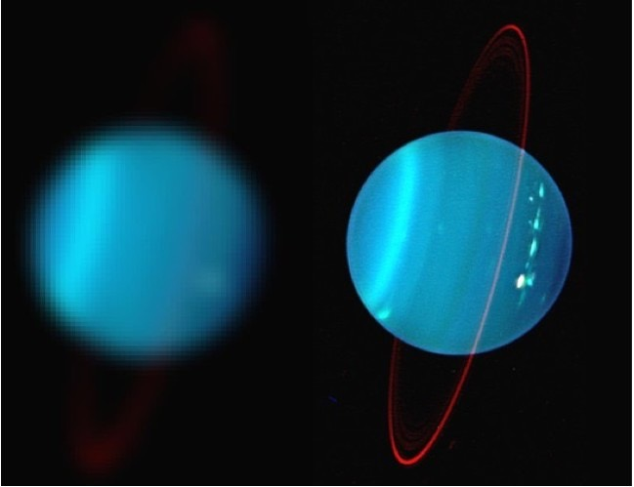
Adaptive Optics (AO) – What is it good for?
Uranus
Credit Keck Observatory
More than absolutely nothing!
Without AO
With AO

Slide 5
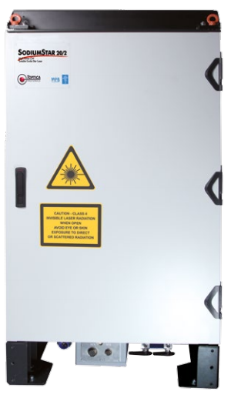
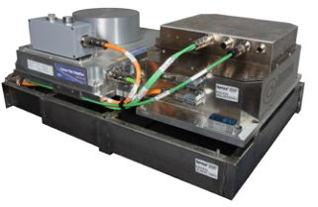
Toptica Laser

Slide 6
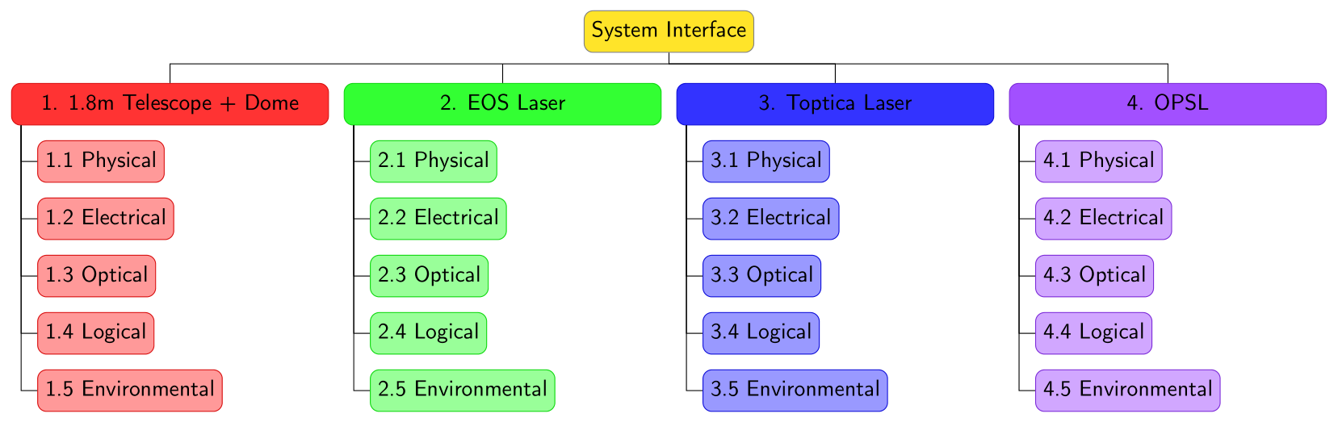
Interface Tree

