Slide 1

Real Time Surface Modeling using Human Pose Estimation
Group 5: Wang Jiaqi, Qiao Qiao, Liu Yang, Kempf Anja
Technical University Munich
3D Scanning & Motion Capture – Project Intermediate Presentation
Faculty for Informatics
Garching, 08. January 2020

Slide 2
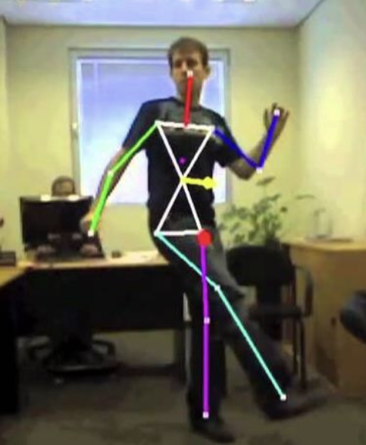
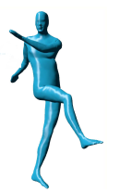
Goal
Animate Character: Get skeleton from Kinect and transfer pose to virtual model in realtime
Other Pictures!?
We chosed Unity 3D for Displaying & Interaction

Slide 3
Steps
Integrate Kinect Camera into Unity
Create Interface/Levels in Unity
Integrate deformable Mesh for virtual Character -> SMPL Asset
Implement Skeleton Tracking with Libraries to get Human Pose -> Kinect SDK, Unity Kit
Filtering per-frame poses over time for temporal Consistency
Move the Avatar Bones according to tracking
Use Avatar for deforming Mesh
Display tracked Skeleton and deformed Character Model
Used Papers?!

Slide 4
Kinect Manager

Slide 5
SMPL Model

Slide 6
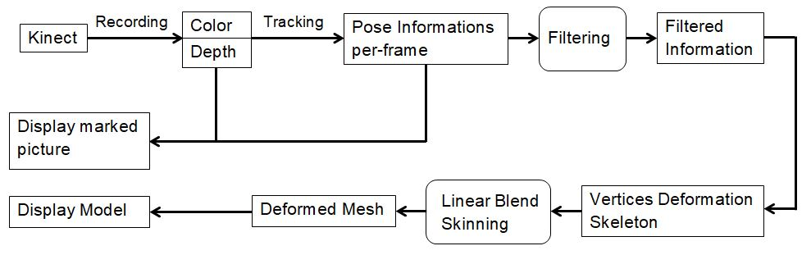
Pipeline

Slide 7
Live Demo / Video

Slide 8
Future Steps
Filtering for temporal coherence
Gestures
Make Dancing Game

