Slide 1

Real Time Surface Modeling using Human Pose Estimation
Group 5: Wang Jiaqi, Qiao Qiao, Liu Yang, Kempf Anja
Technical University Munich
3D Scanning & Motion Capture – Project Intermediate Presentation
Faculty for Informatics
Garching, 08. January 2020

Slide 2
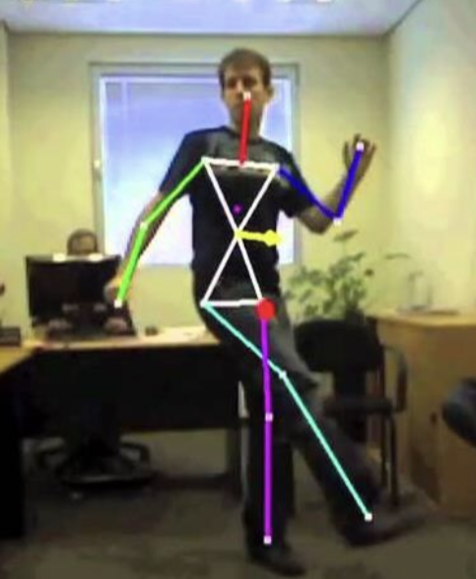
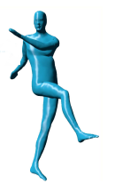
Goal
Animate Character: Get skeleton from Kinect and transfer pose to virtual model in realtime
Other Pictures!?
User Interface: Unity 3D for Display & Interaction

Slide 3
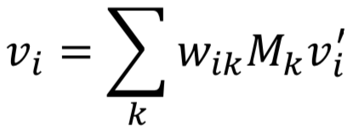
Steps
Integrate Kinect Camera into Unity
Create Interface/Levels in Unity
Implement Skeleton Tracking with Libraries to get Human Pose (Kinect SDK, Unity Kit)
Filtering per-frame poses over time for temporal Consistency (formula Filtering!?)
Get deformation of tracked Skeleton
Integrate deformable Mesh for virtual Character (SMPL)
Transfer deformation of Skeleton to virtual Mesh vertices
Implement linear blend skinning to deform Model
Display tracked Skeleton and deformed Character Model
Used Papers?!
Extra: Dancing Game(getting points for pose imitation)

Slide 4
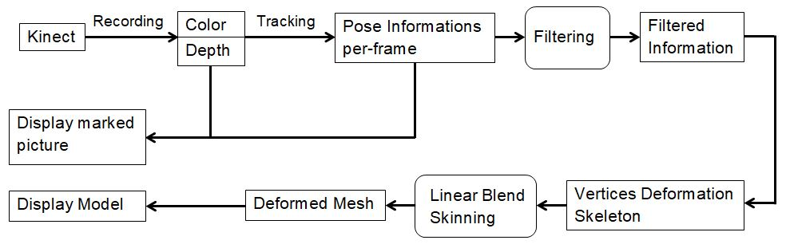
Pipeline

Slide 5
Live Demo / Video

