Slide 1


Sales Growth, AOV and
Customer Targeting Strategy
Canada Vapes operates in a highly regulated and regionally diverse market.
Customer purchasing behaviour can vary across provinces.
This project analyzes sales and customer behaviour to identify growth opportunities, improve AOV, strengthen customer retention, and support regional marketing decisions.
Project team
Absasiaka Anwanakak • Gift Oyugi • Damian Okelue
Sahil Kamane • Busayo Adebayo

Slide 2

Growth is strong. Value capture is the gap.
BUSINESS PROBLEM
The project was designed to move from performance reporting to practical management decisions.
The central question
1
Measure performance
2
Find the value drivers
Where is growth coming from, which customers and region should Canada Vapes prioritize, and how can AOV move closer to the $120 target?
Track completed sales, orders, AOV, and the three-year forecast.
Compare new and returning customers and identify the strongest customer segment.
3
Prioritize regions
4
Recommend action
Decision lens
Compare regional reach, AOV opportunity and priority scores.
Define measurable next steps, turn findings into measurable customer and regional growth actions.
Sale Growth + Customer value + Regional opportunity
Which Provinces offer the strongest growth opportunities, and what action can Canada Vapes take to increase customer value?

Slide 3
Two datasets, one complementary business story
METHODOLOGY
The two datasets could not be reliably merged because no validated shared customer or region key was available, so each was analyzed separately.
1
2
3
4
›
›
›
Transaction data
Customer level regional data
Python analysis
Power BI + report
Sales, orders, customer type, products, coupons and time trends
Province, customer activity, tenure, total spend, orders and regional AOV
Data cleaning, validation, KPI calculations, segmentation and forecast analysis
Dashboards, regional priorities, findings and recommendations
What the analysis did
Filtered completed positive-value orders so that refunds, fraud, reshipments and incomplete records did not distort KPIs.
Analyzed the regional dataset separately to compare customer behaviour and provincial opportunities.
Calculated sales, orders, AOV, repeat purchasing, customer segments, and forecast summaries at the correct grain.
Used Power BI to connect the findings to regional priorities and business recommendations.
Key limitation: the analysis estimates revenue opportunity; it cannot confirm profit without cost, margin and campaign-spend data.

Slide 4
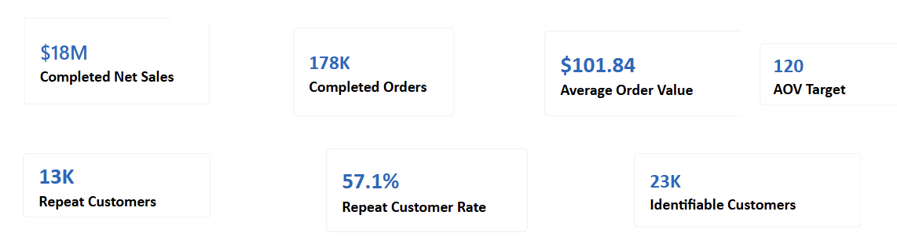
Business performance at a glance
EXECUTIVE VIEW
Canada Vapes has a strong operating base, but the AOV remains below the stated target.
57.1% of identifiable customers are repeat customers, showing that retention is already a strong part of the sales base.
Canada Vapes has a strong sales scale and customer base, but AOV remains below the $120 target. This creates an opportunity to increase the value of each order while continuing to grow repeat purchasing.
Management takeaway

Slide 5
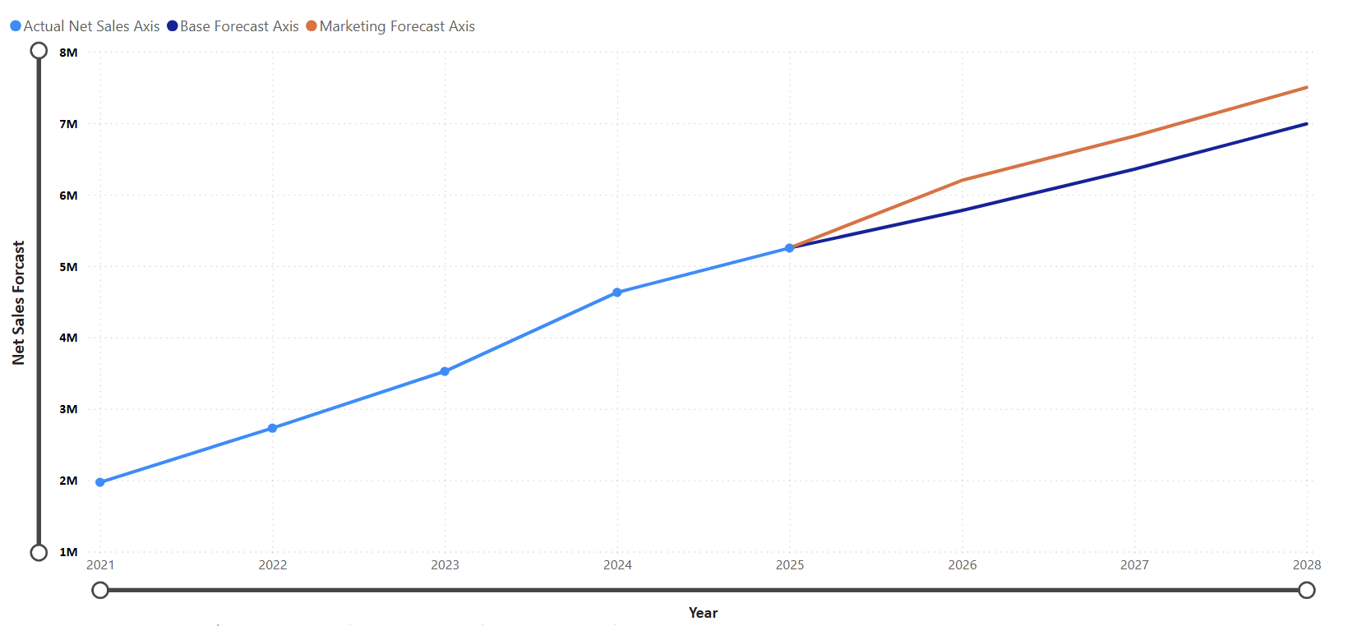
Sales are growing, and the forecast remains positive
INSIGHT 1
Completed net sales more than doubled from 2021 to 2025.
27.9%
2021–2025 sales CAGR
Strong historical momentum
$8.0M
Forecast net sales by 2028
Planning estimate
How management should use it
Review actual vs forecast monthly
Explain major variance
Do not treat the forecast as guaranteed

Slide 6
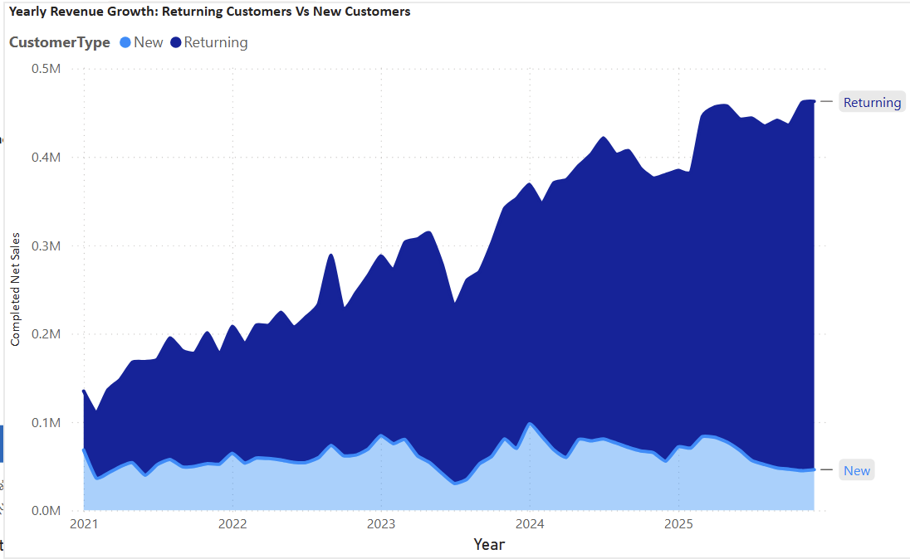
Returning customers drive most of the value
INSIGHT 2
Retention is the strongest existing growth base.
Returning customer consistently completed more net sales than new customers
The returning customer sales trend increases strongly from 2021 to 2025.
What this means
Keep returning and high-value customers active.
Move new customers to a relevant second purchase as early as possible.
KEY TAKEAWAY: Make retention a major growth priority.

Slide 7
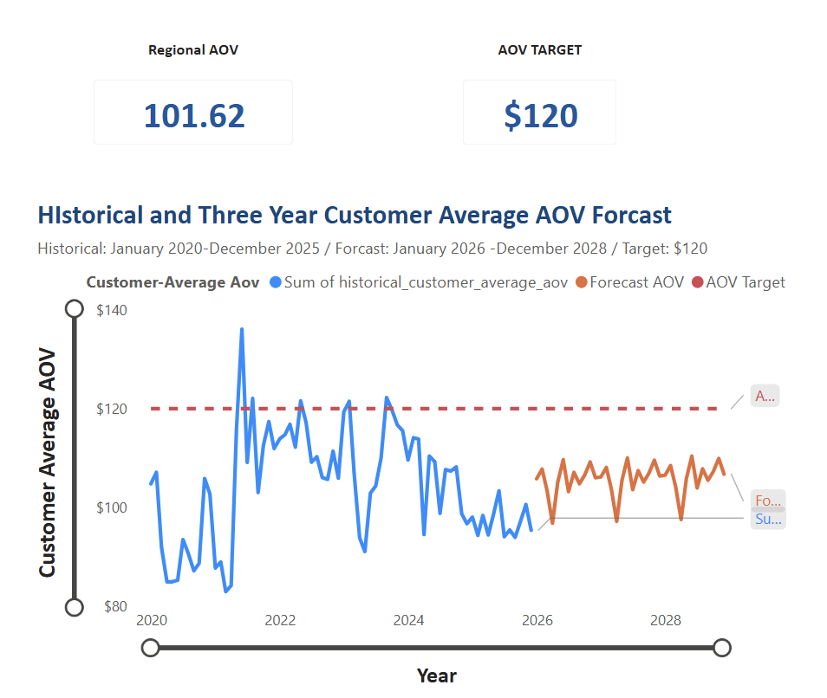
AOV remains below the $120 target
INSIGHT 3
Historical performance and the current forecast that customer AOV remains below target
Regional AOV is $101.62, below the $120 target
Historical performance and the current forecast show that customer AOV remain below target
Recommended Action
Focus on increasing basket value through bundles, cross-sell, loyalty offers and carefully tested spending thresholds.
What this means
Increase basket value through bundles and cross-sell
Test minimum-spend thresholds and loyalty rewards
Avoid relying only on broad discount
Checkout recommendations for eligible adults

Slide 8
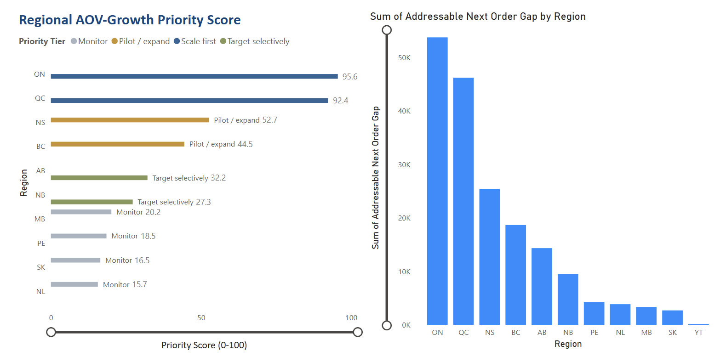
Regional performance changes the story
INSIGHT 4
High AOV does not automatically mean the largest business opportunity, customer reach and addressable gap also matters.
Scale first
ON, QC
Largest reach and strongest priority scores
Pilot / expand
NS, BC
Test bundles and thresholds at manageable scale
Target selectively
AB, NB
Use narrower offers based on behaviour
Monitor
Smaller regions
Strong averages may reflect low customer volume
ON and QC rank highest for scale, while NS and BC are better suited for pilot testing before wider rollout.
Pilot where learning is manageable; scale where reach is large; monitor where high AOV may be driven by a small base.

Slide 9
Recommended growth strategy
ACTION
Four actions link the findings to measurable business decisions.
1
Align with metrics
2
Strengthen retention
Use one clear definition for AOV, regional AOV, target gap and repeat rate before scaling campaigns.
Focus on second purchase conversion and keep high-value returning customers active with relevant reminders and loyalty offers.
3
Increase basket value
4
Pilot before scaling
Test complementary bundles, cross-sell and minimum-spend offers instead of relying on broad discounts.
Test campaigns in selected regions, measure the results, and scale only the strategies that show clear improvement.
Decision rule: no campaign scales without reconciled KPIs, positive lift, acceptable contribution and compliance approval.

Slide 10
90-day implementation plan
NEXT STEPS
Validate → Pilot → Measure → Scale
Days 1–15
Days 16–45
Days 46–75
Days 76–90
1
2
3
4
Validate measures
Design pilots
Run and measure
Scale decision
Confirm AOV definitions, filters, lineage, refresh rules and ownership.
Build eligible treatment and holdout groups; prepare NS/BC tests.
Track AOV, conversion, order rate, margin proxy, quality and campaign performance.
Compare outcomes, update the forecast and scale proven tactics to ON/QC.
Gate: trusted scorecard
Gate: valid test design
Gate: positive lift
Gate: scale / no-scale
Each phase has a decision gate. Progress is earned by evidence, not assumed because the calendar moved forward.

Slide 11
CLOSE
Limitations to keep in view
!
Disconnected datasets
!
Revenue, not profit
!
Forecast and activation limits
Regional findings could not be linked directly to individual orders, products, coupons or customer types.
The files did not include product cost, margin, shipping, payment fees or campaign spend.
Forecasts require monthly validation, while age eligibility and consent must be checked before marketing use.
Final takeaway
Protect the value base.
Raise basket value.
Scale only proven growth.
Canada Vapes has positive momentum. The strongest next move is a controlled 90-day program that standardizes AOV measures, improves repeat purchasing, tests basket-building offers and scales only what produces incremental value responsibly.

Slide 12
Thank You
Questions and discussion
Absasiaka Anwanakak • Gift Oyugi • Damian Okelue • Sahil Kamane • Busayo Adebayo

Slide 13
Appendix: why the AOV values differ
Q&A BACKUP
AOV measure
Value
Calculation grain
What it answers
Completed-order AOV
$102.59
Completed net sales ÷ completed orders
Commercial basket value
Executive dashboard AOV
$101.84
Power BI filter context
Executive dashboard view
Regional dashboard AOV
$101.62
Average across customer level regional measures
Regional comparison
Mean customer AOV
$100.50
Average of customer-level AOV values
Average customer behaviour
Median customer AOV
$84.73
Middle customer-level AOV
Less sensitive to high-value outliers
Different AOV values can all be valid when the denominator, calculation grain or filter context changes. The measure name and definition should always be clearly stated.

