Slide 1
Barriers to Implementing a Just Culture
Kenneth Smith
Module 9
2-23-24

Slide 2
Fear of Blame and Retribution
Fear of disciplinary action or punishment for reporting errors or near misses
Perception that reporting errors will lead to personal and professional consequences
Lack of trust in leadership and organizational systems

Slide 3
Power Imbalance and Hierarchy
Traditional hierarchical structures can create a power imbalance that can hinder the implementation of a just culture. When those in power dominate decision-making and communication, it can lead to intimidation, coercion, and a lack of engagement from frontline staff.
Dominance of traditional hierarchy and authority structures
Intimidation or coercion by those in power to maintain the status quo
Lack of engagement and participation from frontline staff
Limited opportunities for feedback and input from frontline staff

Slide 4
Lack of Transparency and Communication
Transparent and open communication is essential for a just culture. However, inadequate communication and a lack of transparency can create a culture of mistrust and suspicion.
Inadequate or unclear policies and procedures
Insufficient feedback and follow-up on reported errors or near misses
Poor communication about the importance of a just culture
Lack of clarity on the roles and responsibilities of staff

Slide 5
Resource Constraints
Implementing a just culture requires resources and infrastructure. Limited resources can hinder the implementation of a just culture and create a culture of compromise and shortcutting.
Limited time and resources for training and education on just culture principles
Insufficient budget for system improvements and infrastructure changes
Overreliance on technology rather than human factors solutions
Limited capacity for data analysis and interpretation

Slide 6
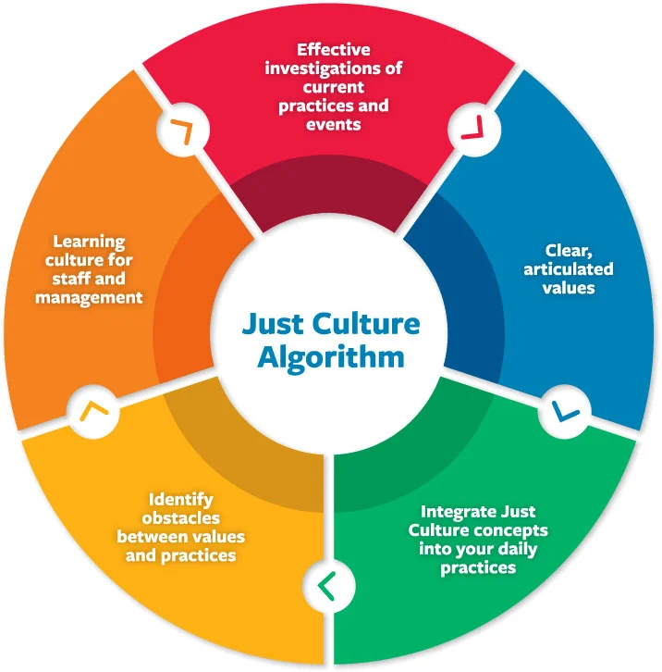
The Just Culture Continuum
Center for Patient Safety. (n.d.). Retrieved from <https://www.centerforpatientsafety.org/just-accountable-culture>

Slide 7
Resistance to Change
Implementing a just culture requires significant changes to organizational culture and practice. However, resistance to change can be a significant barrier to implementation.
Comfort with traditional ways of working and reluctance to adopt new practices
Fear of unknown consequences or outcomes of change
Lack of buy-in from leadership or key stakeholders
Perceived threats to professional identity or autonomy

Slide 8
Strategies for Overcoming Barriers
To overcome the barriers to implementing a just culture, organizations must adopt strategies that address these challenges head-on. This can include leadership commitment, education and training, open communication, and system and process changes.
Leadership commitment and modeling of just culture behaviors
Education and training on just culture principles and practices
Encouraging open communication and feedback
Implementing systems and processes that support a just culture
Recognizing and rewarding just culture behaviors

