Slide 1

Profile .net apps
Ken Tucker

Slide 2
Tools we will cover
We will talk about
Benchmarking
Visual Studio profiler
Code analysis

Slide 3


How to improve your app performance
What can we do
Avoid exceptions
Caching where it makes sense
Use the right linq method

Slide 4
Look at benchmarking

Slide 5
Look at Profile tools

Slide 6
Look at Monitoring

Slide 7
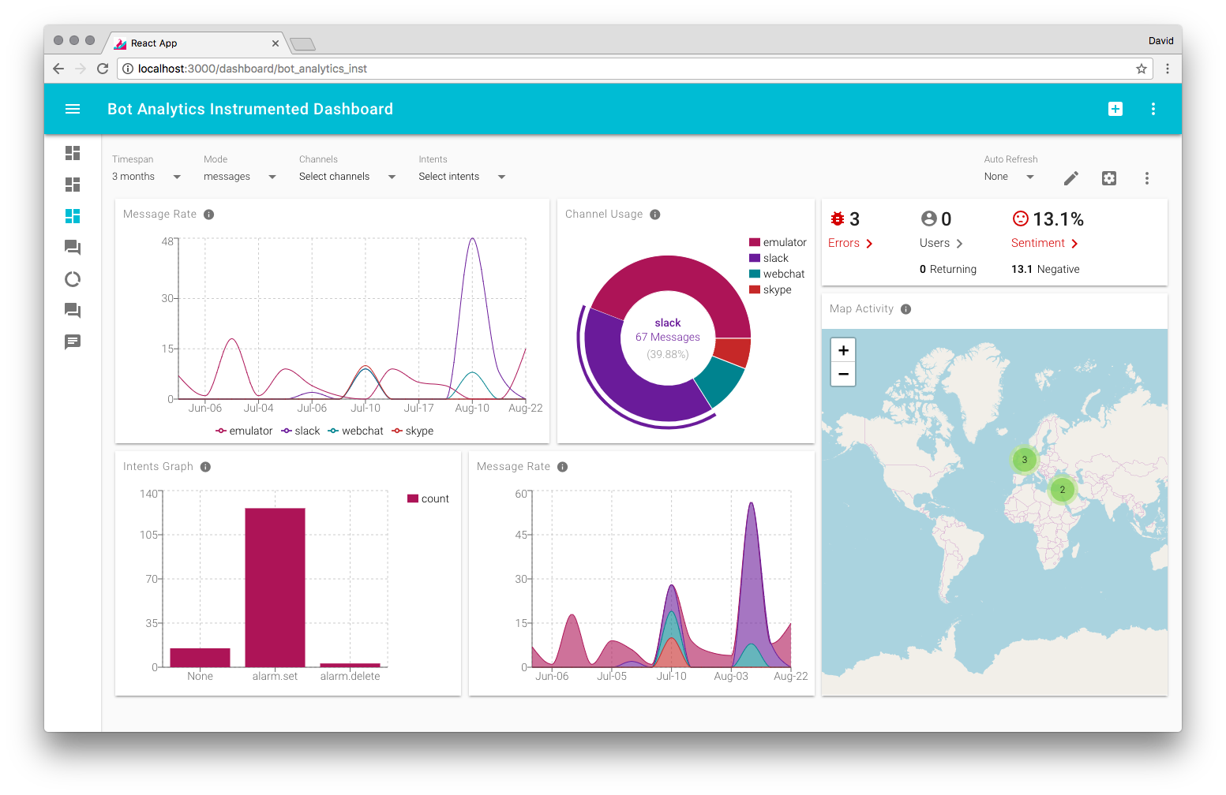
Monitoring
Example dashboard

