Slide 1
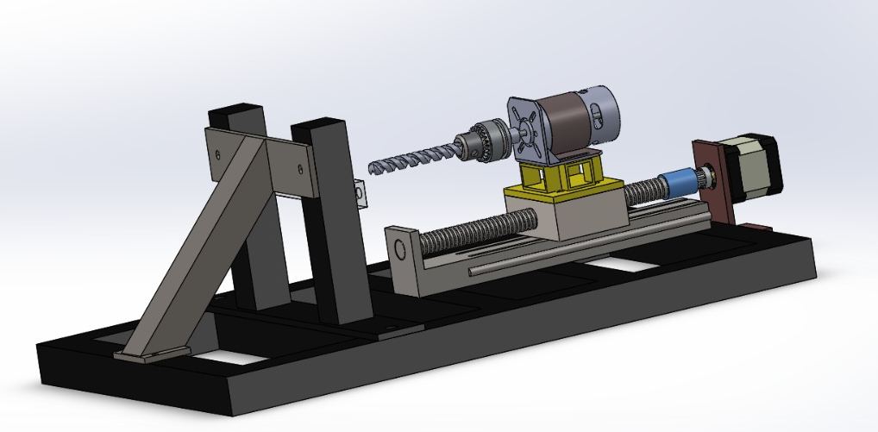
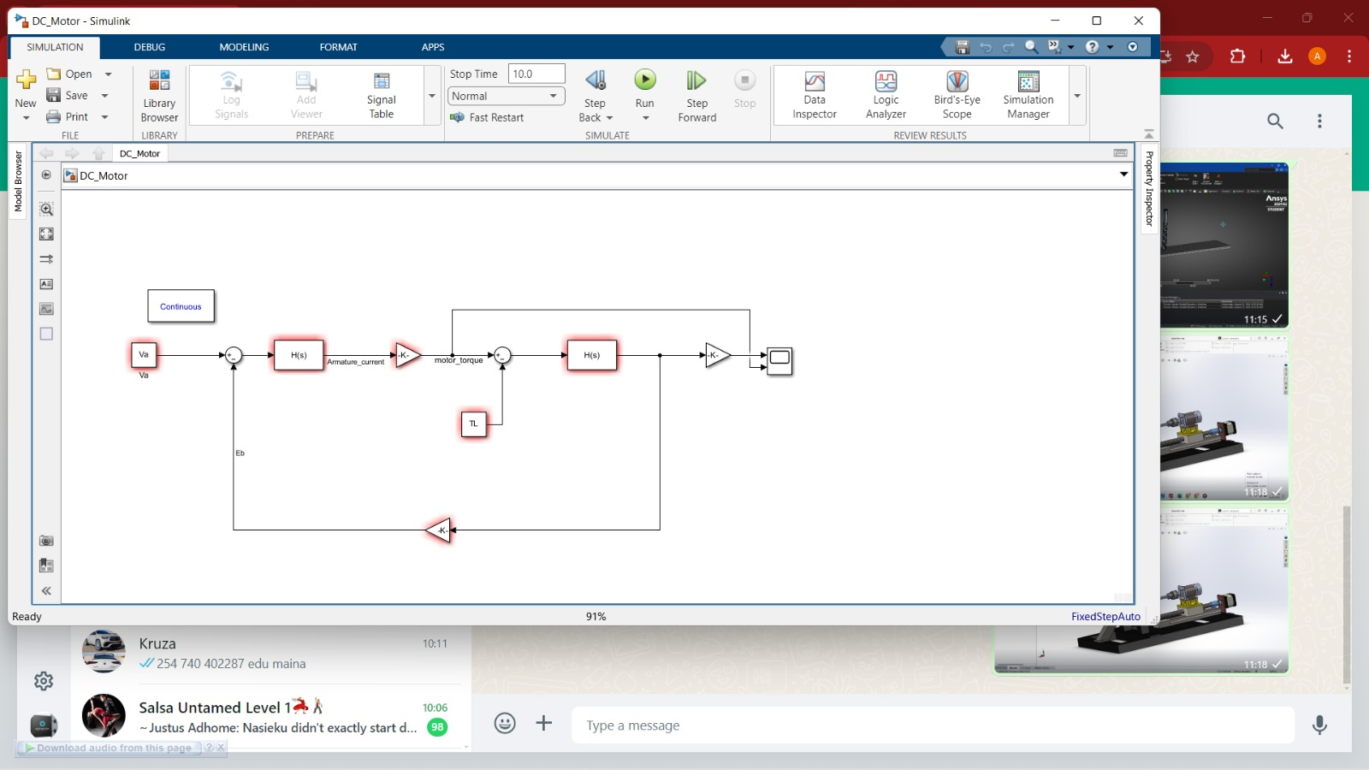
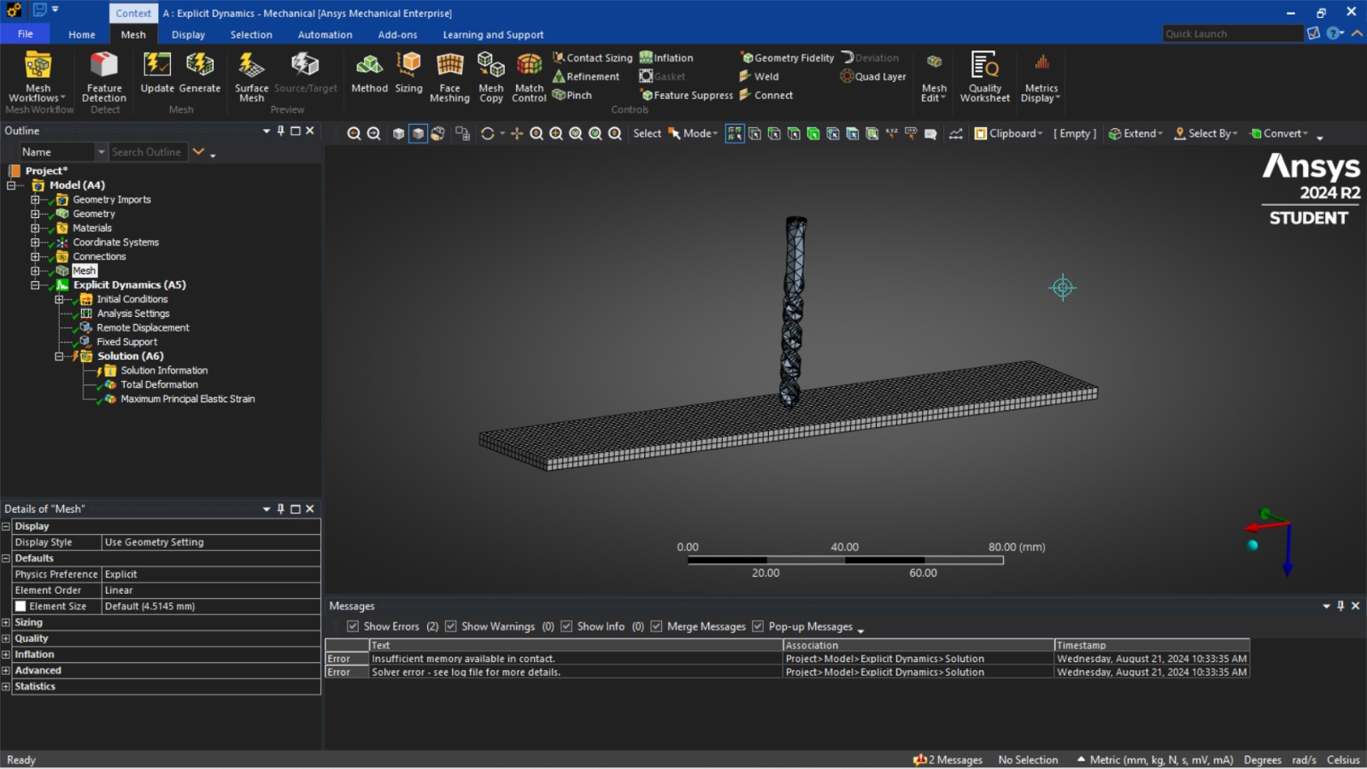
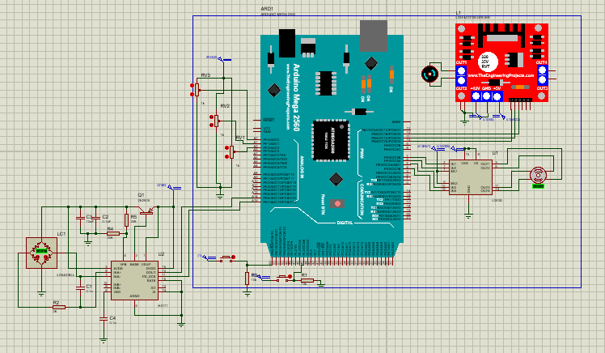
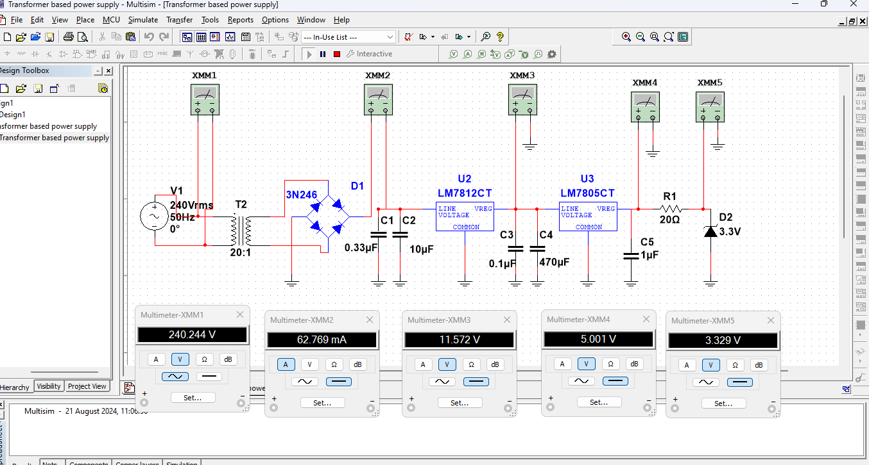
Development Of One Axis Drill
GROUP MEMBERS
Elizabeth Mugure
Fernado Ghati
Edwin Maina
John Kabi
Randy Baraka
Kenneth Wambui
22nd Aug, 2023
Supervisor: Dr. Titus Mulembo
ABSTRACT
Many industrial and medical applications call for perfectly drilled holes. The creation of an affordable, accurate drilling machine that can be used and records vibrations and forces exerted on the workpiece throughout the drilling process is essential. This research aims to improve bone drilling operations in medical applications by developing a one-axis drill system with a polymer workpiece. In order to mitigate vibration and reduce chatter or the risk of drill bit breakage, system monitoring is crucial for identifying the optimal parameters to use in system control. This involves utilizing analytical and computational resources to analyze PMMA behavior during drilling operations and guaranteeing effective material removal.
MAIN OBJECTIVE
Development of a precise automated one axis drill and determine optimal drilling parameters.
Specific Objectives
To design and simulate 3D model of the physical system.
To develop project circuits and firmware to run sensors, actuators and peripherals.
To carry out preliminary experiments and analysis to determine parameters for vibration mitigation
EXPECTED OUTCOMES
To have an efficient firmware program for the working of sensors, actuators and peripherals for precise drilling operation
To establish optimal drilling parameters from experimental and computational analysis.
To visualize forces and vibration on the PMMA with respect to drill and feed speeds
To mitigate vibrations, chatter and reduced risk of drill bit breakage and ensure efficient material removal during drilling.
METHODOLOGY
4. Importing to Matlab Simscape
1. Assessment of existing physical model
2. Development of program flowchart
Determination of drilling control parameters
Upload the program to the microcontroller
Run the experiment
Results and Data Collection
Evaluation and analysis
3. CAD Design in Solidworks
6. Programming and circuit simulation in Proteus, multisim
5. Finite element analysis in Ansys
ACHIEVEMENTS
Design of the project in Solidworks and simulation of the working motors in Matlab
Circuit design in Proteus and simulations using Multism
Development of working firmware program to read accurate real time sensor data and control dc and stepper motor.
Gui Development for motor control and sensor data display

