Slide 1
AI training course HW12
STuser19 賴昱凱

Slide 2
k-means分群演算法
將資料依照相似度分成k個群組

Slide 3
演算法
隨機取k點作為中心
計算各資料點與各中心的直線距離
將資料點納入直線距離最近的中心群組
計算群組的新中心
重複執行3、4直到中心不再變化

Slide 4
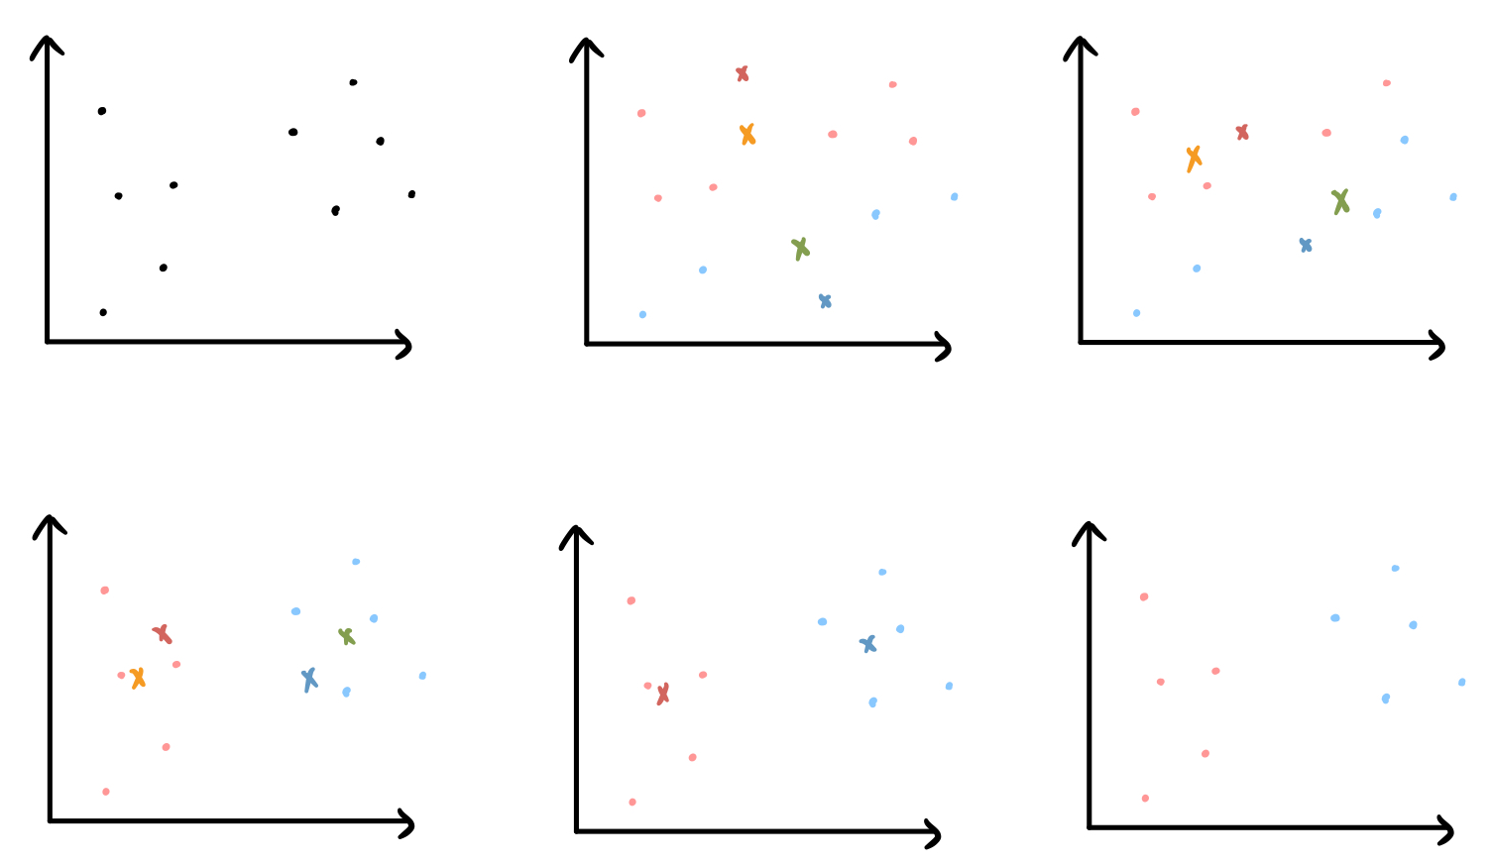
圖例(以k=2為例)
隨機取2個中心(紅藍)
分組計算新中心(橘綠)
由舊中心(紅藍)分組
計算新中心(橘綠)
由舊中心(紅藍)分組
計算新中心(橘綠)
由舊中心(紅藍)分組
計算新中心(橘綠)
中心不再變化
完成分群

Slide 5
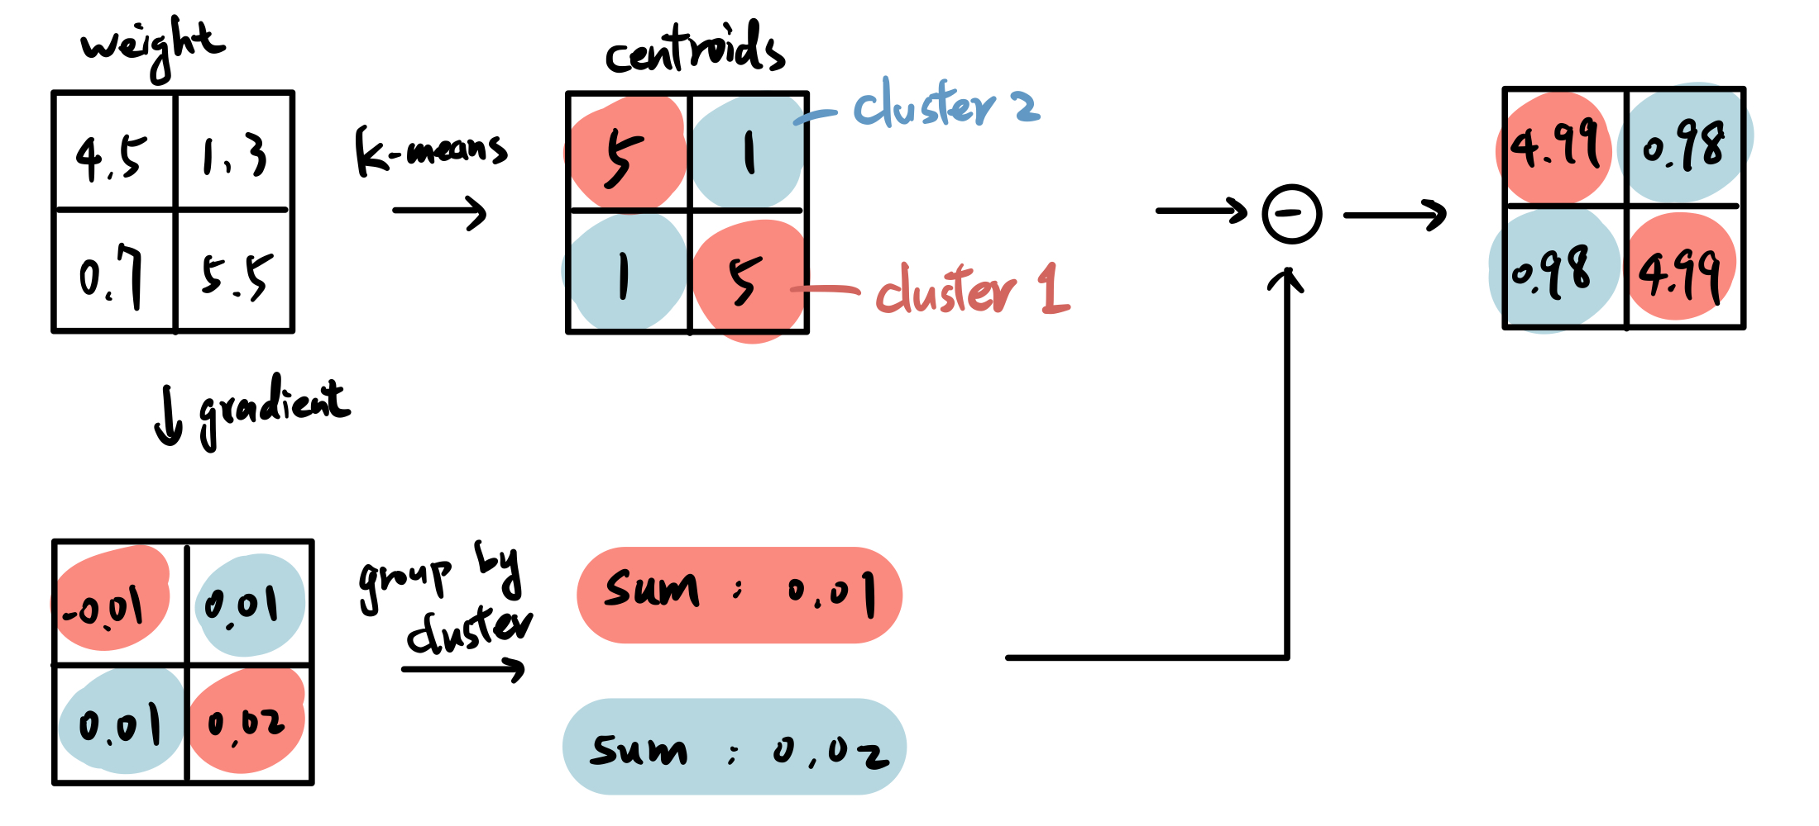
怎麼用來壓縮NN模型(一)
利用k-means將權重分群，形成k個clusters
每個Cluster中的資料皆由中心取代(可減少記憶體需求)
Fine-tuning with summation of corresponding gradients

Slide 6
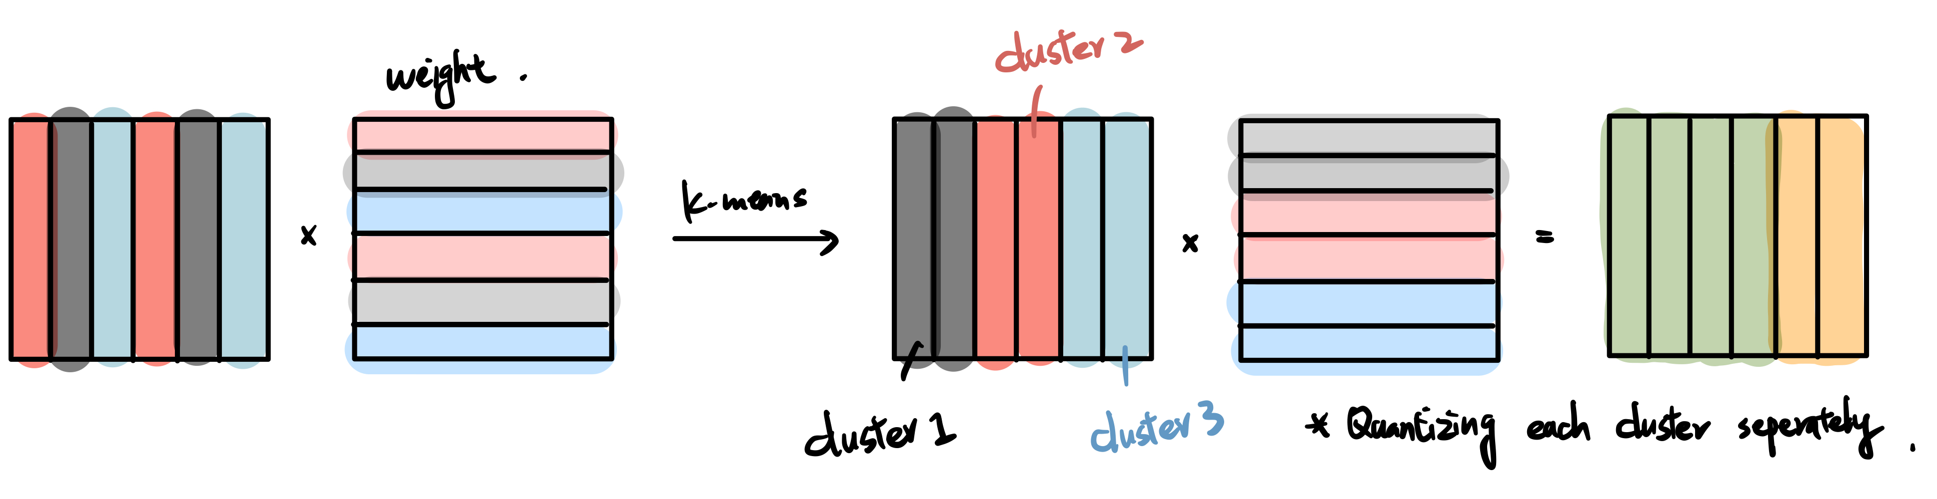
怎麼用來壓縮NN模型(二)
將data利用k-means分成k個clusters
Reorder by clusters
各clusters分別做Quantization (可降低模型壓縮後的表現缺失)

Slide 7
Quantization and Training of Neural Networks for Efficient Integer-Arithmetic-Only Inference
Benoit Jacob, Skirmantas Kligys, Bo Chen, Menglong Zhu, Matthew Tang ,Andrew Howard, Hartwig Adam, Dmitry Kalenichenko
Google Inc.

Slide 8
Introduction
現狀問題
CNN模型過大無法於mobile device使用
現有解法
新架構: MobileNet、SqueezeNet、ShuffleNet、DenseNet等
Quantization: 用低位元降低儲存成本
現有Quantization缺陷
過度參數化的模型易壓縮，較無參考價值: AlexNet等
未於硬體驗證效果，且主要著重於減少儲存而非增加速度

Slide 9
Specific Contributions
Quantization scheme
weight、activation: 8-bit int, Bias: 32-bit int
Quantized inference framework
於int-only hardware實現高效運算
Quantized training framework
low-precision fixed-point arithmetic
benchmark results
基於MobileNet在ARM CPU執行，ImageNet及COCO表現優異平衡

Slide 10
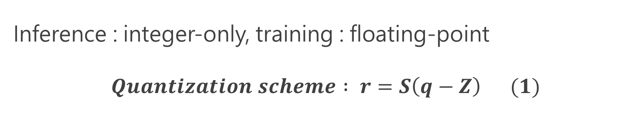
Quantized Scheme
Inference : integer-only, training : floating-point
$$Quantization scheme : r=S\left(q−Z\right) (1)$$
r : real number
q : integer (quantized values)
S : positive real number (const)
Z : integer corresponding to r = 0 (zero-point, const)

Slide 11
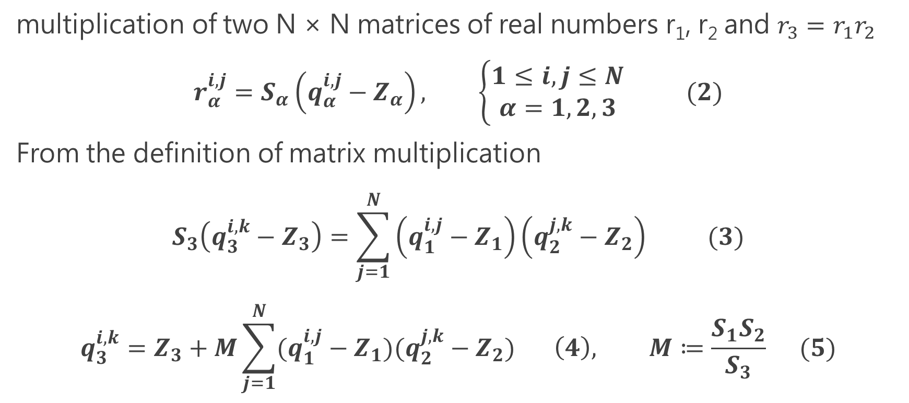
Integer-arithmetic-only matrix multiplication
multiplication of two N × N matrices of real numbers r₁, r₂ and $r_{3}=r_{1}r_{2}$
$$r_{α}^{i,j}=S_{α}\left(q_{α}^{i,j}−Z_{α}\right), \left\{\begin{aligned}1≤i, j≤N \\ α=1,2,3\end{aligned}\right. (2)$$
From the definition of matrix multiplication
$$S_{3}\left(q_{3}^{i,k}−Z_{3}\right)=\sum_{j=1}^{N}{\left(q_{1}^{i,j}−Z_{1}\right)\left(q_{2}^{j,k}−Z_{2}\right)} (3)$$
$$q_{3}^{i,k}=Z_{3}+M\sum_{j=1}^{N}{(q_{1}^{i,j}−Z_{1})(q_{2}^{j,k}−Z_{2})} \left(4\right), M≔\frac{S_{1}S_{2}}{S_{3}} (5)$$

Slide 12
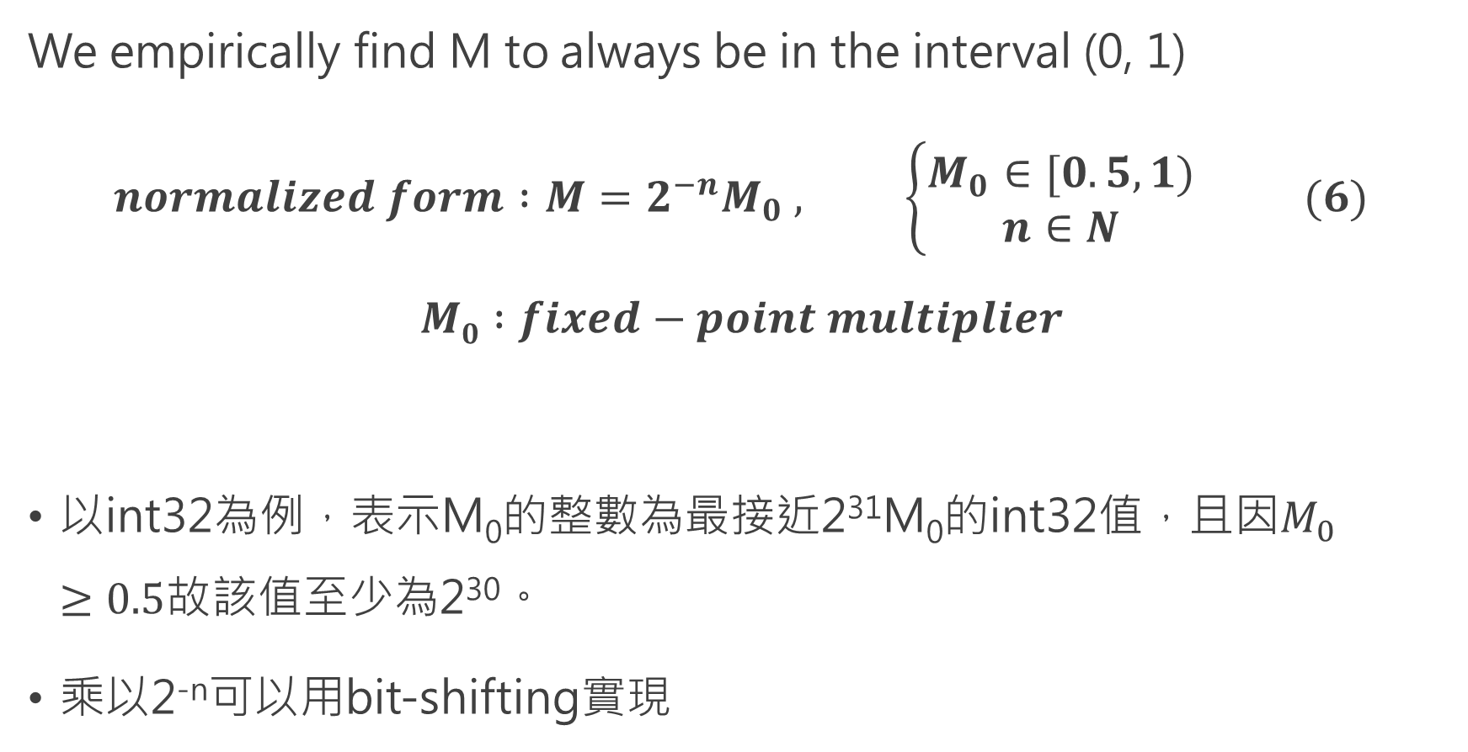
We empirically find M to always be in the interval (0, 1)
$$normalized form :M=2^{−n}M_{0} , \left\{\begin{aligned}M_{0}∈[0.5, 1) \\ n∈N\end{aligned}\right. (6)$$
$$M0 :fixed−point multiplier$$
以int32為例，表示M₀的整數為最接近2³¹M₀的int32值，且因$M_{0}≥0.5故$該值至少為2³⁰。
乘以2^{-n}可以用bit-shifting實現

Slide 13
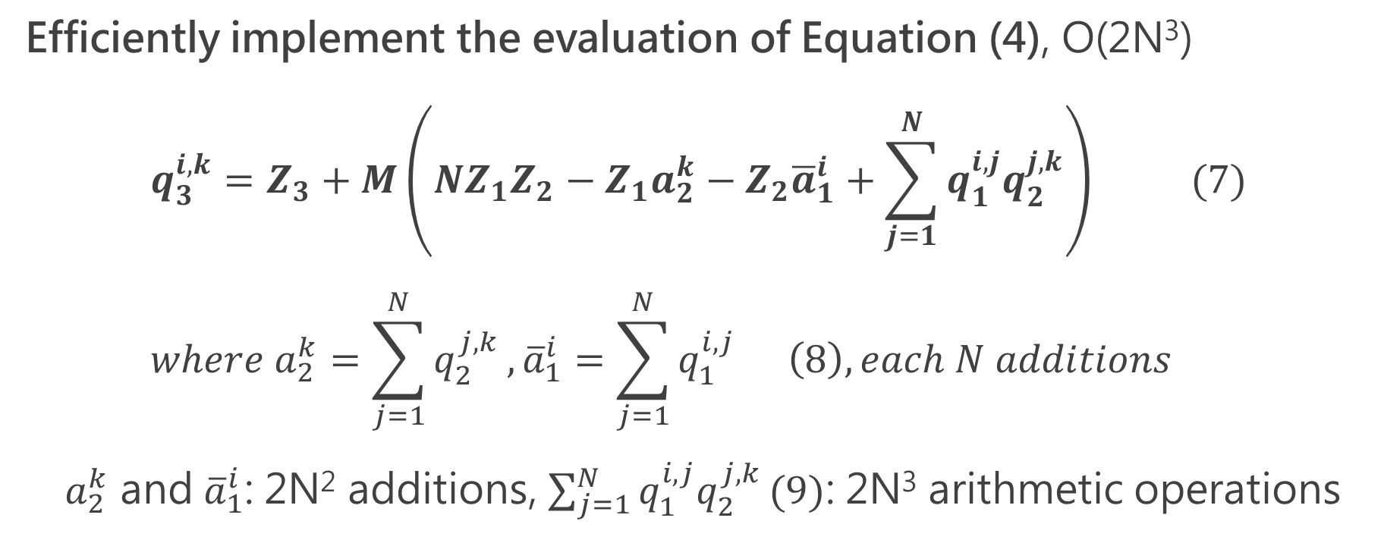
Efficient handling of zero-points
Efficiently implement the evaluation of Equation (4), O(2N³)
$$q_{3}^{i,k}=Z_{3}+M\left(NZ_{1}Z_{2}−Z_{1}a_{2}^{k}−Z_{2}{\overline{a}}_{1}^{i}+\sum_{j=1}^{N}{q_{1}^{i,j}q_{2}^{j,k}}\right) (7) \\ where{ a}_{2}^{k}=\sum_{j=1}^{N}{q_{2}^{j,k}}, {\overline{a}}_{1}^{i}=\sum_{j=1}^{N}{q_{1}^{i,j}} \left(8\right), each N additions$$
${ a}_{2}^{k}$ and ${\overline{a}}_{1}^{i}$: 2N² additions, $\sum_{j=1}^{N}{q_{1}^{i,j}q_{2}^{j,k}}(9)$: 2N³ arithmetic operations

Slide 14
Implementation of a typical fused layer
將bias-addition、activation 融合至矩陣乘法
Weights and activations use uint8 or int8
Accumulator uses int32 to store (uint8 * uint8)
Bias vector is quantized to int32 with S_{bias} = S₁S₂ , Z=0
Output: int32 → int8 [0, 225] (fixed-point multiplication)

Slide 15
Training with simulated quantization
Inference with int、training with FP 的缺點
小模型表現差
數值範圍小的weight誤差大
異常值使精度降低
解法
在forward中simulates quantization，並維持bias、weight用FP
Weights are quantized before ConV.
Activations are quantized at points they would be during inference

Slide 16
Learning quantization ranges
Weight Quantization
範圍由[min w, max w] 量化為 [−127, 127]
Activation Quantization
由Training及EMA找範圍[a, b]。訓練初期不使用防止遺失重要數值
Boundary Adjustment
微調[a, b] 確保 0.0 在量化後精確表示為integer
Quantization in TensorFlow
training使用simulated quantization，inference使用low-bit quantization

Slide 17
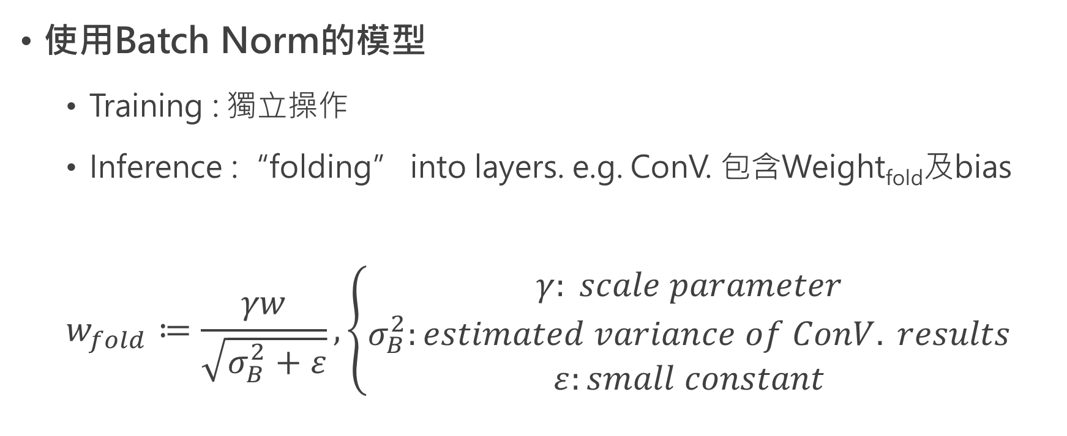
Batch normalization folding
使用Batch Norm的模型
Training : 獨立操作
Inference :“folding” into layers. e.g. ConV. 包含Weight_{fold}及bias
$$w_{fold}≔\frac{γw}{\sqrt{σ_{B}^{2}+ε}}, \left\{\begin{aligned}γ: scale parameter \\ σ_{B}^{2}:estimated variance of ConV. results \\ ε:small constant\end{aligned}\right.$$

Slide 18
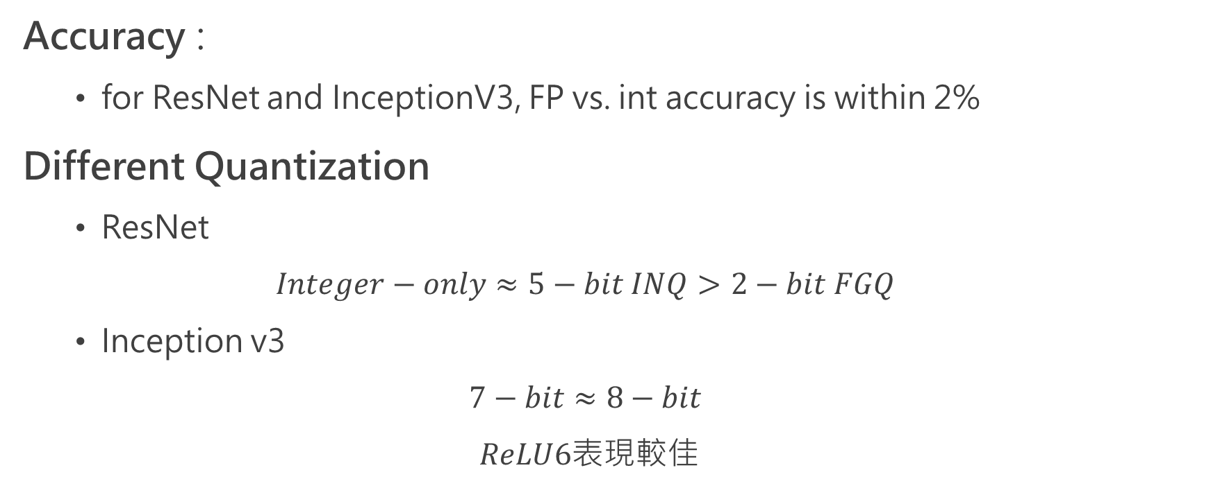
EXP-Quantized training of Large Networks
Accuracy :
for ResNet and InceptionV3, FP vs. int accuracy is within 2%
Different Quantization
ResNet
$$Integer−only≈5−bit INQ>2−bit FGQ$$
Inception v3
$$7−bit≈8−bit$$
$$ReLU6表現較佳$$

Slide 19
EXP-Quantization of MobileNets
MobileNet Quantization (within the same runtime)
accuracy : Integer-only quantized > floating-point models for ~10%
Snapdragon 835 LITTLE cores : 33ms latency for real-time (30 fps) operation
COCO Object Detection
2x speedup with only ~1.8% accuracy loss
Face Detection and Attribute Classification
reduce latency by~2x with only ~2% accuracy loss
Single, Multi core 皆有大幅加速

