Slide 1
AI-Powered Automatic Scoring System for 2-player Toy Bowling
Introduction to AI: Final Project
組員：賴昱凱、周宥任、温蕙瑄

Slide 2
Table of contents
01
02
03
04
05
Motivation
Problem formulation
Proposed Model
Experimental Results
Live Demo

Slide 3
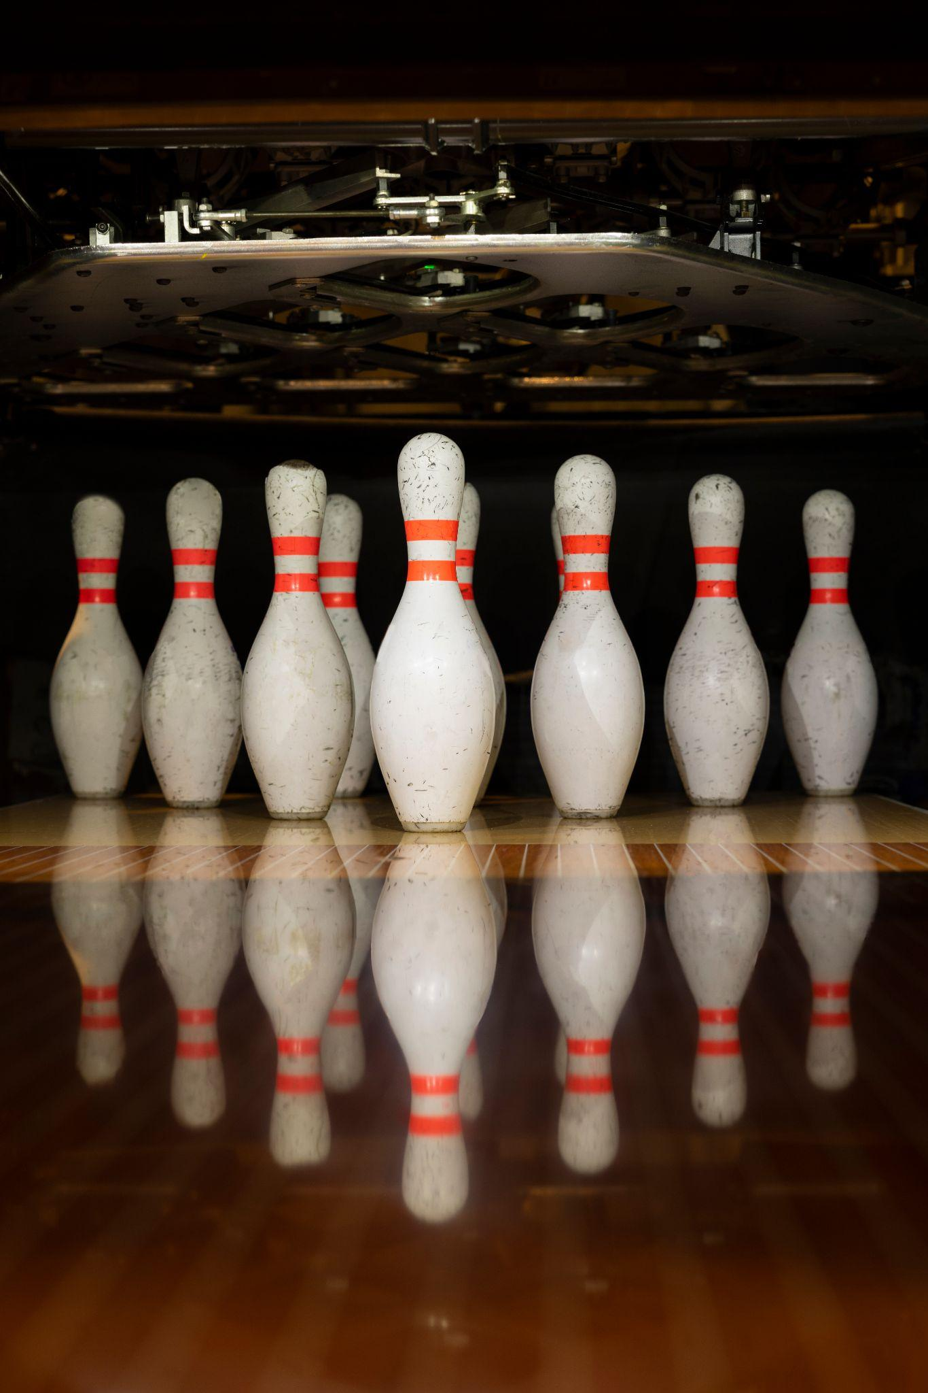
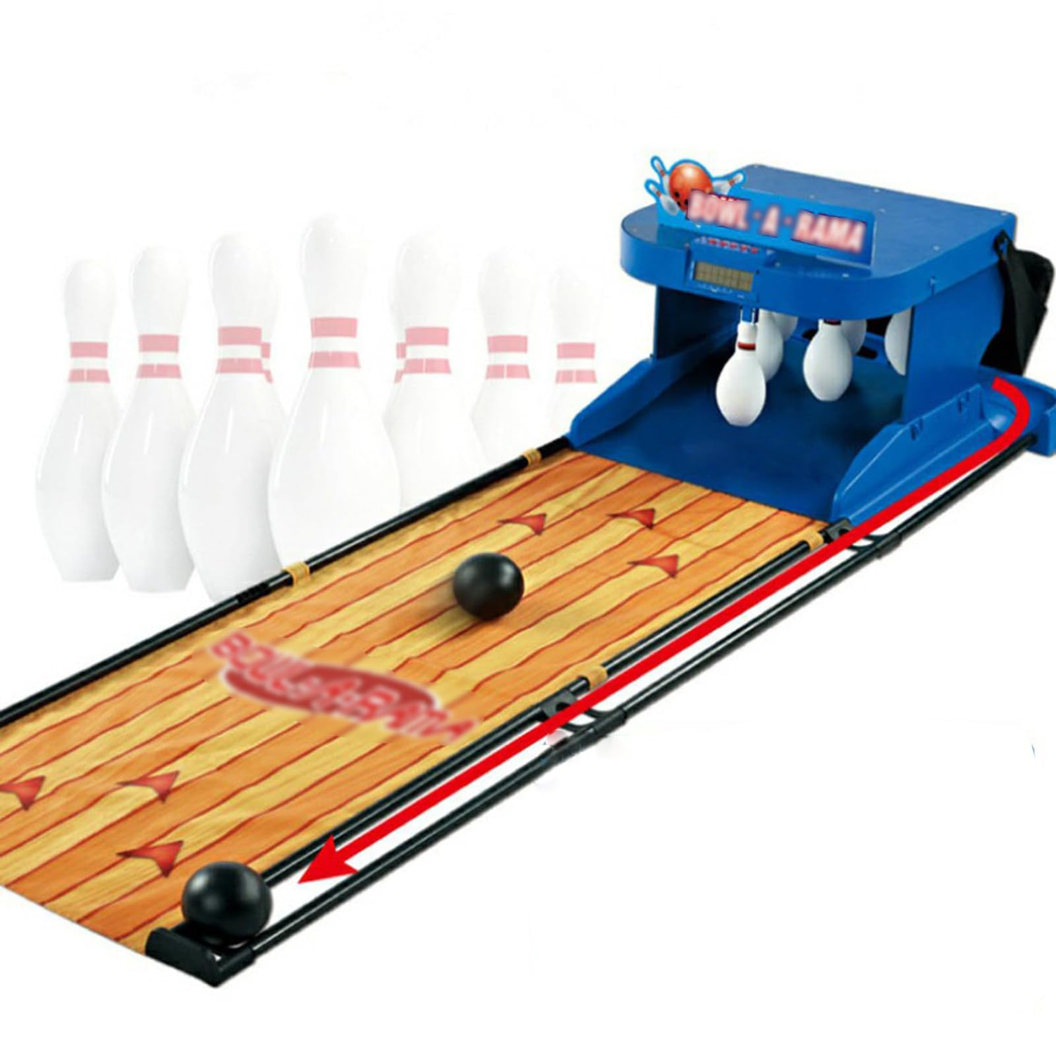






Motivation and Goal
保齡球是一項熱門的休閒活動，但只能在保齡球館進行，或是購買家用保齡球玩具套組。
如果使用寶特瓶與球來DIY保齡球，會需要麻煩的人工計分。
我們希望整合AI影像辨識，設計一個只需電腦與手機鏡頭就能運作的居家保齡球自動計分系統。
低成本！超方便！簡單好用！

Slide 4
Problem Formulation: System Design
Start
For later player identification
Track Current Player
Wrong Player
Player Registration
Once see the ball
Track Ball
Once see the bottles
Track Standing Bottles
Count the bottles
Count Score
Can’t find bottles in 5s: Strike
Switch Player if strike or done two throws
End
All frames are played
Play Again

Slide 5


Problem Formulation: Critical Problems
Player Recognition
Tracking System
Scoring System
為了可以實現自動計分中對每個玩家分開計分的功能，需要在簡單的註冊後就可以即時並高準確度的分辨不同的玩家。
遊玩的過程需要即時、精準、穩定的偵測到玩家、球、瓶在螢幕中的位置，才能準確的判斷並切換遊戲階段。
建立一個符合保齡球規則的計分邏輯。

Slide 6
Proposed Model: Player Recognition
目標：能夠根據少量玩家影像，完成即時、高精準度的玩家辨識系統。
參考模型：
  One-Shot Learning：讓模型在極少樣本(一張)的狀況下也可以學會分類新類別，通常不靠訓練，而是靠比較輸入與樣本的相似度。
  Person Re-identification：讓模型在不同的姿勢、鏡頭、背景、遮擋等狀況下，也能找出同一個人，需要模型穩定學習目標的外觀(通常是衣著造型)而不被環境影響。

Slide 7
Proposed Model: Player Recognition
模型設計：Few-Shot + Re-id
  實作One-shot後，發現打球時人面對鏡頭的角度會變化，只拍一個角度無法涵蓋所有狀況。
  ->改為Few-Shot拍攝前後左右四個角度。
  非正對鏡頭的角度臉部不清楚。
  ->參考Re-id概念，針對衣服顏色建立Prototype Set。
  使用Cosine Similarity計算人物與所有Prototype Set的相似度並計算分數。
  利用Greedy演算法，依序分配分數最高的人物標籤給畫面中的人。

Slide 8
Proposed Model: Player Recognition
Player Registration
Tracking Player Query
Few-Shot: Multi-angle
Yolo get_person_crops
Get person’s cropped image
Yolo get_person_crops
Same Feature Extraction
Get Clothes information
Torso Crop
Hybrid feature
Backbone Model
Get Color Distribution
TTA+Deep Embedding
Torso HSV Histogram
Cosine Similarity
Hybrid feature
Combine Info
Max Sim
Mean Sim
Prototype Set
Score

Slide 9
Experimental Results: Player Recognition
可以穩定且正確的辨識出已註冊玩家。
多位已註冊玩家同時出現在畫面中，可以穩定且正確辨識出每個人的身分。
非註冊人物出現在畫面中可以穩定的被辨識為Unknown。

Slide 10
Proposed Model: Tracking System
目標：能夠及時偵測玩家、球、瓶子的狀態，自動判斷遊戲階段(投擲、計分、換人)。
前置問題：保齡球遊戲空間狹長，手機鏡頭難以拍攝到完整場景，或是物體會因距離太遠，辨識效果不佳。
解法設計：結合Arduino與伺服馬達，設計手機鏡頭自動追蹤雲台，旋轉手機以持續追蹤物體。
180˚馬達
手機
左右旋轉
上下旋轉
360˚馬達
Arduino

Slide 11
Proposed Model: Tracking System
目標：能夠及時偵測玩家、球、瓶子的狀態，自動判斷遊戲階段(投擲、計分、換人)。
參考模型：yolov11
  直接使用yolov11進行物件的追蹤辨識，發現可追蹤到一定程度的物件，但需要選擇較大的模型表現較好，小模型(11n、11s)無法辨識出較遠的物件。
模型設計：yolov11+finetune
  因為只需要辨識人、球、瓶子三個類別，不需要用到完整的yolo，故設計針對這三個label進行finetune。

Slide 12
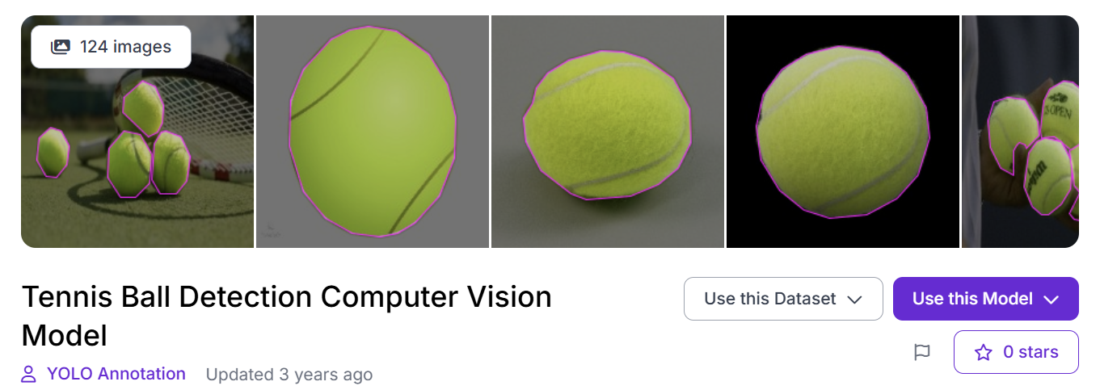
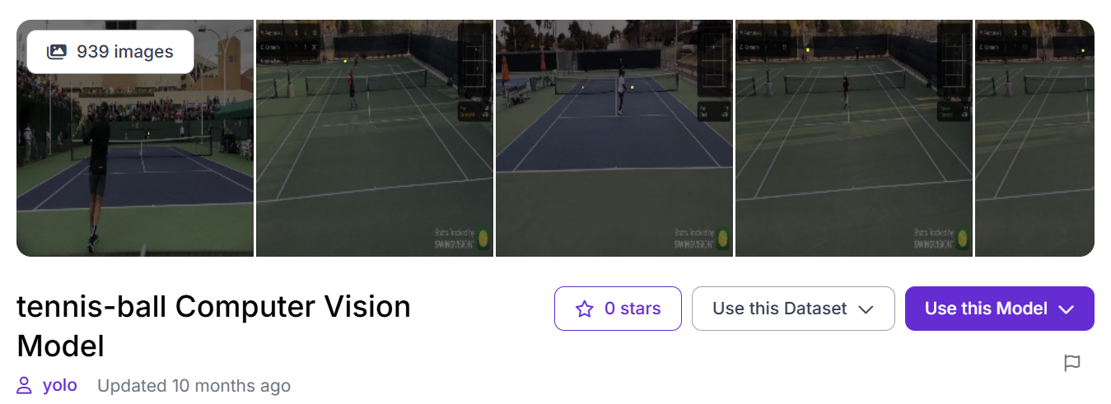
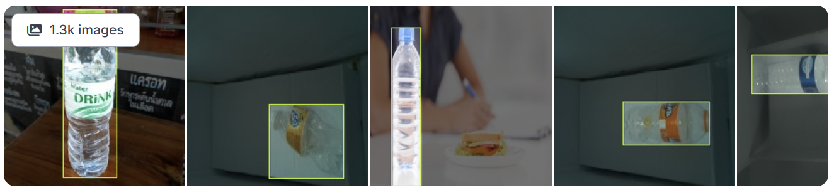
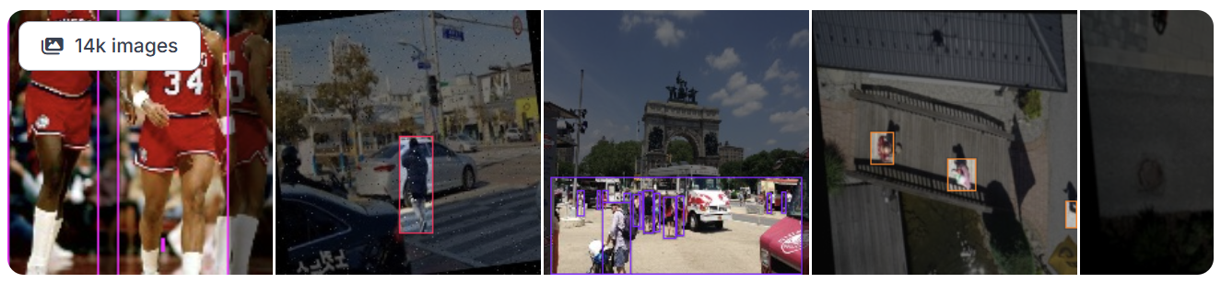
Experimental Results: Tracking System
實驗一：直接使用線上公開dataset。
    Dataset
      Roboflow Public Datasets
    Model：yolov11n?s?
    Testing Result：[Testing正確率]
    Performance：可以辨識人，但球與瓶子需要很靠近鏡頭才能辨識成功。發現現成Dataset中的球與瓶子大小與實際遊玩情況不同。整體而言比Pretrain效果差。

Slide 13
Experimental Results: Tracking System
實驗二：網路公開dataset + 隨機縮小Augmentation
    Dataset
      Roboflow Public Datasets
    Model：yolov11n?s?
    Testing Result：[Testing正確率]
    Performance：辨識人與瓶子效果好，但球在移動時會因模糊難以辨識。

Slide 14
Experimental Results: Tracking System
實驗三：網路公開dataset + 隨機縮小Augmentation + 自行拍攝Data
    Dataset
      Roboflow Public Datasets
      自行拍攝與標註不同角度人物(針對側面與下半身)、球(針對移動中模糊的球)、瓶子(針對站立、重疊的瓶子)。
    Model：yolov11n?s?
    Testing Result：[Testing正確率]
    Performance：比Pretrain更能適應遊戲中物體的大小與移動情況。

Slide 15
Live Demo Time !

Slide 16
Our goals
Short term
Long term
Our main goals now are to increase sales through improved marketing and customer outreach, optimize operational processes to reduce costs and increase efficiency and establish a timeline for new products
The overall goal of the company is to expand into new markets or geographies, develop and implement a strategy to reduce environmental impact and increase sustainability and increase market share

Slide 17
Our guiding principles
Integrity
Customer focus
For us, integrity means operating with honesty, trustworthiness, and strong moral values. We commit to ethical and environmental standards
We put customers at the center of everything they do. We listen to customer feedback and incorporate it into decisions, products and services
Collaboration
Innovation
We create an environment where employees can work together productively and efficiently to achieve common objectives. It involves sharing knowledge and skills
Innovation is an integral part of our company’s culture and is essential for success. It means us coming up with new ideas, methods, and products that can grow the business

Slide 18
Competitor analysis
Features
Pricing
Customer feedback
Compare features and benefits of your product
Analyze your competitors’ pricing and offers
Examine the feedback
on their products
Monitoring
Emerging trends
Organic search
Keep an eye on their offers
and launches
Identify emerging trends in your industry
How are your competitors optimizing their SEO?

Slide 19
333,000
5m 23s
3 languages
New Instagram followers
Average reading time on our posts
We publish our content in different languages for more reach

Slide 20
123,123
New leads during
the last month

Slide 21
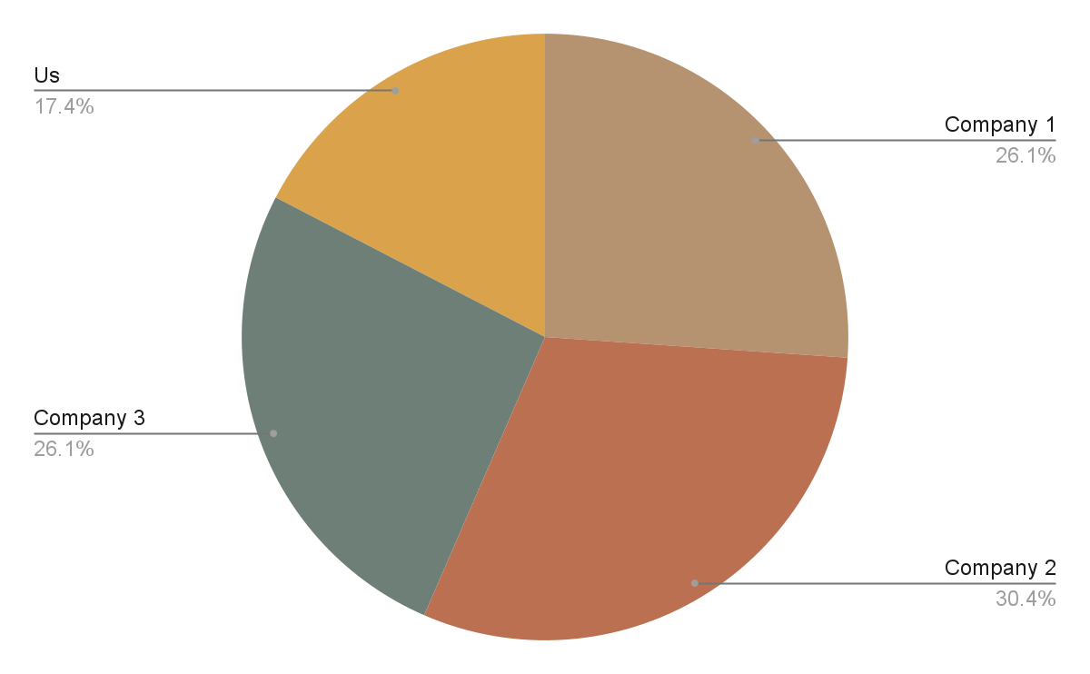
Market share
Here’s the market share of our industry
Market share is the percentage of a market that is controlled by a particular company or industry. It is calculated by dividing the total sales revenue of a company by the total sales revenue generated in the
entire industry
Follow the link in the graph to modify its data and then paste the new one here. For more info, click here

Slide 22
Key action items
 | First quarter | Second quarter | Third quarter
Key action 1 | Create detailed procedures | Monitor and review process performance | Measure the effectiveness of processes
Key action 2 | Use data analytics to gain insights | Develop strategies to reduce waste | Stay up to date with new technologies and trends
Key action 3 | Invest in technology solutions for automation | Establish control of spend and reduce overhead | Foster an environment of collaboration
Key action 4 | Focus on continuous improvement | Ensure proper management of resources | Research best practices from outside

Slide 23
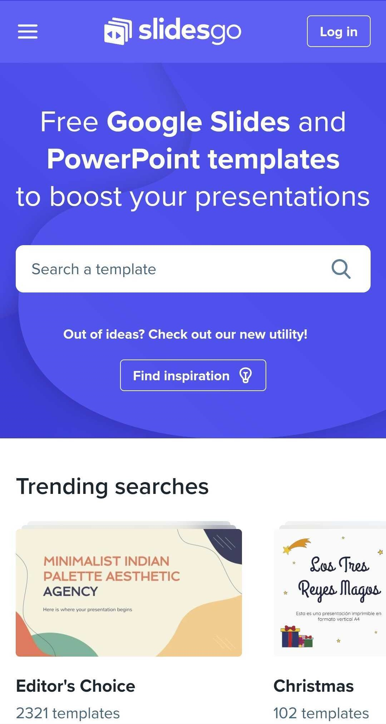
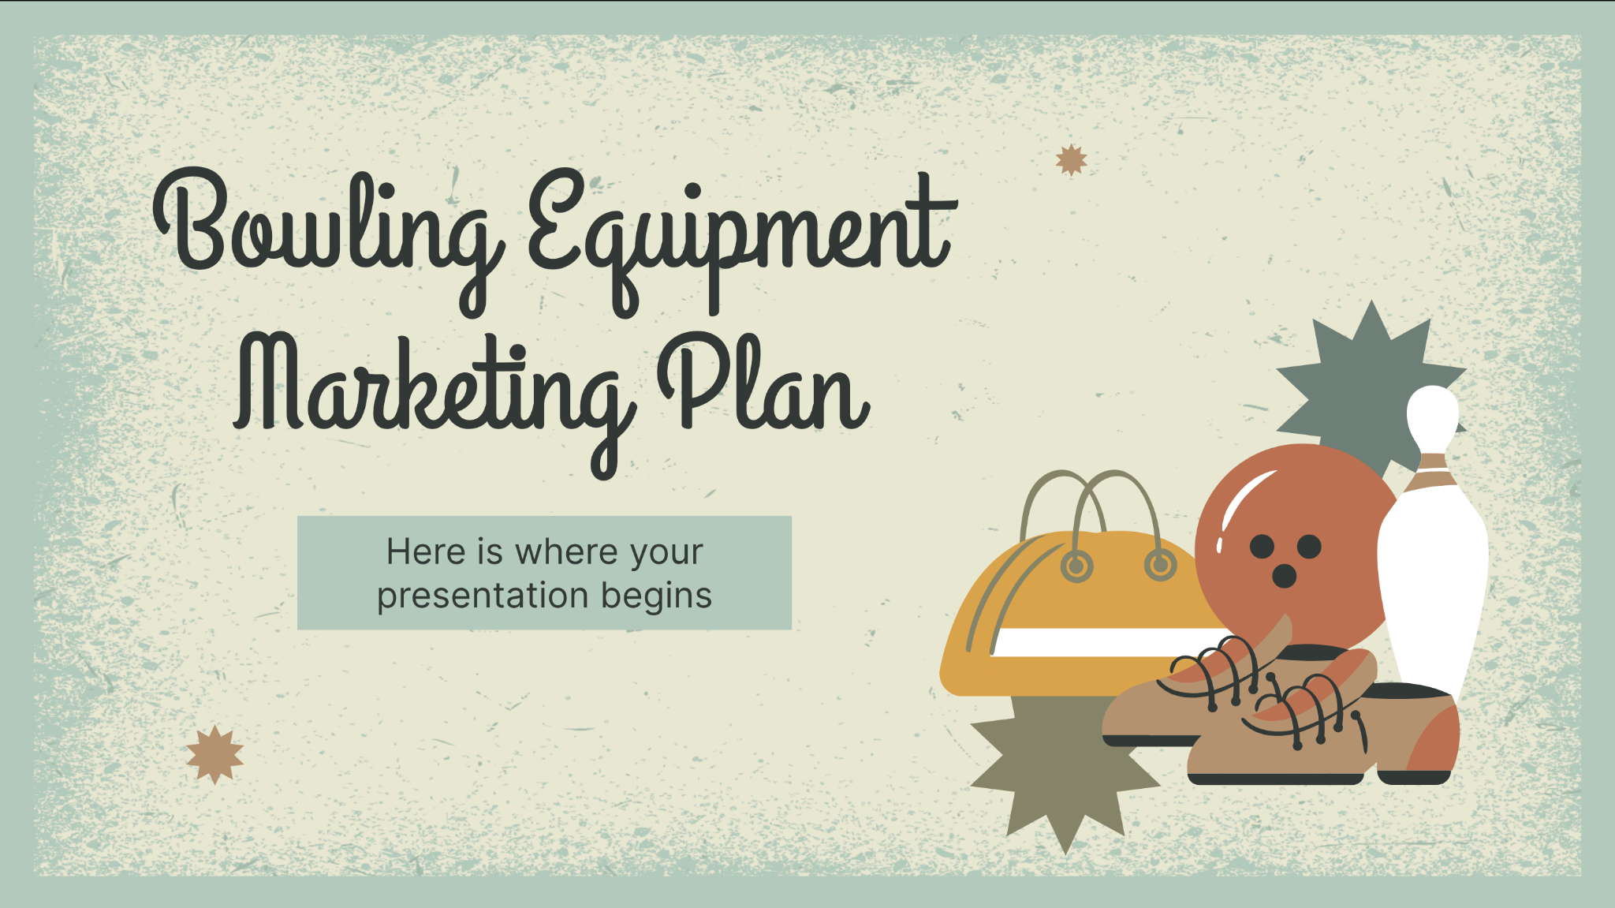
What to show in a mockup
1
Product/website description:
A brief overview of the product/website, including its key features, dimensions, and materials used
Features and benefits: A detailed explanation of the features and how they will benefit the user
Technical specifications: A list of the product's/website's technical specifications, such as dimensions, weight, power requirements, connectivity options and hosting platform
2
3

Slide 24

Buyer persona infographic
“This is a quote, words full of wisdom that can make the reader get inspired.”
Motivations
1
Creativity
2
Ecology
Name
Personality
Age and occupation
Explorer, adventurous. Likes the outdoors and camping
Engaged on social media, speaks for themselves
Not easily influenced by ads or social media
3
Music
Bio
Pain points
Make a short description of what a typical customer would be. Be precise!
Knowing your buyer persona’s pain point will help you create messages that are tailored to their needs

Slide 25
Roadmap infographic
Initiative | Objective | Jan | Feb | Mar | Apr | May | Jun | Jul | Aug | Sep | Oct | Nov | Dec
Understanding | Analyze and understand the needs of your target audience
Conduct research | Research existing products in the industry and analyze how successful they are
Brainstorm ideas | Generate ideas based on user feedback and research findings
Develop a prototype | Create a basic version of the product to show investors
Test for usability | Put the prototype through rigorous testing processes to ensure that it meets user requirements
Analyze feedback | Analyze feedback

Slide 26
Market size overview
Outer circle
$100M
Include the total size of the market, which represents the entire potential customer base for the product or service
$20M
Middle circle
Identify the target market for the product or service, which may be a subset of the total market. This could be based on factors such as demographics, geography, or specific needs
$5M
Inner circle
Indicate the current market size, which represents the portion of the target market that the company has successfully captured

Slide 27
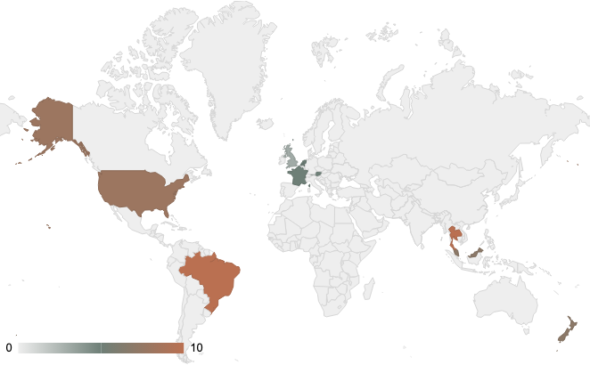
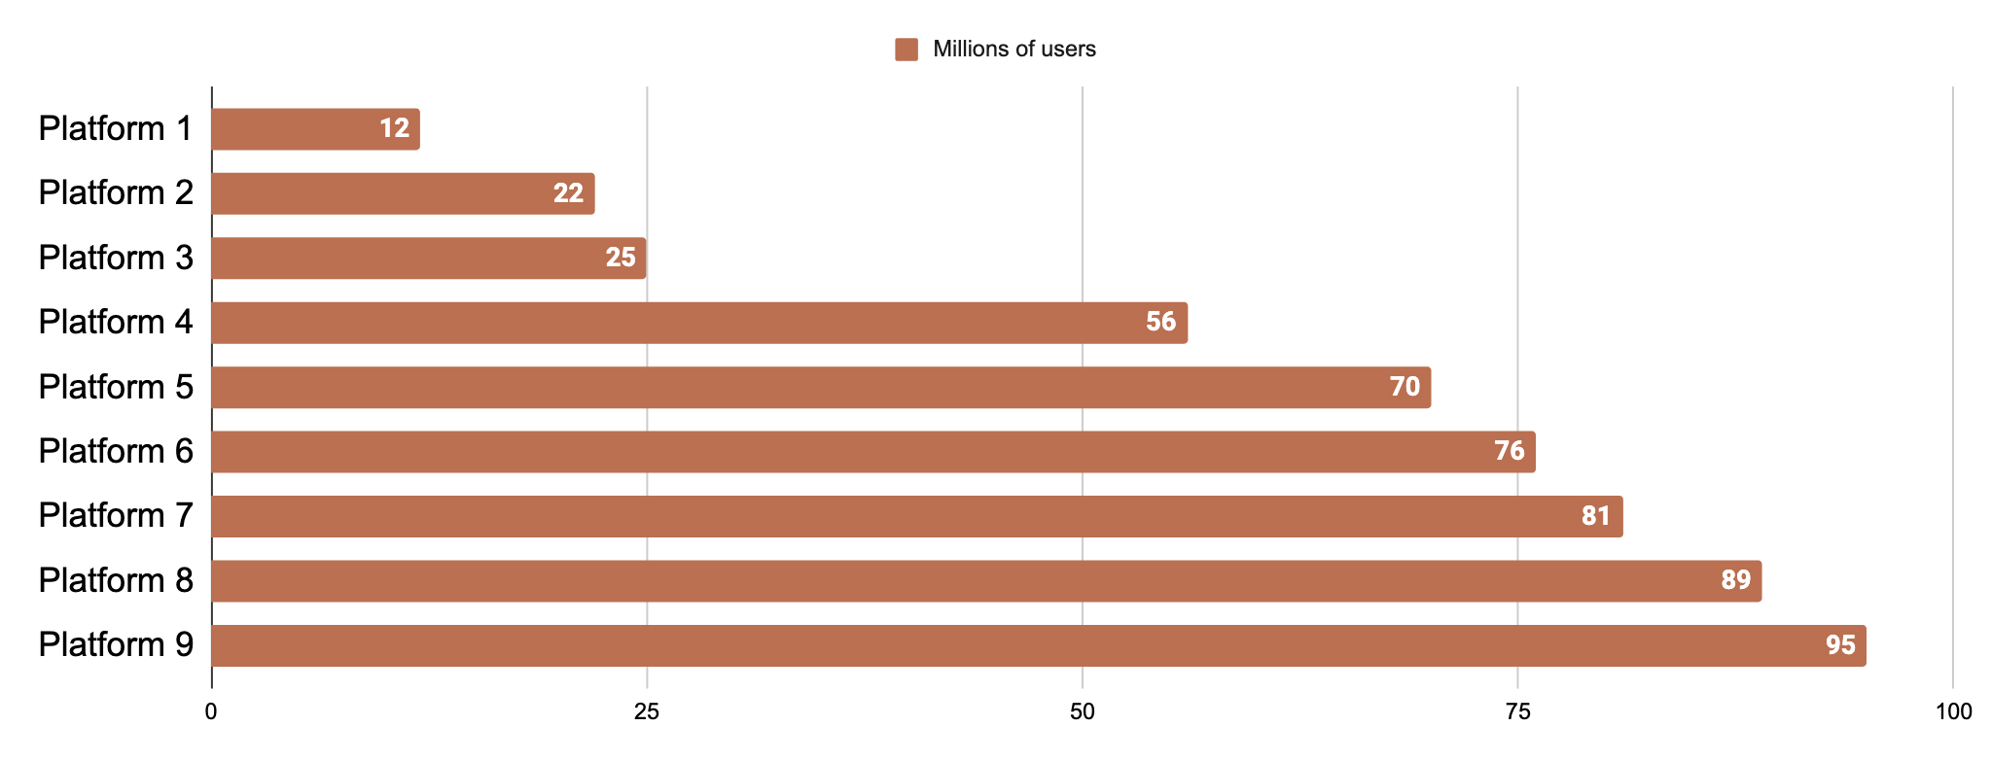
Social media stats
Worldwide reach
xxx billion
xh xmin
xx
Users worldwide
Average
time spent
Number of platforms used
Platforms with most users
xxx billion
xxx billion
Country 1 users
Country 2 users
Follow the link in the graph to modify its data and then paste the new one here. For more info, click here

Slide 28
Case studies
Instagram giveaway
Results
A product giveaway for our second anniversary
23%
80%
10%
Increase in shares
Increase in followers
Increase in clicks
Approach
Preparing a set of posts and stories we can share on Instagram to let more people know about our brand
We can get shared more and maybe reach virality if our content is attractive and easy to share
Content posted on weekdays is shared more
Key takeaway 1
We must design new content to keep new users
Key takeaway 2

Slide 29
Thanks
Do you have any questions?
youremail@freepik.com
+91 620 421 838
yourwebsite.com
Please keep this slide for attribution

Slide 30
Icon pack

Slide 31
Alternative resources
Here’s an assortment of alternative resources whose style fits that of this template:
Vectors
Bowling game facebook cover template
Bowling game landing page template

Slide 32
Resources
Did you like the resources on this template? Get them for free at our other websites:
Vectors
Hand drawn bowling facebook cover template
Hand drawn bowling twitch banner template
Vintage grunge texture
Grunge poster background with scratches, spots and textured frame
Photos
Bowling equipment indoors still life
Portrait of woman dressed in 80s aesthetic
Icon
Bowling elements icon pack fill

Slide 33
Instructions for use (premium users)
As a Premium user, you can use this template without attributing Slidesgo or keeping the "Thanks" slide.
You are allowed to:
Modify this template.
Use it for both personal and commercial purposes.
Hide or delete the “Thanks” slide and the mention to Slidesgo in the credits.
Share this template in an editable format with people who are not part of your team.
You are not allowed to:
Sublicense, sell or rent this Slidesgo Template (or a modified version of this Slidesgo Template).
Distribute this Slidesgo Template (or a modified version of this Slidesgo Template) or include it in a database or in any other product or service that offers downloadable images, icons or presentations that may be subject to distribution or resale.
Use any of the elements that are part of this Slidesgo Template in an isolated and separated way from this Template.
Register any of the elements that are part of this template as a trademark or logo, or register it as a work in an intellectual property registry or similar.
For more information about editing slides, please read our FAQs or visit our blog:
https://slidesgo.com/faqs and https://slidesgo.com/slidesgo-school

Slide 34
Instructions for use
If you have a free account, in order to use this template, you must credit Slidesgo by keeping the Thanks slide. Please refer to the next slide to read the instructions for premium users.
As a Free user, you are allowed to:
Modify this template.
Use it for both personal and commercial projects.
You are not allowed to:
Sublicense, sell or rent any of Slidesgo Content (or a modified version of Slidesgo Content).
Distribute Slidesgo Content unless it has been expressly authorized by Slidesgo.
Include Slidesgo Content in an online or offline database or file.
Offer Slidesgo templates (or modified versions of Slidesgo templates) for download.
Acquire the copyright of Slidesgo Content.
For more information about editing slides, please read our FAQs or visit our blog:
https://slidesgo.com/faqs and https://slidesgo.com/slidesgo-school

Slide 35
Fonts & colors used
This presentation has been made using the following fonts:
Grand Hotel
(https://fonts.google.com/specimen/Grand+Hotel)
Inter
(https://fonts.google.com/specimen/Inter)
#313835
#6e7f77
#868568
#b59270
#daa34b
#ba7051
#e8e6d1
#b2c9bc
#ffffff

Slide 36





Storyset
Create your Story with our illustrated concepts. Choose the style you like the most, edit its colors, pick the background and layers you want to show and bring them to life with the animator panel! It will boost your presentation. Check out how it works.
Pana
Amico
Bro
Rafiki
Cuate

Slide 37
Use our editable graphic resources...
You can easily resize these resources without losing quality. To change the color, just ungroup the resource and click on the object you want to change. Then, click on the paint bucket and select the color you want. Group the resource again when you’re done. You can also look for more infographics on Slidesgo.

Slide 40
JANUARY
FEBRUARY
MARCH
APRIL
MAY
JUNE
PHASE 1
Task 1
Task 2
PHASE 2
Task 1
Task 2
JANUARY
FEBRUARY
MARCH
APRIL
PHASE 1
Task 1
Task 2

Slide 43
...and our sets of editable icons
You can resize these icons without losing quality.
You can change the stroke and fill color; just select the icon and click on the paint bucket/pen.
In Google Slides, you can also use Flaticon’s extension, allowing you to customize and add even more icons.

Slide 44
Educational Icons
Medical Icons

Slide 45
Business Icons
Teamwork Icons

Slide 46
Help & Support Icons
Avatar Icons

Slide 47
Creative Process Icons
Performing Arts Icons

Slide 48
Nature Icons

Slide 49
SEO & Marketing Icons

Slide 50


