Slide 1

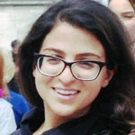




Twitter-Informed Disaster Relief
Extracting useful information from
social media during a crisis
Zahra Ashktorab (UMD)
Christopher Brown (UT)
Manojit Nandi (CMU)
Aron Culotta (IIT)
The Eric & Wendy Schmidt
Data Science for Social Good
Summer Fellowship 2013

Slide 2
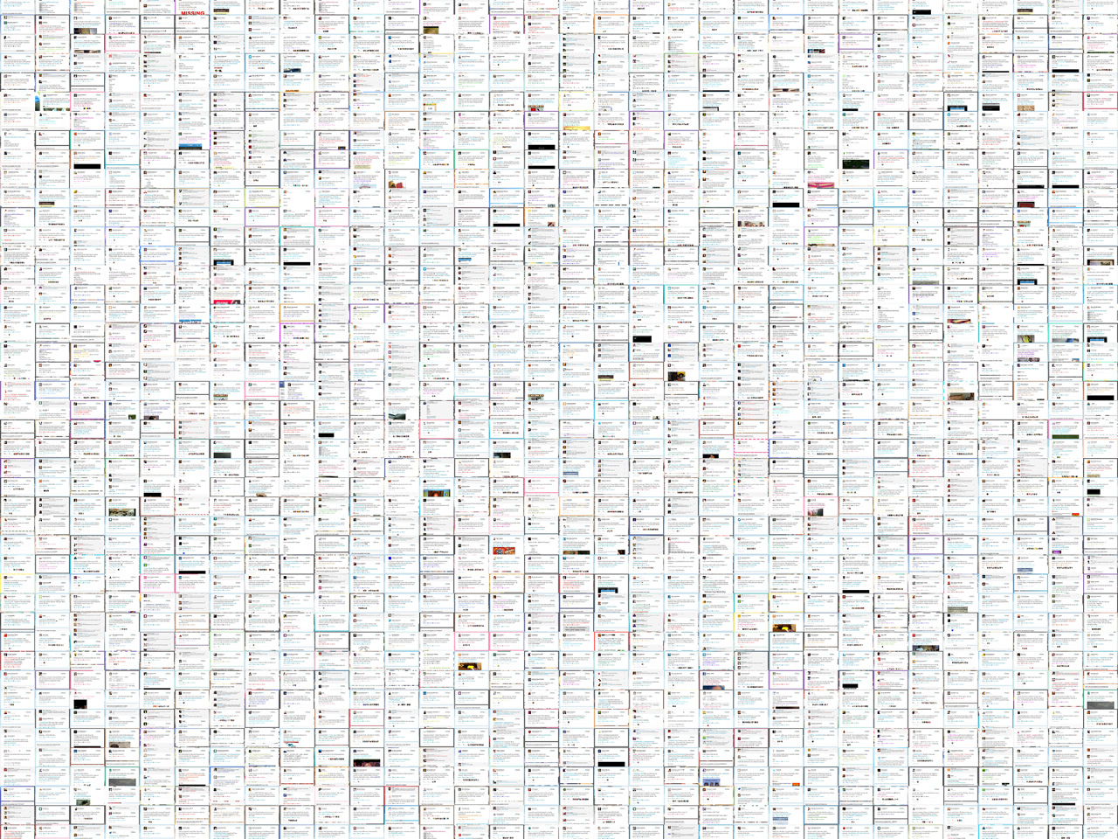

Too little information
Flooding bad up and down sides of Green River Rd
Too many tweets
User Interface & Map
Tweedr
1. Classify & Filter
2. Cluster & Merge
3. Extract & Geolocate
The Eric & Wendy Schmidt
Data Science for Social Good Summer Fellowship 2013

