Slide 1
< WEB DEVELOPMENT />

Slide 2
Presentation Outline
Introduction
Front-end Technologies
Back-end Technologies
Full Stack
Computer Programming
Expectations

Slide 3
Introduction
Data is the “new gold” and the manner in which it is produced, processed and stored is critical to its usefulness and usage.
During the COVID-19 pandemic, data was one of a few commodities that saw an upward surge in its use generating millions for Amazon, Google, Facebook, TikTok, Netflix and Zoom.
AGES-UMaT motto: Resources are not, they become.

Slide 4
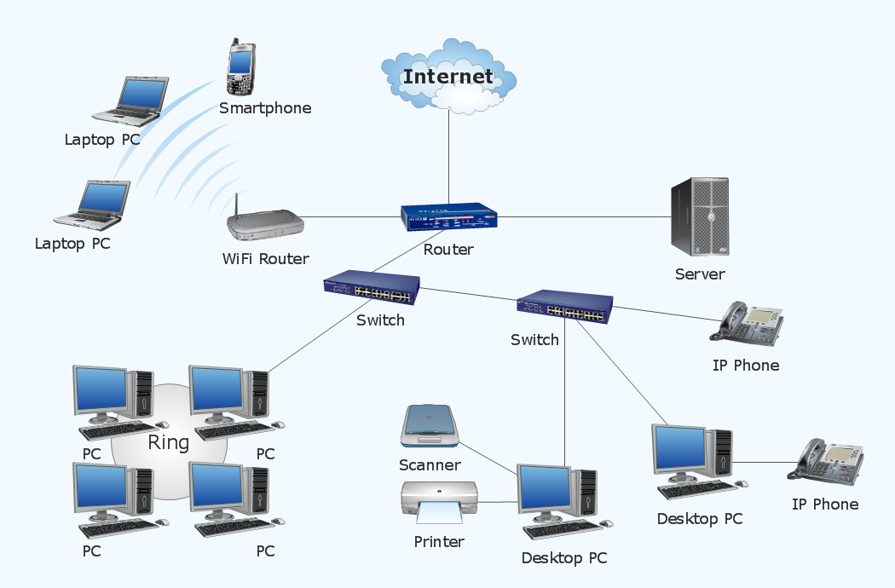
Introduction cont..
The Internet has become an infrastructure for which Data becomes a resource.
Web Applications are some of the building components of the internet services.

Slide 5
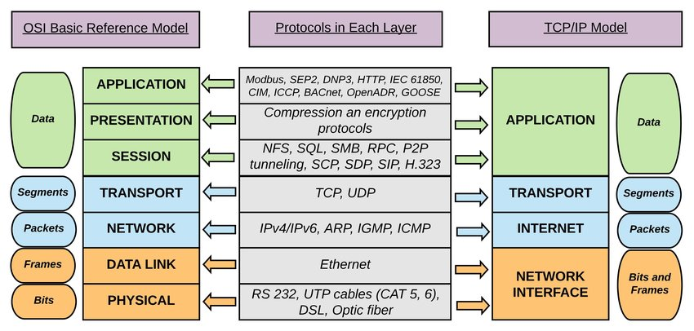
Introduction cont..

Slide 6
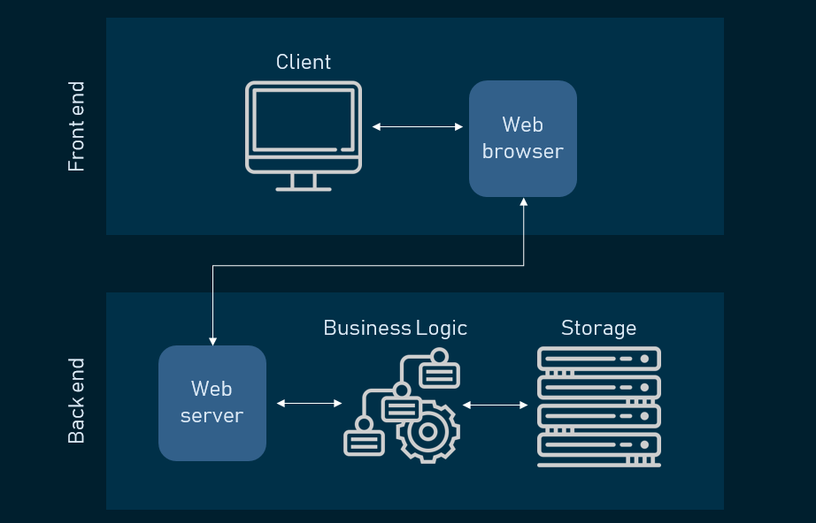
Web Request & Response Cycle

Slide 7
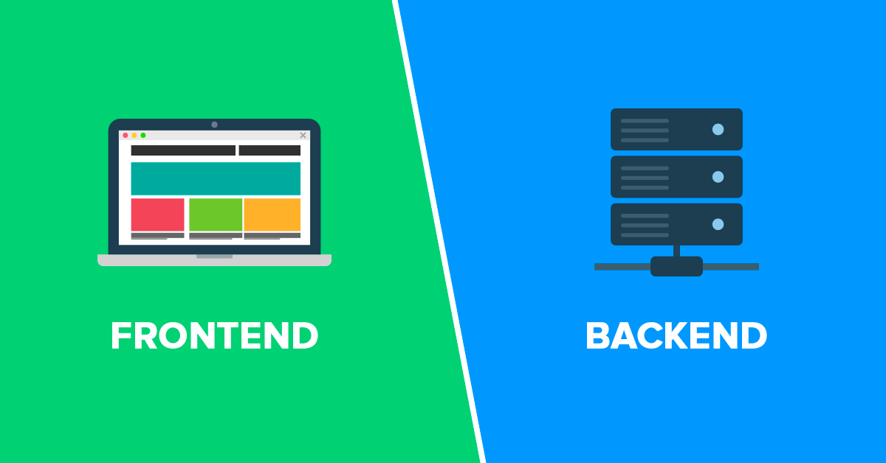






Front-end Technologies

Slide 8
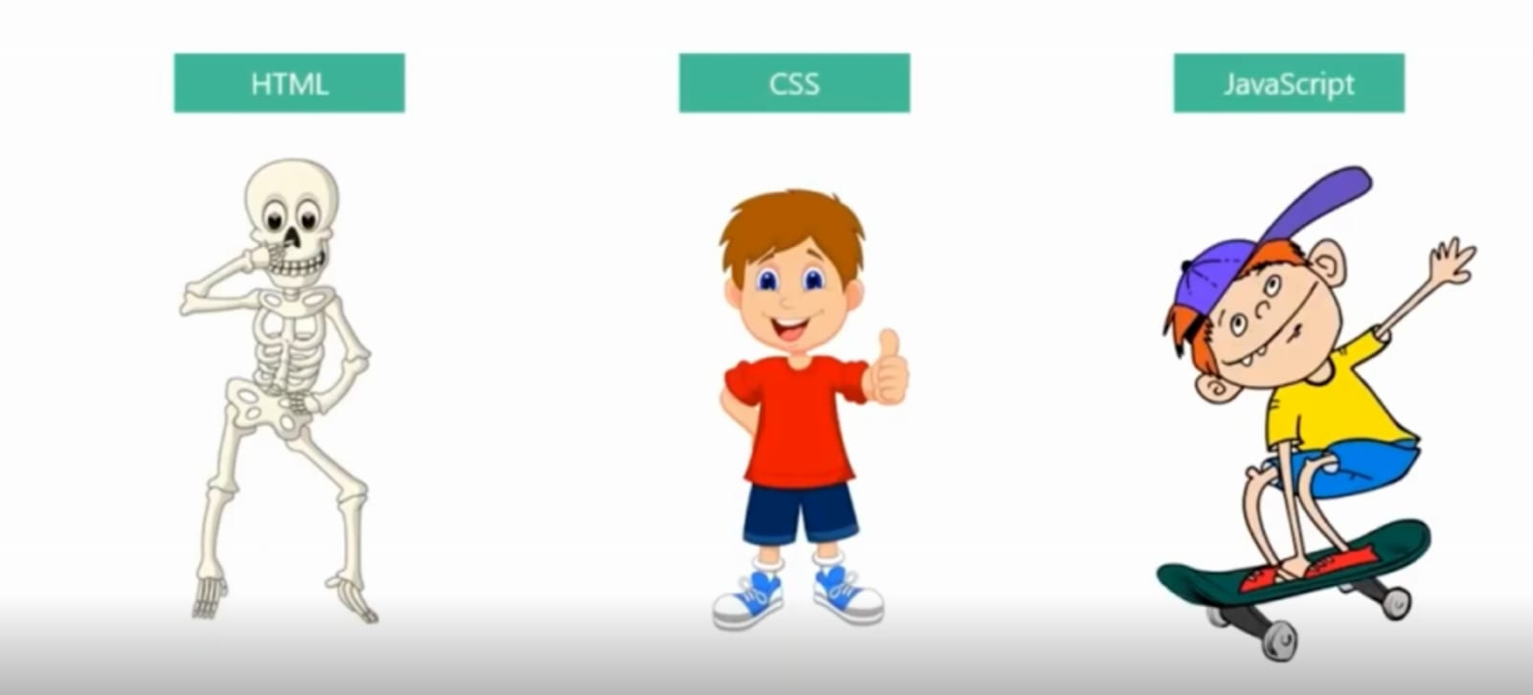
Front-end Technologies

Slide 9







Back-end Technologies

Slide 10
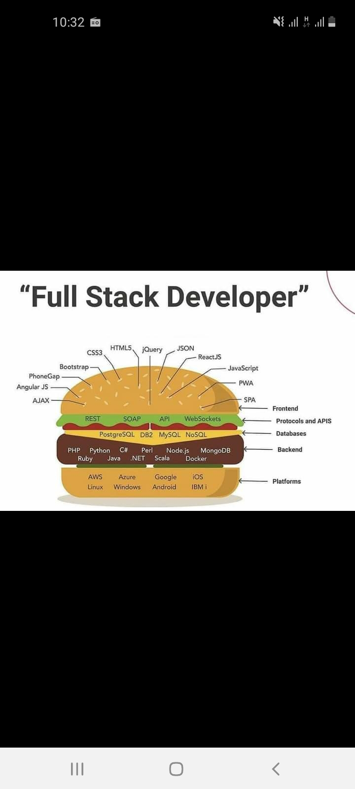
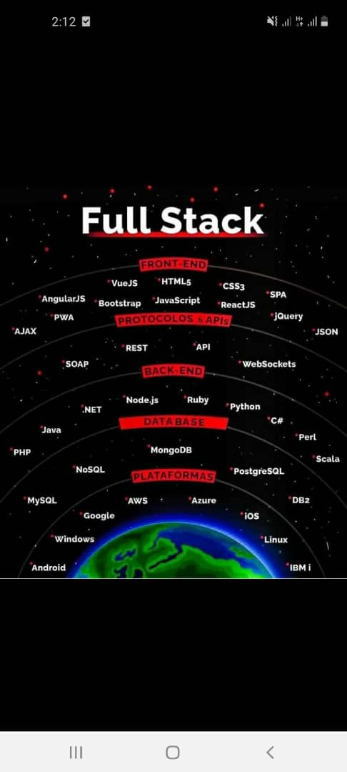
Full Stack Technologies

Slide 11
Full Stack Technologies
LINUX
MySQL / PosgreSQL
PYTHON, DJANGO
HTML, CSS, BOOTSTRAP

Slide 12
Tools and Resources
Google Chrome
VScode
Google Colab or Anaconda(Jupiter Environment)
Internet
Git and GitHub

Slide 13
Expectations
Learn the rudiments of Web Development
Master the Bootstrap library
Learn Python Programming Language
Build the Taskapp Web application using the Django Web Framework
Build an independent and group project at the end of the semester

