Slide 1


Predicting Friction in AI Code
Applying Machine Learning to Anticipate Heavy Review Cycles in Automated Development
AIDev-pop Dataset Analysis
Predictive Modeling Strategy & Final Results

Slide 2






Defining Friction: Why ≥ 2 Review Cycles?
1 Cycle (Standard)
2 Cycles (Friction)
3+ Cycles (Failure)
A single review cycle represents a healthy, human-in-the-loop workflow. Minor syntax tweaks, formatting adjustments, or initial compliance checks. Flagging this would mislabel healthy collaboration.
The operational sweet spot. It means the code was reviewed, sent back for changes, and still failed to pass on the second attempt. It indicates a fundamental gap between AI generation and human expectations.
By the time a PR hits a third round of revisions, significant developer velocity has already been lost. Waiting to predict at this stage defeats the purpose of an early-warning system.

Slide 3
The Imbalance Challenge
86%
33,600 Total PRs Analyzed
The primary challenge of this dataset is the severe class imbalance. A model guessing "Smooth Merge" every time achieves 86% accuracy, but fails the business objective.
SMOOTH MERGES (0-1 CYCLES)
Objective: Build a classification system to identify high-friction AI-generated Pull Requests.
14%
Agents Evaluated: OpenAI Codex, GitHub Copilot, Devin, Cursor, and Claude-Code.
Focus: Protecting engineering velocity and human reviewer bandwidth.
HEAVY REVIEWS (≥ 2 CYCLES)

Slide 4
Feature Engineering & Methodology
We engineered features from the raw metadata to capture the context and complexity of every pull request before review begins.
●Timeline Metrics: hours_to_merge tracking the exact time elapsed from PR creation.
●AI Agent Identity: Used to identify different AI coding agents
●Code Complexity: Metrics describing the scale and scope of the proposed changes.
●total_additions — lines added
●total_deletions — lines removed
●total_changes — additions + deletions
●files_touched — unique files altered
●Context & Effort: pr_desc_length to measure the initial human prompting effort.
●Categorical Data: One-hot encoding for specific Task Types (Bug Fix, Feature, Docs) and the AI Agent Identity.

Slide 5






ML Pipeline: Overcoming Challenges
The Imbalance Problem
SMOTE vs. Weights
Preserving Interpretability
While SMOTE (Synthetic Data Generation) was evaluated on the training set, utilizing XGBoost's built-in scale_pos_weight proved superior by mathematically penalizing the model 6x more for missing a Heavy Review.
With only 14% of data representing our target variable, standard classifiers prioritize the majority class to inflate overall accuracy, rendering them useless for predicting rare friction events.
We actively chose to bypass dimensionality reduction (like PCA) during hyperparameter tuning. This preserved the raw engineering features, ensuring the final insights remain directly actionable for developers.

Slide 6
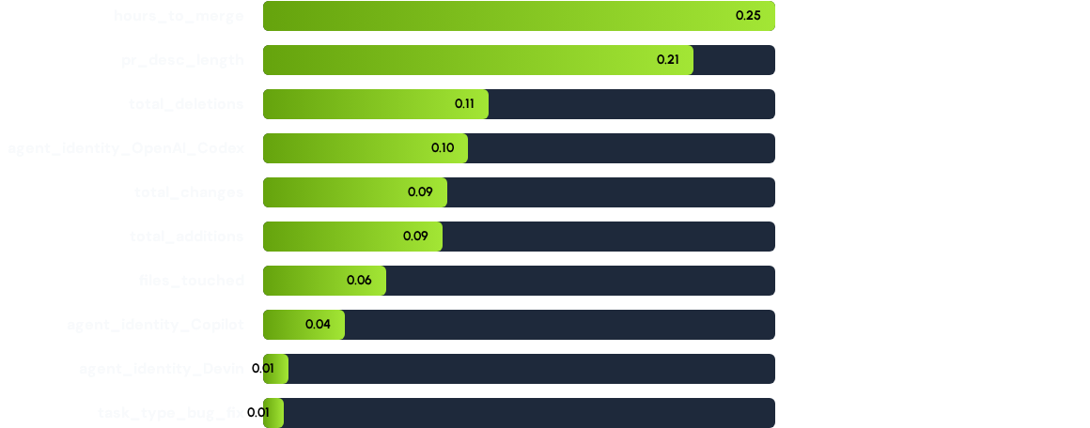
What Drives Friction? (Feature Importance)
Key Insights
Surprisingly, code deletions rank higher than additions, suggesting that removing or refactoring code triggers more human pushback.
The specific AI Agent (OpenAI Codex) is a massive flag for the model compared to task type.

Slide 7
Final Model Metrics Comparison
Evaluation against the 20% holdout test set (n=6,720 PRs). The goal is to optimize for Recall on Class 1 (Heavy Review).
Classification Model | Overall Accuracy | Precision (Class 1) | Recall (Class 1) | F1-Score (Class 1)
Random Forest (Baseline) | 89.5% | 69.2% | 45.1% | 54.6%
Logistic Regression (Linear) | 75.3% | 34.4% | 84.5% | 48.9%
XGBoost (Tuned Champion) | 85.6% | 49.0% | 80.7% | 61.0%

Slide 8
Limitations & Strategic Trade-offs
The Random Forest Failure: While achieving the highest overall accuracy (89.5%), it missed over half the bad PRs (Recall: 45%).
The Logistic Regression Failure: While catching 84.5% of bad PRs, it flagged so many false positives (Precision: 34%) that it would cause "alert fatigue" for reviewers.
The Champion (XGBoost): We made a strategic trade-off. By accepting a 49% Precision (meaning half the flagged PRs are actually fine), we achieved an 80.7% Recall.
Business Result: We successfully intercept 8 out of 10 high-friction PRs before they waste human engineering time.

Slide 9

Conclusion & Future Impact
Summary of Value
What's Next
Intercepting Friction: We catch 8 out of 10 high-friction PRs before they spiral.
Auto-Routing: Route flagged PRs to senior reviewers automatically.
Human-Centric AI: The model protects human judgment, it does not replace it.
Refined Thresholds: Set confidence thresholds by agent and code size.
Key Insight: Agent identity and deletions matter more than task type.
NLP Prevention: Use NLP on review comments to move to prevention.

Slide 10
Questions?
Thank you for your time.
Software Analytics - Drexel University

