Slide 1
Machine Learning in der Energiewirtschaft

Slide 2
Machine Learning categories
Supervised Learning
Labeled training set
Learns shape and characteristics of labeled data
Unsupervised Learning
unlabeled training set
Discovers hidden data patterns and relationships
Reinforcement Learning
No training set necessary
Agent explores environment without previous training
Prediction / Forecasting
Clustering
Optimization / Control

Slide 3
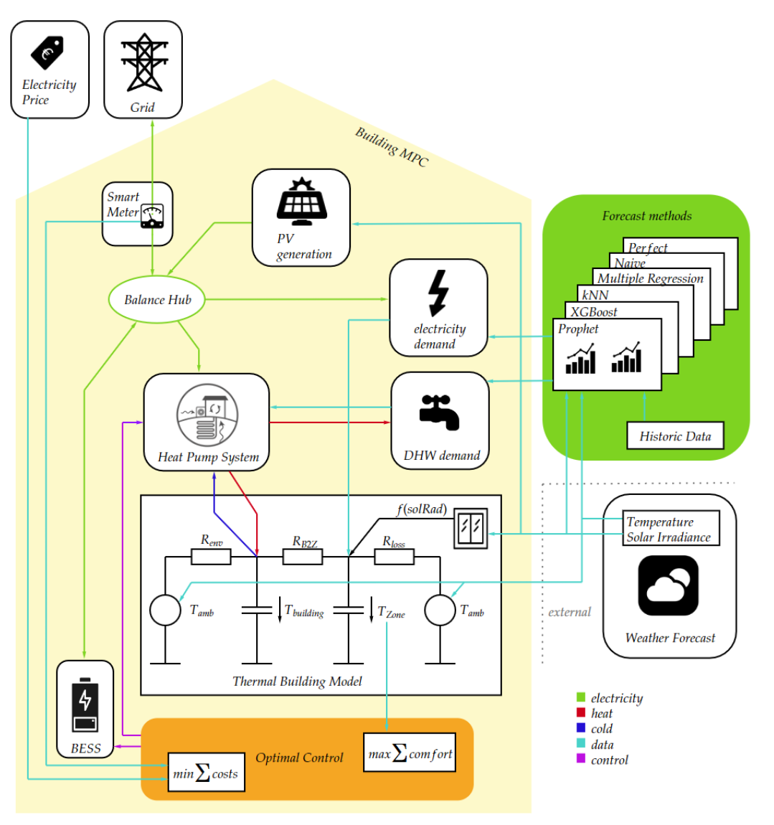
Prediction / Forecasting
Quelle: Putz, 2024
Notes:
1. study: Short-term wind power: +N-BEATS best in accuracy (MAPE); -DL often black box (N-BEATS more interpretable); +less data pre-processing
2. Study: Energy demand forcast

Slide 4
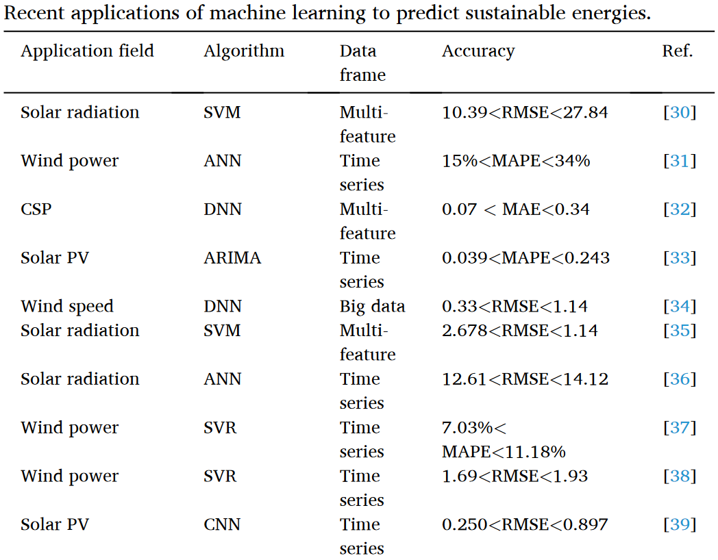
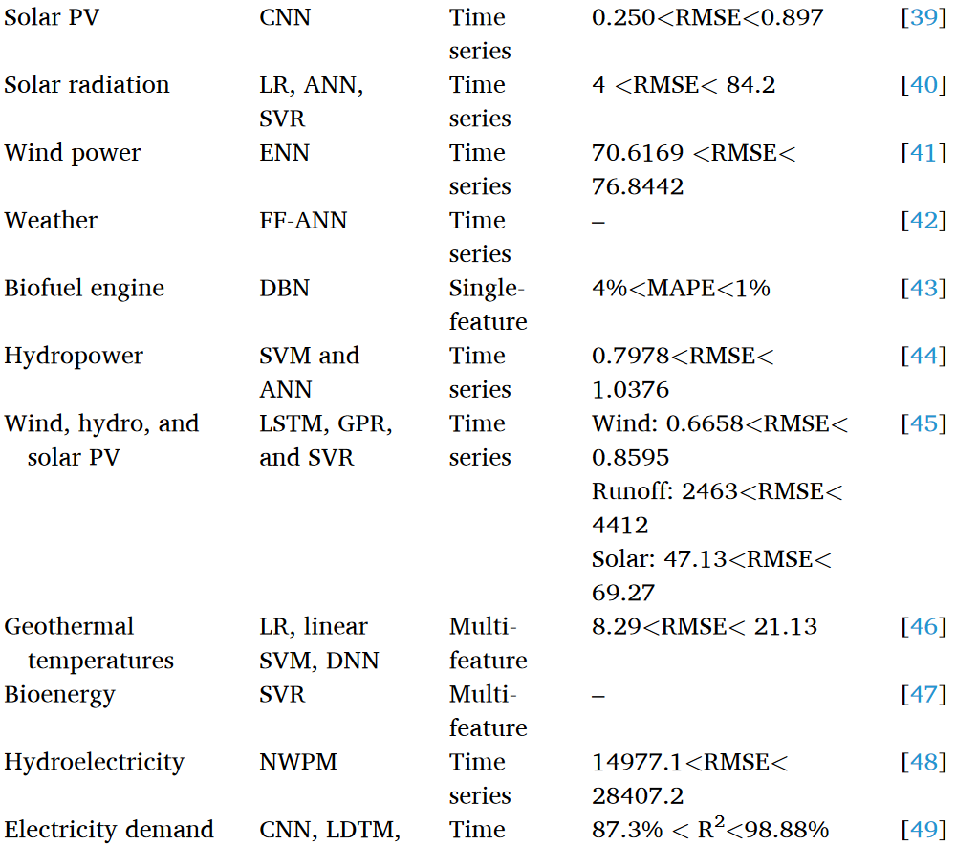
Prediction / Forecasting
Quelle: Ifaei, et al 2023

Slide 5
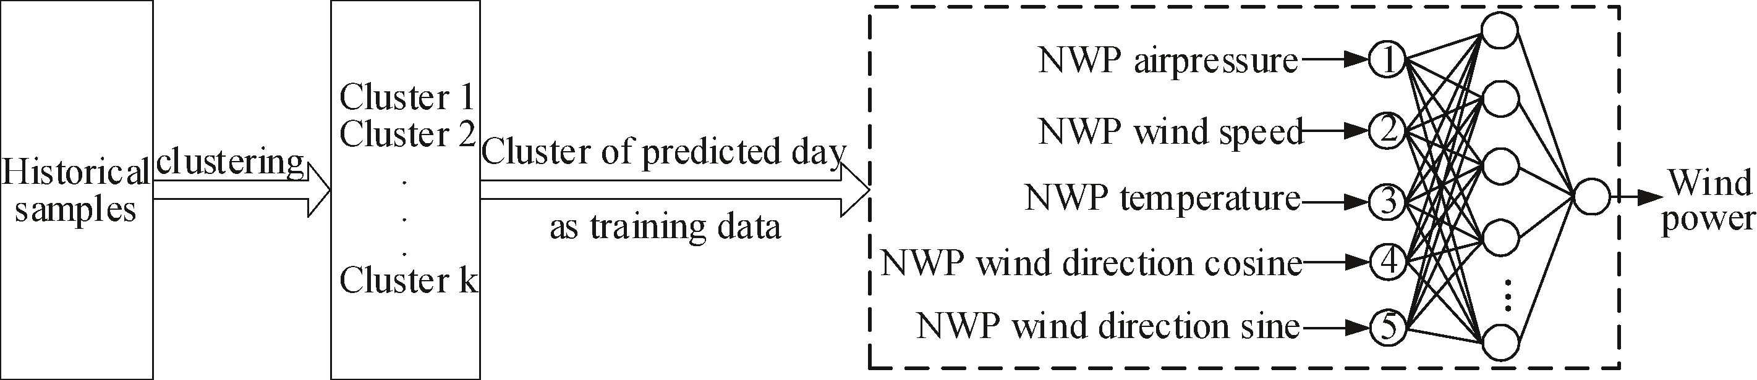
Clustering
Quelle: Hao, et al 2019
Notes:
NWP: Numerical weather prediction -> power forecasting

Slide 6
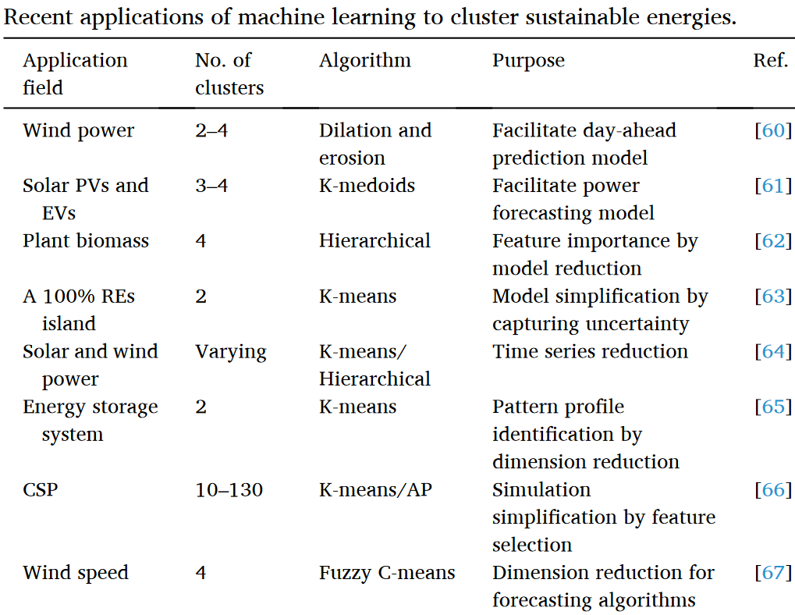
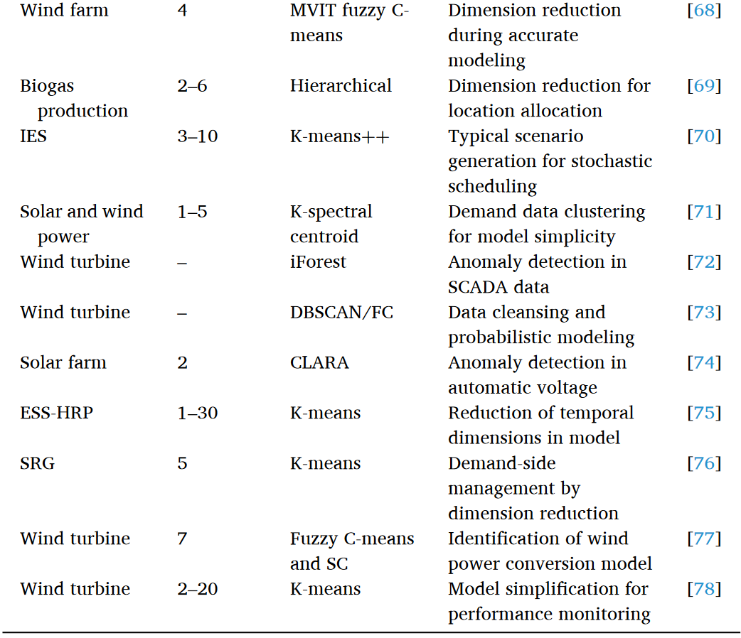
Clustering
Quelle: Ifaei, et al 2023

Slide 7
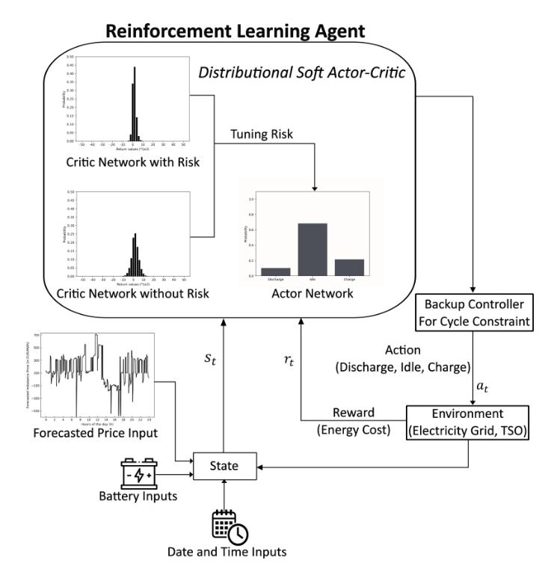
Control
Quelle: Madahi, et al 2023
Notes:
Only Intra-Day considered
1-minute based prices as forecast input
15-minute prices as settlement price

Slide 8
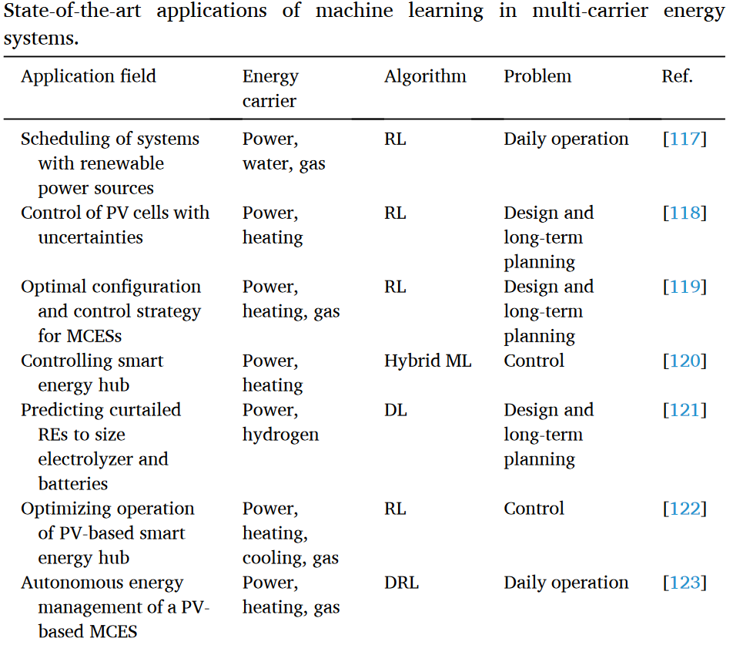
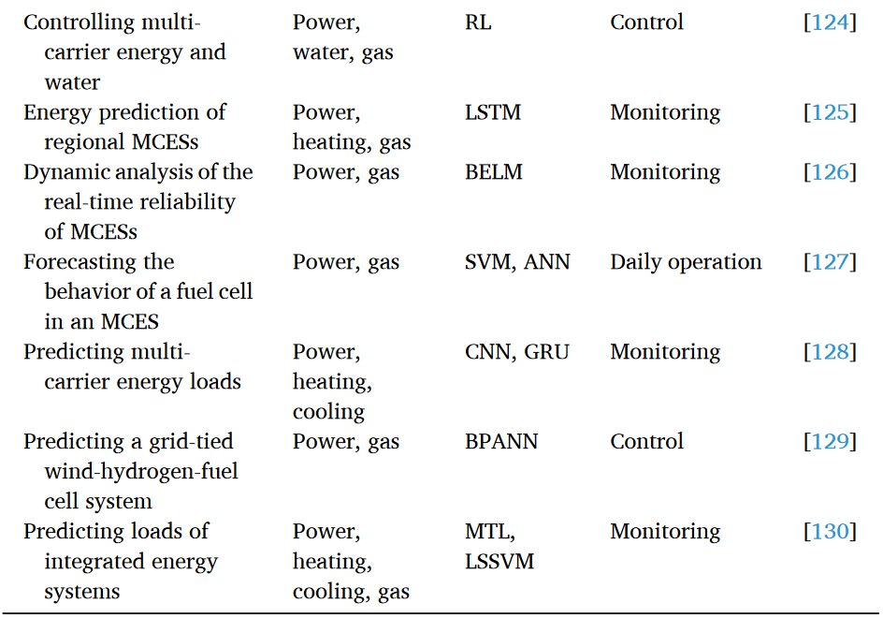
Control
Quelle: Ifaei, et al 2023

Slide 9
Quellen
D. Putz, „Robust Energy Forecasting”, Dissertation, Technische Universität Wien, Österreich, 2024
Y. Hao, et al. „A novel clustering algorithm based on mathematical morphology for wind power generation prediction”, 2019, Renewable Energy, https://doi.org/10.1016/j.renene.2019.01.018
Ifaei, et al. „Sustainable energies and machine learning”, 2023, Energy, https://doi.org/10.1016/j.energy.2022.126432
Madahi, et al. „Distributional Reinforcement Learning-based Energy Arbitrage Strategies in Imbalance Settlement Mechanism”, 2023, https://doi.org/10.48550/arXiv.2401.00015

Slide 10
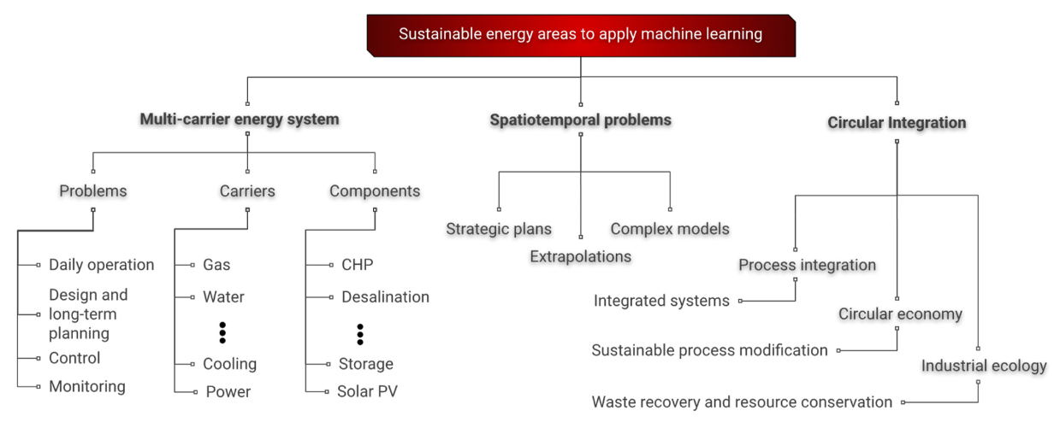

Slide 11
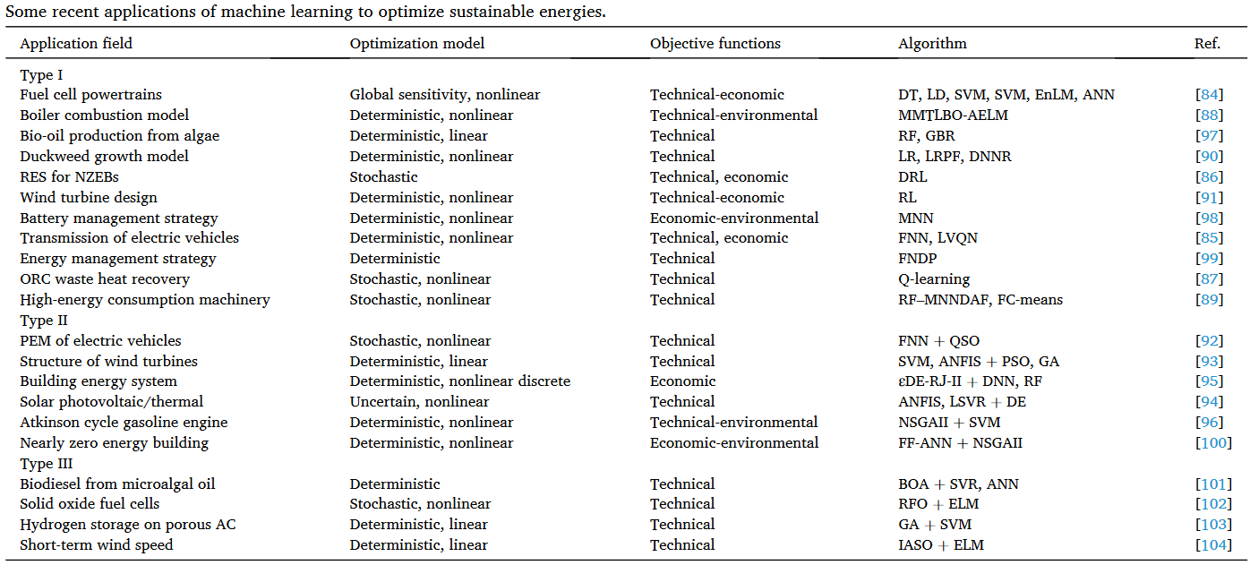
Optimization
Quelle: Ifaei, et al 2023

Slide 12
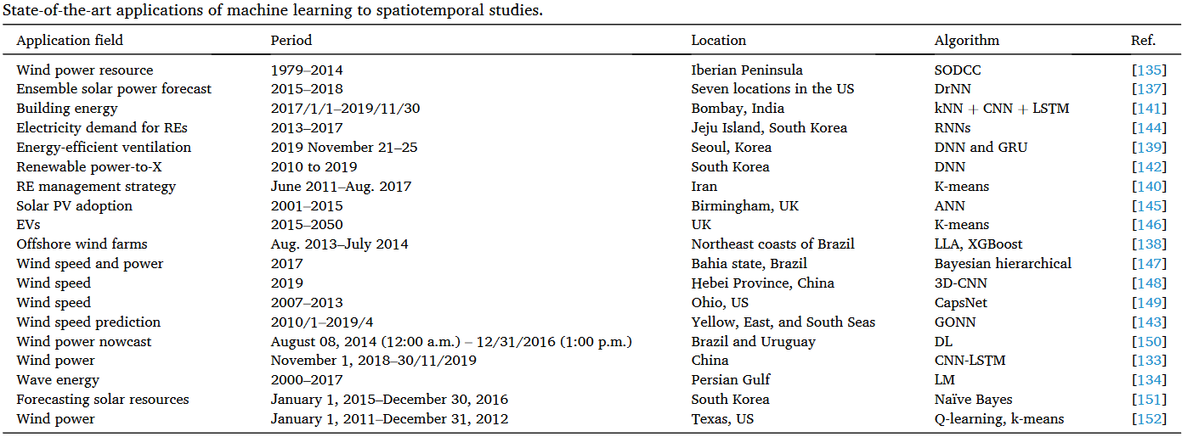
Spatiotemporal problems

Slide 13
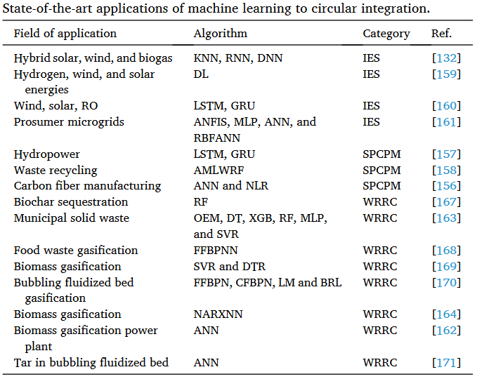
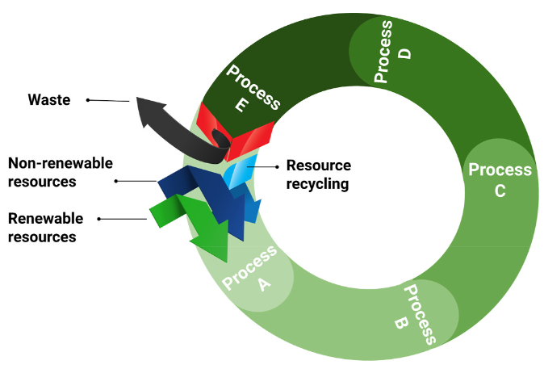
Circular integration

Slide 14
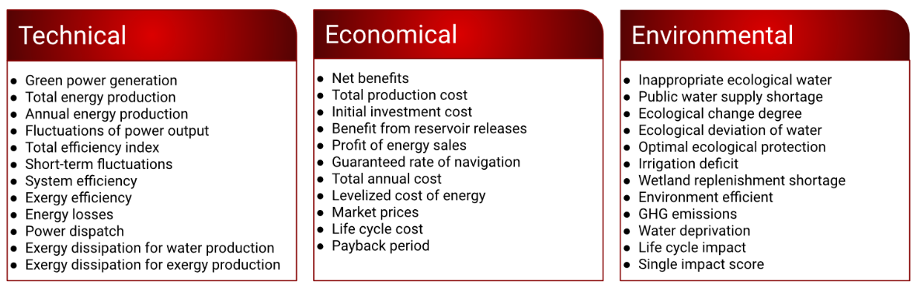
Optimization (Objective functions)
Notes:
System identification

Slide 15
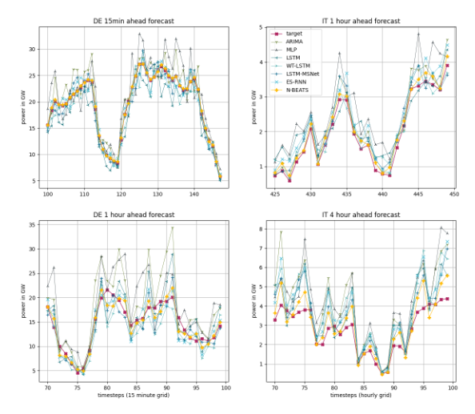
Forecasting results
Quelle: Putz, 2024
Notes:
Top left figure shows a sample of a 15 minutes ahead forecast (Dataset with 15 minutes
time resolution). Bottom left figure shows a sample of a 1 hour ahead forecast (Dataset
with 15 minutes time resolution). Top right figure shows a sample of a 1 hour ahead forecast
(Dataset with 1 hour time resolution). Bottom right figure shows a sample of a 4 hour ahead
forecast (Dataset with 1 hour time resolution).

