Slide 1
Data-driven identification and model predictive control of biomass gasification process for maximum energy production
Elmaz, et al.
Part 1

Slide 2
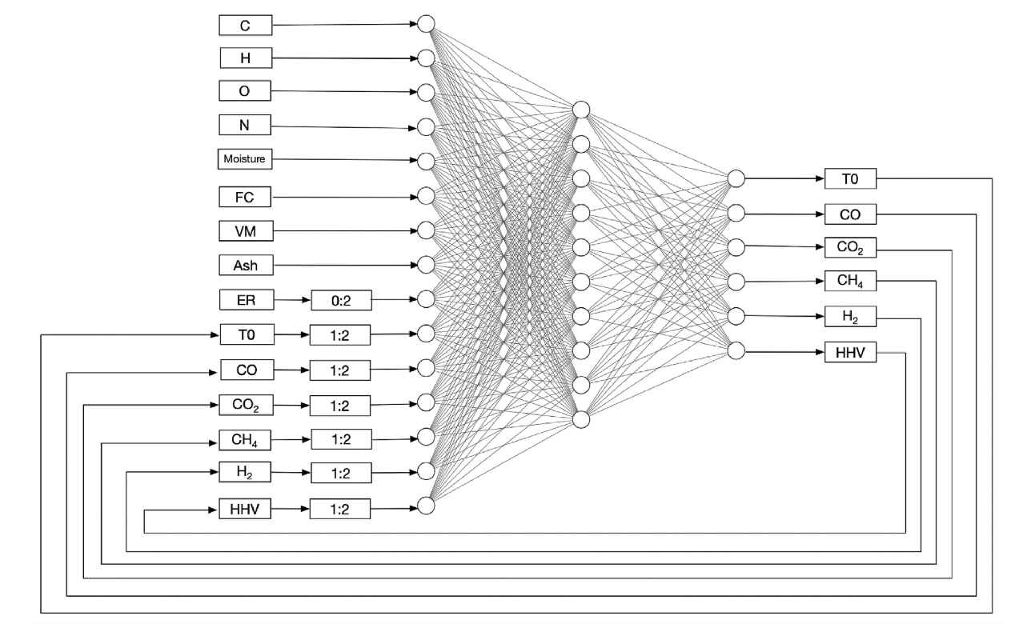
Non-linear autoregressive with exogenous neural network (NARXNN)
Quelle: Elmaz, et al. 2020

Slide 3
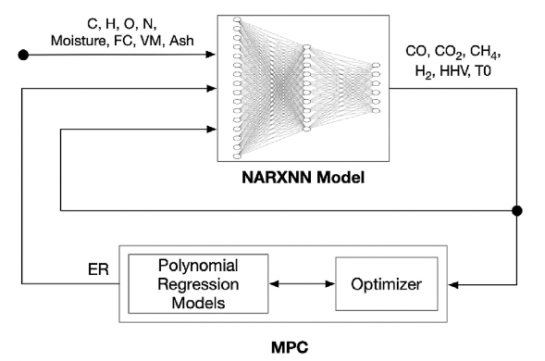
Model predictive controller
Quelle: Elmaz, et al. 2020

Slide 4
Quellen
Elmaz, et al. „Data-driven identification and model predictive control of biomass gasification process for maximum energy production“, 2020, Energy, https://doi.org/10.1016/j.energy.2020.117037

