Slide 1
User Type Utilization of Cyclistic Bikes
A case study of how casual riders and annual members use Cyclistic bikes differently.

Slide 2
Business Question
What is the problem I am trying to solve?
My company; Cyclistic, a bike-share company based in Chicago wants to understand how casual riders (customers) and annual members (subscribers) use Cyclistic bikes differently.
How can my insights drive business decisions?
With the expected insights from my data analysis of the problem at hand and the resultant recommendations that will result from it, my company plans to design a new marketing strategy that will help convert more casual riders into annual members.

Slide 3
Dataset
The data used in this analysis (Q1, 2019) was extracted from an open source dataset and downloaded under licence from Motivate International Inc. It was thereafter checked using industry standard best practices (ROCC) and procedures to ensure data credibility and lack of bias.
There were a few challenges with the original dataset like missing values and blanks in the “gender” and “birth year” columns respectively which were effectively taken care off during the data cleaning process.
New columns like “ride length”, “week day” and “day of the week” was added to the original dataset table after the necessary calculations were performed for context and to make the data analysis process easier.

Slide 4
Tables and Calculations
All calculations and tables were executed using excel spreadsheet and MySQL RDBMS respectively for easy data manipulation and analysis while data visualization was done on Power BI.
Usertype | Week_day | Count_of_trip
Customer | Friday | 3375
Customer | Monday | 1892
Customer | Saturday | 5993
Customer | Sunday | 3766
Customer | Thursday | 2920
Customer | Tuesday | 2728
Customer | Wednesday | 2489
Subscriber | Friday | 59672
Subscriber | Monday | 48507
Subscriber | Saturday | 29309
Subscriber | Sunday | 24233
Subscriber | Thursday | 63983
Subscriber | Tuesday | 58277
Subscriber | Wednesday | 57925
Usertype | Week_day | Mean_ride_length
Customer | Friday | 0.226962963
Customer | Monday | 0.200317125
Customer | Saturday | 0.262139162
Customer | Sunday | 0.220127456
Customer | Thursday | 0.246232877
Customer | Tuesday | 0.248900293
Customer | Wednesday | 0.240257131
Subscriber | Friday | 0.014831077
Subscriber | Monday | 0.012080731
Subscriber | Saturday | 0.027704801
Subscriber | Sunday | 0.022324929
Subscriber | Thursday | 0.009611928
Subscriber | Tuesday | 0.015168935
Subscriber | Wednesday | 0.012067328

Slide 5
Total user type
Usertype | total_usertype
Customer | 23163
Subscriber | 341906
Mean ride length of user type
usertype | Mean_ride_length
Customer | 0.239217718
Subscriber | 0.014688248

Slide 6
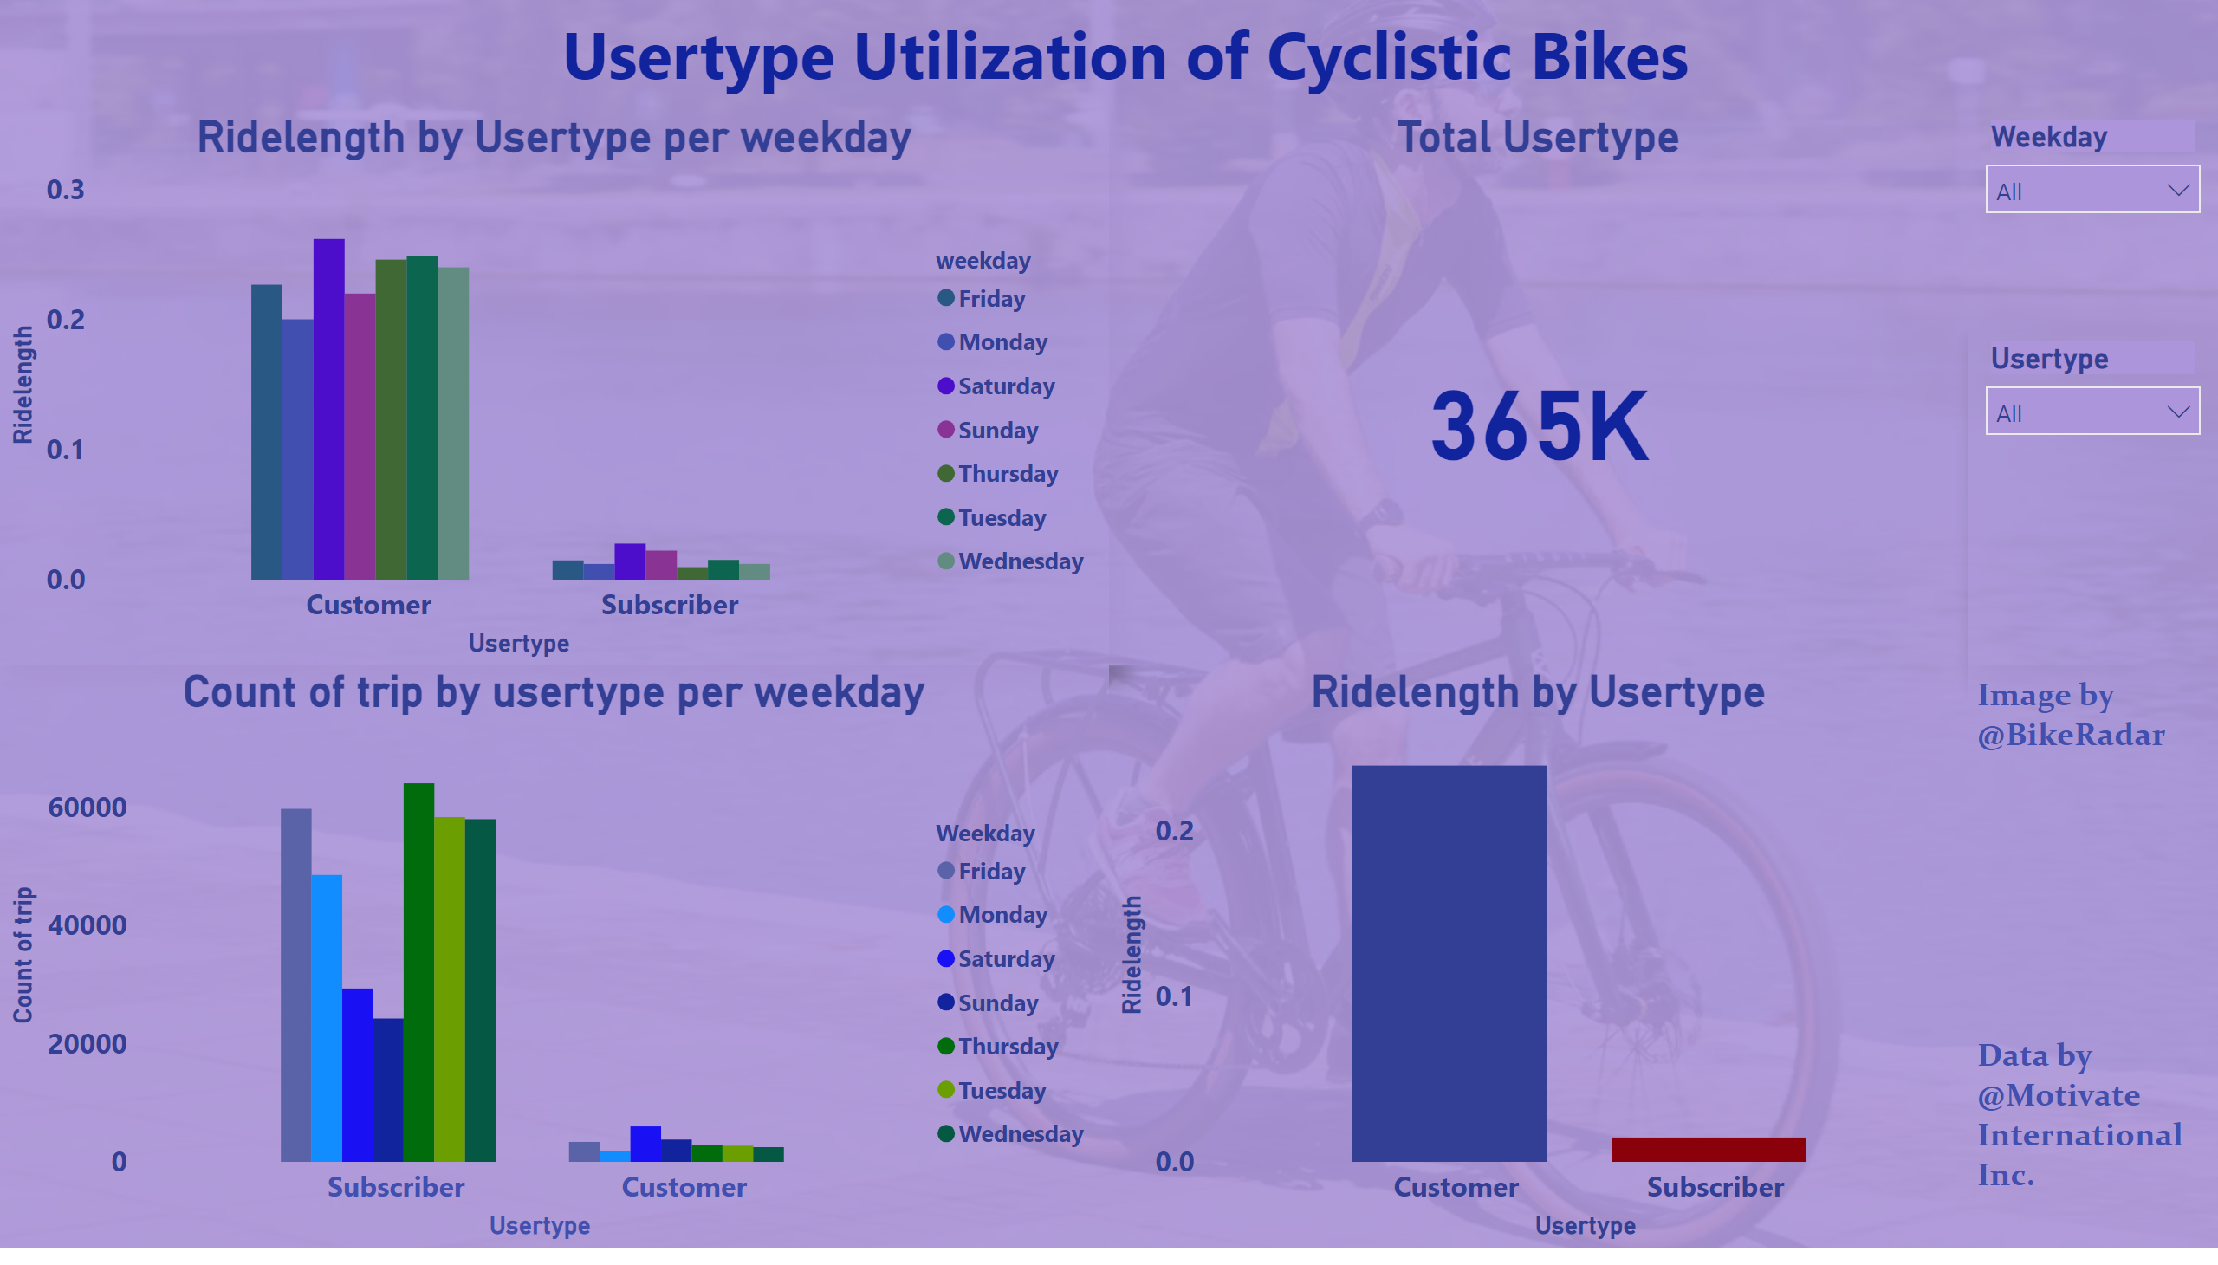
Notes:
User type Utilization Dashboard https://app.powerbi.com/links/pmEfhrmxLT?ctid=e0ee2929-d851-44c0-a5c4-6ebc96ad1971&pbi_source=linkShare

Slide 7
Data Analysis
From a total database of 365 thousand user types of cyclistic bikes (i.e. out of the total number of trips made by cyclistic bikes for the period under review), 23 thousand of those are from customers with a sum of mean ride length of 1.64 (average mean ride length was 0.24). It is much higher than that of subscribers which amounted to 0.11 (average mean ride length was 0.02) meaning that subscribers accounted for 93.53% of the sum of mean ride length of cyclistic users.
The sum of mean ride length for customers was highest on Saturdays (0.26),lowest on Mondays (0.20) and highest on Saturdays (0.03) and Sundays (0.02) for subscribers (0.03) with their lowest (0.01) coming up on Mondays, Wednesdays, Thursdays and Fridays respectively.

Slide 8
Key Findings
Average ride length and sum of mean ride length was higher for customers compared to subscribers even though the overall total subscribers were more in numbers than customers, this may be due to the fact that customers tend to maximize their limited time purchase compared to subscribers who take their time since they have unlimited access all through the year.
Count of trip was significantly higher (93%) for subscribers in comparison to customers which amounted to just 7 %, which was not surprising given that subscribers has a higher percentage of the total user type.
Mean ride length was highest for both user types on weekends and lowest on weekdays for reasons which can not be immediately verified.

Slide 9
Conclusion
These findings shows the proportion of cyclistic bikes usage by the different user types, with subscribers enjoying a far greater share of the utilization ratio (over 90%) compared to customers which was less than 7% as can be seen from the count of trip visualization chart. This implies that the overall distribution margin of cyclistic bike usage by subscribers far outweighs that of customers which is a good development but more effort should be channelled into further improving the margin.

Slide 10
Recommendations
A new marketing strategy should be designed and tailored towards increasing the number of subscribers even more by offering attractive discounts to first year subscribers who migrate directly from casual membership to annual membership.
This new marketing strategy should specifically reflect more on the benefits of annual membership over casual membership.
The marketing strategy should look into why count of trip is lowest for both user types on weekdays and act accordingly to address the imbalance.

