Slide 1
GROUP 5 : CUSTOMER
[ MEMBERS ]
Vincent John R. Ruales
Rowmel P. Roque
Joshua Jade D. Ramos
Ralp Lauren L. Calayag

Slide 2
PRESENTATION ABOUT ERD AND FLOW CHART (PROGRESS CHART)

Slide 3
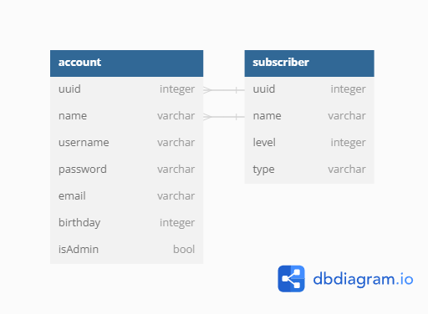
OUR FIRST CONCEPT ERD

Slide 4
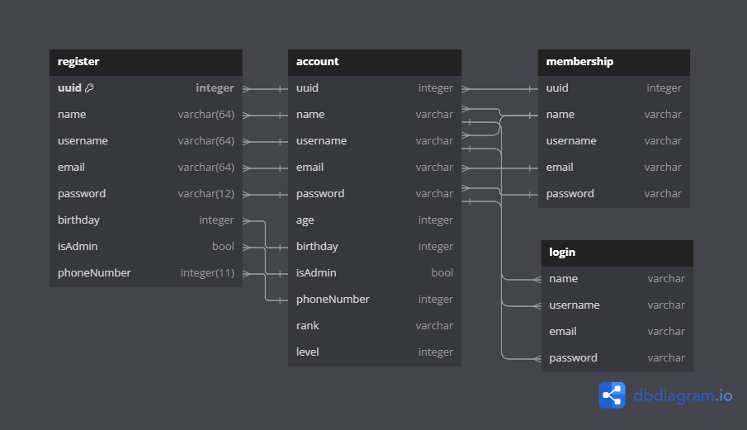
THE OUTPUT OF CONCEPT

Slide 5
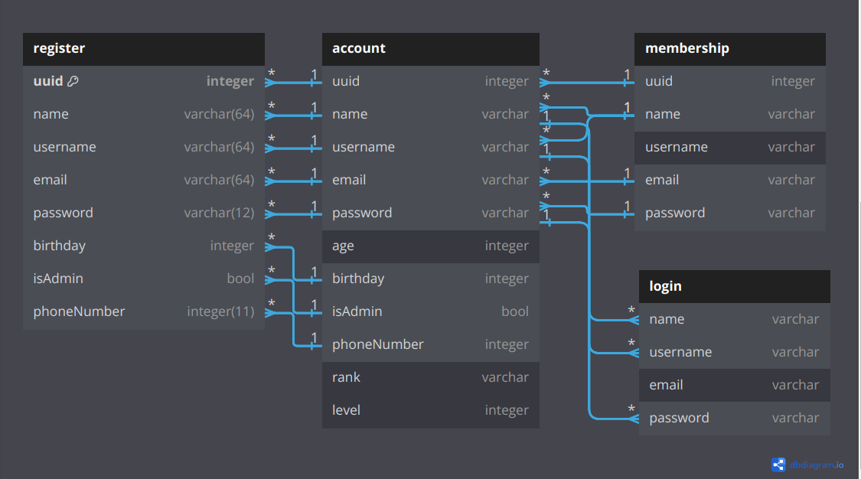
THE OUTPUT OF CONCEPT

Slide 6
FLOW CHART
We base the flow chart on the ERD we make
and the html how works

Slide 7
