Slide 1
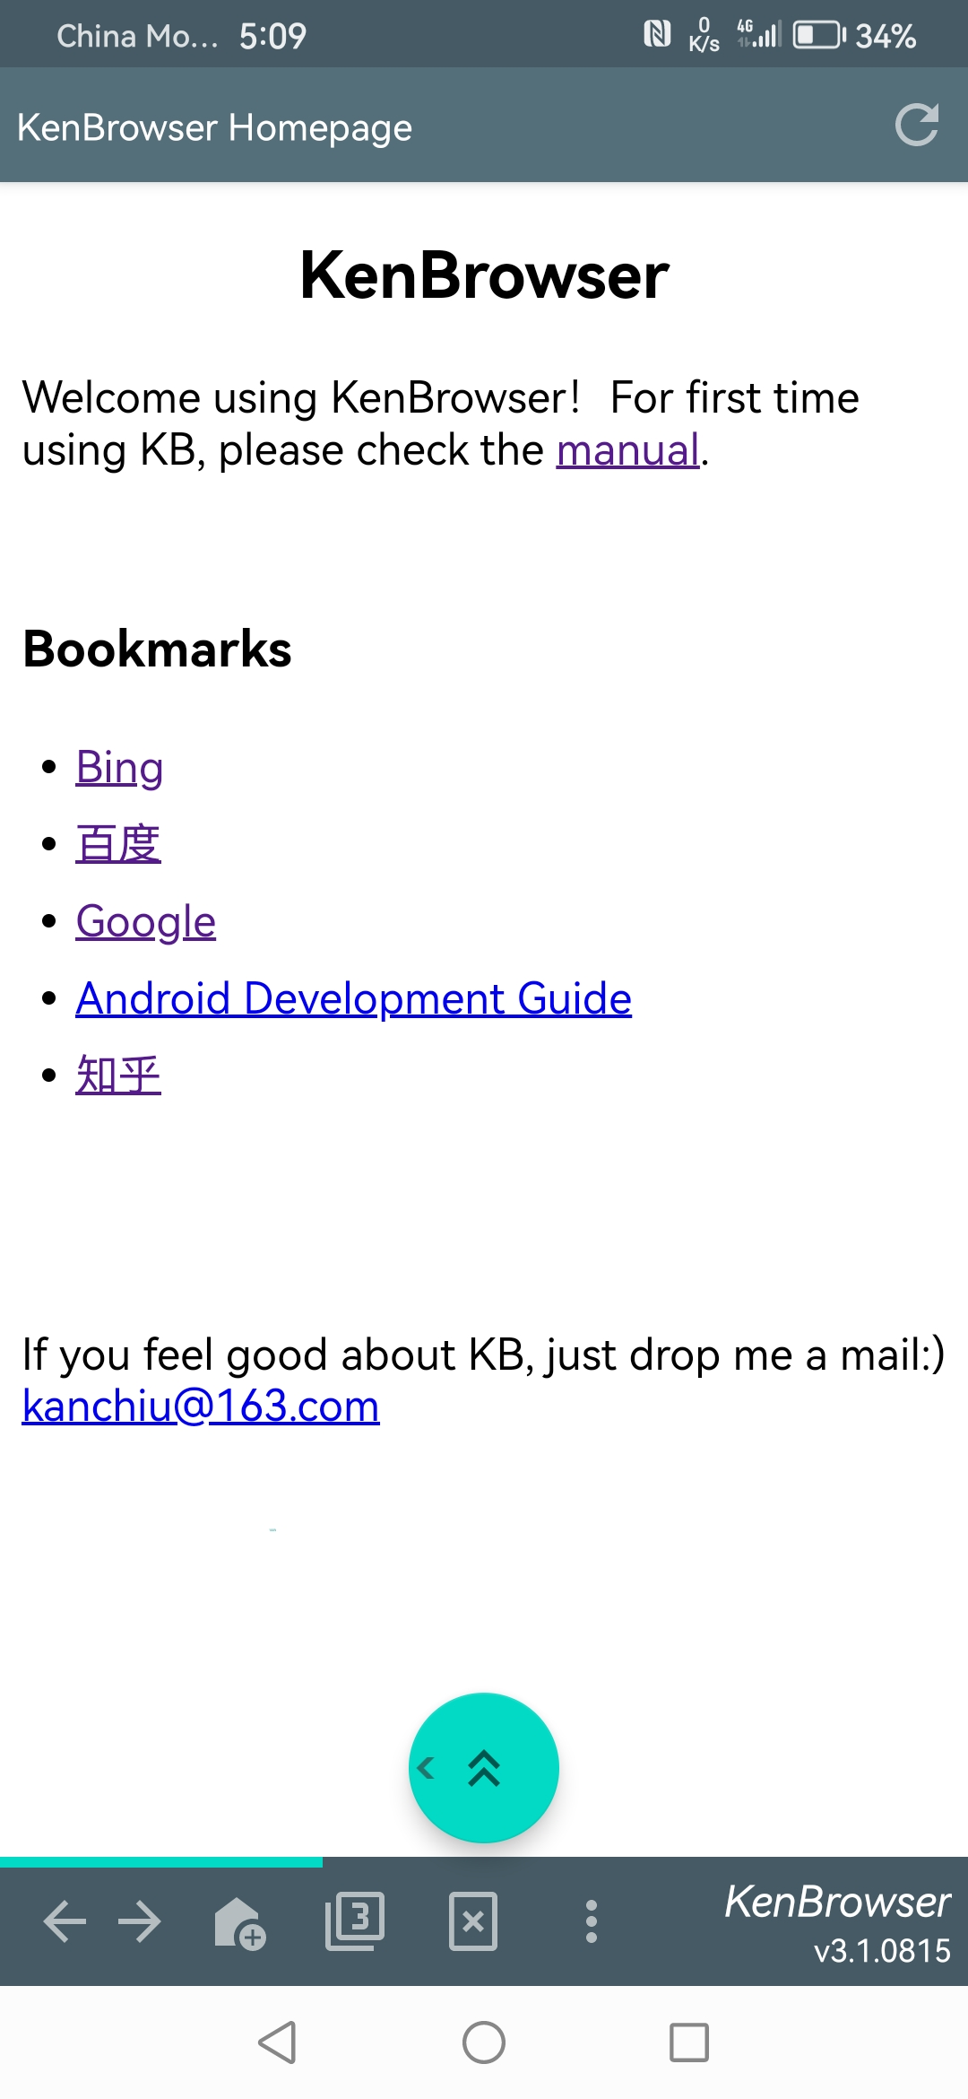
KenBrowser
A tiny and clean Android mobile browser,
Enables you to browser webpages with only one finger!

Slide 2

KB

