Slide 1
Code guideline
2024/02/14

Slide 2
Github
Lab: https://github.com/KenLee1996/Lesion-delineation-framework-for-stereotactic-magnetic-resonance-images
SynthSeg: https://github.com/BBillot/SynthSeg

Slide 3
Data input: loading and pre-processing
Tensorflow:
Tensorflow API: tf.data.Dataset
Keras API: tf.keras.utils.Sequence
Training: tf.keras.models.Model.fit → compatible with the above data pipelines
PyTorch API:
torch.utils.data.Dataset: define the process for each sample
torch.utils.data.DataLoader: define the data input pipeline, workers, shuffle and compile with the Dataset above
Training: self-defined training loop, yield the data inputs from above defined DataLoader

Slide 4
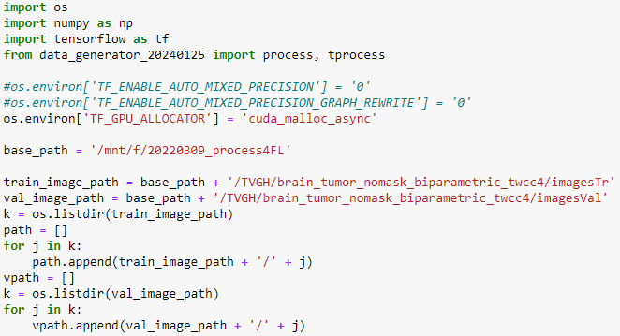
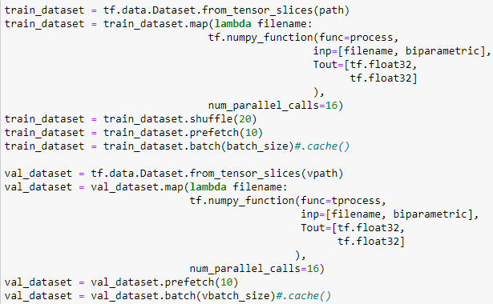
Data input: Tensorflow API
Define the list of filename or directory
Define the Dataset:
train_dataset = tf.data.Dataset.from_tensor_slices(path)
val_dataset = tf.data.Dataset.from_tensor_slices(vpath)
Map the pre-processing function (numpy) into tf Dataset and define the pipeline properties
For training data: process
For validation data: tprocess
Can be used for multi-GPU training

Slide 5
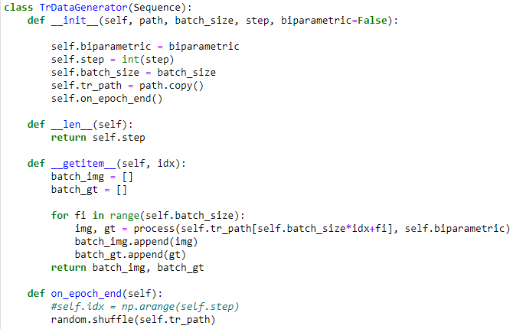
Data input: Keras API
Define the list of filename or directory
Define the Class based on tf.keras.utils.Sequence
Define the pipeline properties and place the pre-processing function at __getitem__
Can not be used for multi-GPU training

Slide 6
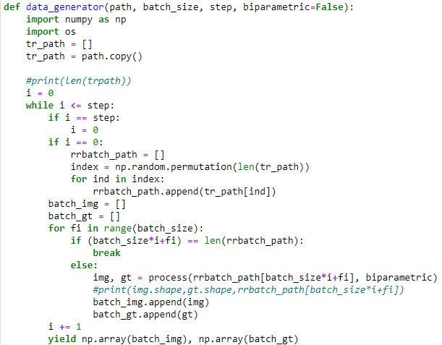
Data input: Keras (self defined generator)
Define the list of filename or directory
Define generator based while-yield loop
Define the pre-processing function inside the while-yield loop
Can not be used for multi-GPU training

Slide 7
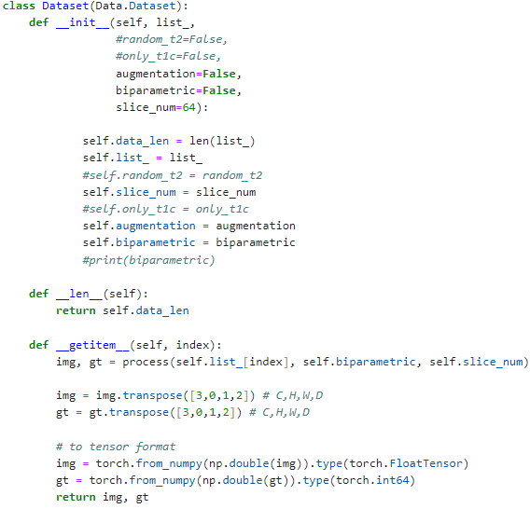
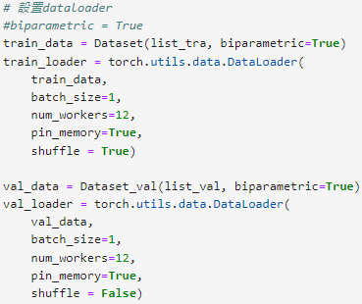
Data input: PyTorch API
Define the list of filename or directory
Define the Class based on torch.utils.data.Dataset and place the pre-processing function at __getitem__
Compile the Dataset and define the pipeline properties based on torch.utils.data.DataLoader

Slide 8
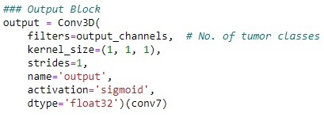
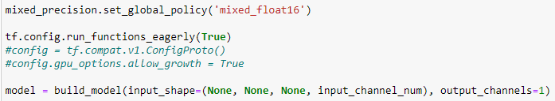
Model training: mixed precision
Tensorflow API: tensorflow.keras.mixed_precision
mixed_precision.set_global_policy('mixed_float16’)
Define the dtype=‘float32’ at the last layer of model

Slide 9
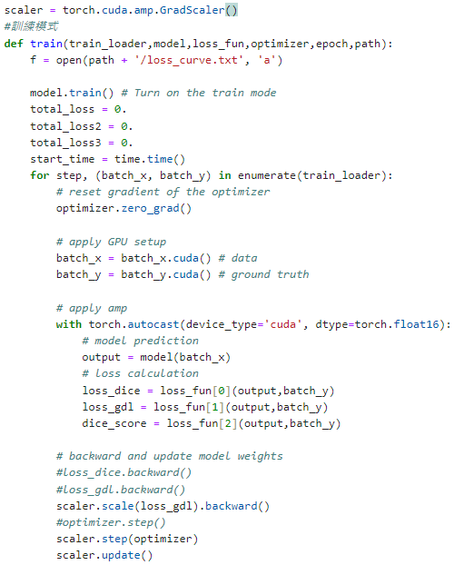
Model training: mixed precision
PyTorch API:
Define the gradient scaler using torch.cuda.amp.GradScaler
Run the forward with torch.autocast
Scale the loss and backward scaler.scale(loss).backward
Step the optimizer scaler.step(optimizer)
Gradient update scaler.update

Slide 10
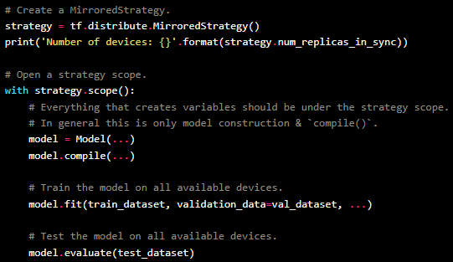
Model training: multi-GPU training
Focus on data parallel, which increase the batch size
Forward step will execute at multi-GPU
Backpropagation will execute at only one GPU
Tensorflow API: tf.distribute.MirroredStrategy
Define strategy=tf.distribute.MirroredStrategy
Build, compile and fit the model inside the strategy.scope
https://keras.io/guides/distributed_training_with_tensorflow/#singlehost-multidevice-synchronous-training

Slide 11
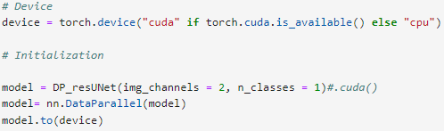
Model training: multi-GPU training
Focus on data parallel, which increase the batch size
Forward step will execute at multi-GPU
Backpropagation will execute at only one GPU
PyTorch API: torch.nn.DataParallel

Slide 12
Federated learning
FL framework: Nvidia Clara SDK (not recommended now)
Folder, loader and model must follow the MMAR format, not friendly for customized code
v3.0: every computing service can be set independently, SSL certification is not necessary
V3.1, v4.0: only administrator can launch the server and deploy the code for each client, server needs DNS for SSL certification to launch and deploy the training
FL framework: Flower (need to care about the version update)
Compatible package: Tensorflow and Keras (easier), PyTorch (more complicate)
YOLO: PyTorch based, but need to reload the model weights at each round

Slide 13
Flower framework:
Server scripts:
Define the class based on fl.server.strategy.FedAvg
Define the server address IP:port, aggregation rule, initial weight
Define the code for global model saving
Client scripts:
Define the class based on fl.client.NumPyClient
Define the model training parameter, local epoch, evaluation rule
Define the connection address

Slide 14
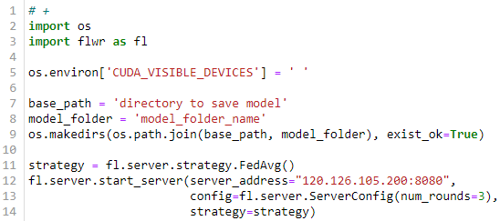
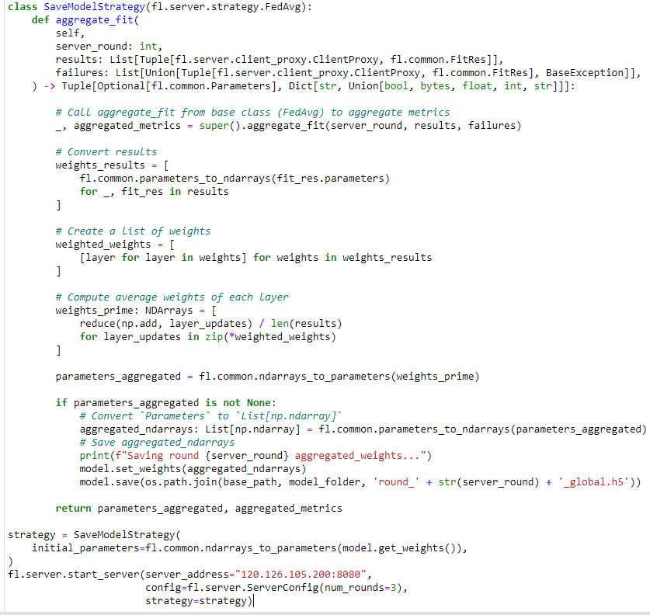
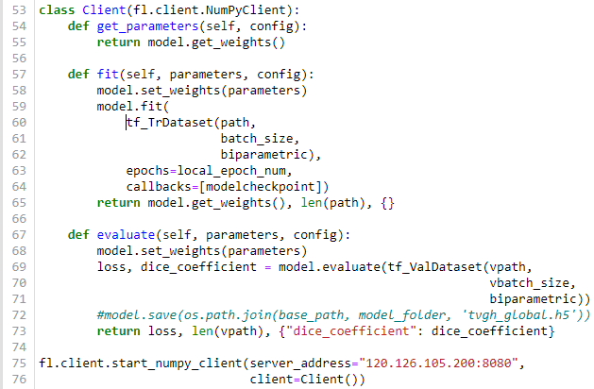
Flower framework: Keras
Simple server script
Customized server script
Client script

Slide 15
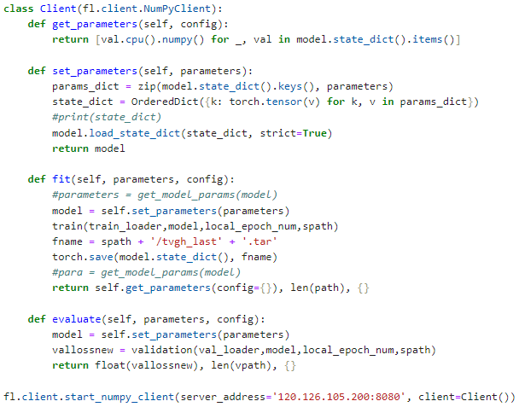
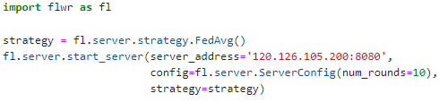
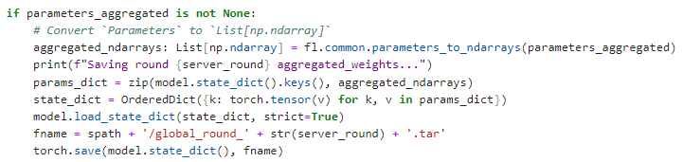
Flower framework: PyTorch
Client script
Simple server script
Customized server script: different at saving model

Slide 16
Flower framework: YOLO
Server script: just like the torch
Client script: YOLO package will reset the model parameter after YOLO model training
get_parameter: load the last weight using attempt_load_weights, deepcopy the state_dict as parameter
set_parameter: load the last weight into YOLO model, load_state_dict from deepcopied parameter, set ckpt

Slide 17
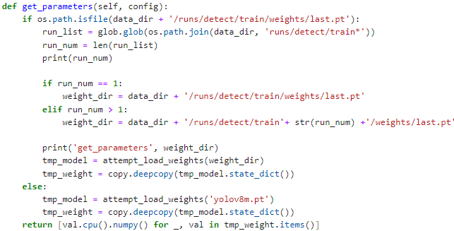
Flower framework: YOLO
Client: get_parameter

Slide 18
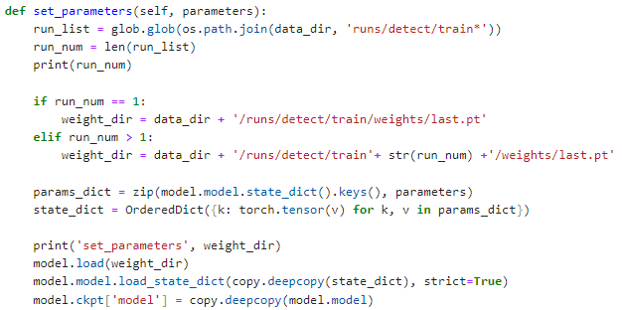
Flower framework: YOLO
Client: set_parameter

Slide 19
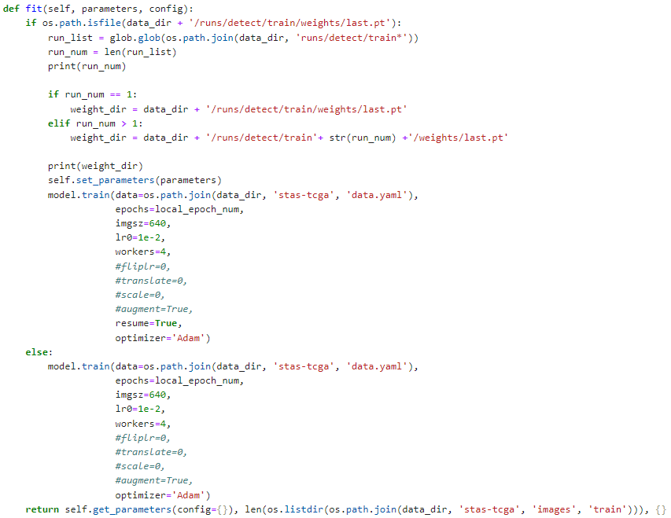
Flower framework: YOLO
Client: fit
FL rounds >=2: YOLO model.train need to set the resume as True

Slide 20
SynthSeg: environment setup
Clone the repository:
URL: https://github.com/BBillot/SynthSeg
Virtual environment:
conda create -n synthseg_38 python=3.8
Unzip the cloned repository and cd to the directory
python setup.py install
conda install cudatoolkit=10.1
conda install cudnn=7.6.*
Download the models and copy them into folder named “models” (already copied)

