Slide 1

Spring RESTful API Lab-01
By
Pichet Limvajiranan

Slide 2
RESTful Resource
URI | HTTP verb | Description
api/offices | GET | Get all office
api/offices/1 | GET | Get an office with id = 1
api/offices/1/employees | GET | Get all employee for office id = 1
api/offices | POST | Add new office
api/offices/1 | PUT | Update an office with id = 1
api/offices/1 | DELETE | Delete an office with id = 1

Slide 3
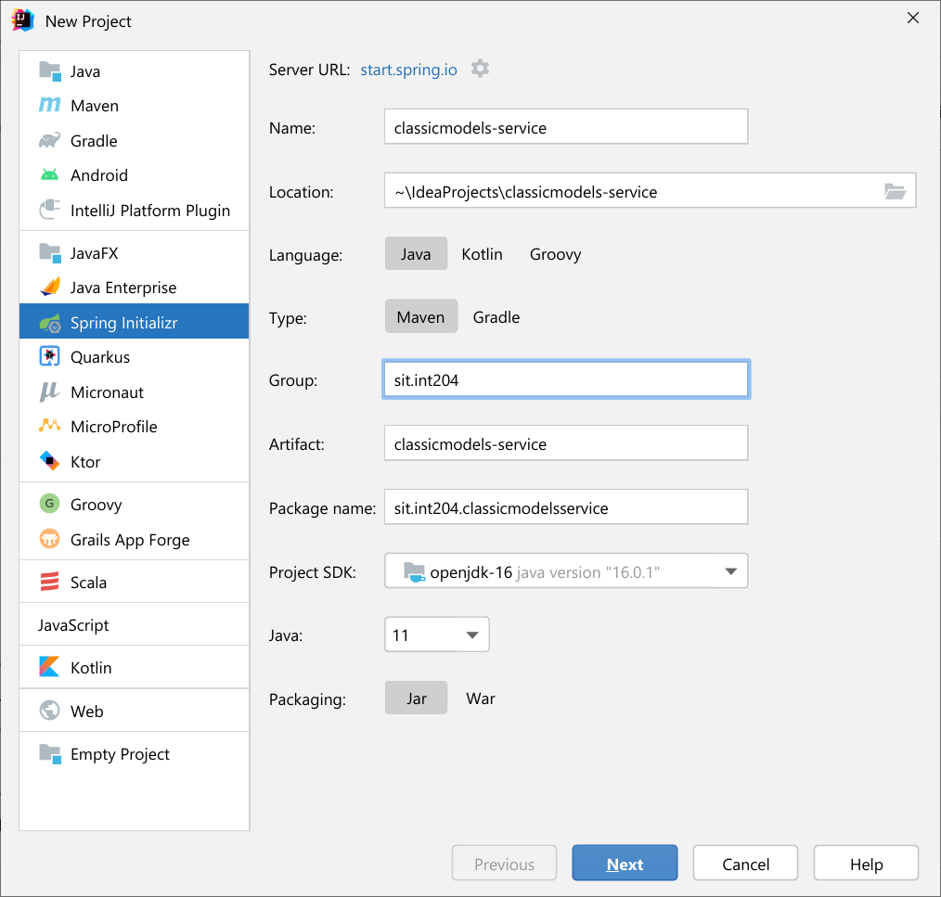
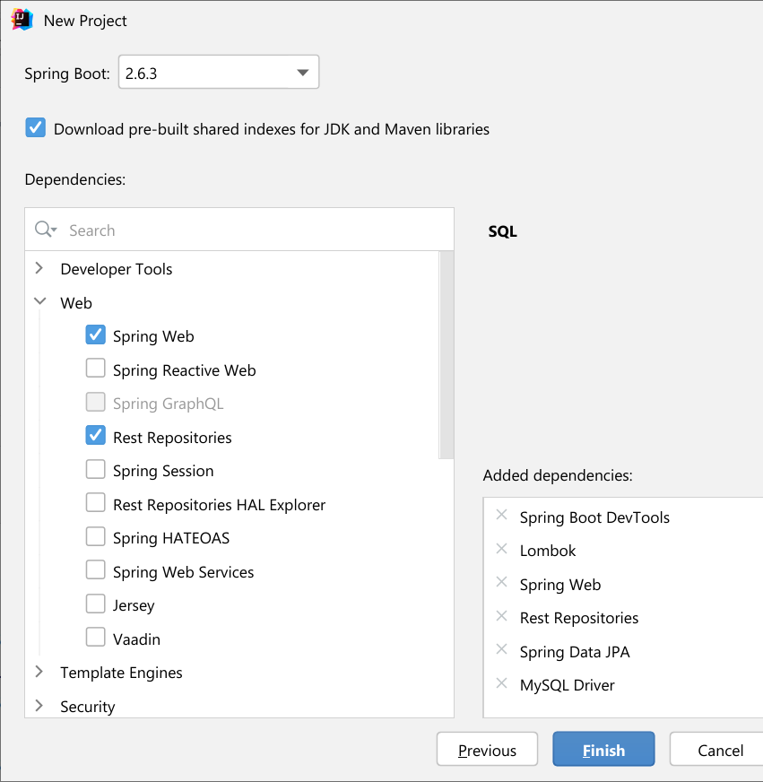
Step 1: Initializing a Spring Boot Project
3.0.2
?
17

Slide 4
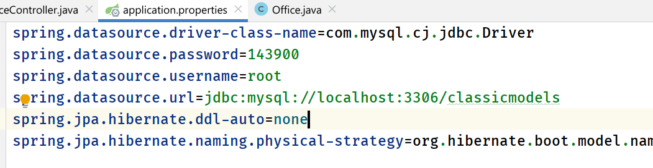
Step 2: Connecting Spring Boot to the Database
org.hibernate.boot.model.naming.PhysicalNamingStrategyStandardImpl
ถ้าไม่กำหนด spring.jpa.hibernate.naming.physical-strategy
จะใช้ convention ดังนี้
การระบุ @Column(name) ใน enitity clase ต้องพิมพ์เป็นตัวเล็กหมด หรือถ้าระบุคอลัมน์เป็น camel case ชื่อฟิลด์ ใน ตารางต้องแยกคำด้วย ขีดล่าง ( _ )

Slide 5
Step 3: Creating an Office Model (1)
@Getter @Setter @Entity @Table(name = "offices") public class Office { @Id @Column(name = "officeCode", nullable = false, length = 10) private String id; @Column(name = "city", nullable = false, length = 50) private String city; @Column(name = "phone", nullable = false, length = 50) private String phone; @Column(name = "addressLine1", nullable = false, length = 50) private String addressLine1;

Slide 6
Step 3: Creating an Office Model (2)
@Column(name = "addressLine2", length = 50) private String addressLine2;
@Column(name = "state", length = 50) private String state; @Column(name = "country", nullable = false, length = 50) private String country; @Column(name = "postalCode", nullable = false, length = 15) private String postalCode; @Column(name = "territory", nullable = false, length = 10) private String territory; @JsonIgnore @OneToMany(mappedBy = "office") private Set<Employee> employees = new LinkedHashSet<>();
{
"id": "1",
"city": "San Francisco",
:
"territory": "NA",
"employees": [
{
"id": 1002,
"lastName": "Murphy",
:
},
{
"id": 1166,
"lastName": "Thompson",
},

Slide 7
Step 3: Creating an Employee Model (1)
@Getter @Setter @Entity @Table(name = "employees") public class Employee { @Id @Column(name = "employeeNumber", nullable = false) private Integer id;
@JsonIgnore @ManyToOne @JoinColumn(name = "office") private Office office;
@Column(name = "lastName", nullable = false, length = 50)
{
"id": 1076,
"lastName": "Firrelli",
"firstName": "Jeff",
:
"office": {
"id": "1",
"city": "San Francisco",
"phone": "+1 650 219 4782",
:
"territory": "NA"
},
"jobTitle": "VP Marketing“
},

Slide 8
Step 3: Creating an Employee Model (2)
private String lastName; @Column(name = "firstName", nullable = false, length = 50) private String firstName;
@Column(name = "extension", nullable = false, length = 10) private String extension; @Column(name = "email", nullable = false, length = 100) private String email;
@JsonIgnore @ManyToOne @JoinColumn(name = "reportsTo") private Employee employees;
@Column(name = "jobTitle", nullable = false, length = 50) private String jobTitle;

Slide 9
Step 4: Creating Repository Classes
public interface OfficeRepository extends JpaRepository<Office, String> {
}
public interface EmployeeRepository extends JpaRepository<Employee, Integer> {
}
public interface CustomerRepository extends JpaRepository<Customer, Integer> {
}

Slide 10
Step 5: Creating Service Class
OfficeService
EmployeeService
CustomerService

Slide 11
Step 6: Creating Controller
OfficeController
EmployeeController
CustomerController

Slide 12
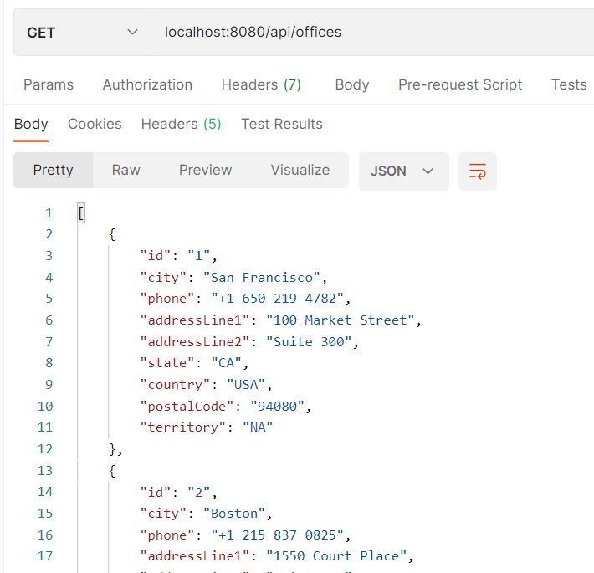
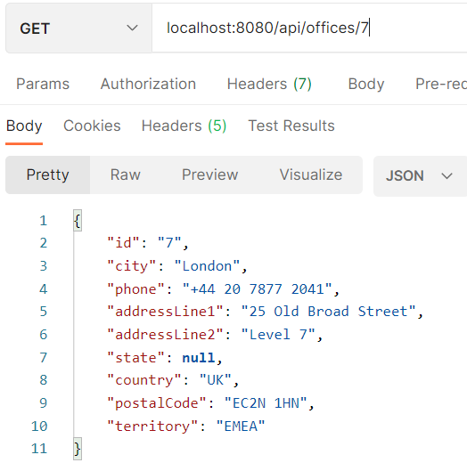
Step 8: Testing the APIs (GET)

Slide 13
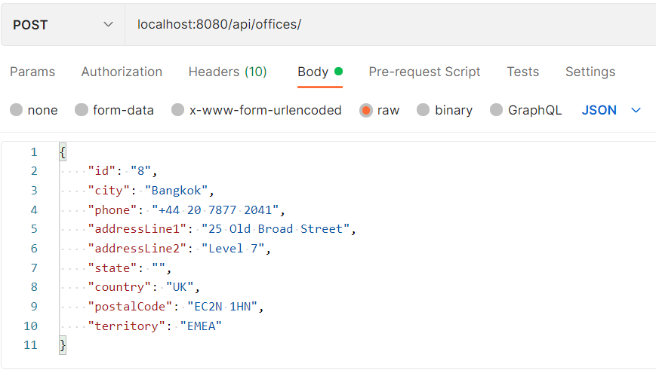
Step 8: Testing the APIs (POST)

Slide 14
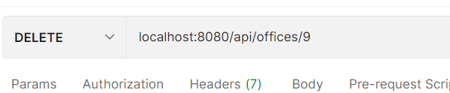
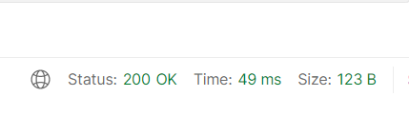
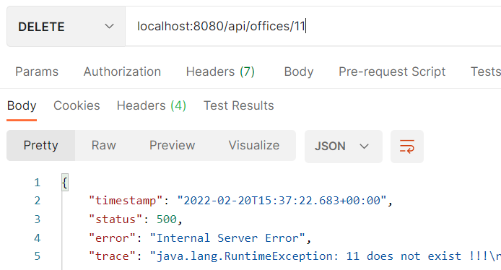
Step 8: Testing the APIs (DELETE)

Slide 15
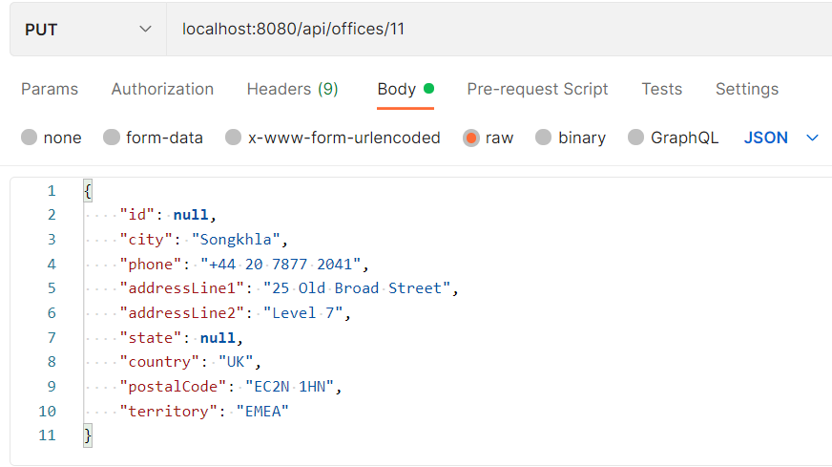
Step 8: Testing the APIs (PUT)

