Slide 1

Deceptive Visualizations
CSC173-01
Kenneth Munk

Slide 2
Illegible Visualization
Explanation:
The reason why this visualization is deceptive is because it is illegible regardless of how the image is scaled meaning that the viewer cannot derive any meaning from it.

Slide 3
Incorrect Visualization
Explanation:
This visualization was also originally intended as an incorrect visualization since there are better ways to visualize the individual joviality of participants in a way that is easier to communicate.

Slide 4
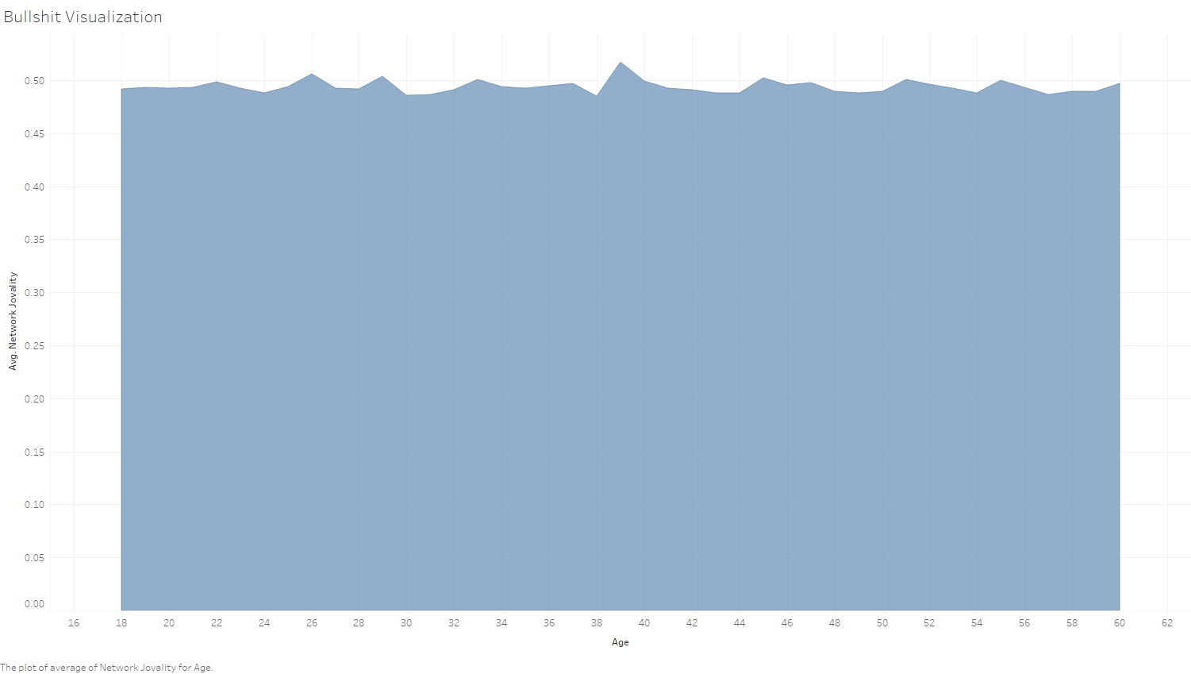
Bullshit Visualization
Explanation:
The reason why this is a bullshit visualization in my eyes is due to the association of individual age to the average network joviality of the individual.

Slide 5
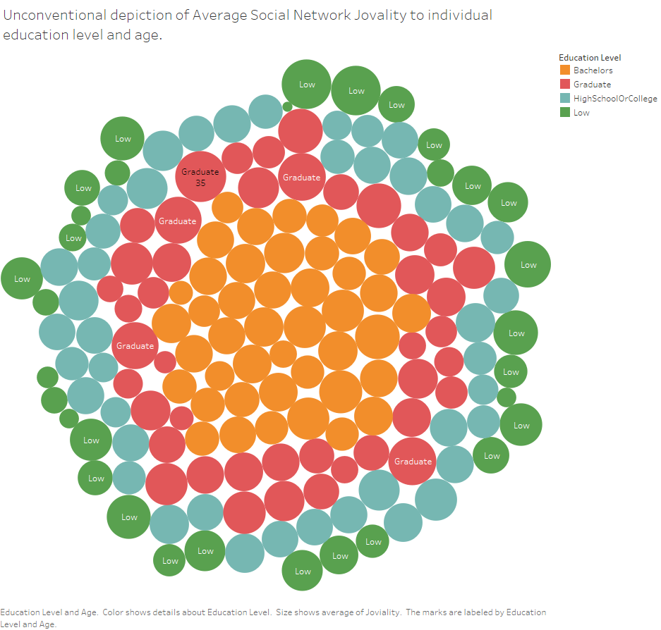
Unconventional Visualization
Explanation:
The depiction of average social network joviality to individual education level can be considered unconventional since the conventional understanding of such relationship would be associated more with the education level in general rather than the individual.

