Slide 1

Discussion Section classCfier

Slide 2

Math
Me
More Math
Let’s just jump right into it

Slide 3
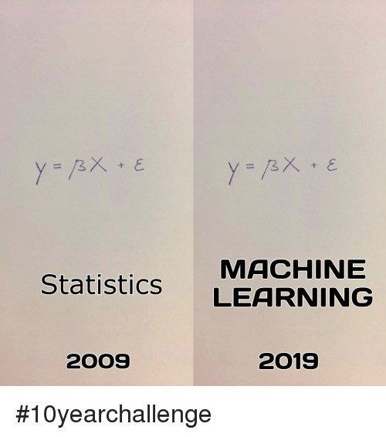
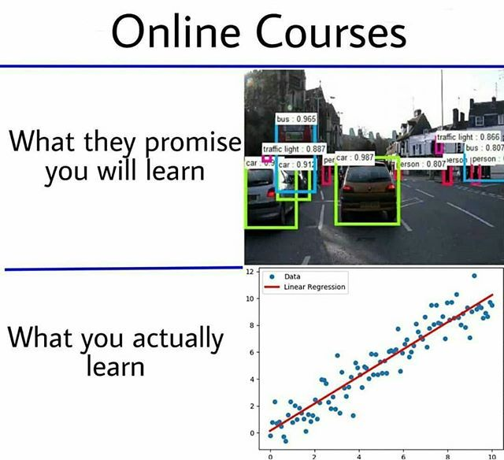

Slide 4
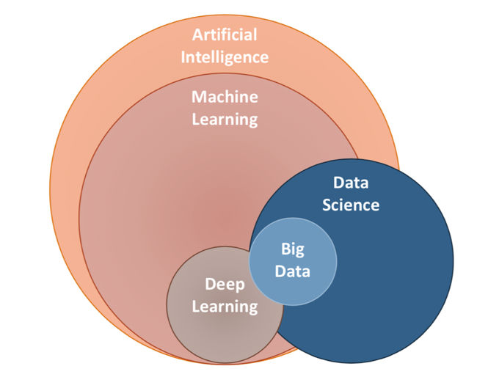
Data science, AI, Machine Learning, etc.

Slide 5


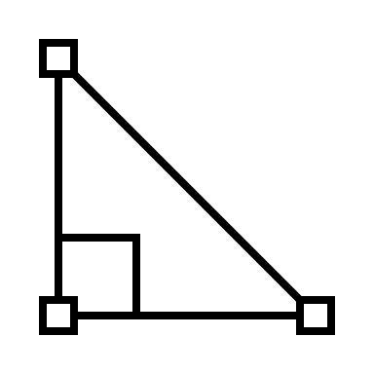


Data science is an art of computer, math, and analysis

Slide 6
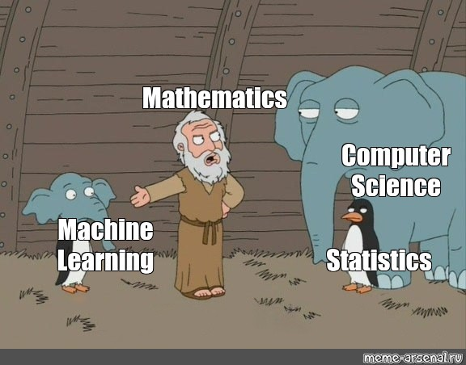
Basically, math is the backbone of data science and machine learning

Slide 7
Let’s learn python

Slide 8

But you know, I learned something today
With combination of math, python, and data analysis, we can work with big data

