Slide 1
Seatwork 10.1 Case Study
Improving RT-IoT2022 Analysis
Pascual | (Moldez) – CPE22S3 | CPE311-Computational Thinking with Python

Slide 2
RT-IoT2022 Dataset
Primarily used to train Quantized Autoencoder intrusion detection systems (IDS) to detect and identify anomalous attacks in IoT network traffic
Features / Elements
123117 rows / observations (no duplicates, no missing values)
85 columns (only 15 used for this analysis)

Slide 3
Steps Taken for Analysis
Preprocessing of Dataset
Dropping columns
Changing data types to appropriate usage
Creating Dataframes for each Attack_type
Focus on attack types that occurred the least (rare cases)
Usage of normalized values for the graphs and charts (except for mean and standard deviation)
Filtering of datasets via IQR to remove outliers
Used in finding the mean and standard deviation

Slide 4
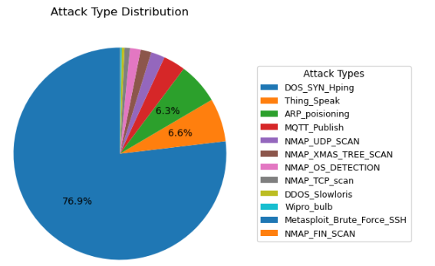
Insights
The Attack type that occurred the most accounts for ~76% of the observations, while the 4 Attack types that occurred the least only accounts for ~0.69% of the observations.
Intrusion detection systems that use this data to train their models have higher chances to perform terribly in minority cases.

Slide 5
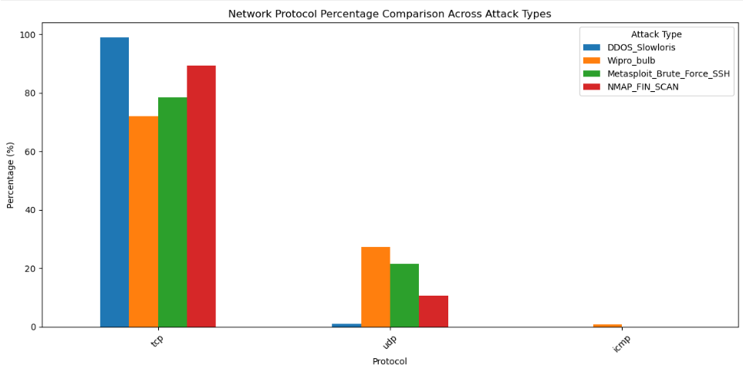
Insights
Attack types that occurred the least mostly breach or do their damage using the TCP network protocol
However, attacks using other network protocols should not be ignored too

Slide 6
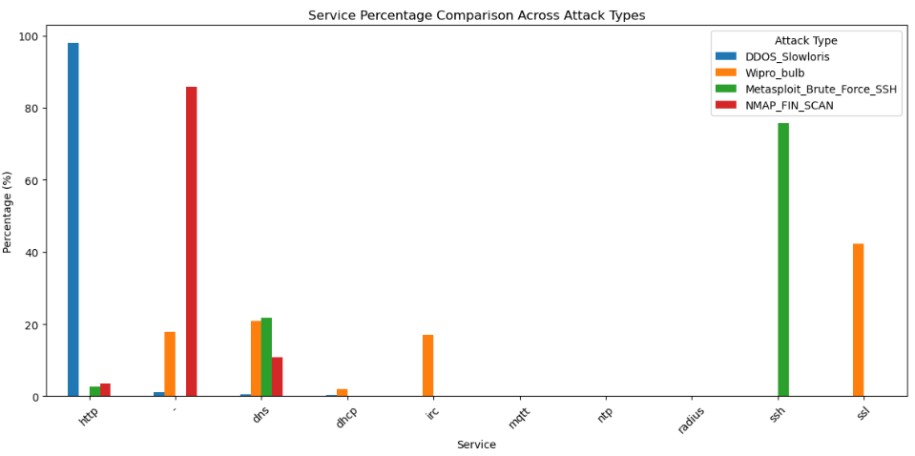
Insights
Some attack types use one service the most
DDOS_Slowloris frequently uses http
Metasploit_Brute_Force_SSH frequently uses SSH
However, these attack types can also use other services

Slide 7
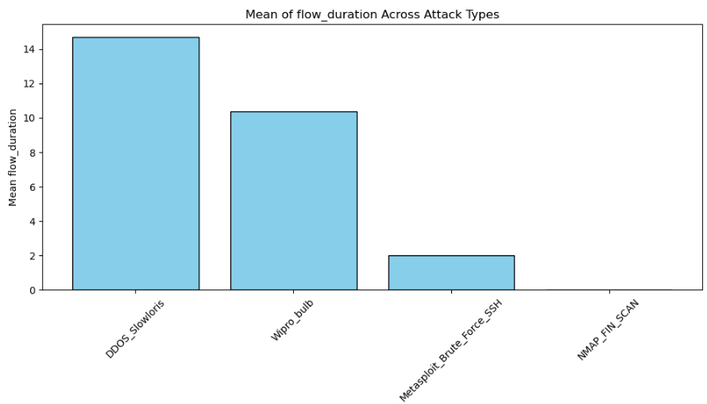
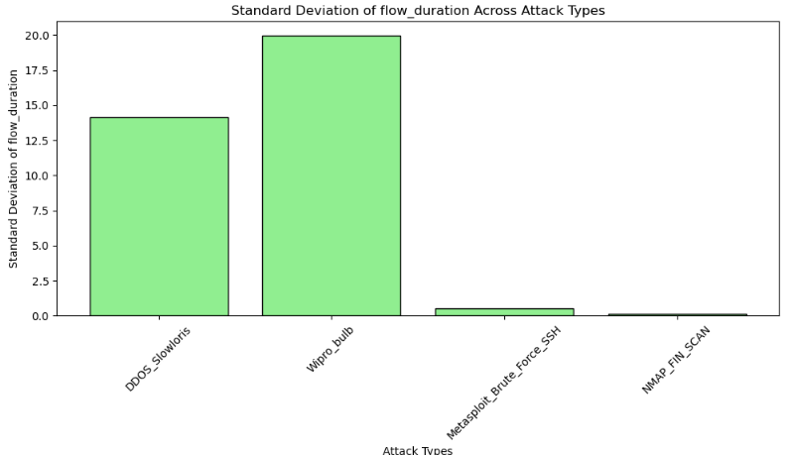
Insights
Flow_duration is consistent amongst all observations for these attack types
Brute_Force_SSH
NMAP_FIN_SCAN
Flow_duration varies amongst all observations for these attack types
DDOS_Slowloris
Wipro_bulb

Slide 8
Recommendations
More balanced distribution of attack types
Introduction of attack types that use other network protocols
Further investigation of attack types that attack through multiple services
Service-specific targeting would work for attack types that attack through only one service, but how about others that use multiple services?
Flow_duration can help in identifying the attack type, based on its value
For example, if flow_duration is ~2 units, maybe it’s time to determine if the attack type is Metasploit_Brute_Force_SSH
Not applicable for all attacks

Slide 9
Thank you! References

