Slide 1
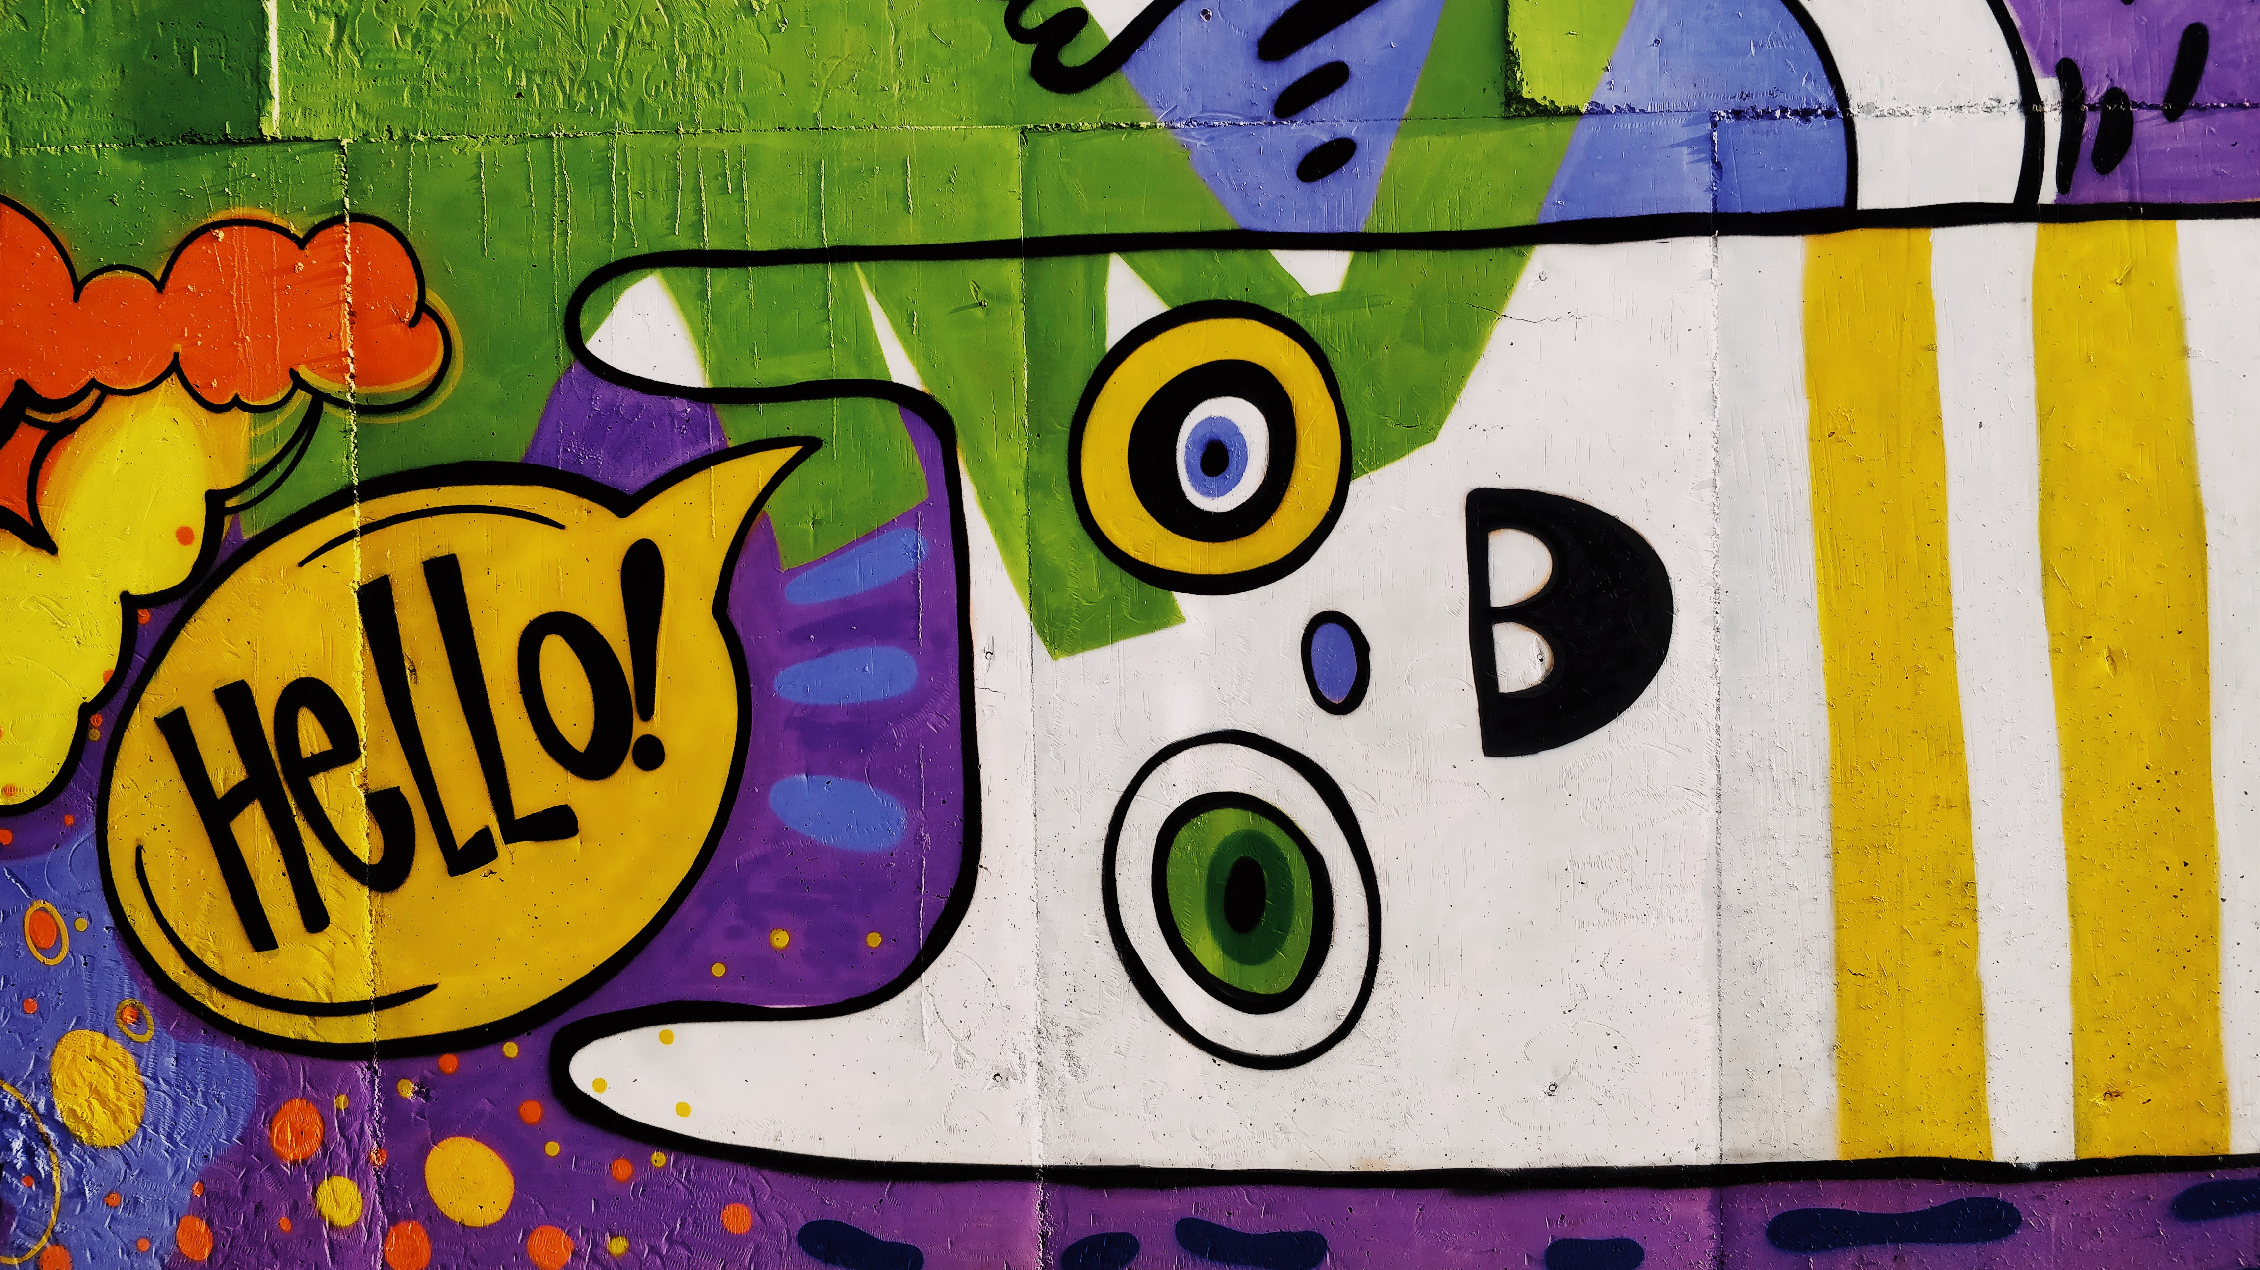
Photo by Artem Bryzgalov on Unsplash

Slide 2
Getting started with git, GitHub, PowerShell and Azure Bicep

Slide 3
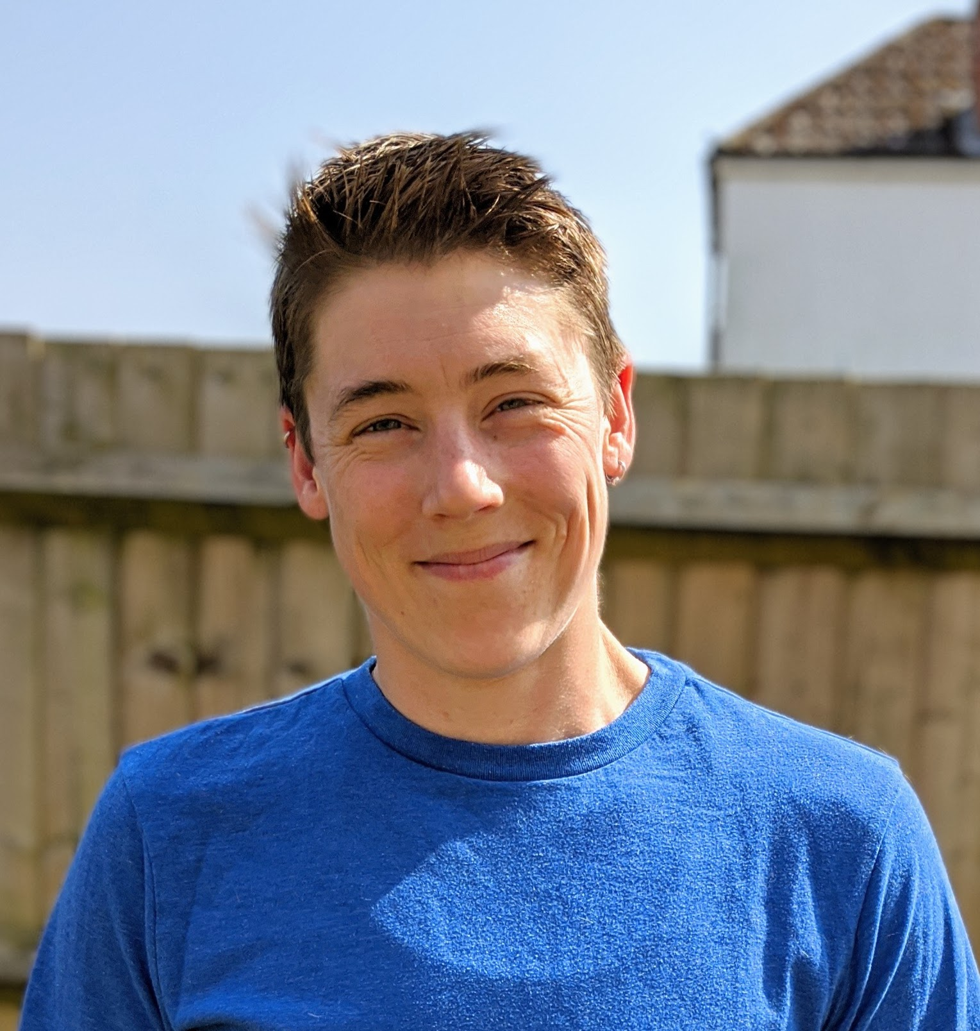

Jess Pomfret
She/Her
Passionate about
Automation
Proper Football
Fitness
Database Platform Architect Data Masterminds
beard.media/book dbatools dbachecks PowerShell & Data Community
/jpomfret
@jpomfret
jesspomfret.com

Slide 4
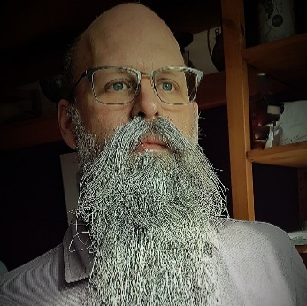
Rob Sewell
He/Him
Bearded Consultant, Automator,
Trainer
Consultant Sewells Consulting Ltd
beard.media/book dbachecks PowerShell & Data Community
/robsewellsqldba
@sqldbawithbeard
blog.robsewell.com

Slide 5
It’s Weird – It’s New – It’s OK
Please leave the room to take phone calls
"Morning Break is 10:30 AM for 15 minutes"
"Lunch is at 12:30 PM for one hour"
"Afternoon Break is 3:00 PM for 15 minutes"
"We finish at 5:00 PM"
We will respect each other
We will accept each others beliefs
We will keep each other safe
We will appreciate each other
Remote or in person, please add to the Miro board anything that you would like to see and we will do our very best to demo/show/answer anything that we can – We LOVE going down the rabbit hole ;-) The Miro Board link is https://beard.media/questions

Slide 6
What are we going to talk about?
That’s Us. Who are you?
What do you want to learn today?

Slide 7
What are we going to talk about?
We are talking tech today not people

