Slide 1


My JAMPACK Journey!
Diving into the fun and features developed during the JAMPACK Incubator program!

Slide 2
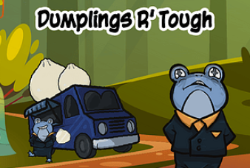



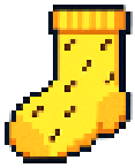
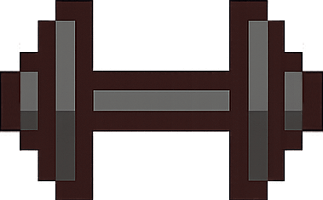
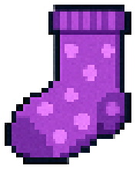


Who is Ken Wheadon?
I’m a (mostly) solo game designer / developer who’s been making games for over 15 years.
Games have been an obsession of mine since I was a quite young – playing lots of Sonic and Pokemon early on!
Fun fact: I once made a clicker about gangter frogs that made dumplings (the dumplings were as tough as they are.)
I love helping others and making a positive impact, another charity I help with is Cats for Keeps – a local cat rescue.

Slide 3
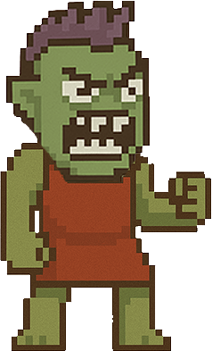

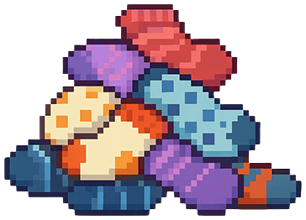
Meet the Game:
Match pairs and YEET those stinky orbs at your landlady to pay rent.
Target audience: Kids from 6-14.
Instantly friendly with inviting colors, animations, humor, and a gentle challenge
Supports: Mouse, keyboard, touchscreen and controller!

Slide 4



A Peek at the World
Martha is a tiny goblin landlady who demands rent payment in socks! She has a tragic backstory – but you’ll have to beat each of the 9 base levels to unlock it!
Each level has a matching section for making sock balls and a throwing section – where Martha is trying to dodge rent so she can evict you and earn more with the next tenant!
It’s easy to jump in but tough to master! With lots of incentives to encourage you to become a sock ball throwing expert!

Slide 5
Why It Works for Kids in Hospitals
Simple controls with short levels and clear feedback.
Colorful socks, animations, positive reinforcement and humor.
Huge replay value! Achievements, new game plus system and an audio player.
Accessibility by design with socks patterns, clear target areas and more

Slide 6
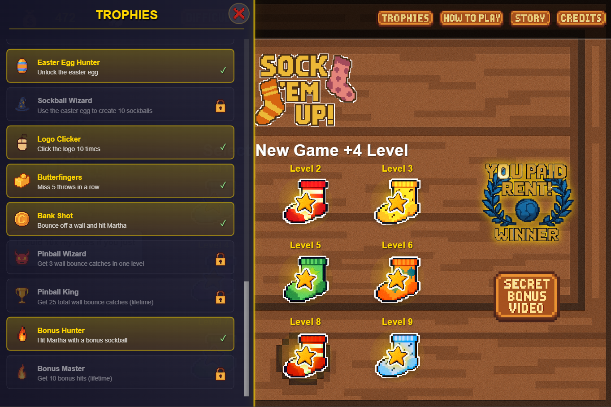


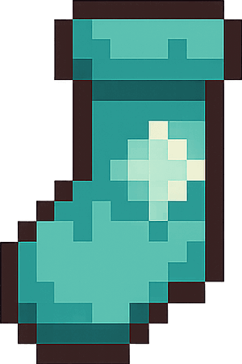
Jam Chaos to Polished Gem
Expanded from 6 levels -> 9 levels & 4 additional difficulties
Added a tutorial and unlockable backstory for Martha
UI / UX improvements to every screen!
Added 65 achievements, each with a unique icon
5 secret bonus videos, 1 for beating each difficulty
Added 8+ audio tracks and an audio player
Added 18+ sprite animations

Slide 7
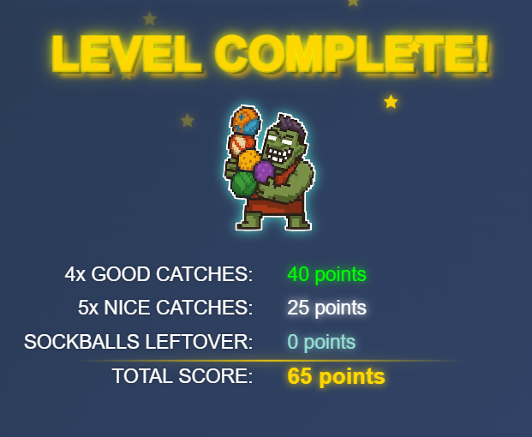

Let’s Play!
Gameplay Showcase
Are you ready to see some gameplay from the first few levels?
https://weird-demon-games.itch.io/sock-em-up

Slide 8
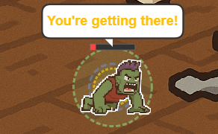





What I Learned (and Loved)
I normally lose steam polishing my games but having a goal helped me push me through with a smile on my face.
It was my first time building a game with controller support!
Developing the marketing materials has made posting about Sock ‘Em Up so much easier (premade tags and descriptions).
I used Claude Code directly in my IDE and it was awesome, letting me focus on design and polish and not coding.

Slide 9
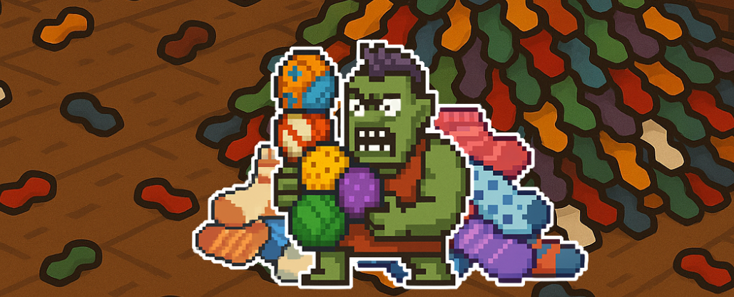

Thanks!
This wouldn’t have been possible without Games for Love and the awesome team supporting me.
It’s been lovely meeting new people and getting to share my game development journey with everyone.
I can’t wait for what’s next with Sock ‘Em Up and the next games that I’ll tackle with all that I’ve learned!

