Slide 1
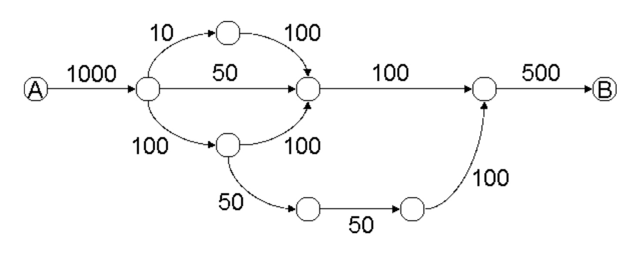
1
2
3
4
Figure 1. Feasible Paths between A & B in a general Network

Slide 2
0
90
10
10
10
10
990
90
490
10
Figure 2. Blue Path from A & B in a residual graph

Slide 3
0
90
60
60
10
10
940
0
40
440
60
50
Figure 3. Blue Path adding Purple Path from A & B in a residual graph

Slide 4
0
90
100
100
10
10
900
0
0
400
100
50
40
40
60
60
Figure 4. Blue Path adding Purple Path adding Red Path a from A & B in a residual graph

Slide 5
0
90
100
150
10
10
850
0
0
350
150
50
90
40
10
60
50
50
50
50
0
0
Figure 5. Residual Graph A for the Generic Network

Slide 6
100
150
850
0
0
350
150
50
100
50
0
50
50
50
50
50
0
0
Figure 6. Residual Graph B for the Generic Network

Slide 7
0
90
100
150
10
10
850
10
0
350
150
40
100
50
0
50
50
50
50
50
0
0
Figure 7. Residual Graph C for the Generic Network

