Slide 1

SPH ASESSMENT
PRESENTATION BY KENNY NG

Slide 2







Technology
v

Slide 3
Technology
v
Repository
Database
ETL

Slide 4


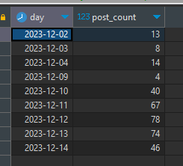
Pull rate of the API
FINDINGS:
After 1 week testing with API:
50 Post every 10 minutes is able to populate the entire day of post table.
With the max to 10,000
10,000/50 =200 times every 24 hours = 8.3 time per hour
Leadership board is only required to run min 1 per-day
but it can be increase depending on business requirement.
GET /posts/
6 hours
GET /leaderboard/
24 hours

Slide 5







7
PUBLICATIONS

Slide 6
PUBLICATIONS PERFORMANCE
Interactions
7281 | 5779 | 817 | 803 | 357
1891 | 805 | 172 | 62 | 47
2532 | 3028 | 175 | 222 | 6
140 | 35 | 29 | 16 | 5
Likes
Shares
Comments
Average interactions per post

Slide 7
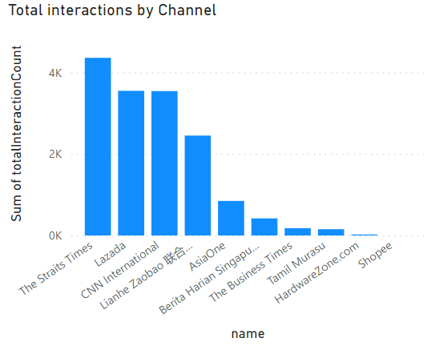
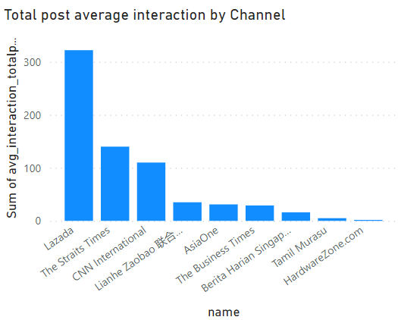
COMPARISON OF PUBLICATIONS PERFORMANCE

Slide 8
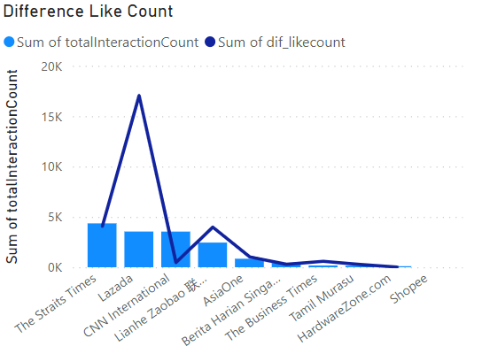
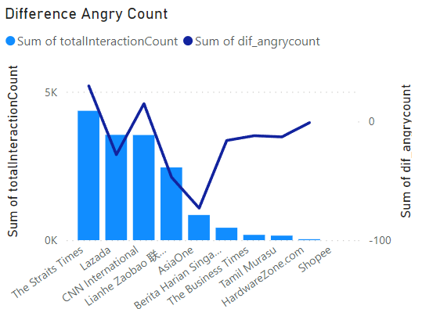
COMPARISON OF PUBLICATIONS PERFORMANCE (CONT.)

Slide 9
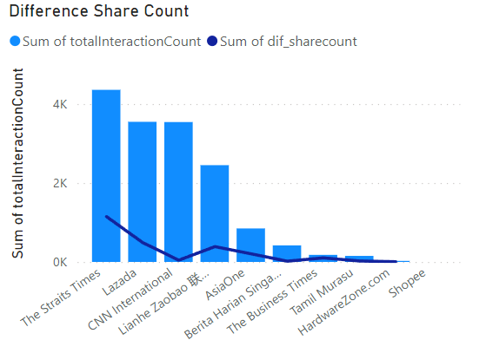
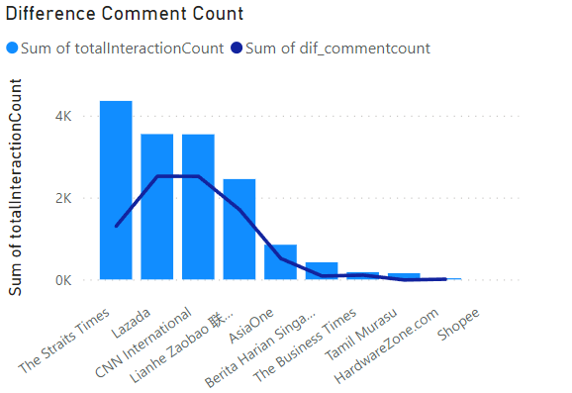
COMPARISON OF PUBLICATIONS PERFORMANCE (CONT.)

Slide 10
Thank You!

