Slide 1

SPH ASESSMENT
PRESENTATION BY KENNY NG

Slide 2







7
PUBLICATIONS

Slide 3
PUBLICATIONS PERFORMANCE
Interactions
7281 | 5779 | 817 | 803 | 357
1891 | 805 | 172 | 62 | 47
2532 | 3028 | 175 | 222 | 6
140 | 35 | 29 | 16 | 5
Likes
Shares
Comments
Average interactions per post

Slide 4
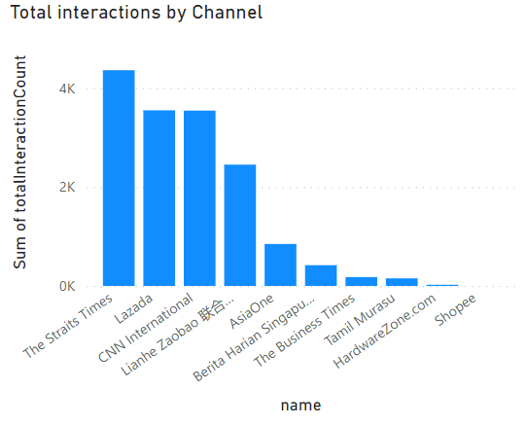
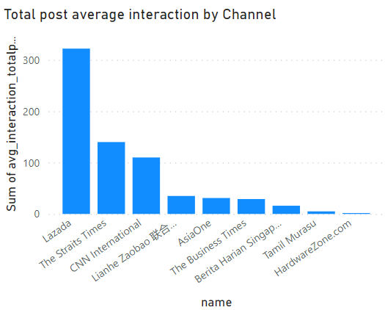
COMPARISON OF PUBLICATIONS PERFORMANCE

Slide 5
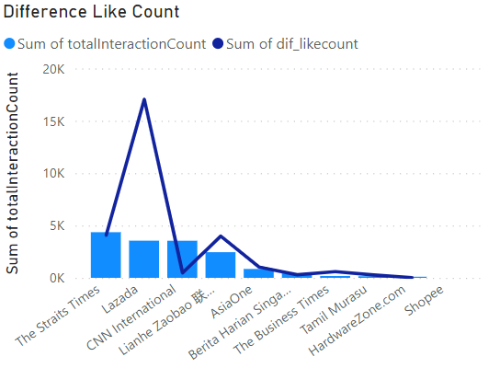
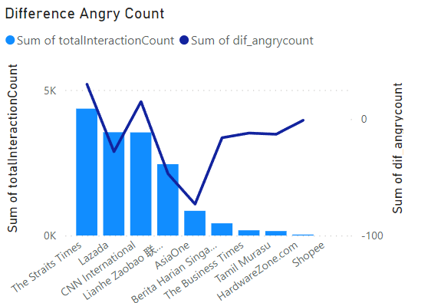
COMPARISON OF PUBLICATIONS PERFORMANCE (CONT.)

Slide 6
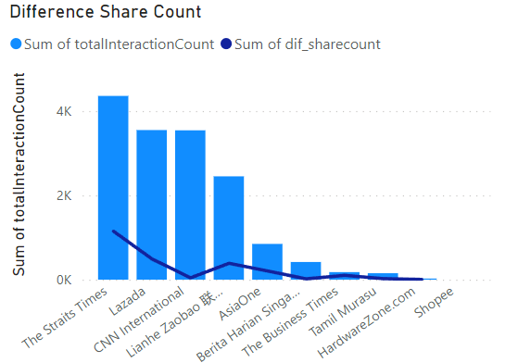
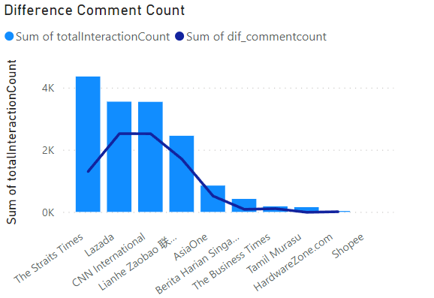
COMPARISON OF PUBLICATIONS PERFORMANCE (CONT.)

