Slide 1
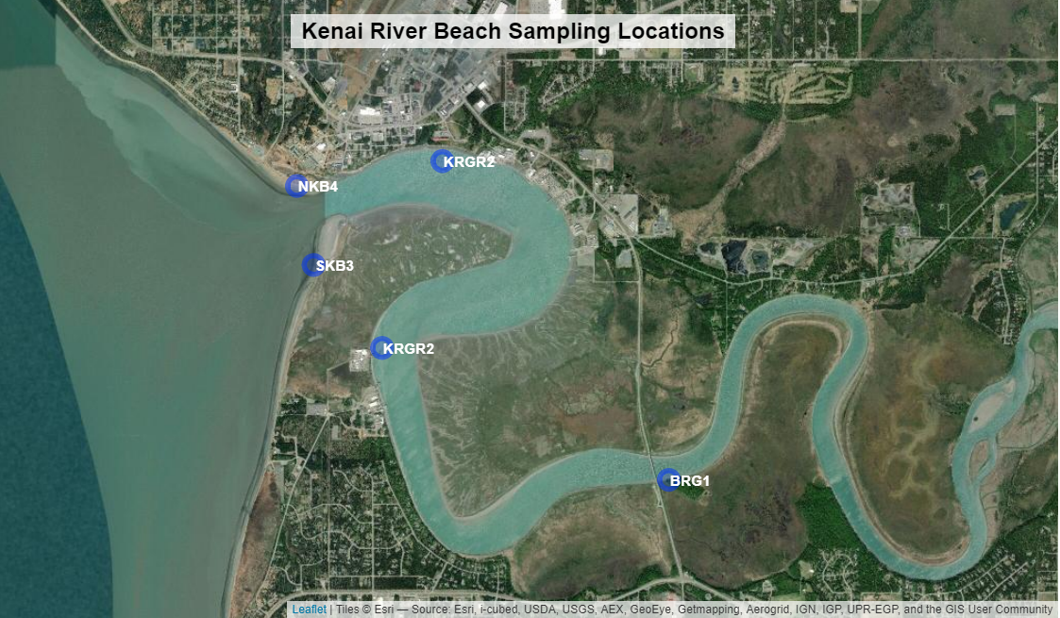
Sampling Sites
Gull Rookery Area

