Slide 1
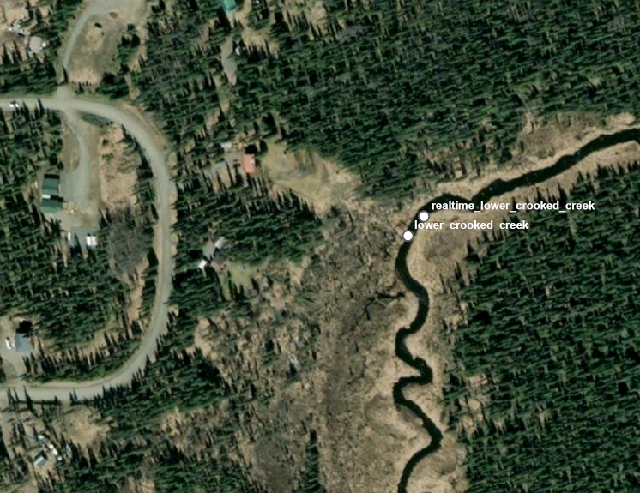
60.31638, -151.28432
60.31638, -151.28452

