Slide 1
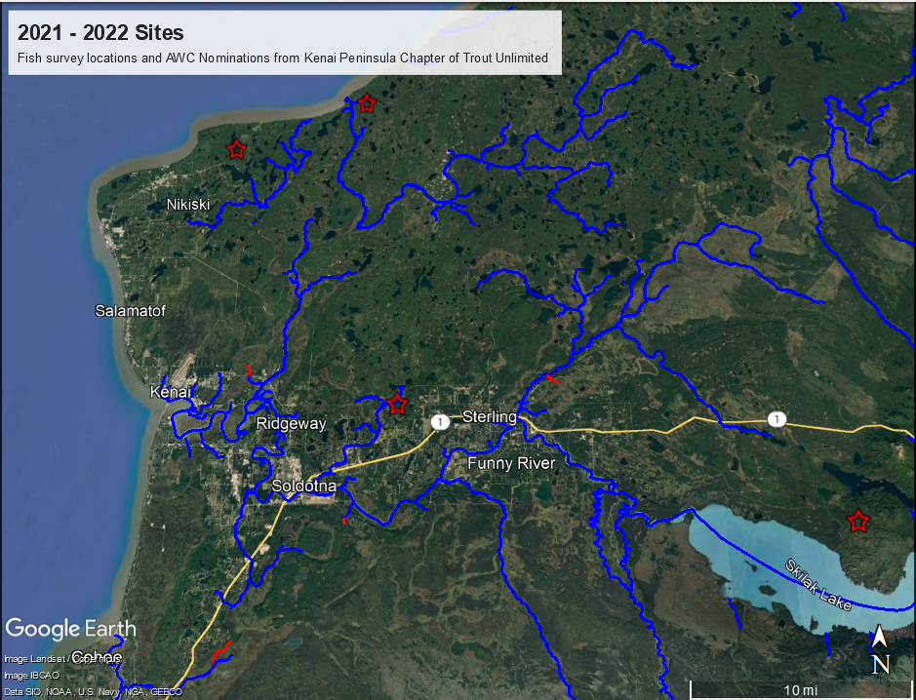
Legend
Existing AWC streams
New AWC Nominations
Site surveyed with no
AWC species

Slide 2
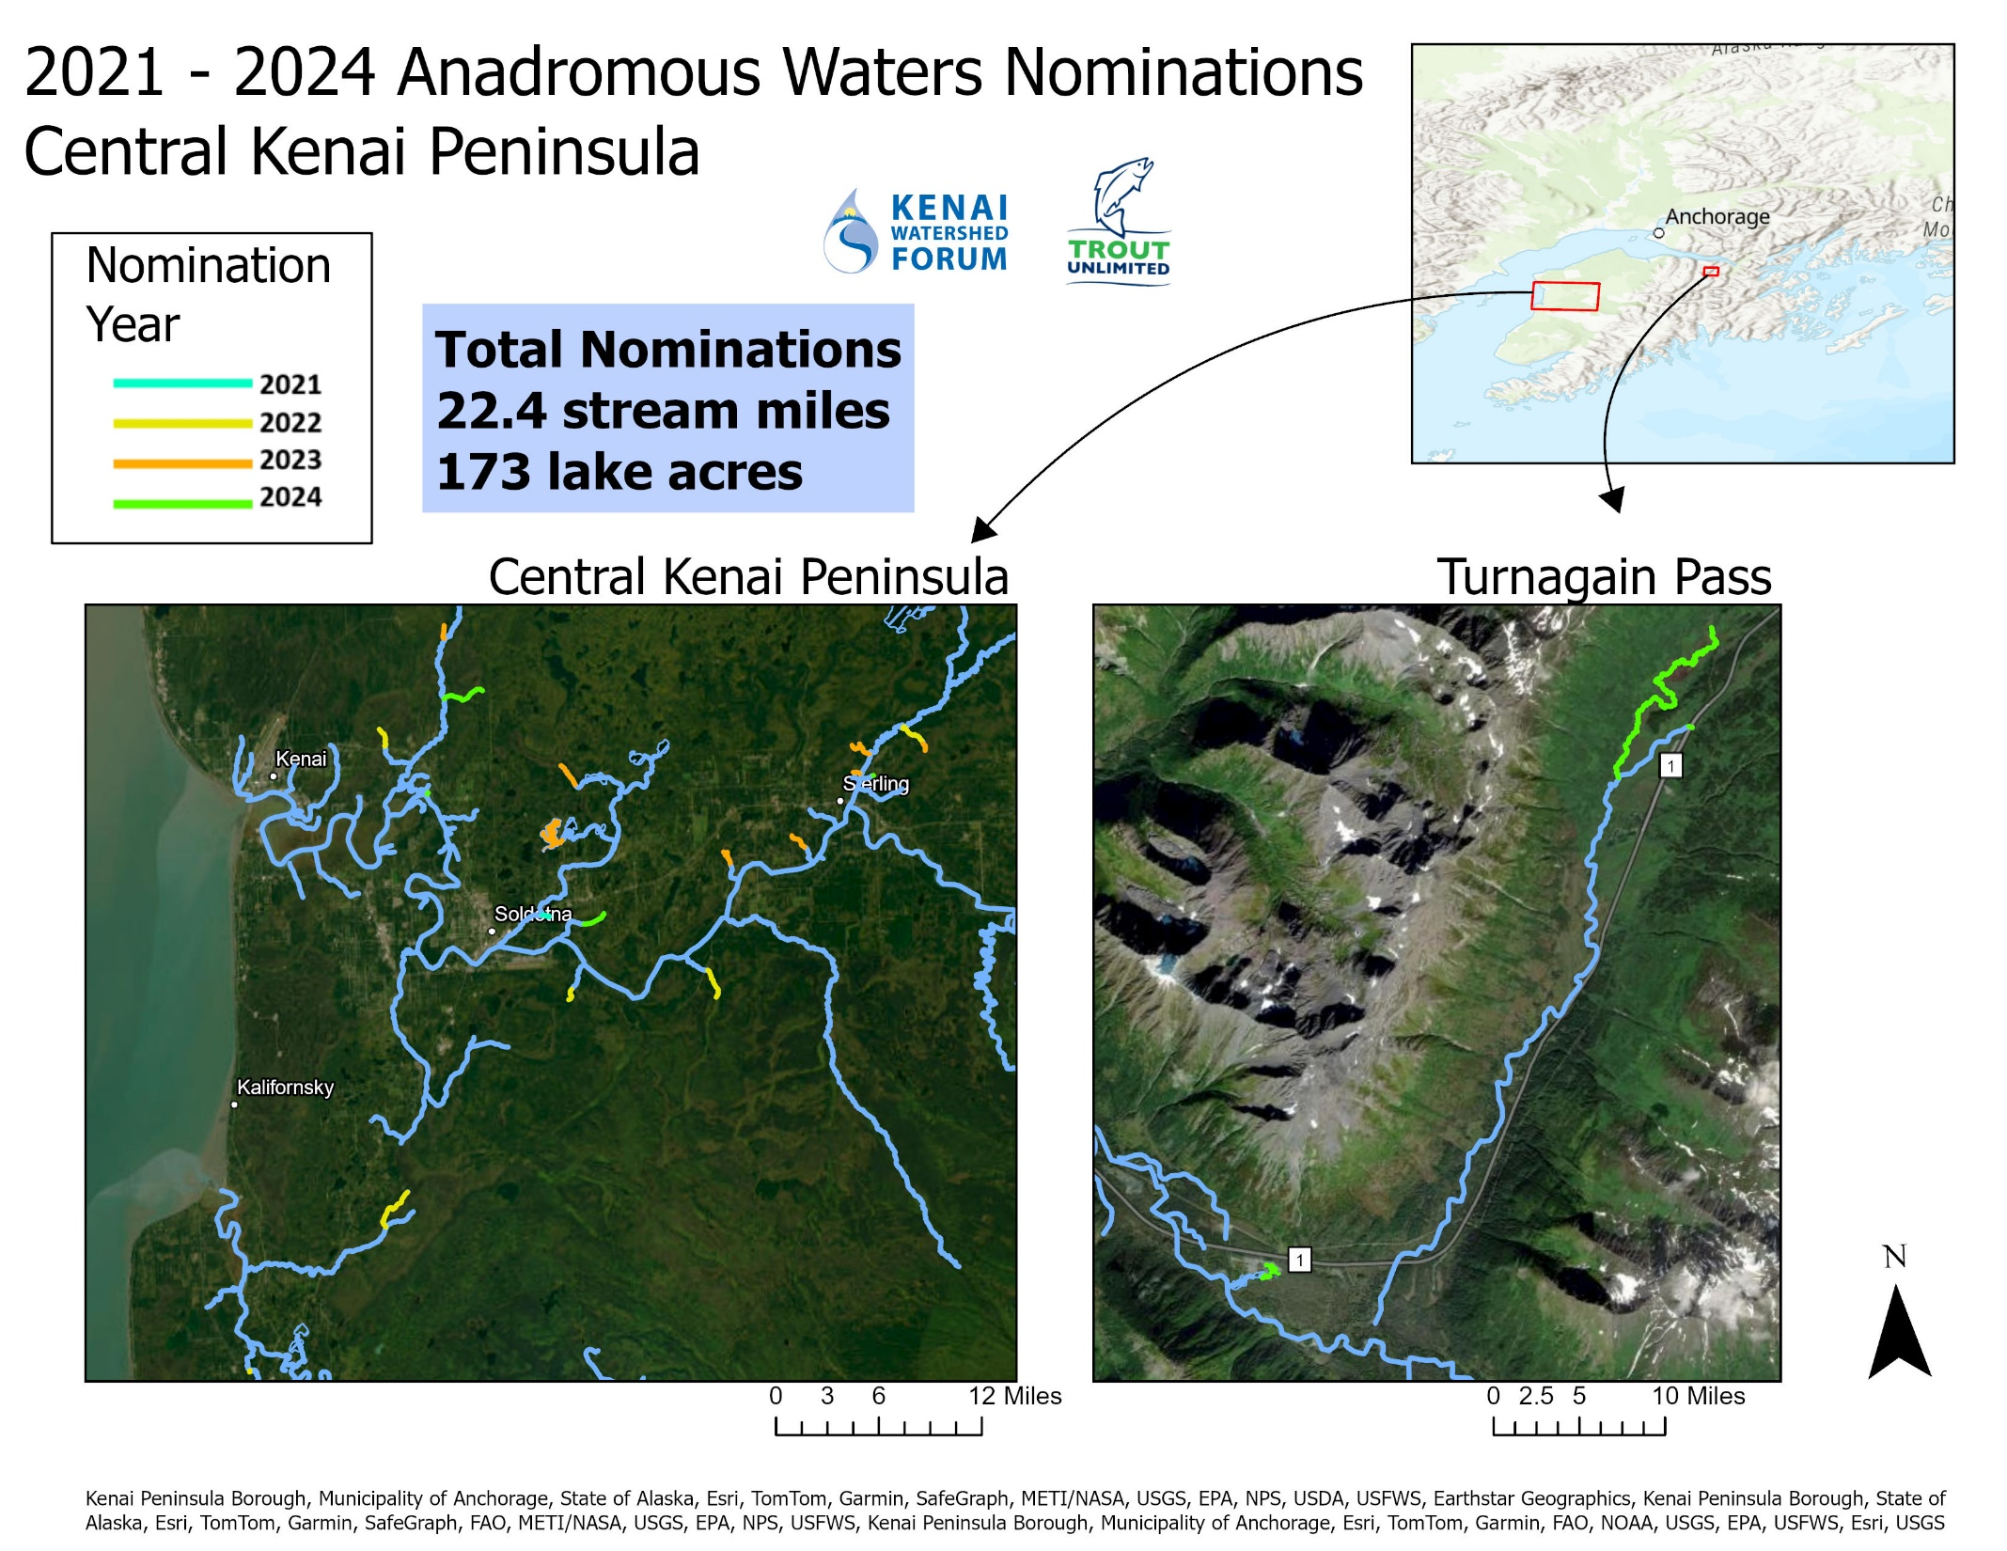
2021 -2025
Total Nominations
24.5 stream miles
173 lake acres
2025

