Slide 1
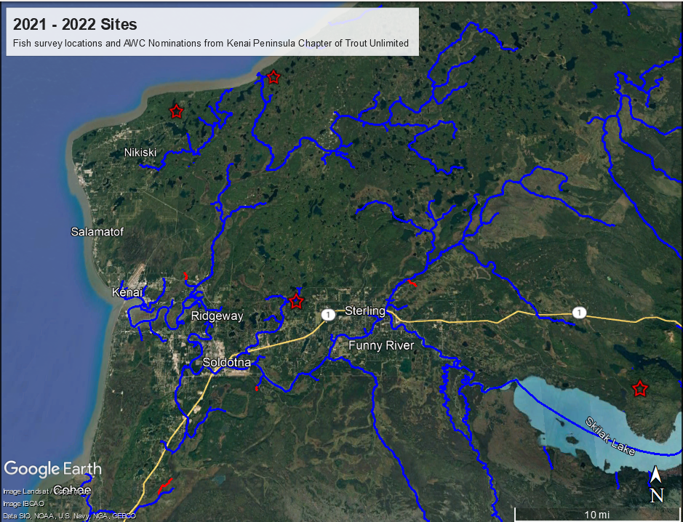
Legend
Existing AWC streams
New AWC Nominations
Site surveyed with no
AWC species

